Slide 1
Life Expectancy Using W.H.O. & U.N. Data Sources
Matthew Curcio
1/29/2022
matt.curcio.us@gmail.com

Slide 2
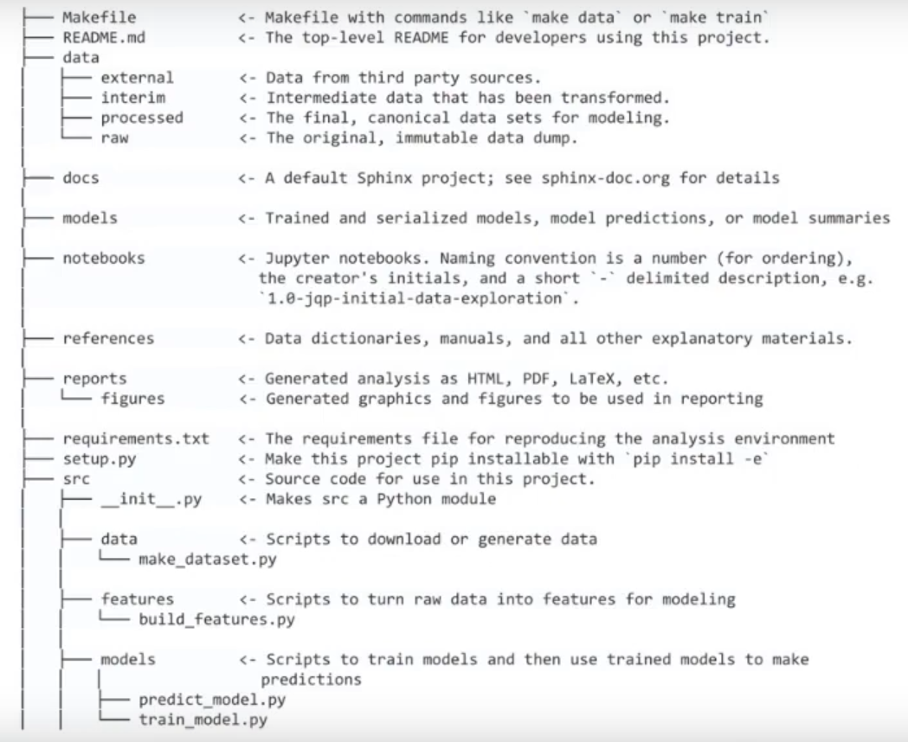
10 Commandments of Reliable Data Science
youtu.be/dxUMBVTvbW
Isaac Slavitt
PyData Global ‘22

Slide 3
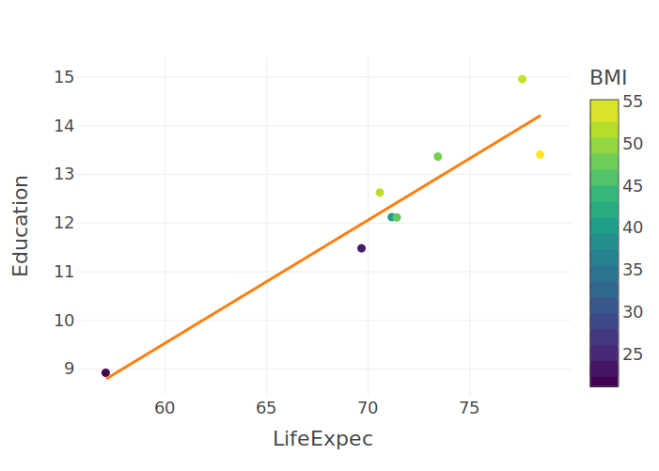
Fatter is Better!?!

Slide 4
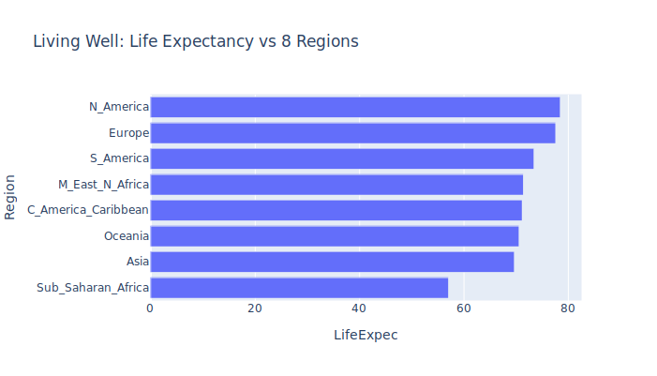
Which Continent to Live On?

