Slide 1
Case Study 3
Machine Learning – Tf-idf
Data Science 501
w/ Dr Xiangnan Kong, Dr R Paffenroth
Matt Curcio

Slide 2
Data
[mean: 0.83533, std: 0.01221, params: {}]
precision recall f1-score support
neg 0.85 0.84 0.85 248
pos 0.84 0.86 0.85 252
avg / total 0.85 0.85 0.85 500
[[208 40]
[ 36 216]]

Slide 3
Best parameters for TfidfVectorizer:
vect__max_df: 0.87
vect__min_df: 2
precision recall f1-score support
neg 0.85 0.86 0.85 248
pos 0.86 0.85 0.85 252
avg / total 0.85 0.85 0.85 500
[[213 35]
[ 38 214]]

Slide 4
  ngram-range:
  Best parameters for TfidfVectorizer
vect__ngram_range: (1, 2)
precision recall f1-score support
neg 0.87 0.85 0.86 248
pos 0.85 0.88 0.86 252
avg / total 0.86 0.86 0.86 500
[[210 38]
[ 31 221]]

Slide 5
  Machine learning algorithms
  Best parameters for LinearSVC
clf__C: 1001
precision recall f1-score support
neg 0.85 0.86 0.86 248
pos 0.86 0.85 0.86 252
avg / total 0.86 0.86 0.86 500
[[214 34]
[ 37 215]]

Slide 6
  Machine learning algorithms
  Best parameters for KNN
clf__n_neighbors: 10
clf__weights: 'uniform'
precision recall f1-score support
neg 0.73 0.63 0.68 248
pos 0.68 0.77 0.72 252
avg / total 0.70 0.70 0.70 500
[[156 92]
[ 58 194]]

Slide 7
Examples of False Positives
joe versus the volcano is really one of the worse movies made in very recent memory .
the strangest thing is that you would think nothing would go wrong with it .
it has a solid cast with tom hanks & meg ryan as the lead roles .
but you can never judge a movie by its cast . . .
if there is one good thing about joe vs the volcano , it is that the plot is original .
unfortunately , it is also incredibly stupid .
the movie begins with joe ( tom hanks ) going to work .
this opening sequence is very boring and slow .
it shows joe walking to his office .
but on the way , he has to wait in a long line passing by strange and slightly depressing scenery with obnoxious lighting

Slide 8
Examples of False Negatives
synopsis : it's 1977 in a small italian american neighborhood in new york .
disco music is popular , and the sexual revolution is on , but the people of new york are not happy .
in fact , they're terrified .
as in spike lee's do the right thing a heat wave has the city in its grip , and peoples' tempers are flaring .
the cool of night offers no respite : the neighborhood is being terrorized by a nocturnal psychotic killer who calls himself the son of sam .

Slide 9
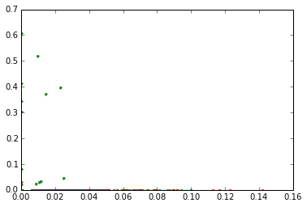

Slide 10
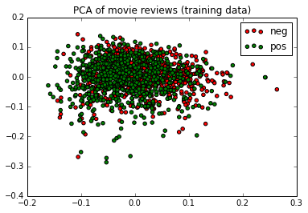
Principle Component Analysis
Training Set

Slide 11
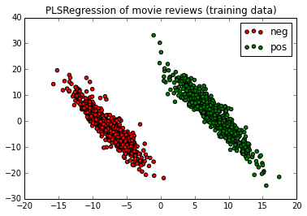
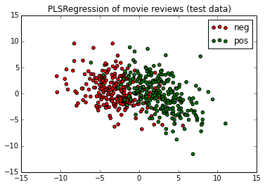
PLS Resgression:
Training & Testing

Slide 12
Thank You

