Slide 1
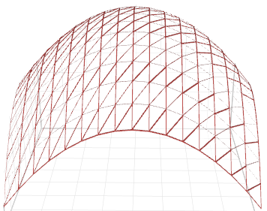
Non-Linear Decision Boundary vs. Kernel
Non-Linear
Decision
Boundary
Kernel
Method

