Slide 1
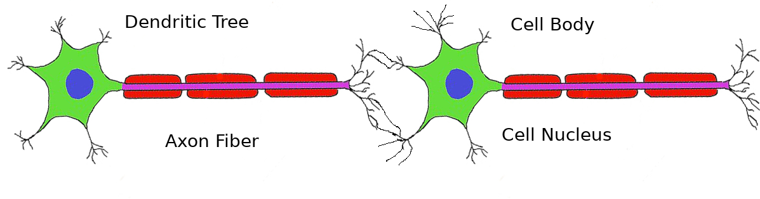
Synaptic Junction

