Slide 1
Case Study 1
Collecting Data From Twitter
Data Science 501
w/ Professor Xiangnan Kong
Matt Curcio, Tingting Meng, Wenlu Du

Slide 2
Collecting Data from Twitter
How did we collect data from Twitter? API
Using what tools? Ipython notebook
Goals:
1.Sampling Twitter Data with Streaming API about iPhone 6
2.Analyzing Tweets and Tweet Entities with Frequency Analysis
3.Getting "friends” and "followers”

Slide 3
Sampling Twitter Data with Streaming API
After searching ‘IPhone 6’ through Twitter streaming API, we get about 1000 tweets. And then these data is stored into a local file automatically. The following analysis is based on the data we collected.

Slide 4
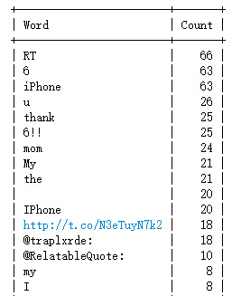
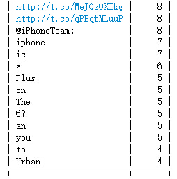
Top 30 words

Slide 5
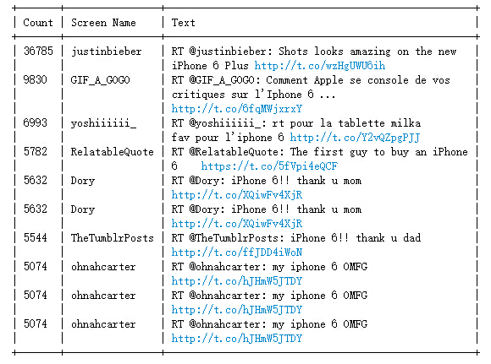
Top 10 retweets

Slide 6
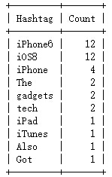
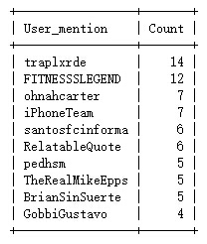
Top 10 Hashtags and User mentions

Slide 7
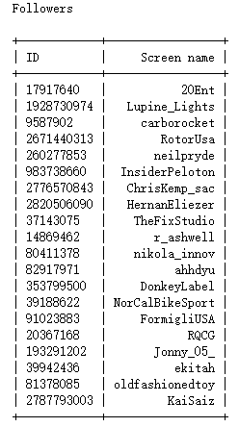
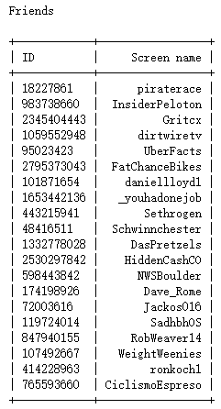
20 of Friends & Followers
User screen name: angryasian

Slide 8

Mutual friends

Slide 9
Thank you!

