Slide 1
Yelp Dataset Challenge
Chong Zhou (Andy)
Diana Batista
Matthew Curcio
Marcus Moyses
Tabassum Kakar

Slide 2
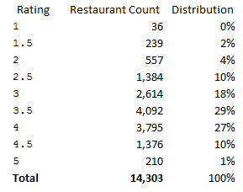
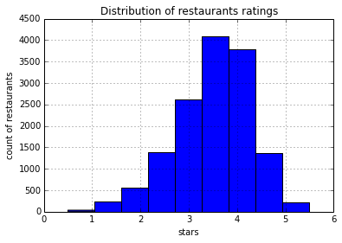
Restaurants
Total restaurants : 14301
Normal distribution – left skewed
73% of restaurants have a rating between 3 and 4.

Slide 3
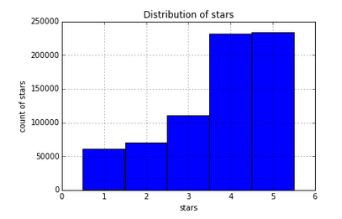
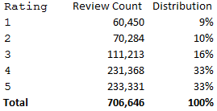
Distribution of Reviews
The distribution of reviews among restaurants

Slide 4
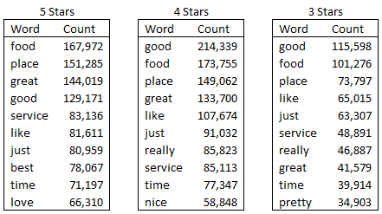
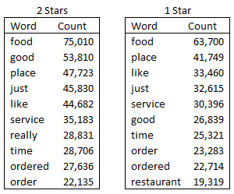
Top 10 words
Words such as good, food, place time, service appears in all reviews

Slide 5
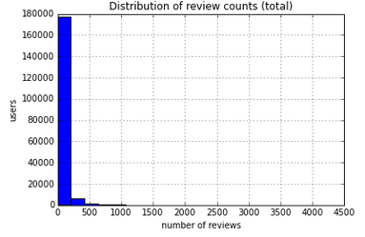
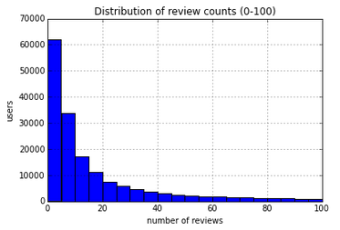
Distribution of Reviews by User
Most of the users have rated restaurants about 5 times
Overall most of the users have rated restaurants less than 250 times

Slide 6
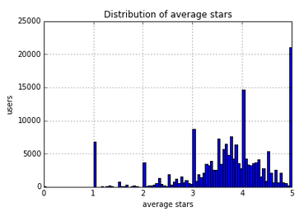
Average Distribution of Reviews among Users

Slide 7
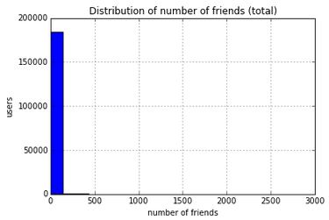
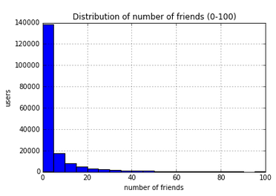
Distribution of Number of Friends
Most of the users have less than 20 friends

Slide 8
Map-Reduce Data Analysis
Required Tasks:
Frequency of a term ( e.g. “good”) in a given document
Number of terms ( e.g. “good”) appear in each document
Number of documents in which term ( e.g. “good”) appears
Total number of documents

Slide 9
Generalized MapReduce Flowchart
Yelp
Dataset:
~ 1 Gb
Yelp
Dataset
~ 1 Gb
Yelp
dataset
divided
into
smaller
blocks
Result
'A'
Computer
#1
'B'
Computer
#2
'C'
'reduce'
Process
'map'
Process
Computer
#3
'D'
Computer
#4
Notes:
<number>

Slide 10
Job- 1
Mapper:
Input:( word_key , line)
Output:
Total number of documents:(None, 1)
Frequency on review (word, 1)
Reducer:
Input: (key , values)
Output:
Total number of documents (None sum(values))
Total count in review (None, (key, words_counts))
Number of documents a word appears
(None,(key,sum(values)))

Slide 11
Job – 2
Reducer:
Input(_,values)
Calculate tf-idf value
Tf= values
Idf= log(total number of words / word_counts for each word )
Output: (i , (word , Tf*Idf ))

Slide 12
Top- 30 User’s PageRank Scores
After eliminating sinks, we got 92817 nodes.
Created Sparse matrix
Multiplied with a vector of size 92817 according to formula I^{t} . H = I^{t+1}

Slide 13
Analysis
Initial page rank score
3.95 E-006
Top 1st user percent increase page rank score:
(1.108270255E-5 / 3.95416333858E-006) x 100% = 280.3 %
Top 30th user percent increase page rank score:
(9.04544714197E-6/ 3.95416333858E-006) x 100% = 228.7.3%

Slide 14
Reviews based on User’s PageRank Scores
Top 20 Businesses with highest difference in average star rating using the PageRank scores

