Slide 1
BUSINESS INTELLIGENCE PITCH
US MARKET ENTRY STRATEGY
1Q2019 Aviation Market Analysis & Route Investment Recommendations
Airline Data Challenge | Corporate Strategy | May 2026

Slide 2
01 / STRATEGIC BLUEPRINT
Executive Summary
✦ The Challenge: Establish a highly competitive domestic airline in the United States, utilizing an initial fleet of 5 aircraft.
✦ Upfront Aircraft Cost: A substantial upfront capital expenditure of $90 million per aircraft ($450 million portfolio total).
✦ Core Motto: *'On time, for you.'* Our brand is anchored on punctuality, which demands incorporating real-world delays into our financial risk evaluations.
✦ Recommended Solution: Operate a diversified network of 5 highly liquid transcontinental and regional routes, generating $502.2M in profit.
$450M
FLEET CAPITAL CAPEX
5
AIRCRAFT ACTIVE
$502.2M
PORTFOLIO NET PROFIT
65.5%
AVERAGE OCCUPANCY
STRATEGIC MANDATE:
Target high-occupancy transcontinental channels and extreme-yield short hauls to lock in market dominance and accelerate capital amortization.

Slide 3
02 / DATA MANAGEMENT
Data Quality & Imputation Rules
1. Reward Ticket & Security Fee Clean
Over 5% of fares were under $11 (the standard Sept 11 security fee). Passenger yield is distorted if included. Filtered out all tickets under $50 (reward tickets) and over $5,000 (corrupted segment rates) to isolate commercial fares.
2. Missing Distance Imputation
We encountered 2,700 records containing null distances or **** characters. Imputed using the median distance of all non-null flights on the exact same directed route (e.g. LAX->JFK). Protects distance-based cost calculations ($9.18/mi).
3. Diverted Flight Delay Management
Identified 4,377 non-cancelled flights that had valid departure delays but null arrival delays (representing diverted flights). Imputed arrival delay using the departure delay value to preserve volume and delay metrics.
4. Mixed-Type Format Clean
Raw datasets contained massive formatting anomalies like '$$$' in air times and '$ 200.00' string values in ticket fares. Designed a high-speed cleaning pipeline that stripped currency symbols and coerced data to clean numeric values.

Slide 4
03 / DATA ENGINEERING
Engineered Field Formulas & Metadata Dictionary
PASSENGERS
Formula: 200 * Occupancy Rate
Expected passenger load per leg. Fixed mainline capacity scaled by real Flights occupancy data.
REVENUE_TICKET
Formula: Passengers * (Avg Fare / 2)
Isolates flight leg fare yield. divided by 2 because joined Average Fare represents a round trip.
REVENUE_BAGGAGE
Formula: Passengers * 50% * $35.00
Ancillary baggage revenue per leg. Assumes a $35 checked bag fee at a conservative 50% check rate.
COST_DISTANCE
Formula: Distance * $9.18 / mile
Variable operating costs: fuel, crew, maintenance ($8.00/mi) + depreciation, insurance ($1.18/mi).
COST_AIRPORT
Formula: Large: $10,000 | Medium: $5,000
Fixed destination airport landing operational fee. Evaluated per leg using Airport_Codes.csv sizes.
COST_DELAY
Formula: (Delay - 15) * $75 / minute
Punctuality penalty. Tracks departure/arrival delays over 15 minutes at $75/min in added cost.

Slide 5
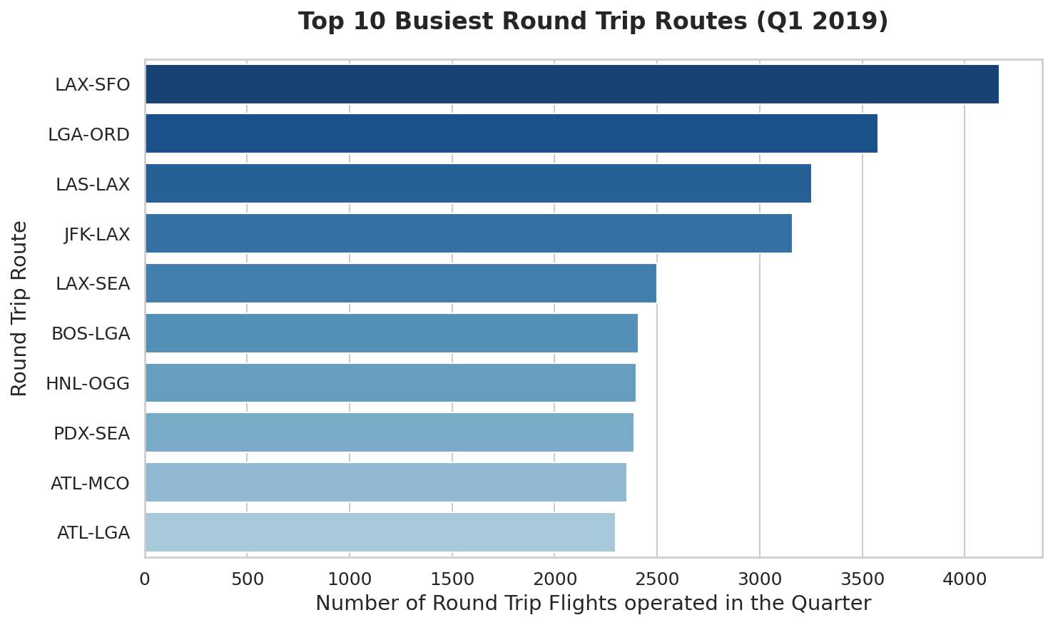
04 / MARKET DEMAND
Busiest Round-Trip Routes
✦ Volume Indicated Liquidity: High flight volume indicates deep, sustained commercial demand between cities.
✦ Market Constraints: However, high-volume routes are extremely competitive, leading to severe yield compression.
✦ Transcontinental Standout: JFK-LAX is the only transcontinental route in the top 5 busiest routes, showcasing its massive scale.
Rank | Route | Round Trips | Avg Distance
1 | LAX - SFO | 4,170.0 | 337 mi
2 | LGA - ORD | 3,578.0 | 733 mi
3 | LAS - LAX | 3,255.5 | 236 mi
4 | JFK - LAX (Rec) | 3,160.0 | 2,475 mi
5 | LAX - SEA | 2,499.5 | 954 mi

Slide 6
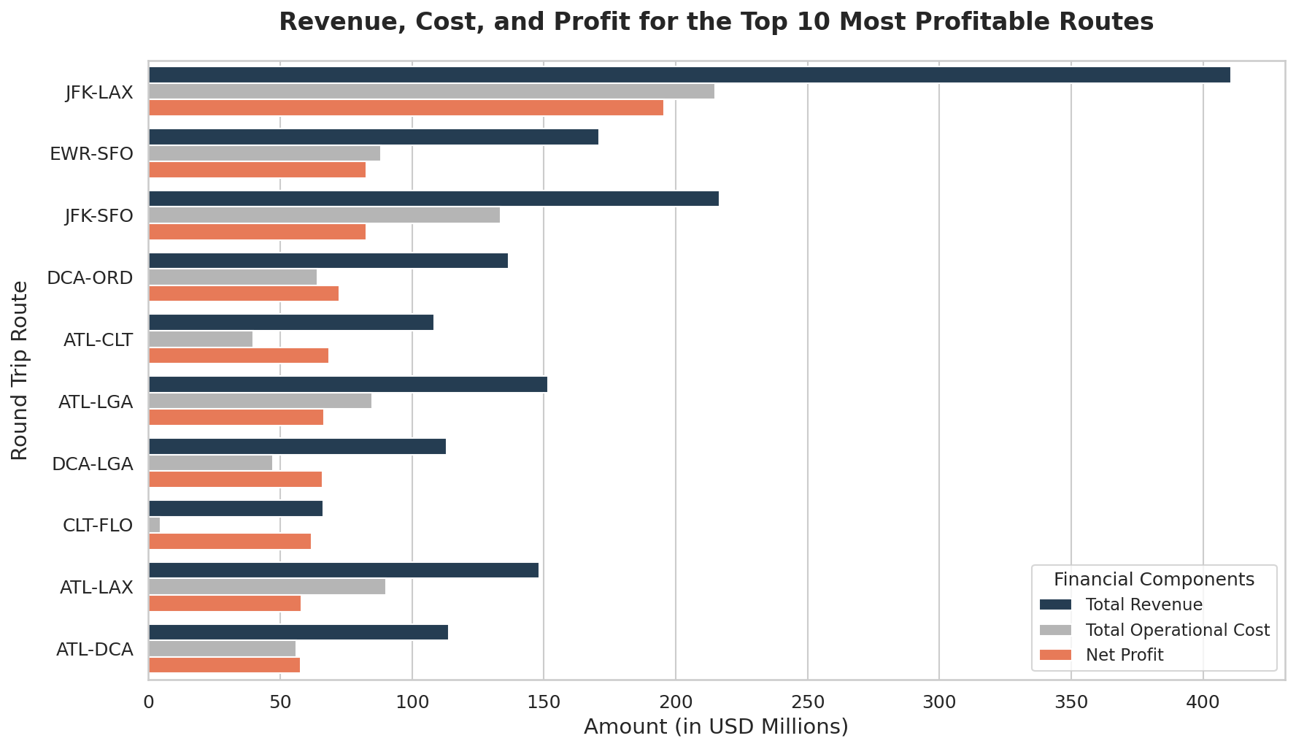
05 / FINANCIAL ASSESSMENT
Most Profitable Round-Trip Routes
✦ Scale Matters: Profits are calculated at the individual flight leg level by mapping fare average yield against physical costs.
✦ Transcon Dominance: Long-haul transcontinental flights sweep the top 3 spots, fueled by high ticket fares.
✦ Regional Outlier: CLT-FLO appears at #8 due to regional monopoly pricing, but it represents a tiny regional market.
Rank | Route | Q1 Net Profit | Avg Fare | Round Trips
1 | JFK - LAX (Rec) | $195.6M | $964.35 | 3,160.0
2 | EWR - SFO (Rec) | $82.8M | $1,050.82 | 1,212.0
3 | JFK - SFO (Rec) | $82.8M | $860.38 | 1,860.5
4 | DCA - ORD (Rec) | $72.4M | $535.33 | 1,847.5
5 | ATL - CLT (Rec) | $68.6M | $508.35 | 1,538.0

Slide 7
06 / FLEET INVESTMENT
Recommended Route Portfolio & Full Airport Identification
JFK-LAX
New York John F. Kennedy Int'l (JFK) to Los Angeles Int'l (LAX). Undisputed premium transcon corridor.
Net Profit: $195.6M
Avg Fare: $964.35
RT Flights: 3,160.0
EWR-SFO
Newark Liberty Int'l (EWR) to San Francisco Int'l (SFO). Tech-finance corridor. Highest U.S. average fare.
Net Profit: $82.8M
Avg Fare: $1,050.82
RT Flights: 1,212.0
JFK-SFO
New York JFK to San Francisco Int'l (SFO). Pairs with JFK-LAX & EWR-SFO for maximum network capture.
Net Profit: $82.8M
Avg Fare: $860.38
RT Flights: 1,860.5
DCA-ORD
Washington Reagan National (DCA) to Chicago O'Hare Int'l (ORD). High-volume corporate business trunk.
Net Profit: $72.4M
Avg Fare: $535.33
RT Flights: 1,847.5
ATL-CLT
Hartsfield-Jackson Atlanta (ATL) to Charlotte Douglas (CLT). Low-cost regional southeastern powerhouse.
Net Profit: $68.6M
Avg Fare: $508.35
RT Flights: 1,538.0
CRITICAL STRATEGIC FOCUS: Avoided regional monopoly CLT-FLO despite extreme raw fares ($1,999). Operating 200-seat aircraft in a small 3-flight-per-day market is physically unviable and would collapse prices. Mainline assets require high-density, deep markets.

Slide 8
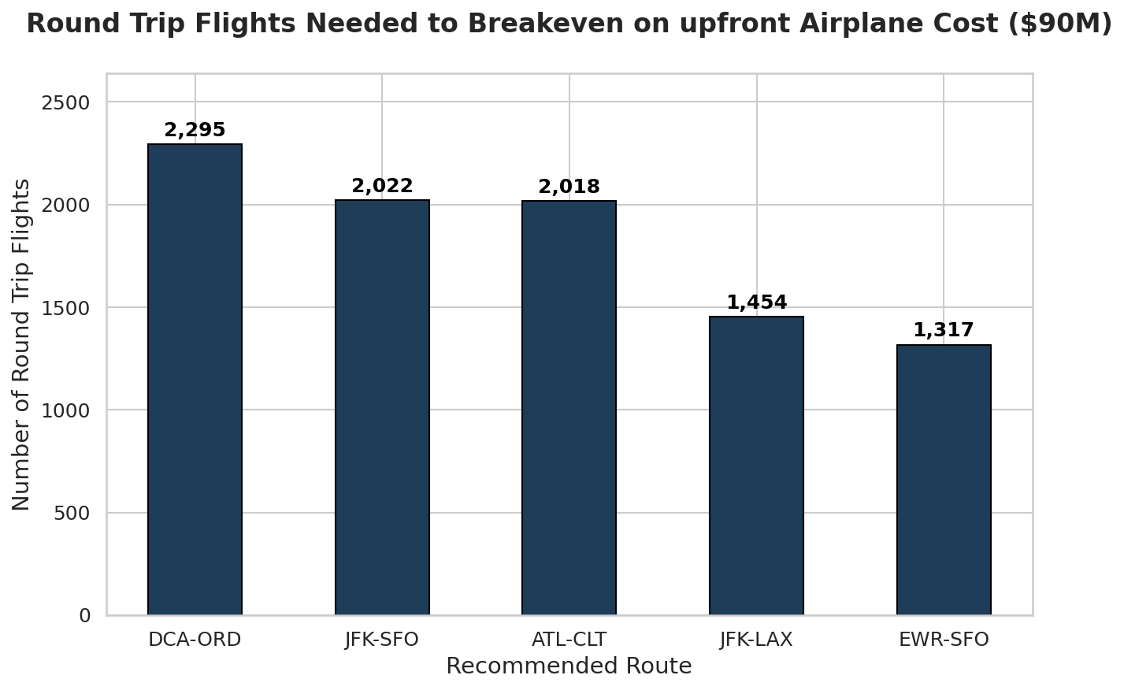
07 / FINANCIAL BREAKEVEN
Capital Breakeven Analysis ($90M Aircraft)
✦ Upfront Investment: Each dedicated aircraft requires a $90,000,000 capital expenditure.
✦ Breakeven Speed: EWR-SFO offers the fastest flight amortization (1,317 RTs) due to its massive $68k profit per round trip.
✦ Days to Breakeven: Based on capturing average Q1 daily volumes, aircraft cost is fully amortized in under 120 days.
Route | Profit / RT | Breakeven RTs | Projected Days
EWR - SFO | $68,324 | 1,317 RTs | 98 Days
JFK - LAX | $61,902 | 1,454 RTs | 41 Days
ATL - CLT | $44,602 | 2,018 RTs | 118 Days
JFK - SFO | $44,503 | 2,022 RTs | 98 Days
DCA - ORD | $39,213 | 2,295 RTs | 112 Days

Slide 9
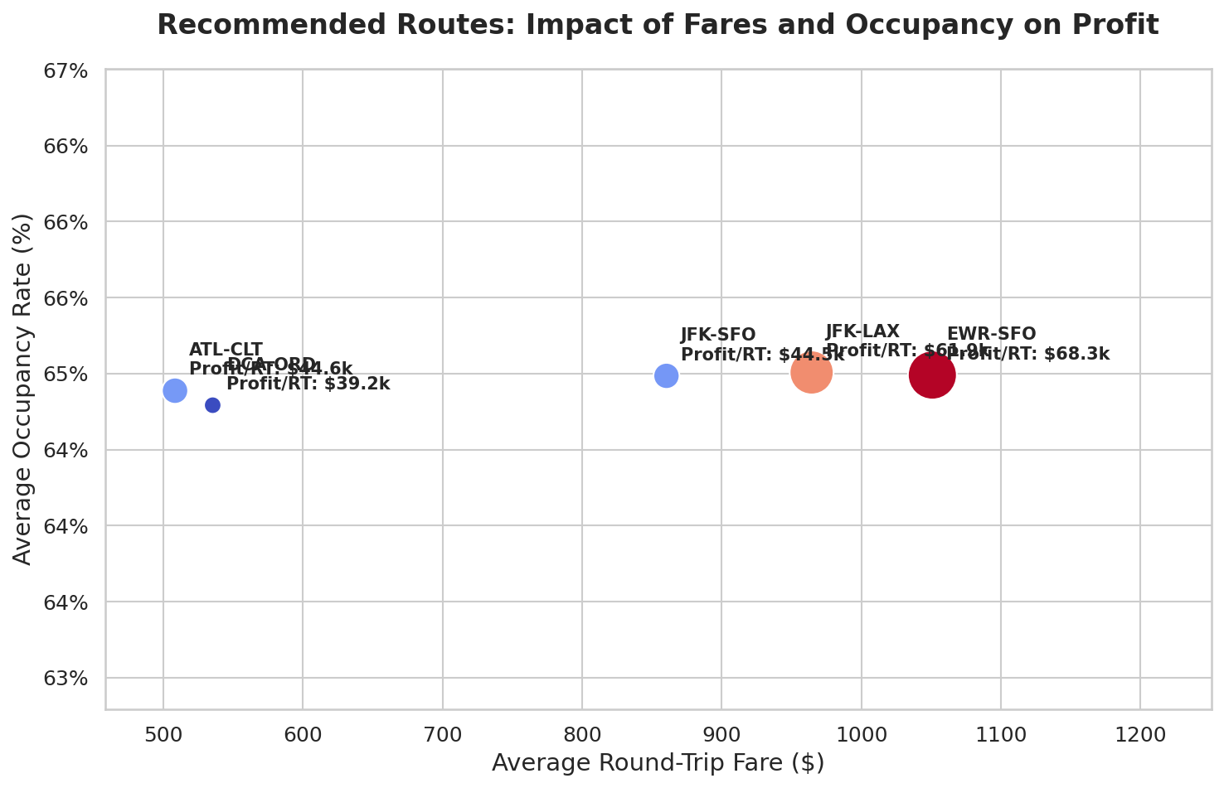
08 / BUSINESS DRIVERS
Recommended Routes: Profitability Drivers
✦ Dual Engines of Profit: High load factor (occupancy rate) and premium fares are the core engines of profitability.
✦ High Fare, High Yield: EWR-SFO and JFK-LAX occupy the sweet spot of massive premium transcontinental yields.
✦ Short Haul Capacity: ATL-CLT bypasses normal distance limits with high fares ($508) and tiny operating costs ($2,074/leg).
✦ Network Leverage: Operating multiple endpoints from New York (JFK/EWR) to San Francisco/Los Angeles maximizes aircraft routing flexibility and capture.

Slide 10
09 / OPERATIONAL RISK
On-Time Performance & Operational Delay Risk
✦ Brand Promise: Our brand motto is *'On time, for you'*. Minimizing delays is not just a marketing slogan—it directly protects our high-yield margins.
✦ Delay Cost Penalties: Delays over 15 minutes incur heavy crew and gate penalties of $75.00 per minute for departure and arrival.
✦ Newark (EWR) Turnaround Focus: EWR-SFO has the highest average delay penalty ($5,720 per round trip). We must implement tight ground-turn execution and dedicated gates at Newark to mitigate this risk.
✦ ATL-CLT Stability: The regional short haul ATL-CLT is highly stable, with a tiny average delay penalty of only $1,762 per round trip.
Route | Q1 Delays | Avg Delay / RT | Risk Assessment
EWR - SFO | $6.93M | $5,720 / RT | HIGH RISK (Turnaround Focus)
JFK - SFO | $8.17M | $4,391 / RT | MODERATE RISK (JFK Congestion)
DCA - ORD | $6.39M | $3,456 / RT | MODERATE RISK (Weather Slots)
JFK - LAX | $8.18M | $2,588 / RT | LOW-MODERATE RISK (Dense Trunk)
ATL - CLT | $2.71M | $1,762 / RT | LOW RISK (High Resilience)
OPERATIONAL MITIGATION PLAN:
Establish standby crews and secondary routing options for our premium transcontinental routes (EWR/JFK to SFO) to absorb localized hub congestion and protect our customer on-time experience.

Slide 11
10 / OPERATIONS CONTROL
Strategic Key Performance Indicators (KPIs)
01
On-Time Performance (OTP)
Track D15/A15 departure and arrival delay percentages. Bottom Line: Since delays over 15 minutes cost $75 per minute, maintaining a 90%+ OTP directly protects our operating margins.
02
Route Load Factor
Percentage of the 200 seats filled by paying passengers. Bottom Line: Occupancy is the core scaler of revenue. An extra 1% load factor on JFK-LAX yields $1.5M/quarter in high-margin revenues.
03
Yield/Seat Mile (YASM)
Total leg ticket and bag revenue divided by Available Seat Miles (Seats * Distance). Bottom Line: Measures pricing efficiency and isolates premium transcontinental margins.

Slide 12
11 / NEXT STEPS
Ready for Takeoff: Future Roadmap
✦ Airport Slot & Gate Audit: Secure slot entries and gate allocations at highly congested, slot-controlled hubs (JFK, LGA, DCA).
✦ Full-Year Demand Analysis: Expand modeling to Q2-Q4 DOT databases to capture seasonal passenger pricing elasticity.
✦ Competitor Share Modeling: Assess capacity shares of dominant carriers (Delta, United, American) to optimize entry pricing.
✦ Baggage Fee Elasticity: Model incremental impact of bag pricing adjustments ($30 vs $35 vs $40) on load factor.
"On time, for you."
Operational excellence starts with data-driven network design. Our premium 5-route portfolio is financially primed to succeed.

