Slide 1
MAE140 Linear Circuits (for non-electrical engs)
Topics covered
  Circuit analysis techniques
    Kirchoff’s Laws – KVL, KCL
    Nodal and Mesh Analysis
    Thévenin and Norton Equivalent Circuits
    Resistive circuits, RLC circuits
    Steady-state and dynamic responses
      Impulse and step responses Laplace transforms
    Sinusoidal steady-state response
  Circuit design techniques
    Active circuit elements – dependent sources and operational amplifiers
    Feedback basics
    Signal filtering – if we get time
MAE140 Linear Circuits

Slide 2
What do I expect you to know?
Prerequisites
  Mathematics 21D or 20D (some are doing this concurrently)
    Solution of sets of linear equations
      Ax=b equations for vector x given matrix A and vector b
    Solution of constant coefficient linear ordinary differential equations
      Laplace transform introduction
      Initial conditions and forced response
    Complex analysis
      Numbers, arithmetic, poles, zeros
  Physics 2B
    Behavior of circuit elements: R, L and C
      Underlying physical principles
MAE140 Linear Circuits

Slide 3
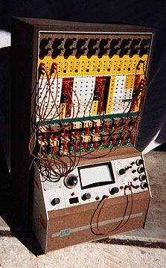
Why should you be excited about MAE140?
Linear circuits are exceptionally well described by simple and powerful mathematics
  The quality of concordance between measured physical behavior and mathematical description is amazing
This is an analog computer from around 1963
It was used to solve nonlinear ODEs via analog circuitry
It contained: about 20 integrators based on valves or transistors, some nonlinear function blocks using diodes, comparators
This was the state of the art for much physical system simulation
It relies on ideas underpinning MAE140
The tools of MAE140 are immediately useful in design
MAE140 Linear Circuits

Slide 4

Why should you still be excited about MAE140?
The front and back ends of your digital cell phone are comprised of analog circuits
  This is pretty much true of all digital technology
Why does the stagecoach wheel appear to rotate backwards?
  Aliasing
    A high frequency masquerading as a low frequency
  Anti-aliasing filters MUST be used in all
  sampled data systems
After MAE140 you will be able to start designing
such anti-aliasing filters
  The real thing!
MAE140 Linear Circuits

Slide 5


Why should you still be excited about MAE140?
You will learn how these knobs and plugs work:
We will not have time to cover this one:
MAE140 Linear Circuits

Slide 6
Circuit variables (T&R Chap 1)
Charge and Energy
  -1 coulomb (C) = 6.25×10¹⁸ electrons’ charge q
  1 ampere (A) = 1 coulomb/second
    Current is a measure of charge passing
    Direction of flow is of positive charge
      This is important for understanding some devices
  Voltage/potential difference/electromotive force/tension
    Voltage measures the energy gained by a charge
  1 joule(J)/coulomb = 1 volt (V)
    Voltage is measured between two points (potential difference)
      This is akin to gravitational potential and fluid flow or temperature and heat flow
dq
i
=
dt
dw
v
=
dq
MAE140 Linear Circuits

Slide 7
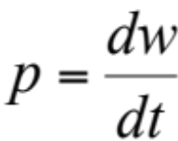
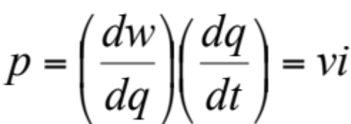
Circuit variables (contd)
Power is the rate of energy change per unit time watts (W)
  Note the chain rule
    The instantaneous electrical power associated with a voltage and a current flow is given by the product v×i
Passive sign convention
  Power is positive when a device absorbs power
    Signs are measured as illustrated
      Voltage is applied (across)
      and current results (into) or vice versa
        Note that v(t) or i(t) can be negative
        This just defines the sense
        In the illustration the current into the device is the negative of that into the rest of the circuit
i(t)
+
rest of
circuit
v(t)
device
-
MAE140 Linear Circuits

Slide 8
An example
The figure at right depicts the circuit inside my flashlight
  The devices are the battery and the lamp
  A voltmeter reads v(t) is 12V
  An ammeter reads i(t) is –1.5A
Which device is the battery and which is the lamp? How much power is being consumed by the lamp?
i(t)
_
A
B
v(t)
+
Using the passive sign convention
  The power absorbed by device A is 12×-1.5 W = -18 W
  A is the battery and B is the lamp, which consumes 18W
MAE140 Linear Circuits

Slide 9
Circuit variables (contd)
Ground
  Because all voltages are measured between two points, there is no absolute voltage - it is a potential
  In circuits we often refer all voltages of points as being relative to a fixed point or ground voltage
  This is depicted via the symbol
  The terms v_{A} etc mean the voltage at A relative
  to G
    This is like referring heights relative to sea level
      Gravity is also a potential
      Check out the elevator buttons in the Math & App Phys Building!
v_{A}(t)
v_{B}(t)
v_{C}(t)
₊
₊
₊
A
B
C
_
G
MAE140 Linear Circuits

Slide 10
Circuit variables (contd)
A circuit is a collection of interconnected electrical devices
  For us:
    All electromagnetic interactions in the circuit take place within the devices (This is a lumped-parameter circuit)
    The circuit devices are connected together by wires which are ideal
        They have the same voltage at both ends instantaneously
        They propagate current without loss instantaneously
        They may be stretched arbitrarily without changing properties
    All circuit devices have at least two terminals and are assumed not to accumulate charge – current in equals current out
A node is the junction of terminals of two or more devices
A loop is a closed path formed by tracing thorough an ordered sequence of nodes without passing through any node more than once
MAE140 Linear Circuits

Slide 11
Circuit variables
The important physical circuit variables are currents into and voltages across circuit elements and their associated power consumption or production.
Circuit analysis consists of solving for the circuit variables in a given circuit
Circuit design or synthesis consists of constructing a circuit whose circuit variables exhibit a specified behavior
The topology of a circuit is the key structure
  It can be stretched and wrapped around without changing circuit variables
    Nodes can be stretched and shrunk to cover many terminals
MAE140 Linear Circuits

Slide 12
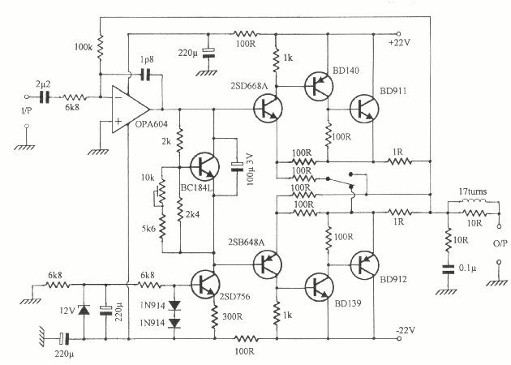
Circuit Topology
This is the circuit diagram of an audio amplifier
It shows the relationship between parts but not their actual physical location
The ground/earth is likely the chassis or case
The output transistors BD912 and BD911 will need to be attached to an external heat sink
The op-amp OPA604 will be board mounted
The volume control needs to be accessible
MAE140 Linear Circuits

Slide 13
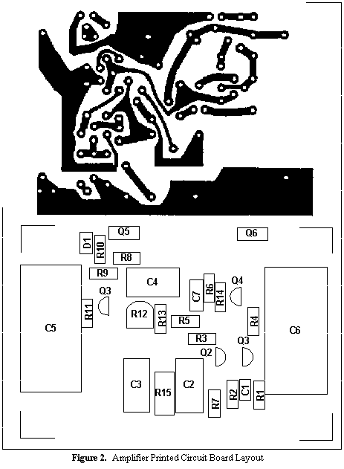
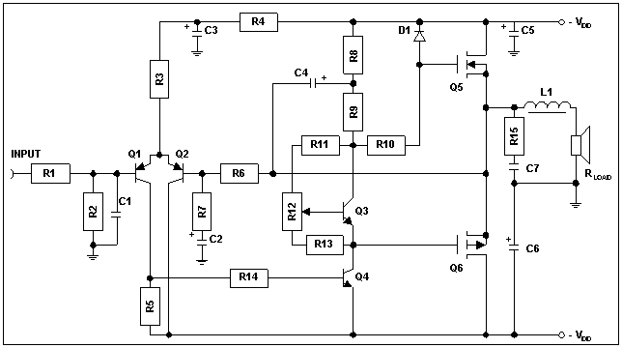
Circuit Topology – high power amplifier with complementary HEXFETS
Circuit Board Layout
Circuit Diagram
HEXFET – power MOSFET
from International Rectifier
MAE140 Linear Circuits

Slide 14
Basic Circuit Analysis (T&R Chap 2)
Kirchoff’s Current Law (KCL)
  The algebraic sum of currents entering a node is zero at every instant
    This is a restatement of the principle of conservation of charge
    Alternatively, but not so nice,
  The sum of currents entering a node is equal to the sum of currents leaving a node at every instant
    KCL provides linear constraints between the currents in a circuit
  In a circuit containing a total of N nodes there are only N-1 independent KCL connection equations
MAE140 Linear Circuits

Slide 15




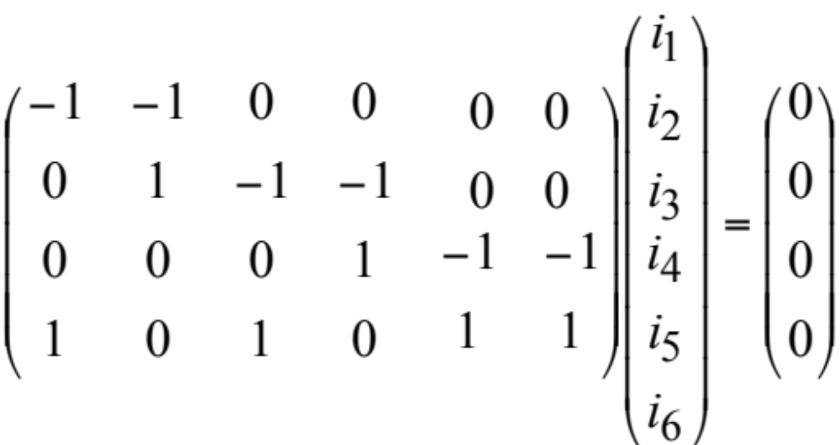
T&R Exercise 2-1 p 22
Write KCL at nodes A, B, C, D
  Node A:
  Node B:
  Node C:
  Node D:
If i₁=–1mA, i₃=0.5mA, i₆=0.2mA, find the rest
  i₂=1mA
  i₄=0.5mA
  i₅=0.3mA
Note that we have 4 nodes
But only 3 independent currents
i₂
i₄
A
B
C
i₁
i₃
i₅
i₆
D
MAE140 Linear Circuits

Slide 16
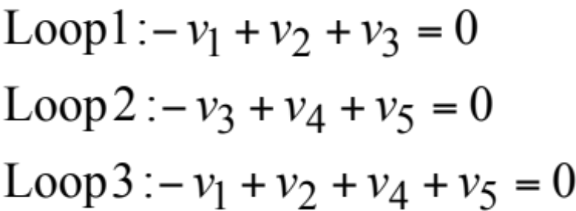
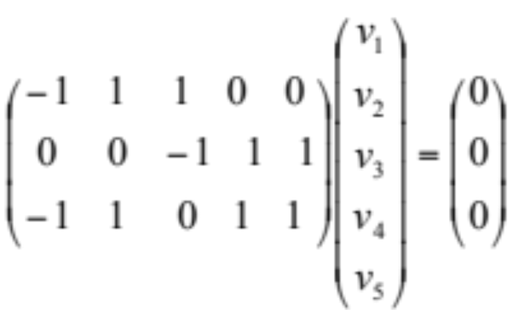
Kirchoff’s Voltage Law (KVL)
The algebraic sum of voltages around a loop is zero at every instant
This is really a restatement of voltage as a potential, effectively a statement of the principle of conservation of energy
Example:
+
v₂
_
+
v₅
_
+
+
+
v₁
v₃
v₄
_
_
_
Loop 1
Loop 2
Loop 3
MAE140 Linear Circuits

Slide 17
Circuit Analysis
One way to consider the analysis of a circuit (i.e. the computation of the currents in and voltage across the circuit elements) is through the specification of constraints on these variables
  KCL and KVL provide one set of constraints on circuit variables reflecting connection topology
  The i-v properties of the devices themselves provide further constraints
    N nodes and E circuit elements
      N-1 independent KCL relations
      E-N+1 independent KVL relations (number of independent loops)
      E independent i-v characteristics
    2E circuit variables
If we keep to linear devices then we have linear circuit analysis
  2E Linear algebraic equations for 2E variables
MAE140 Linear Circuits

Slide 18
Linear Circuit Elements
Linearity in v-i relations
  Doubling v doubles i and vice versa i=αv
    Straight lines in i-v plane
  Note that i=αv+β describes an affine relation
Resistor
  v=Ri or i=Gv Ohm’s Law
  R resistance in ohms (Ω), G conductance in siemens (S)
  Power P=i²R= v²/R=v²G
  A resistor always absorbs power – i-v line has positive slope
This is an instantaneous linear element
  We will look at circuit elements with memory like C and L later
v
i
MAE140 Linear Circuits

Slide 19

MAE140 Linear Circuits

Slide 20
Linear Circuit Elements (contd)
v
Independent Voltage and Current Source (IVS and ICS)
  IVS v=v_{s} for any i
  ICS i=i_{s} for any v
    These are affine elements rather than linear. But we admit them here.
Open circuit and short circuit – variants of ICS and IVS resp.
  Open circuit i=0 for any v Same as R=∞
  Short circuit v=0 for any i Same as R=0
    These are truly linear since the curves pass through (0,0)
Switches – either o.c. or s.c.
v_{s}
i
i_{s}
i
v
MAE140 Linear Circuits

Slide 21
Example 2-10 (T&R p. 31)_x001c_
i₁
100Ω
Write a complete set of equations
for each element
  v_{A}=30V;
  v₁=100i₁;
  v₂=200i₂;
  v₃=300i₃;
Write a complete set of connection equations
  -i_{A}-i₁-i₃=0; i₁-i₂=0; -30+v₃=0; v₁+v₂-v₃=0;
Solve these equations for all currents and voltages
  v_{A}=30V; v₁=10V; v₂=20V; v₃=30V;
  i_{A}=-200mA; i₁=i₂=i₃=100mA;
i_{A}
i₃
+
v₁
-
i₂
300Ω
+
+
+
v₂
200Ω
30V
v_{A}
+
-
-
v₃
-
-
MAE140 Linear Circuits

Slide 22

Time out puzzle
We have three lamps – red, green and blue – connected to three switches as in the diagram
The lamps are outside the switch room and we are alone
What single test can we perform by playing with the switches to determine which switch is connected to which light?
      I know of two solutions, one of physicists one of engineers
+32V
S₁
S₂
S₃
MAE140 Linear Circuits

Slide 23
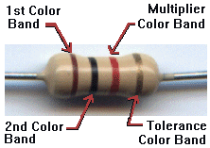
All you ever wanted to know about resistors …
Resistors are color coded to indicate their value
and tolerance
    This is a 1KΩ resistor with 5% tolerance
Resistors come at standard values (e.g at 10% tolerance)
Black | Brown | Red | Orange | Yellow | Green | Blue | Violet | Grey | White
0 | 1 | 2 | 3 | 4 | 5 | 6 | 7 | 8 | 9
5% | 10% | 20%
Gold | Silver | Empty
1 | 1.2 | 1.5 | 1.8 | 2.2 | 2.7 | 3.3 | 3.9 | 4.7 | 5.6 | 6.8 | 8.2 | Nominal
.9 | 1.08 | 1.35 | 1.62 | 1.98 | 2.43 | 2.97 | 3.51 | 4.23 | 5.04 | 6.12 | 7.38 | Lower
1.1 | 1.32 | 1.65 | 1.98 | 2.42 | 2.97 | 3.63 | 4.29 | 5.17 | 6.16 | 7.48 | 9.02 | Upper
MAE140 Linear Circuits

Slide 24
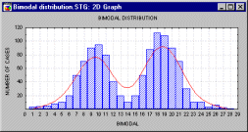
Even more than you ever wanted to know about resistors …
The distribution of resistances
  Why should this be so?
How can we get a 258.3Ω resistor?
  Keep testing the ones in the box
  A really finely tunable potentiometer
  (variable resistor) – a trimpot
  A coarsely tunable potentiometer in parallel with a lower R
  Make one from high precision components
Another important characteristic of R is the power rating
  Why?
-10%
+10%
Nominal value
MAE140 Linear Circuits

