Slide 1
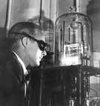
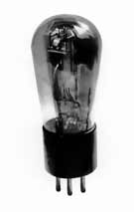
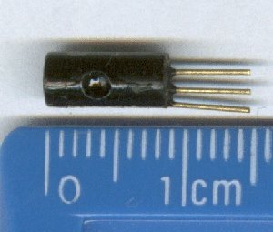
Active Circuits: Life gets interesting
Active cct elements – operational amplifiers (OP-AMPS) and transistors
  Devices which can inject power into the cct
  External power supply – normally comes from connection to the voltage supply “rails”
  Capable of linear operation – amplifiers
  and nonlinear operation – typically switches
  Triodes, pentodes, transistors
MAE140 Linear Circuits

Slide 2
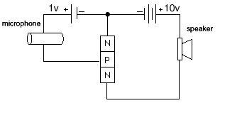
Active Cct Elements
Amplifiers – linear & active
  Signal processors
  Stymied until 1927 and Harold Black
    Negative Feedback Amplifier
      Control rescues communications
      Telephone relay stations manageable
      against manufacturing variability
  Linearity
    Output signal is proportional to the input signal
      Note distinction between signals and systems which transform them
    Yes! Just like your stereo amplifier
  Idea – controlled current and voltage sources
MAE140 Linear Circuits

Slide 3
A Brief Aside - Transistors
C
Bipolar Junction Transistors
  Semiconductors – doped silicon
    n-doping: mobile electrons
      Si doped with Sb, P or As
    p-doping: mobile holes
      Si doped with B, Ga, In
  Two types npn and pnp
    Heavily doped Collector and Emitter
    Lightly doped Base and very thin
    Collector and Emitter thick and dopey
  Need to bias the two junctions properly
    Then the base current modulates a strong C→E current
      Amplification i_{C}=βi_{B}
E
C
p
n
p
B
B
E
C
E
C
n
p
n
B
B
E
MAE140 Linear Circuits

Slide 4
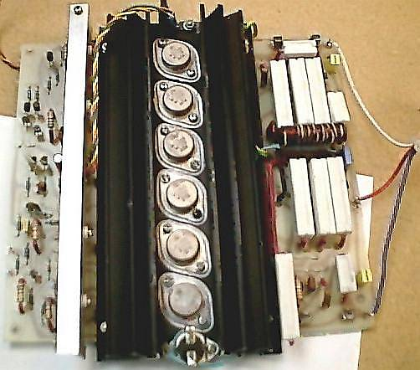
Transistors
+V_{CC}
R_{C}
C_{B2}
Common Emitter Amplifier Stage
  Biasing resistors R₁ and R₂
    Keep transistor junctions biased in amplifying range
  Blocking capacitors C_{B1} and C_{B2}
    Keep dc currents out
  Feedback capacitor C_{E}
    Grounds emitter at high frequencies
+
R₁
C
C_{B1}
+
B
R_{L}
v_{out}
v_{in}
R₂
E
R_{E}
C_{E}
-
-
MAE140 Linear Circuits

Slide 5
Linear Dependent Sources
Active device models in linear mode
  Transistor takes an input voltage v_{i} and produces an output current i₀=gv_{i} where g is the gain
    This is a linear voltage-controlled current source VCCS
i₁
+
ri₁
i₁
βi₁
-
CCVS
r transresistance
CCCS
β current gain
+
+
v₁
+
μv₁
v₁
gv₁
-
-
-
VCVS
μ voltage gain
VCCS
g transconductance
MAE140 Linear Circuits

Slide 6
Linear dependent source (contd)
Linear dependent sources are parts of active cct models – they are not separate components
  But they allow us to extend our cct analysis techniques to really useful applications
  This will become more critical as we get into dynamic ccts
Dependent elements change properties according to the values of other cct variables
+
+
i_{S}
i₁
+
ri₁=ri_{S}=v₀
i_{S}=0
i₁
ri₁=v₀=0
-
-
-
Source on
Source off
MAE140 Linear Circuits

Slide 7
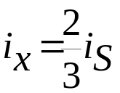
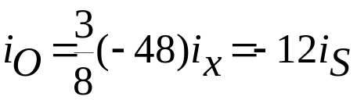

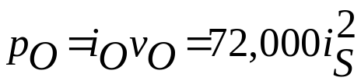
Cct Analysis with Dependent Sources
Golden rule – do not lose track of control variables
  Find i_{O}, v_{O} and P_{O} for the 500Ω load
  Current divider on LHS
  Current divider on RHS
  Ohm’s law
  Power
i_{x}
i_{y}
A
+
25Ω
300Ω
i_{O}
i_{S}
500Ω
v_{O}
50Ω
48i_{x}
-
MAE140 Linear Circuits

Slide 8
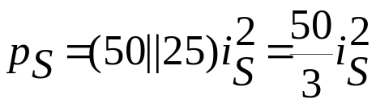
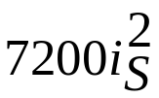
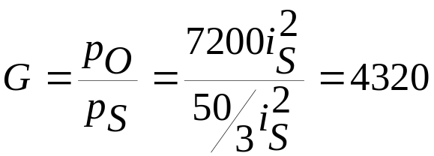
Analysis with dependent sources
i_{x}
i_{y}
A
+
25Ω
300Ω
i_{O}
i_{S}
500Ω
v_{O}
50Ω
48i_{x}
-
Power provided by ICS
Power delivered to load
Power gain
Where did the energy come from?
MAE140 Linear Circuits

Slide 9


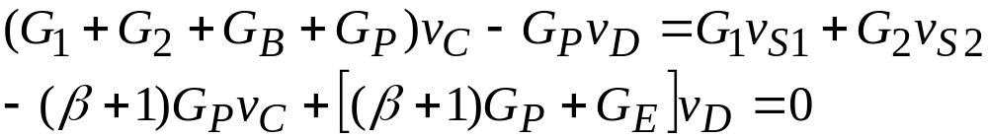
Nodal Analysis with Dependent Source
v_{A}
R₁
v_{B}
R₂
v_{C}
R_{P}
v_{D}
+
i_{B}
v_{S1}
+
v_{S2}
+
R_{B}
R_{E}
v_{O}
_
_
βi_{B}
-
KCL at node C
KCL at node D
CCCS element description
Substitute and solve
MAE140 Linear Circuits

Slide 10



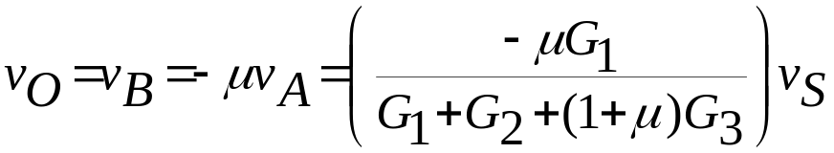
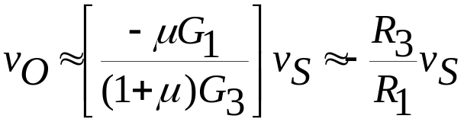
T&R Example 4-3 p 148
R₁
R₃
i_{O}
+
+
Find v_{O} in terms of v_{S}
What happens as μ→∞?
+
v_{S}
R₂
-
R₄
v_{O}
_
v_{x}
+
-
μv_{x}
-
v_{A}
R₃
v_{B}
Node A:
Node B:
Solution:
i_{O}
+
R₁
+
R₂
-
R₄
v_{O}
v_{x}
+
-
μv_{x}
-
For large gains μ: (1+μ)G₃>>G₁+G₂
This is a model of an inverting op-amp
MAE140 Linear Circuits

Slide 11
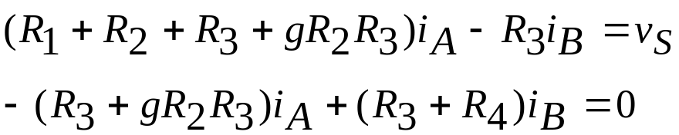
Mesh Current Analysis with Dependent Sources
Dual of Nodal Analysis with dependent sources
  Treat the dependent sources as independent and sort out during the solution
R₁
R₂
i_{O}
+
v_{x}
-
+
+
v_{S}
_
R₃
gv_{x}
R₄
v_{O}
-
R_{in}
R₁
R₂
i_{O}
+
v_{x}
-
R₃
+
+
v_{S}
_
+
i_{B}
R₄
v_{O}
i_{A}
-
-
gR₃v_{x}
R_{in}
MAE140 Linear Circuits

Slide 12


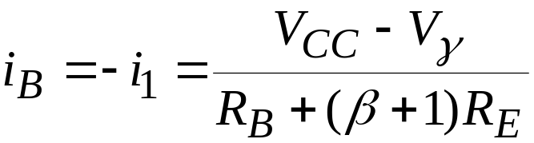
Example 4-5 BJTransistor
Needs a supermesh
  Current source in two loops without R in parallel
  Supermesh = entire outer loop
Supermesh equation
Current source constraint
Solution
+
V_{CC}
R_{B}
R_{C}
_
C
i_{C}
i₁
i₂
βi_{B}
B
i_{B}
+
-
i_{E}
E
V_{γ}
R_{E}
MAE140 Linear Circuits

Slide 13

Example 4-6 Field Effect Transistor
+
v_{x}
-
-
v_{y}
+
gv_{x}
r_{ds}
r_{ds}
gv_{y}
+
+
+
v_{S1}
_
R₁
R₃
R₄
v_{O}
R₂
_
v_{S2}
-
Since cct is linear
  Solve via superposition
    First v_{S1}=1 and v_{S2}=0 then v_{S1}=0 and v_{S2}=1
    This gives K₁ and K₂
MAE140 Linear Circuits

Slide 14


Operational Amplifiers - OpAmps
Basic building block of linear analog cicruits
  Package of transistors, capacitors, resistors, diodes in a chip
Five terminals
  Positive power supply V_{CC}
  Negative power supply - V_{CC}
  Inverting input v_{p}
  Non-inverting input v_{n}
Linear region of operation
  Ideal behavior
  Saturation at V_{CC}/-V_{CC} limits range
1
8
v_{n}
2
7
V_{CC}
-
V_{O}
v_{p}
3
+
6
-V_{CC}
5
4
v_{O}
V_{CC}
Slope A
v_{p}-v_{n}
-V_{CC}
MAE140 Linear Circuits

Slide 15
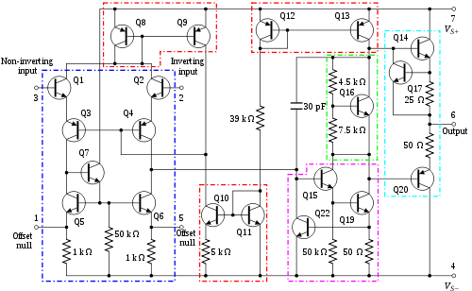
Real OpAmp (u741)
MAE140 Linear Circuits

Slide 16
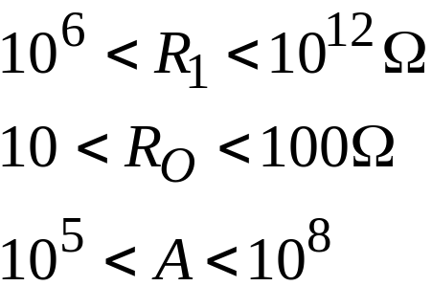
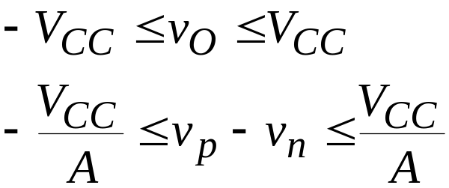
Ideal OpAmp
v_{O}
V_{CC}
Equivalent linear circuit
  Dependent source model
  Need to stay in linear range
  Ideal conditions
Slope A
∞
Ω
v_{p}-v_{n}
0
Ω
∞
-V_{CC}
+
i_{p}
+
v_{p}
R_{O}
i_{O}
R₁
v_{O}
+
+
i_{n}
+
A(v_{p}-v_{n})
v_{n}
-
v
=
v
-
p
n
i
=
i
=
0
p
n
MAE140 Linear Circuits

Slide 17
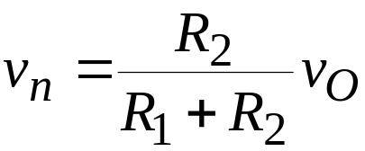
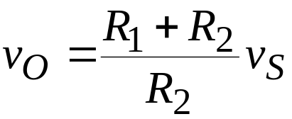
Non-inverting OpAmp - Feedback
What happens now?
  Voltage divider feedback
  Operating condition v_{p}=v_{S}
  Linear non-inverting amplifier
    Gain K=
v_{p}
+
v_{O}
v_{n}
-
R₁
v_{S}
+
_
R₂
R
+
R
1
2
R
2
MAE140 Linear Circuits

Slide 18
Example 4-13
Analyze this
OpAmp has zero output resistance
  R_{L} does not affect v_{O}
R₁
v_{p}
v_{O}
i
=
0
+
p
v_{n}
-
R₃
v
p
R
K
=
=
2
+
v_{S}
R₂
R_{L}
S
+
_
v
S
R
1
R
2
R₄
v
R
+
R
K
=
O
=
3
4
AMP
v
R
p
4
v
⎡
R
⎤
⎡
R
+
R
⎤
K
=
K
K
=
O
=
2
3
4
Total
S
AMP
⎢
+
⎥
⎢
⎥
v
S
⎣
R
1
R
2
⎦
⎣
R
4
⎦
MAE140 Linear Circuits

Slide 19
Voltage Follower - Buffer
Feedback path
Infinite input resistance
Ideal OpAmp
Loop gain is 1
  Power is supplied from the Vcc/-Vcc rails
R₁
i_{p}
v_{p}
v_{O}
i_{O}
i_{n}
+
v
=
v
v_{n}
-
n
O
+
v_{S}
R_{L}
_
i
=
0
,
v
=
v
p
p
S
v
=
v
v
O
p
n
v
=
v
i
=
O
S
O
R
L
MAE140 Linear Circuits

Slide 20
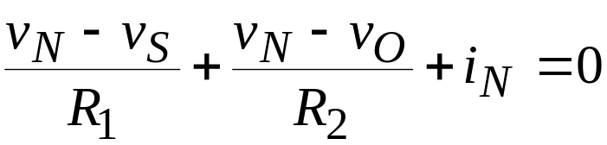

OpAmp Ccts – inverting amplifier
Input and feedback applied at same terminal of OpAmp
  R₂ is the feedback resistor
    So how does it work?
      KCL at node A
  v_{O}=-Kv_{S} hence the name
R₁
A
R₂
v_{O}
i₁
i_{N}
i₂
v_{N}
v_{S}
+
-
_
+
v_{p}
Inverting amp
v_{p}
+
v_{O}
-
v_{n}
R
R₁
v
=
−
2
v
+
O
S
v_{S}
_
R
1
R₂
Non-inverting amp
MAE140 Linear Circuits

Slide 21
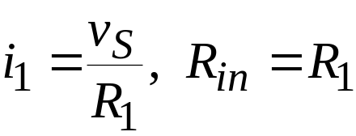
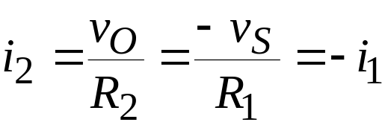
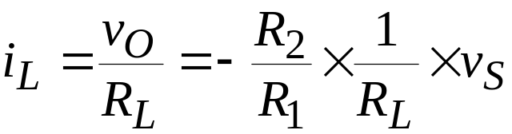
Inverting Amplifier (contd)
R₁
A
R₂
v_{O}
Current flows in the inverting amp
i₁
i_{N}
i₂
v_{N}
v_{S}
+
-
R_{L}
_
+
v_{p}
i_{L}
MAE140 Linear Circuits

Slide 22
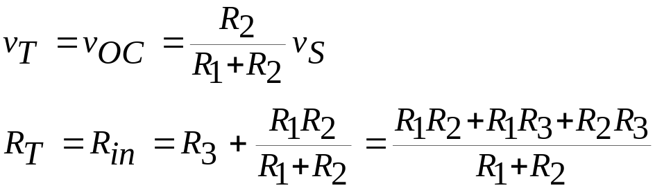
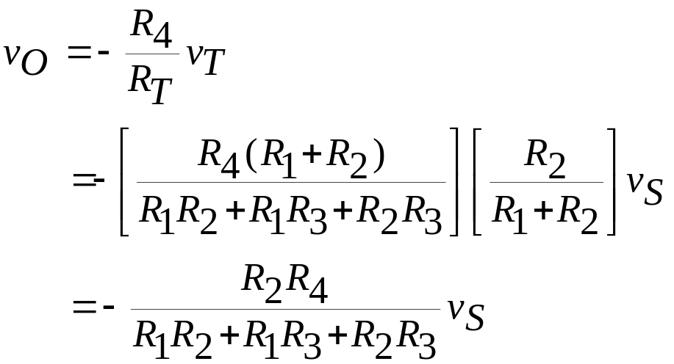
OpAmp Analysis – Example 4-14
Compute the input-output relationship of this cct
  Convert the cct left of the node A to its Thévenin equivalent
Note that this is not the inverting amp gain times the voltage divider gain
  There is interaction between the two parts of the cct (R₃)
  This is a feature of the inverting amplifier configuration
R₁
B
R₃
A
R₄
v_{O}
v_{S}
+
R₂
-
R_{L}
_
+
R_{T}
A
R₄
v_{O}
v_{T}
+
-
R_{L}
_
+
MAE140 Linear Circuits

Slide 23
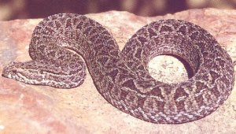
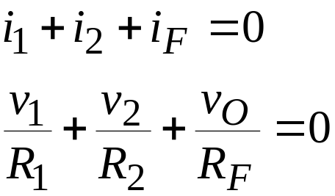
Summing Amplifier - Adder
So what happens?
  Node A is effectively grounded
  v_{n}=v_{p}=0
  Also i_{N}=0 because of R_{in}
    So
    This is an inverting summing amplifier
R₁
A
R_{F}
v_{O}
i₁
R₂
v_{N}
i_{F}
+
i_{N}
v₁
_
i₂
-
v_{p}
+
+
v₂
_
⎛
R
⎞
⎛
R
⎞
v
=
⎜
−
F
⎟
v
+
⎜
−
F
⎟
v
O
R
1
R
2
⎝
1
⎠
⎝
2
⎠
=
K
v
+
K
v
1
1
2
2
Ever wondered about audio mixers? How do they work?
MAE140 Linear Circuits

Slide 24
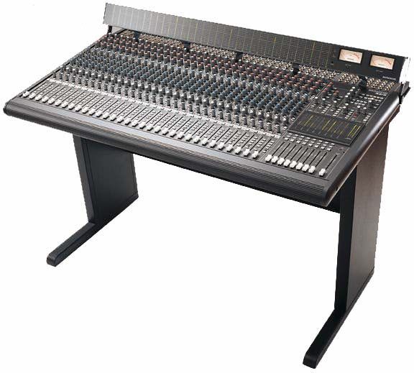

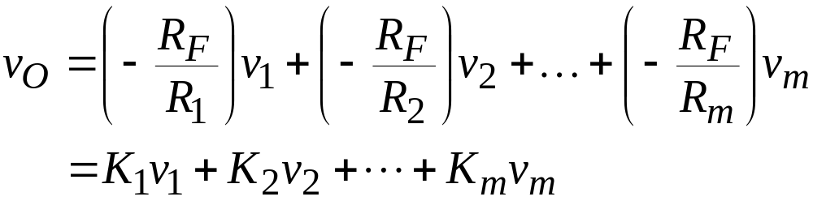
Mixing desk – Linear ccts
R₁
A
R_{F}
v_{O}
i₁
R₂
v_{N}
i_{F}
v₁
+
-
_
i₂
+
R_{m}
v_{p}
+
v₂
_
i_{m}
+
v_{m}
_
Virtual ground at v_{n}
  Currents add
  Summing junction
    Permits adding signals to create a composite
      Strings+brass+woodwind+percussion
      Guitars+bass+drums+vocal+keyboards
MAE140 Linear Circuits

Slide 25
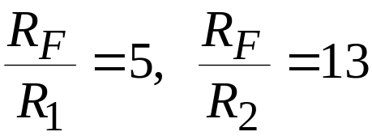
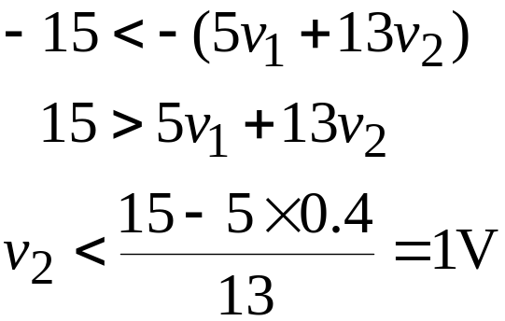
Design Example 4-15
(
)
Design an inverting summer to realize
  Inverting summer with
  If v₁=400mV and V_{CC}=±15V what is max of v₂ for linear op^{n}?
    Need to keep v_{O}>-15V
v
=
−
5
v
+
13
v
O
1
2
13KΩ
65KΩ
11KΩ
56KΩ
v₁
v_{O}
v₁
v_{O}
5KΩ
4.3KΩ
v₂
-
v₂
-
+
+
Nominal values
Standard values
MAE140 Linear Circuits

Slide 26
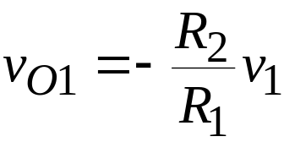
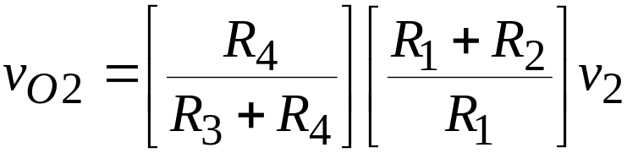
OpAmp Circuits – Differential Amplifier
i₁
R₁
R₂
i₂
Use superposition to analyze
  v₂=0: inverting amplifier
  v₁=0: non-inverting amplifier plus voltage divider
  K₁ inverting gain
  K₂ non-inverting gain
i_{n}
v_{O}
v_{n}
+
v₁
R₃
i_{p}
-
_
+
v_{p}
+
_
v₂
R₄
v
=
v
+
v
O
O
1
O
2
⎡
R
⎤
⎡
R
⎤
⎡
R
+
R
⎤
=
−
⎢
2
⎥
v
1
+
⎢
4
⎥
⎢
1
2
⎥
v
⎣
R
⎦
⎣
R
+
R
⎦
⎣
R
⎦
2
1
3
4
1
=
−
K
v
+
K
v
1
1
2
2
MAE140 Linear Circuits

Slide 27
Exercise 4-13
What is v_{O}?
  This is a differential amp
  v₁ is 10V, v₂ is 10V
  R₁=1KΩ||1KΩ=500Ω
  R₂=R₃=R₄=1KW
1KΩ
1KΩ
1KΩ
+
-
v_{O}
+
+
10V
_
1KΩ
1KΩ
v
=
K
v
+
K
v
O
1
1
2
2
R
⎡
R
+
R
⎤
⎡
R
⎤
=
−
2
v
+
⎢
1
2
⎥
⎢
4
⎥
v
R
1
R
R
+
R
2
1
⎣
1
⎦
⎣
3
4
⎦
1
=
−
20
+
3
×
×
10
=
−
5
V
2
MAE140 Linear Circuits

Slide 28
Lego Circuits
v₁
+
v_{O}
v₁
v_{O}
R
+
R
-
K
K
=
1
2
R
2
R₁
R₂
Non-inverting amplifier
R₁
R₂
v₁
v_{O}
R
v₁
K
v_{O}
K
=
−
2
-
R
1
+
Inverting amplifier
MAE140 Linear Circuits

Slide 29
Lego Circuits (contd)
v₁
R
F
R₁
R_{F}
K₁
K
=
−
v₁
v_{O}
1
R
v_{O}
1
v₂
v₂
+
R₂
-
K₂
R
F
+
K
=
−
2
R
2
Inverting summer
v₁
R₁
R₂
v_{O}
v₂
R₃
-
+
v₁
R
K
=
−
2
K₁
1
v_{O}
R
1
R₄
v₂
+
K₂
⎛
R
+
R
⎞
⎛
R
⎞
K
=
⎜
1
2
⎟
⎜
4
⎟
2
⎜
+
⎟
⎝
R
1
⎠
⎝
R
3
R
4
⎠
Differential amplifier
MAE140 Linear Circuits

Slide 30

Example 4-16: OpAmp Lego
v_{F}
+
10KΩ
10KΩ
3.3KΩ
10KΩ
10KΩ
9KΩ
5KΩ
v_{C}
9.7V
>>
>>
+
+
-
-
-
+
+
+
V_{CC}=±15V
So what does this circuit do?
    It converts tens of ºF to tens of ºC
      Max current drawn by each stage is 1.5mA
v_{F}
-1
v_{C}
+
9.7V
3.2V
3.2-v_{F}
-0.33
-1
MAE140 Linear Circuits

Slide 31
OpAmp Cct Analysis
OpAmp Nodal Analysis
  Use dependent voltage source model
    Identify node voltages
    Formulate input node equations
      Solve using ideal characteristic v_{p}=v_{n}
Rest of
circuit
v_{p}
i_{p}
+
+
-
i_{O}
+
v_{O}
Rest of
circuit
Rest of
circuit
v_{n}
i_{n}
-
+
+
A(v_{p}-v_{n})
-
-
-
MAE140 Linear Circuits

Slide 32
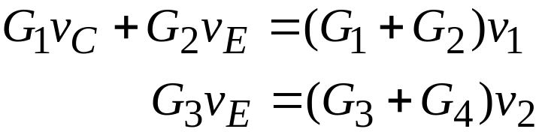
OpAmp Analysis – Example 4-18
Seemingly six non-reference nodes: A-E
  Nodes A, B: connect to reference voltages v₁ and v₂
  Node C, E: connected to OpAmp outputs (forget for the moment)
  Node D:
  Node F:
  OpAmp constraints
A
C
+
<
-
+
v₁
+
v_{O}
_
R₁
-
<
D
R₂
(
G
+
G
)
v
−
G
v
−
G
v
=
0
B
1
2
D
1
C
2
E
+
(
G
+
G
)
v
−
G
v
=
0
-
E
3
4
F
3
E
v₂
+
_
R₃
v
=
v
=
v
,
v
=
v
=
v
A
1
D
B
2
F
F
R₄
⎡
G
+
G
⎤
G
⎡
G
+
G
⎤
v
=
v
=
1
2
v
−
2
⎢
3
4
⎥
v
O
C
⎢
⎥
1
2
⎣
G
1
⎦
G
1
⎣
G
3
⎦
MAE140 Linear Circuits

Slide 33
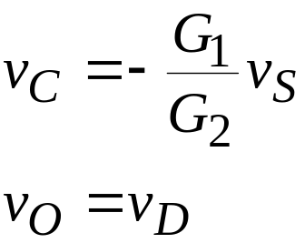
OpAmp Analysis – Exercise 4-14
R₂
C
R₄
Node A: v_{A}=v_{S}
Node B:
(G₁+G₂)v_{B}-G₁v_{A}-G₂v_{C}=0
Node C:
(G₂+G₃+G₄)v_{C}-G₂v_{B}-G₄v_{D}=0
Constraints
v_{B}=v_{p}=v_{n}=0
Solve
A
R₁
B
R₃
v_{S}
+
_
+
v_{O}
-
+
D
(
G
+
G
+
G
)
−
G
v
=
2
3
4
×
1
v
O
G
G
S
4
2
(
R
R
+
R
R
+
R
R
)
=
−
2
3
2
4
3
4
v
R
R
S
1
3
MAE140 Linear Circuits

Slide 34
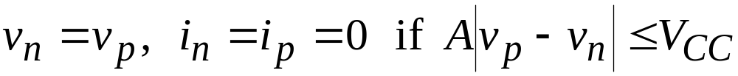
Comparators – A Nonlinear OpAmp Circuit
We have used the ideal OpAmp conditions for the analysis of OpAmps in the linear regime
What about if we operate with v_{p}≠ v_{n}?
  That is, we operate outside the linear regime.
  We saturate!!
Without feedback, OpAmp acts as a comparator
  There is one of these in every FM radio!
v
=
+
V
if
v
>
v
O
CC
p
n
v
=
−
V
if
v
<
v
O
CC
p
n
MAE140 Linear Circuits

Slide 35

“Analog-to-digital converter” - comparators
Current laws still work
Parallel comparison
  Flash converter
  “3-bit” output
    Not really how it is done
      Voltage divider switched
8V
3R
+
v_{O3}
-
2R
+
v_{O2}
-
2R
+
v_{O1}
Input | v_{O1} | v_{O2} | v_{O3}
1>v_{S} | 0 | 0 | 0
3>v_{S}>1 | 5 | 0 | 0
5>v_{S}>3 | 5 | 5 | 0
v_{S}>5 | 5 | 5 | 5
v_{S}
+
-
_
R
+V_{CC}=5V
-V_{CC}=0V
MAE140 Linear Circuits

Slide 36
OpAmp Circuit Design – the whole point
Given an input-output relationship design a cct to implement it
  Build a cct to implement v_{O}=5v₁+10v₂+20v₃
    Inverting summer followed by an inverter
20KΩ
10KΩ
100KΩ
100KΩ
100KΩ
v_{O}
>
>
+
_
5KΩ
v₁
-
-
+
+
+
_
v₂
+
_
v₃
Summer
Inverter
MAE140 Linear Circuits

Slide 37
Example 4-21
20KΩ
10KΩ
How about this one?
  Non-inverting amp v_{p}→v_{O}
  KCL at p-node with i_{p}=0
  Non-inverting summer
    Fewer elements than inverting summer
+
+
_
5KΩ
-
v_{O}
v₁
+
_
v₂
+
100KΩ
_
2.94KΩ
100
×
10
3
+
2
.
94
×
10
3
v₃
v
=
Kv
=
v
=
35
v
O
p
3
p
p
2
.
94
×
10
R₁
v₁
−
−
−
R₂
v
1
v
p
v
2
v
p
v
3
v
p
v₂
+
+
+
=
0
-
v_{O}
2
×
10
4
10
4
0
.
5
×
10
4
R_{m}
3
.
5
v
=
0
.
5
v
+
v
+
2
v
v_{m}
(K-1)R
p
1
2
3
R
⎡
R
eq
R
eq
R
eq
⎤
v
O
=
K
⎢
v
1
+
v
2
+
L
+
v
m
⎥
R
eq
=
R
1
R
2
R
3
L
R
m
⎣
R
1
R
2
R
m
⎦
MAE140 Linear Circuits

Slide 38
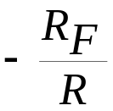
Digital-to-analog converter
v₁
MSB
R/8
R/4
R_{F}
v₁
8
v₂
v_{O}
R/2
v₂
4
v₃
-
v_{O}
LSB
R
+
v₃
+
v₄
2
v₄
1
Parallel
Digital
Inputs
MSB
DAC
Single
Analog
Voltage
v_{O}
LSB
Conversion of digital data to analog voltage value
  Bit inputs = 0 or 5V
  Analog output varies between v_{min} and v_{max} in 16 steps
MAE140 Linear Circuits

Slide 39
Signal Conditioning
Your most likely brush with OpAmps in practice
  Signal – typically a voltage representing a physical variable
    Temperature, strain, speed, pressure
  Digital analysis – done on a computer after
    Anti-aliasing filtering – data interpretation
    Adding/subtracting an offset – zeroing
      Normally zero of ADC is 0V
    Scaling for full scale variation – quantization
      Normally full scale of ADC is 5V
    Analog-to-digital conversion – ADC
      Maybe after a few more tricks like track and hold
  Offset correction: use a summing OpAmp
  Scaling: use an OpAmp amplifier
  Anti-aliasing filter: use a dynamic OpAmp cct
MAE140 Linear Circuits

Slide 40
Thévenin and Norton for dependent sources
Cannot turn off the ICSs and IVSs to do the analysis
  This would turn off the DCSs and DVSs
Connect an independent CS or VS to the terminal and compute the resulting voltage or current and its dependence on the source
R_{T}
Compute v_{S} in response to i_{S}:
+
v
=
v
+
i
R
S
T
S
T
v_{T}
+
v_{S}
i_{S}
_
-
MAE140 Linear Circuits

Slide 41
Where to now?
Where have we been?
  Nodal and mesh analysis
  Thévenin and Norton equivalence
  Dependent sources and active cct models
  OpAmps and resistive linear active cct design
Where to now?
  Laplace Transforms and their use for ODEs and ccts (Ch.9)
  Capacitors, inductors and dynamic OpAmp ccts (Ch.6)
  s-domain cct design and analysis (Ch.10)
  Frequency response (Ch.12) and filter design (Ch.14)
    We will depart from the book more during this phase
MAE140 Linear Circuits

