Slide 1
Frequency Response
We now know how to analyze and design ccts via s-domain methods which yield dynamical information
  Zero-state response
  Zero-input response
  Natural response
  Forced response
    The responses are described by the exponential modes
      The modes are determined by the poles of the response Laplace Transform
We next will look at describing cct performance via frequency response methods
  This guides us in specifying the cct pole and zero positions
MAE140 Linear Circuits

Slide 2
Sinusoidal Steady-State Response
Consider a stable transfer function with a sinusoidal input v(t)=Acos(ωt)
  The Laplace Transform of the response has poles
    Where the natural cct modes lie
      These are in the open left half plane Re(s)<0
    At the input modes s=+jω and s=-jω
Only the response due to the poles on the imaginary axis remains after a sufficiently long time
  This is the sinusoidal steady-state response
A
s
V
(
s
)
=
s
2
+
ω
2
MAE140 Linear Circuits

Slide 3
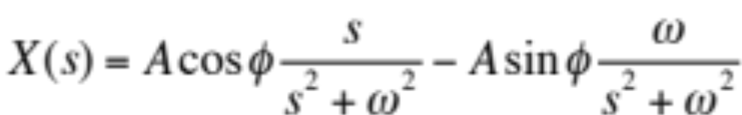
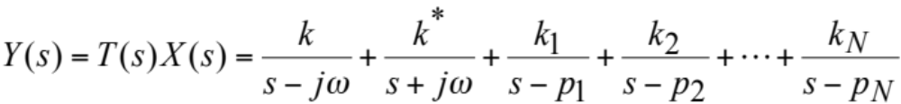
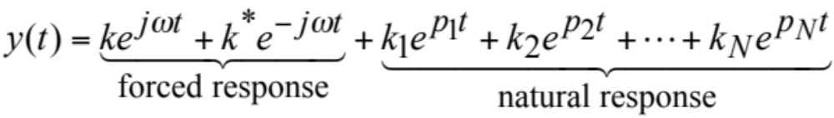
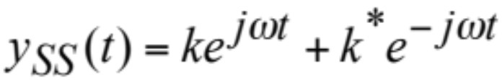
Sinusoidal Steady-State Response contd
Input
Transform
Response Transform
Response Signal
Sinusoidal Steady State Response
MAE140 Linear Circuits

Slide 4
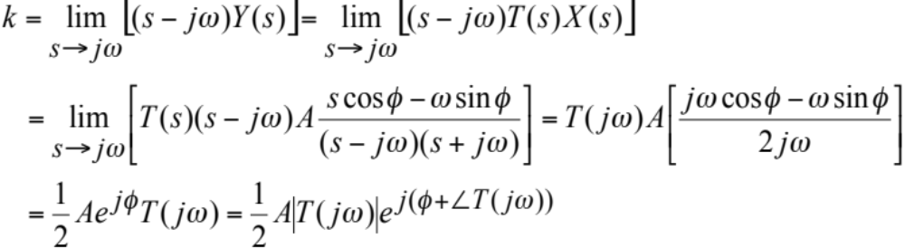
Sinusoidal Steady-State Response contd
Calculating the SSS response to
    Residue calculation
    Signal calculation
x
(
t
)
=
A
cos(
ω
t
+
φ
)
⎧
*
⎫
−
1
⎪
k
k
⎪
y
SS
(
t
)
=
L
⎨
+
⎬
⎪
s
−
j
ω
s
+
j
ω
⎪
⎩
⎭
=
k
e
j
∠
k
e
j
ω
t
+
k
e
−
j
∠
k
e
−
j
ω
t
=
2
k
cos(
ω
t
+
∠
k
)
y
(
t
)
=
A
T
(
j
ω
)
cos
(
ω
t
+
φ
+
∠
T
(
j
ω
)
)
SS
MAE140 Linear Circuits

Slide 5

Sinusoidal Steady-State Response contd
Response to
is
  Output frequency = input frequency
  Output amplitude = input amplitude × |T(jω)|
  Output phase = input phase + T(jω)
The Frequency Response of the transfer function T(s) is given by its evaluation as a function of a complex variable at s=jω
    We speak of the amplitude response and of the phase response
      They cannot independently be varied
        Bode’s relations of analytic function theory
x
(
t
)
=
A
cos(
ω
t
+
φ
)
y
SS
(
t
)
=
A
T
(
j
ω
)
cos
ω
t
+
φ
+
∠
T
(
j
ω
)
MAE140 Linear Circuits

Slide 6
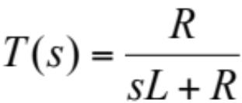
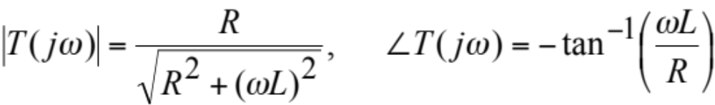
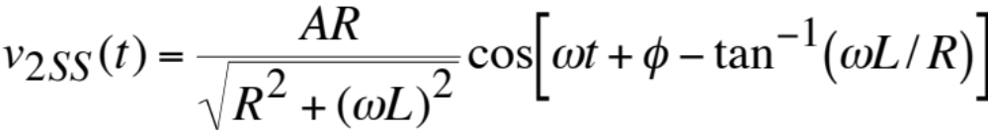
Example 11-13 T&R p 527
Find the steady state output for v₁(t)=Acos(ωt+φ)
Compute the s-domain transfer function T(s)
  Voltage divider
Compute the frequency response
Compute the steady state output
sL
+
+
R
V₂(s)
V₁(s)
_
-
MAE140 Linear Circuits

Slide 7
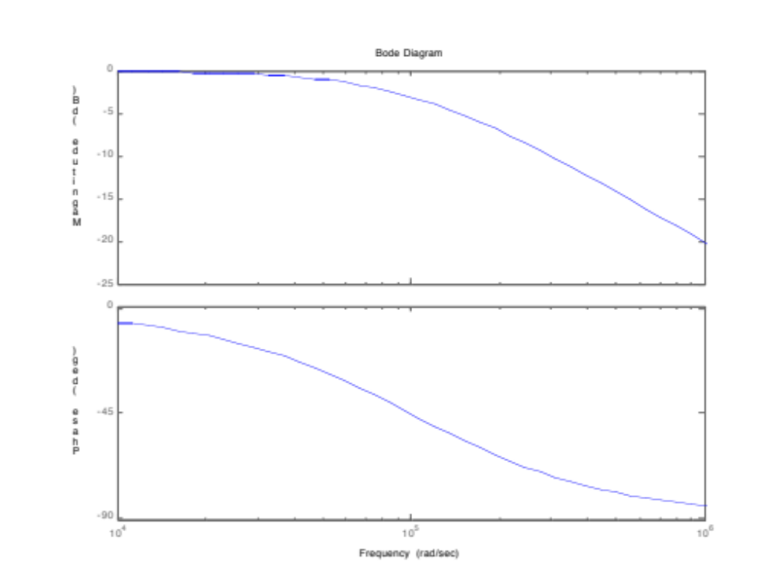
Frequency Responses – Bode Diagrams
Log-log plot of mag(T), log-linear plot arg(T) versus ω
Magnitude (dB)
Phase (deg)
MAE140 Linear Circuits

Slide 8
Matlab Commands for Bode Diagram
Specify component values
Set up transfer function
>> R=1000;L=0.01;
>> Z=tf(R,[L R])
Transfer function:
1000
-------------
0.01 s + 1000
>> bode(Z)
MAE140 Linear Circuits

Slide 9
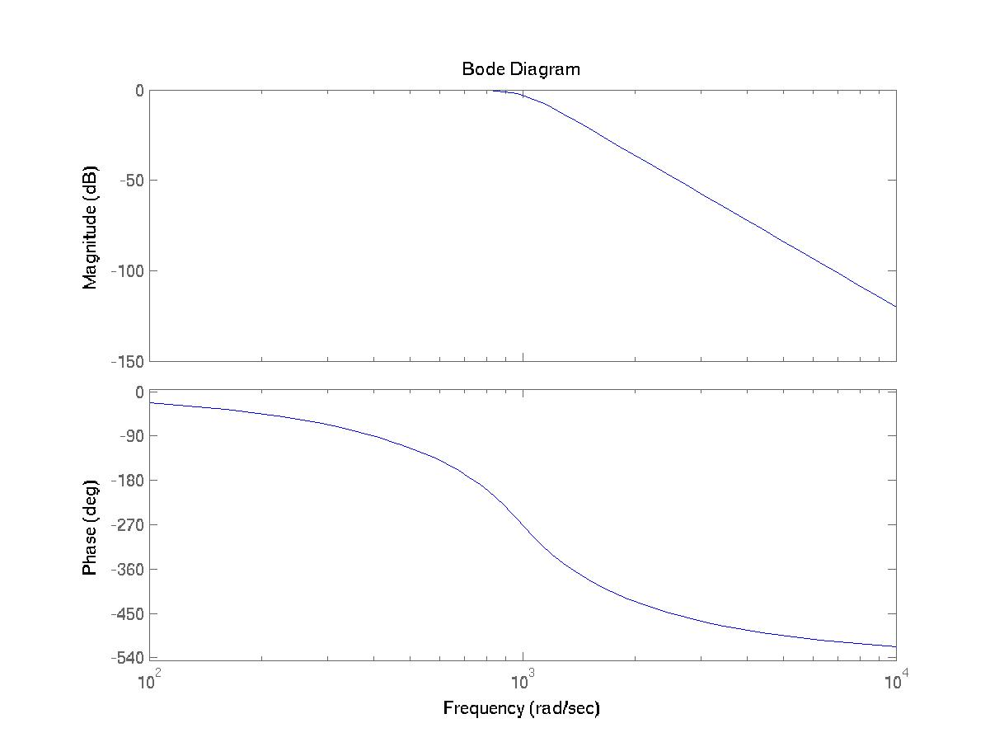
Frequency Response Descriptors
Lowpass Filters
[num,den]=butter(6,1000,'s');
lpass=tf(num,den);
lpass
Transfer function:
1e18
-------------------------------------------------------------------------------
s^6 + 3864 s^5 + 7.464e06 s^4 + 9.142e09 s^3 + 7.464e12 s^2 + 3.864e15 s + 1e18
bode(lpass)
MAE140 Linear Circuits

Slide 10
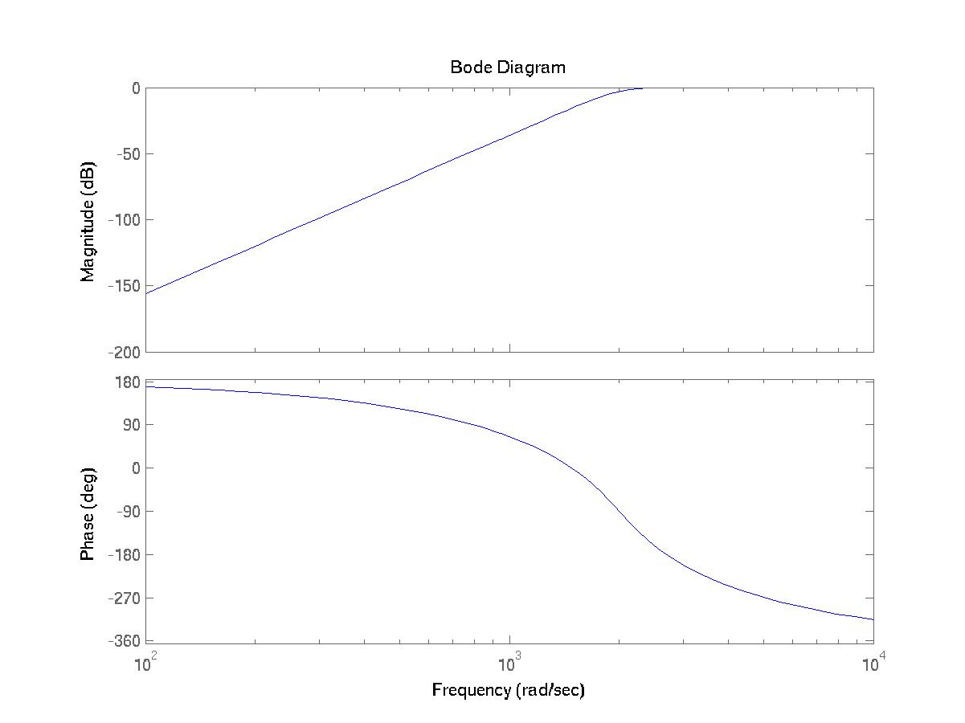
High Pass Filters
[num,den]=butter(6,2000,'high','s');
hpass=tf(num,den)
Transfer function:
s^6
---------------------------------------------------------------------------------
s^6 + 7727 s^5 + 2.986e07 s^4 + 7.313e10 s^3 + 1.194e14 s^2 + 1.236e17 s + 6.4e19
bode(hpass)
MAE140 Linear Circuits

Slide 11
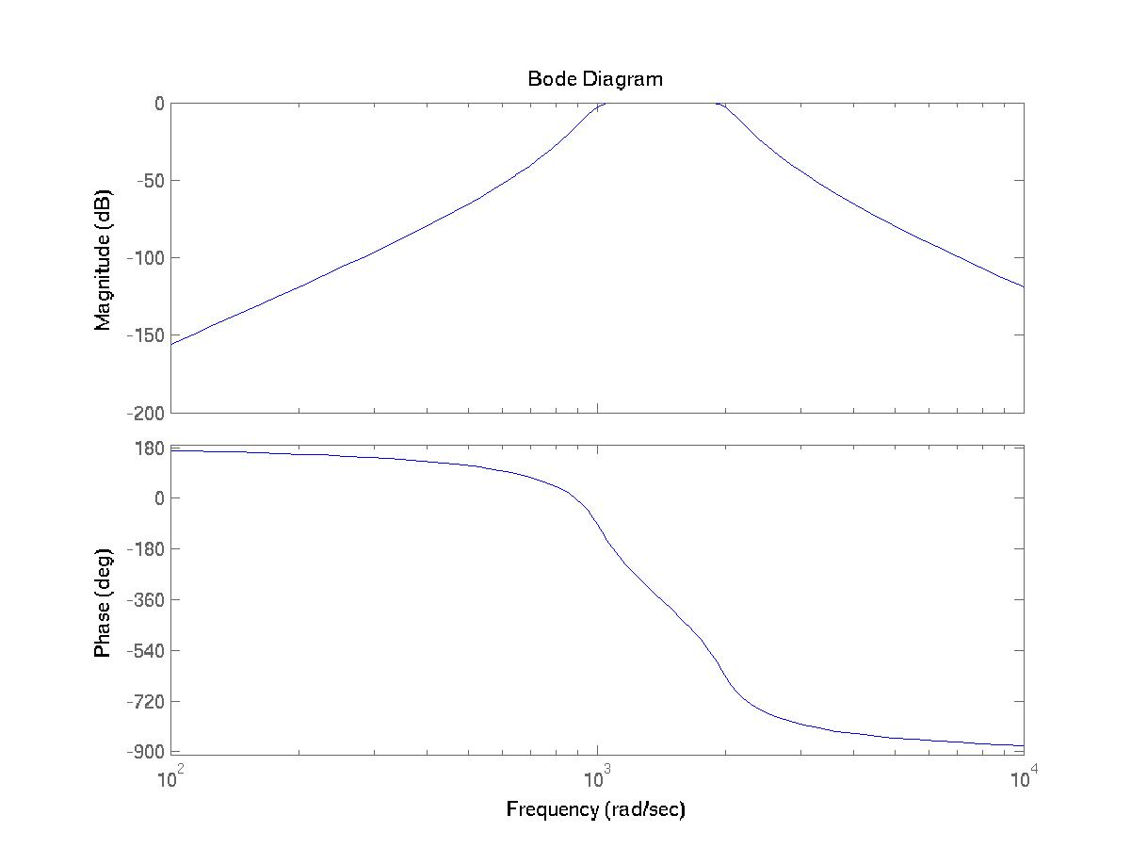
Bandpass Filters
[num,den]=butter(6,[1000 2000],'s');
bpass=tf(num,den)
Transfer function:
1e18 s^6
-------------------------------------------------------------------------------------------
s^12 + 3864 s^11 + 1.946e07 s^10 + 4.778e10 s^9 + 1.272e14 s^8 + 2.133e17 s^7 + 3.7e20 s^6
+ 4.265e23 s^5 + 5.087e26 s^4 + 3.822e29 s^3 + 3.114e32 s^2 + 1.236e35 s + 6.4e37
bode(bpass)
MAE140 Linear Circuits

Slide 12
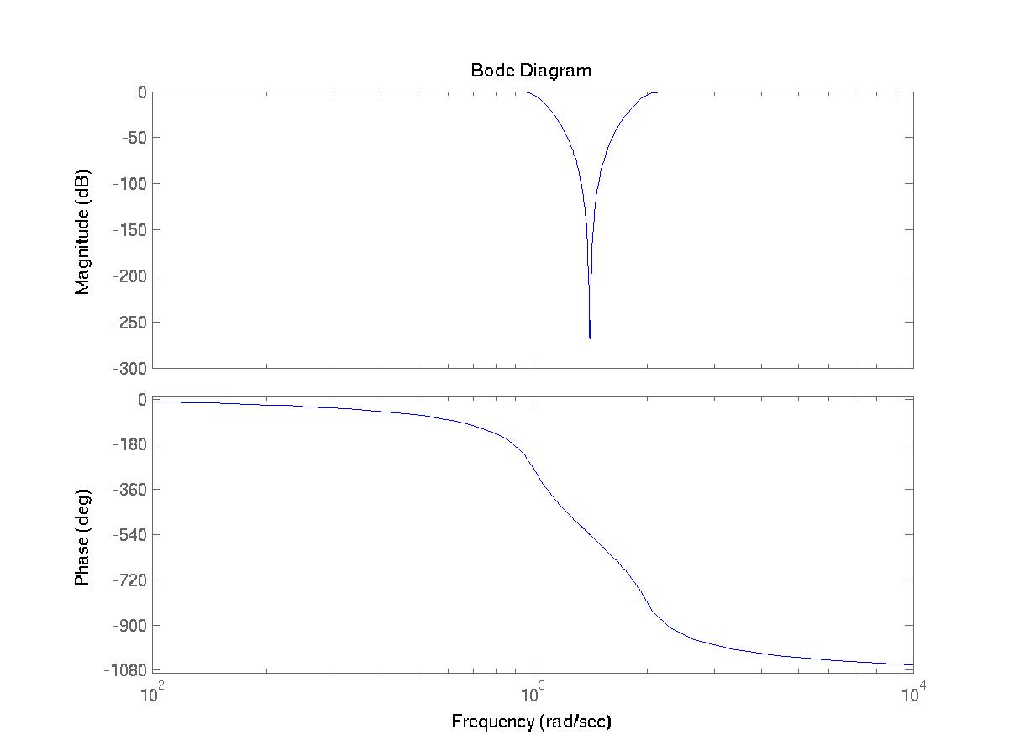
Bandstop Filters
[num,den]=butter(6,[1000 2000],'stop','s');
bstop=tf(num,den)
Transfer function:
s^12 + 1.2e07 s^10 + 6e13 s^8 + 1.6e20 s^6 + 2.4e26 s^4 + 1.92e32 s^2 + 6.4e37
-------------------------------------------------------------------------------------------
s^12 + 3864 s^11 + 1.946e07 s^10 + 4.778e10 s^9 + 1.272e14 s^8 + 2.133e17 s^7 + 3.7e20 s^6
+ 4.265e23 s^5 + 5.087e26 s^4 + 3.822e29 s^3 + 3.114e32 s^2 + 1.236e35 s + 6.4e37
bode(bstop)
MAE140 Linear Circuits

