Slide 1
Breadth-First Search of Graphs
Analysis of Algorithms
Week 9, Lecture 1
Prepared by
John Reif, Ph.D.
Distinguished Professor of Computer Science
Duke University

Slide 2
Applications of Breadth-First Search of Graphs
Single Source Shortest Path
Graph Matching

Slide 3
Reading on Breadth-First Search of Graphs
Reading Selection:
  CLR, Chapter 24

Slide 4
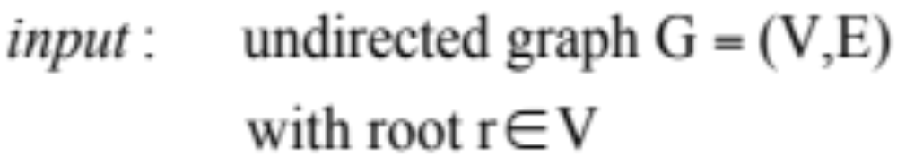
Breadth-First Search Algorithm Input

Slide 5
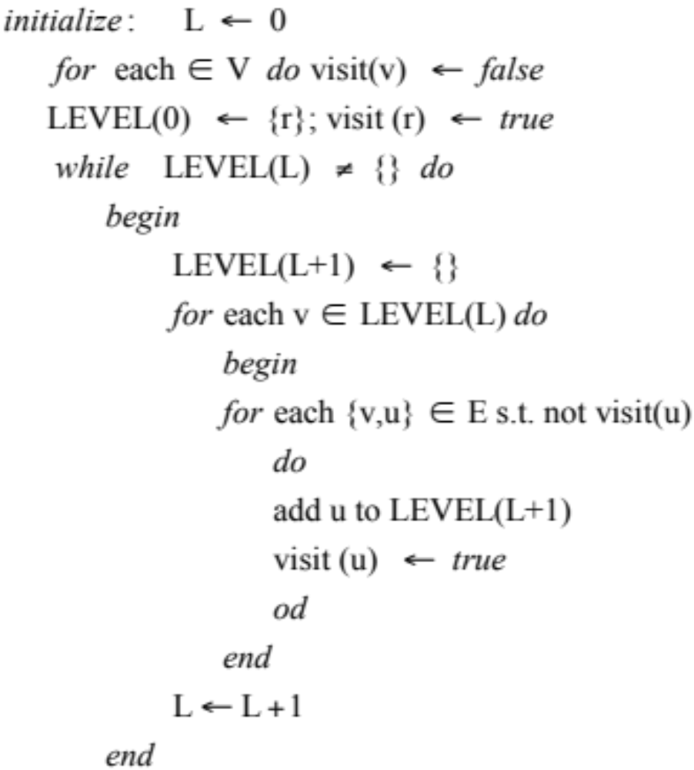
Breadth-First Search Algorithm

Slide 6
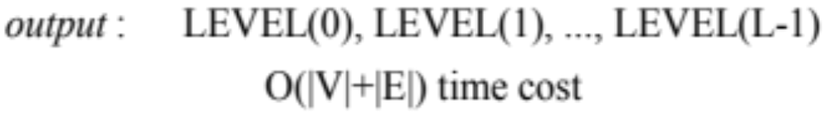
Breadth-First Search Algorithm Output

Slide 7
Edges in Breadth-First Search
All edges {u,v} ∈ E have level distance ≤ 1
Example
root r
1
LEVEL(0)
2
3
4
5
LEVEL(1)
6
7
8
LEVEL(2)

Slide 8
Breadth-First Search Tree
Breadth First Search Tree T
1
LEVEL(0)
r
2
3
4
5
LEVEL(1)
6
7
8
LEVEL(2)

Slide 9
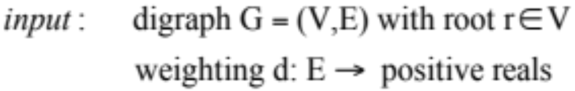

Single Source Shortest Paths Problem
problem: For each vertex v, determine D(v) = min length path from root r to v

Slide 10
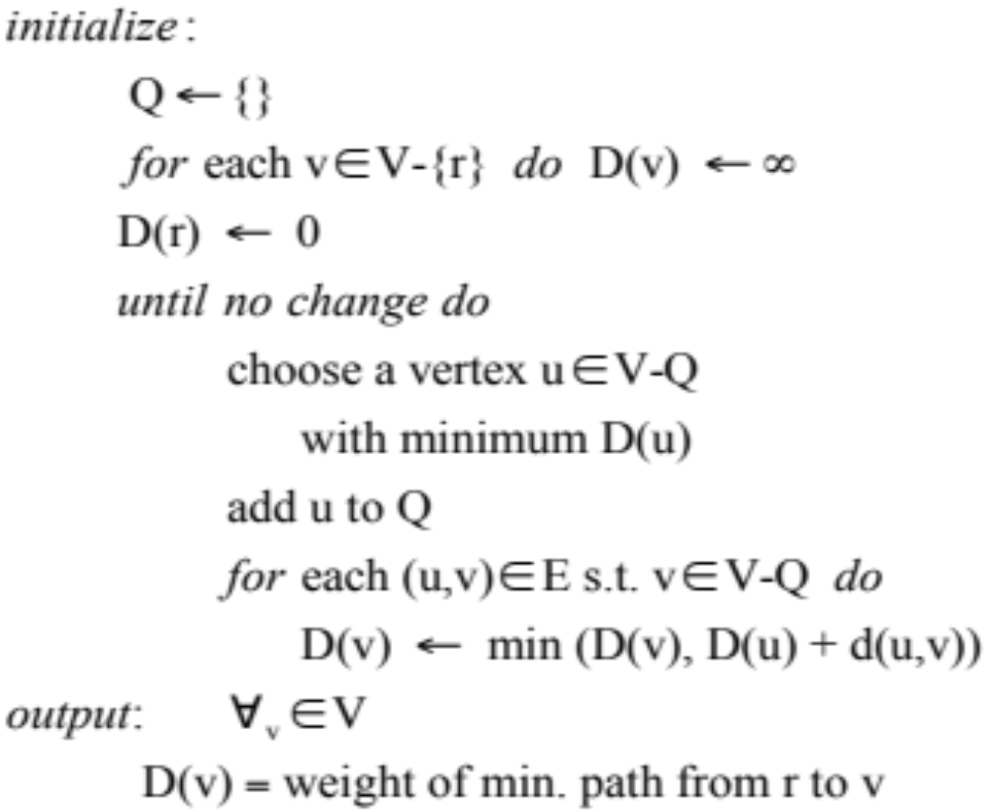
Dijkstra’s Algorithm for Single Source Shortest Paths

Slide 11
Example Single Source Shortest Paths Problem
example
root r
1
100
10
30
2
3
50
20
4
40
5

Slide 12
Example Execution of Dijkstra’s Algorithm
Q | u | D(1) | D(2) | D(3) | D(4) | D(5)
☞ | 1 | 0 | ◎ | ◎ | ◎ | ◎
{1} | 2 | 0 | 10 | 30 | ◎ | 100
{1,2} | 3 | 0 | 10 | 30 | 60 | 100
{1,2,3} | 4 | 0 | 10 | 30 | 50 | 100
{1,2,3,4} | 5 | 0 | 10 | 30 | 50 | 90

Slide 13
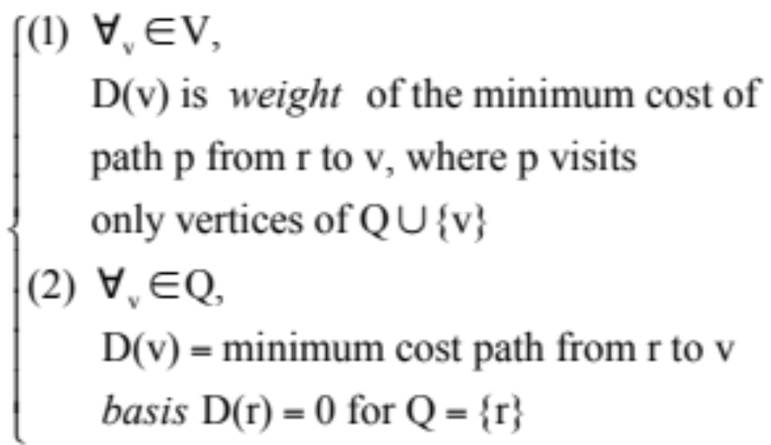
Proof of Dijkstra’s Algorithm
Use induction hypothesis:

Slide 14
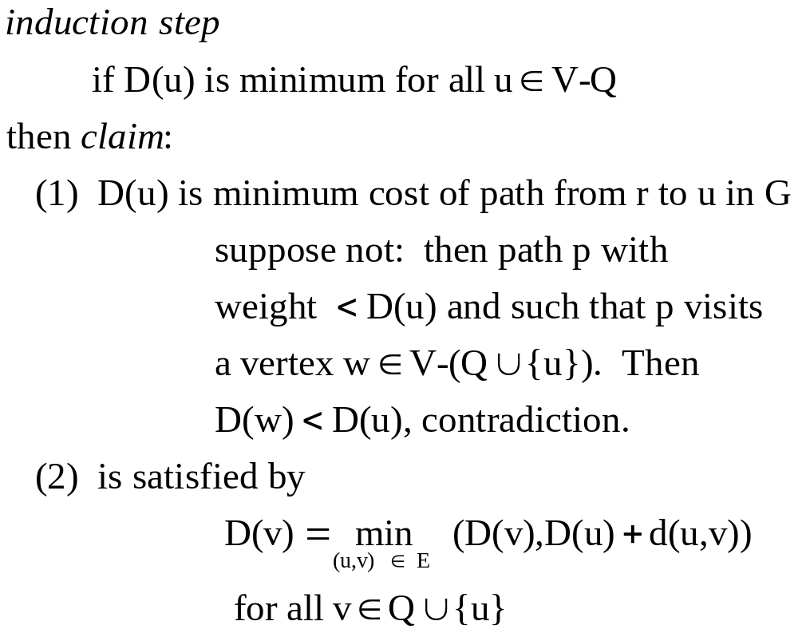
Proof of Dijkstra’s Algorithm (cont’d)

Slide 15
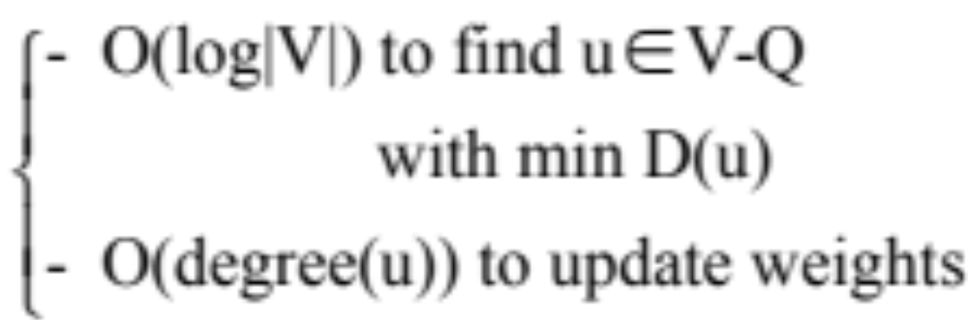
Time Cost of Dijkstra’s Algorithm on a RAM Model
Time cost: per iteration
Since there are |V| iterations,
Total Time O( |V| (log |V| ) + |E|)

Slide 16
Graph Matching
Graph G = (V,E)
Graph Matching M is a subset of E
  if e₁, e₂ distinct edges in M
  Then they have no vertex in common
  Vertex v is matched if v is in an edge of M
example

Slide 17
Graph Matching Problem
Graph Matching Problem:
Find a maximum size matching
Suppose:
  G = (V,E) has matching M
Goal:
  find a larger matching

Slide 18
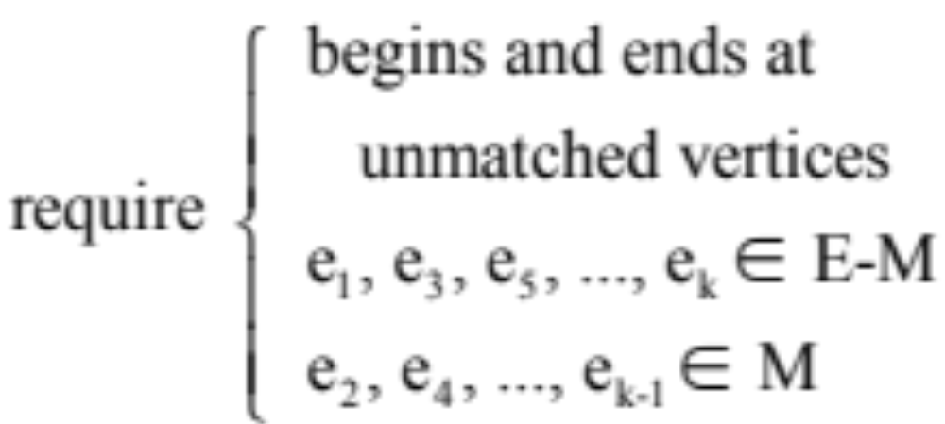
Augmenting Path in G given Graph Matching M
An augmenting path p = (e₁, e₂, …, e_{k})

Slide 19
Graph Matching (cont’d)
Initial matching M in G
Augmenting path
p = ((5,2), (2,6), (6,4), (4,7), (7,3))
1
5
2
6
|M| = 2
3
7
4
8

Slide 20
Graph Matching (cont’d)
New matching M‘ = P ⊕ M = (P ∪ M) – (P ∩ M)
1
5
2
6
|P ⊕ M| = 3
3
7
4
8

Slide 21
Characterization of a Maximum Graph Matching via Lack of Augmented Path
Theorem
M is maximum matching
iff there is no augmenting path
relative to M

Slide 22
Proof of Characterization of Maximum Graph Matching (cont’d)
Proof
(1) If M is smaller matching and p is an augmenting path for M,
then M ⊕ P is a matching size > |M|
(2) If M, M ' are matchings with
|M| < |M '|

Slide 23
Claim: M  M' contains an augmenting path for M.
Proof
The graph G' = (V, M ⊕ M ' )
has only paths with edges alternating
between M and M '.
Repeatedly delete a cycle in G '
(with equal number of edges in M, M ')
Since |M| < |M '| must eventually get
augmenting path remaining for M.

Slide 24
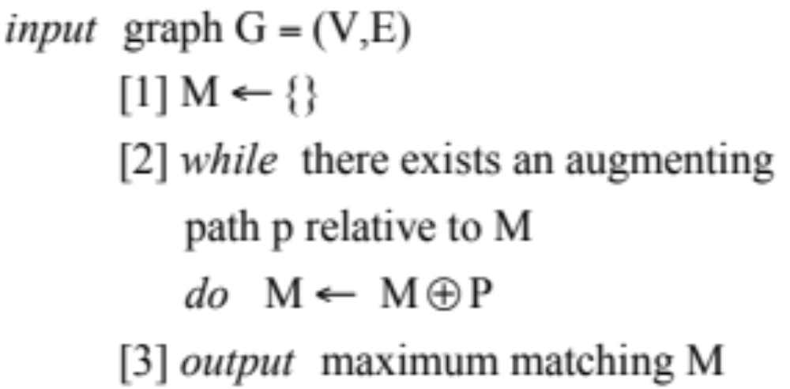
Maximum Matching Algorithm
Algorithm

Slide 25
Maximum Matching (cont’d)
Remaining problem:
Find augmenting path
Assume
weighting d: E → R⁺ = pos. reals

Slide 26
Maximum Weighted Matching Algorithm
Assume
  weighting d: E → R⁺ = positive reals
Theorem
  Let M be maximum weight among matchings of size |M|.
  Let P be an augmenting path for M of maximum weight.
  Then matching M ⊕ P is of maximum weight among matchings of size |M|+1.

Slide 27
Proof of Maximum Weighted Matching Algorithm
Proof
  Let M' be any maximum weight matching of size |M|+ 1.
  Consider the graph G' = (V, M ⊕ M ' ).
  Then the maximum weight augmenting path p in G' gives a matching M ⊕ P of the same weight as M'.

Slide 28
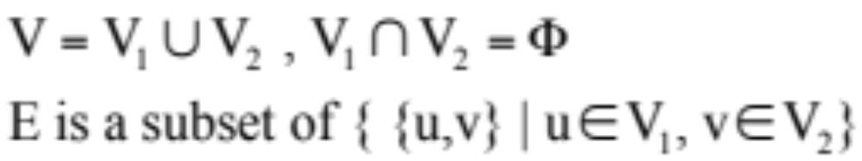
Bipartite Graph
Bipartite Graph G = (V,E)
V₂
V₁

Slide 29
Breadth-First Search Algorithm for Augmented Path
Assume G is bipartite graph with matching M.
Use Breadth-First Search:
LEVEL(0) = some unmatched vertex r
for odd L > 0,
LEVEL(L) = {u|{v,u} ∈ E – M
when v ∈ LEVEL(L -1)
and when u in no lower level}
For even L > 0,
LEVEL(L) = {u|{v,u} ∈M
when v∈LEVEL(L -1)
and u in no lower level}

Slide 30
Proof of Breadth-First Search Algorithm for Augmented Path
Cases
(1) If for some odd L >0,
LEVEL(L) contains an unmatched vertex u
then the Breadth First Search tree T has an augmenting path from r to u
(2) Otherwise no augmenting path exists, so
M is maximal.

Slide 31
Finding a Maximal Matching in a Bipartite Graph
Theorem
  If G = (V,E) is a bipartite graph,
  Then the maximum matching can be
  constructed in O(|V||E|) time.
Proof
  Each stage requires O(|E|) time for
  Breadth First Search construction of
  augmenting path.

Slide 32
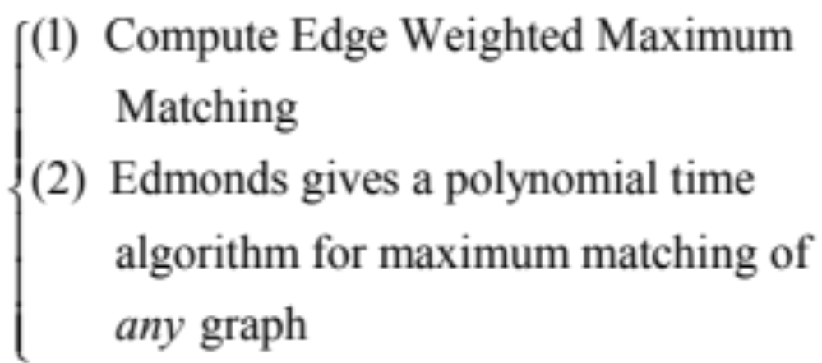
Generalizations of Matching Algorithm
Generalizations:

Slide 33
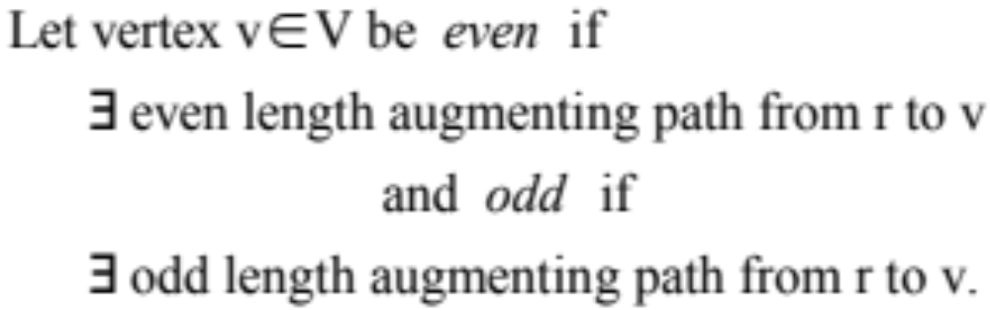
Computing Augmented Paths in General Graphs
Let M be matching in general graph G
Fix starting vertex r to be an unmatched vertex

Slide 34
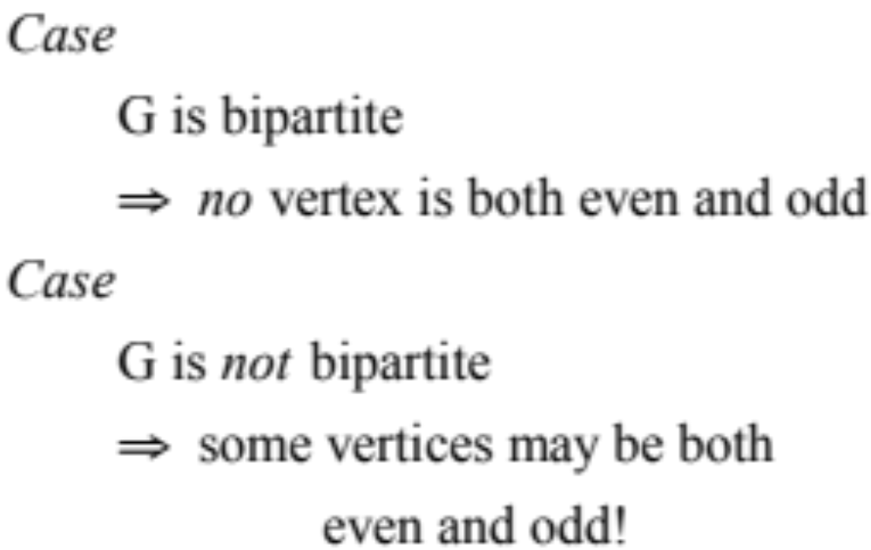
Why Algorithm for Augmented Paths in Bipartite Graphs does not work for General Graphs

Slide 35
Edmond’s Algorithm for Augmented Paths in General Graphs
P is
augmenting path from r to v
r
STEM
is subpath of p from r to v
STEM
BLOSSOM
is subpath of p from v to w plus edge {w,v}
even vertex
BASE
t
is vertex w
v
base w even vertex
t
BLOSSOM
⇒
Shrink Blossom
w, v
t'
t'

Slide 36
Blossom Shrinking Maintains the Existence of Augmented Paths
Theorem
  If G' is formed from G by shrinking of blossom B, then
  G contains an augmenting path iff G' does.

Slide 37
Proof of Blossom Shrinking
Proof
  (1) If G' contains an augmenting path p,
  then if p visits blossom B we can insert an
  augmenting subpath p' within blossom into
  p to get a new augmenting path for G
  (2) If G contains an augmenting path, then
  apply Edmond’s blossom shrinking algorithm
  to find an augmenting path in G'.

Slide 38
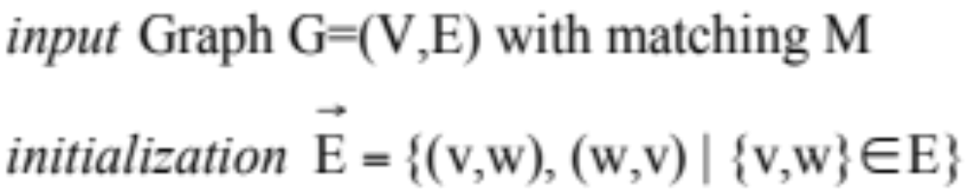
Edmond’s Blossom Shrinking Algorithm
comment
Edmond’s algorithm will construct a
forest of trees whose paths are partial
augmenting paths

Slide 39
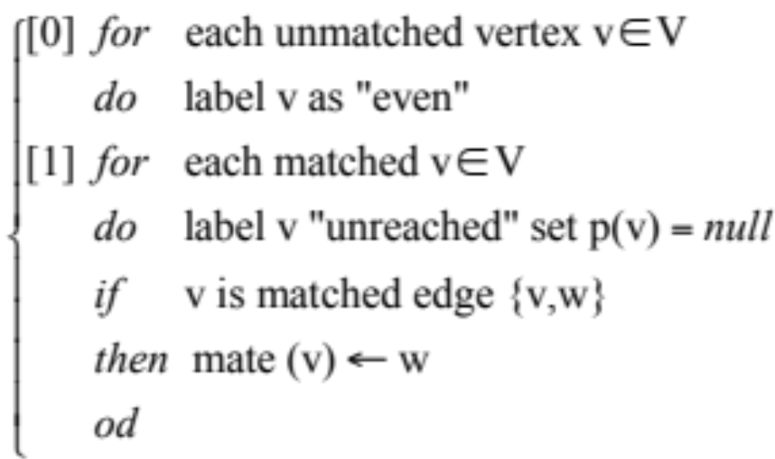
Edmond’s Blossom Shrinking Algorithm (cont’d)
Note: We will let P(v) = parent of vertex v

Slide 40
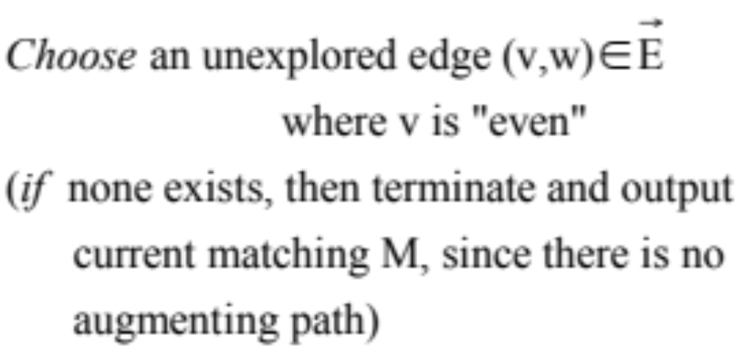
Main Loop
Edmond’s Main Loop:

Slide 41
Main Loop (cont’d)
Case 1 if w is “odd” then do nothing.
Case 2 if w is “unreached” and matched
      then set w “odd” and set mate (w)
      “even”
      Set P(w) ← v , P(mate (w)) ← w
even odd even
v
w
mate(w)

Slide 42
Main Loop (cont’d)
Case 3 if w is “even” and v, w are in distinct
      trees T, T' then output augmenting
      path p from root of T to v, through {v,w}, in T' to root.
Unmatched root
Unmatched root
T
T'
v
w
even
Unmatched edge
even

Slide 43
Main Loop (cont’d)
Case 4 w is “even” and v,w in same tree T
      then {v,w} forms a blossom B
      containing all vertices which are
both (i) a descendant of LCA(v,w) and
(ii) an ancestor of v or w
where LCA(v,w) = least common ancestor
of v,w in T

Slide 44
Main Loop (cont’d)
Shrink all vertices of B to a single
vertex b. Define p(b) = p(LCA(v,w))
and p(x) = b for all x ∈ B
LCA (v,w)
*
*
Blossom
v
w

Slide 45
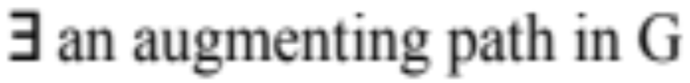
Proof Edmond’s blossom-shrinking algorithm succeeds
Lemma
Edmond’s blossom-shrinking algorithm succeeds iff
Proof
Uses an induction on blossom shrinking stages

Slide 46
Time Bounds for Matching in General Graphs
Edmond’s blossom-shrinking algorithm costs time O(n⁴)
[Gabow and Tarjan] implement in time O(nm) all O(n) stages of matching algorithmtaking O(m) time per stage for blossom shrinking
[Micali and Vazirani] using network flow to find augmented paths and reduce time to O(n^{1/2} m) for unweighted matching in general graphs

Slide 47
Breadth-First Search of Graphs
Analysis of Algorithms
Week 9, Lecture 1
Prepared by
John Reif, Ph.D.
Distinguished Professor of Computer Science
Duke University

