Slide 1
Using computational hardness as a barrier against manipulation
Vincent Conitzer
conitzer@cs.duke.edu

Slide 2
Inevitability of manipulability
Ideally, our mechanisms are strategy-proof
However, in certain settings, no reasonable strategy-proof mechanisms exist
Recall Gibbard-Satterthwaite theorem:
Suppose there are at least 3 candidates
There exists no rule that is simultaneously:
  onto (for every candidate, there are some votes that would make that candidate win),
  nondictatorial, and
  nonmanipulable
Nobody would suggest using a rule that is dictatorial or not onto
With restricted preferences (e.g. single-peaked preferences), we may still be able to get strategy-proofness
Also if payments are possible and preferences are quasilinear

Slide 3
Computational hardness as a barrier to manipulation
A successful manipulation is a way of misreporting one’s preferences that leads to a better result for oneself
Gibbard-Satterthwaite only tells us that for some instances, successful manipulations exist
It does not say that these manipulations are always easy to find
Do voting rules exist for which manipulations are computationally hard to find?

Slide 4
A formal computational problem
The simplest version of the manipulation problem:
CONSTRUCTIVE-MANIPULATION:
  We are given a voting rule R, the (unweighted) votes of the other voters, and a candidate p.
  We are asked if we can cast our (single) vote to make p win.
E.g. for the Borda rule:
  Voter 1 votes A > B > C
  Voter 2 votes B > A > C
  Voter 3 votes C > A > B
Borda scores are now: A: 4, B: 3, C: 2
Can we make B win?
Answer: YES. Vote B > C > A (Borda scores: A: 4, B: 5, C: 3)

Slide 5
Early research
Theorem. CONSTRUCTIVE-MANIPULATION is NP-complete for the second-order Copeland rule. [Bartholdi, Tovey, Trick 1989]
  Second order Copeland = alternative’s score is sum of Copeland scores of alternatives it defeats
Theorem. CONSTRUCTIVE-MANIPULATION is NP-complete for the STV rule. [Bartholdi, Orlin 1991]
Most other rules are easy to manipulate (in P)

Slide 6
“Tweaking” voting rules
It would be nice to be able to tweak rules:
  Change the rule slightly so that
    Hardness of manipulation is increased (significantly)
    Many of the original rule’s properties still hold
It would also be nice to have a single, universal tweak for all (or many) rules
One such tweak: add a preround [Conitzer & Sandholm IJCAI 03]

Slide 7
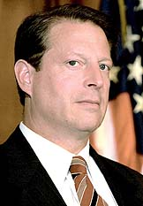
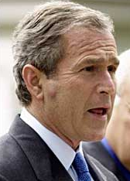

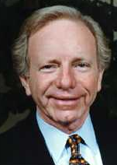
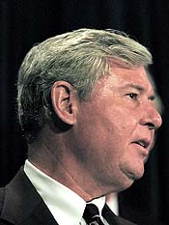
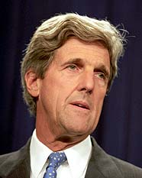
Adding a preround
A preround proceeds as follows:
  Pair the candidates
  Each candidate faces its opponent in a pairwise election
  The winners proceed to the original rule
Original rule

Slide 8
Preround example (with Borda)
  STEP 1:
  A. Collect votes and
  B. Match candidates
  (no order required)
  Voter 1: A>B>C>D>E>F
  Voter 2: D>E>F>A>B>C
  Voter 3: F>D>B>E>C>A
  Match A with B
  Match C with F
  Match D with E
  A vs B: A ranked higher by 1,2
  C vs F: F ranked higher by 2,3
  D vs E: D ranked higher by all
  STEP 2:
  Determine winners of preround
  STEP 3:
  Infer votes on remaining candidates
  Voter 1: A>D>F
  Voter 2: D>F>A
  Voter 3: F>D>A
  STEP 4:
  Execute original rule
  (Borda)
  A gets 2 points
  F gets 3 points
  D gets 4 points and wins!

Slide 9



Matching first, or vote collection first?
Match, then collect
“A vs C,
B vs D.”
“A vs C,
B vs D.”
“D > C > B > A”
Collect, then match (randomly)
“A vs C,
B vs D.”
“A > C > D > B”

Slide 10
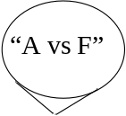

Could also interleave…
Elicitor alternates between:
  (Randomly) announcing part of the matching
  Eliciting part of each voter’s vote
“A vs F”
“B vs E”
“C > D”
“A > E”
…
…

Slide 11
How hard is manipulation when a preround is added?
Manipulation hardness differs depending on the order/interleaving of preround matching and vote collection:
Theorem. NP-hard if preround matching is done first
Theorem. #P-hard if vote collection is done first
Theorem. PSPACE-hard if the two are interleaved (for a complicated interleaving protocol)
In each case, the tweak introduces the hardness for any rule satisfying certain sufficient conditions
  All of Plurality, Borda, Maximin, STV satisfy the conditions in all cases, so they are hard to manipulate with the preround

Slide 12
What if there are few candidates? [Conitzer et al. AAAI 02, TARK 03]
The previous results rely on the number of candidates (m) being unbounded
There is a recursive algorithm for manipulating STV with O(1.62^{m}) calls (and usually much fewer)
E.g. 20 candidates: 1.62²⁰ = 15500
Sometimes the candidate space is much larger
  Voting over allocations of goods/tasks
  California governor elections
But what if it is not?
  A typical election for a representative will only have a few

Slide 13
Manipulation complexity with few candidates
Ideally, would like hardness results for constant number of candidates
But then manipulator can simply evaluate each possible vote
  assuming the others’ votes are known
Even for coalitions of manipulators, there are only polynomially many effectively different votes
However, if we place weights on votes, complexity may return…
Unbounded #candidates
Constant #candidates
Unweighted
voters
Weighted
voters
Unweighted
voters
Weighted
voters
Individual
manipulation
Can be
hard
Can be
hard
easy
easy
Coalitional
manipulation
Can be
hard
Can be
hard
Potentially
hard
easy

Slide 14
Constructive manipulation now becomes:
We are given the weighted votes of the others (with the weights)
And we are given the weights of members of our coalition
Can we make our preferred candidate p win?
E.g. another Borda example:
Voter 1 (weight 4): A>B>C, voter 2 (weight 7): B>A>C
Manipulators: one with weight 4, one with weight 9
Can we make C win?
Yes! Solution: weight 4 voter votes C>B>A, weight 9 voter votes C>A>B
  Borda scores: A: 24, B: 22, C: 26

Slide 15
A simple example of hardness
We want: given the other voters’ votes…
… it is NP-hard to find votes for the manipulators to achieve their objective
Simple example: veto rule, constructive manipulation, 3 candidates
Suppose, from the given votes, p has received 2K-1 more vetoes than a, and 2K-1 more than b
The manipulators’ combined weight is 4K
  every manipulator has a weight that is a multiple of 2
The only way for p to win is if the manipulators veto a with 2K weight, and b with 2K weight
But this is doing PARTITION => NP-hard!

Slide 16
What does it mean for a rule to be easy to manipulate?
Given the other voters’ votes…
…there is a polynomial-time algorithm to find votes for the manipulators to achieve their objective
If the rule is computationally easy to run, then it is easy to check whether a given vector of votes for the manipulators is successful
Lemma: Suppose the rule satisfies (for some number of candidates):
  If there is a successful manipulation…
  … then there is a successful manipulation where all manipulators vote identically.
Then the rule is easy to manipulate (for that number of candidates)
  Simply check all possible orderings of the candidates (constant)

Slide 17
Example: Maximin with 3 candidates is easy to manipulate constructively
Recall: candidate’s Maximin score = worst score in any pairwise election
3 candidates: p, a, b. Manipulators want p to win
Suppose there exists a vote vector for the manipulators that makes p win
WLOG can assume that all manipulators rank p first
  So, they either vote p > a > b or p > b > a
Case I: a’s worst pairwise is against b, b’s worst against a
  One of them would have a maximin score of at least half the vote weight, and win (or be tied for first) => cannot happen
Case II: one of a and b’s worst pairwise is against p
  Say it is a; then can have all the manipulators vote p > a > b
    Will not affect p or a’s score, can only decrease b’s score

Slide 18
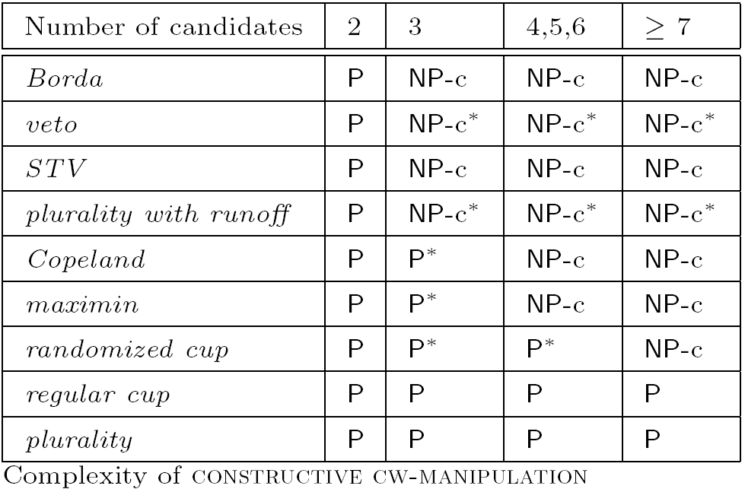
Results for constructive manipulation

Slide 19
Destructive manipulation
Exactly the same, except:
Instead of a preferred candidate
We now have a hated candidate
Our goal is to make sure that the hated candidate does not win (whoever else wins)

Slide 20
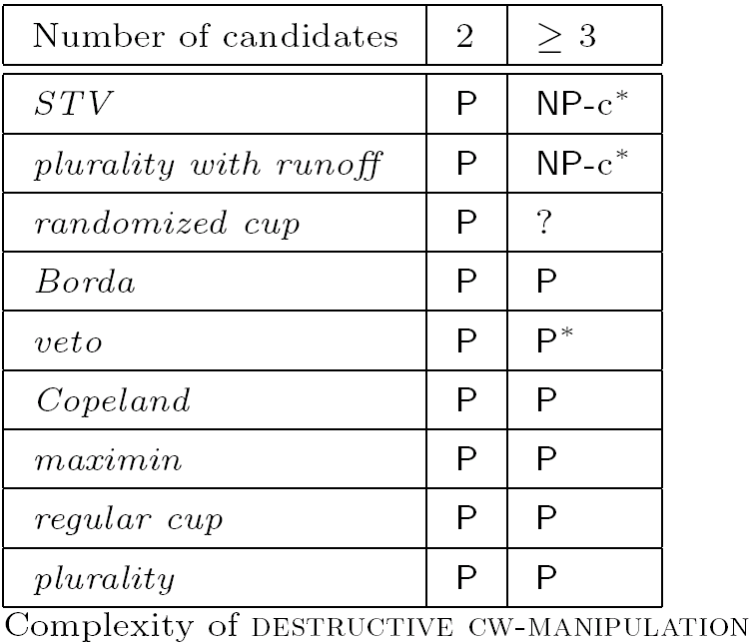
Results for destructive manipulation

Slide 21
Hardness is only worst-case…
Results such as NP-hardness suggest that the runtime of any successful manipulation algorithm is going to grow dramatically on some instances
But there may be algorithms that solve most instances fast
Can we make most manipulable instances hard to solve?

Slide 22
Weak monotonicity
nonmanipulator votes
nonmanipulator weights
candidate set
manipulator weights
voting rule
An instance (R, C, v, k_{v}, k_{w})
is weakly monotone if for every pair of candidates c₁, c₂ in C, one of the following two conditions holds:
either: c₂ does not win for any manipulator votes w,
or: if all manipulators rank c₂ first and c₁ last, then c₁ does not win.

Slide 23
A simple manipulation algorithm
[Conitzer & Sandholm AAAI 06]
Find-Two-Winners(R, C, v, k_{v}, k_{w})
choose arbitrary manipulator votes w₁
c₁ ← R(C, v, k_{v}, w₁, k_{w})
for every c₂ in C, c₂ ≠ c₁
  choose w₂ in which every manipulator ranks c₂ first and c₁ last
  c ← R(C, v, k_{v}, w₂, k_{w})
  if c ≠ c₁ return {(w₁, c₁), (w₂, c)}
return {(w₁, c₁)}

Slide 24
Correctness of the algorithm
Theorem. Find-Two-Winners succeeds on every instance that
  (a) is weakly monotone, and
  (b) allows the manipulators to make either of exactly two candidates win.
Proof.
  The algorithm is sound (never returns a wrong (w, c) pair).
  By (b), all that remains to show is that it will return a second pair, that is, that it will terminate early.
  Suppose it reaches the round where c₂ is the other candidate that can win.
  If c = c₁ then by weak monotonicity (a), c₂ can never win (contradiction).
  So the algorithm must terminate.

Slide 25
Experimental evaluation
For what % of manipulable instances do properties (a) and (b) hold?
  Depends on distribution over instances…
Use Condorcet’s distribution for nonmanipulator votes
  There exists a correct ranking t of the candidates
  Roughly: a voter ranks a pair of candidates correctly with probability p, incorrectly with probability 1-p
    Independently? This can cause cycles…
  More precisely: a voter has a given ranking r with probability proportional to p^{a(r, t)}(1-p)^{d(r, t)} where a(r, t) = # pairs of candidates on which r and t agree, and d(r, t) = # pairs on which they disagree
Manipulators all have weight 1
Nonmanipulable instances are thrown away

Slide 26
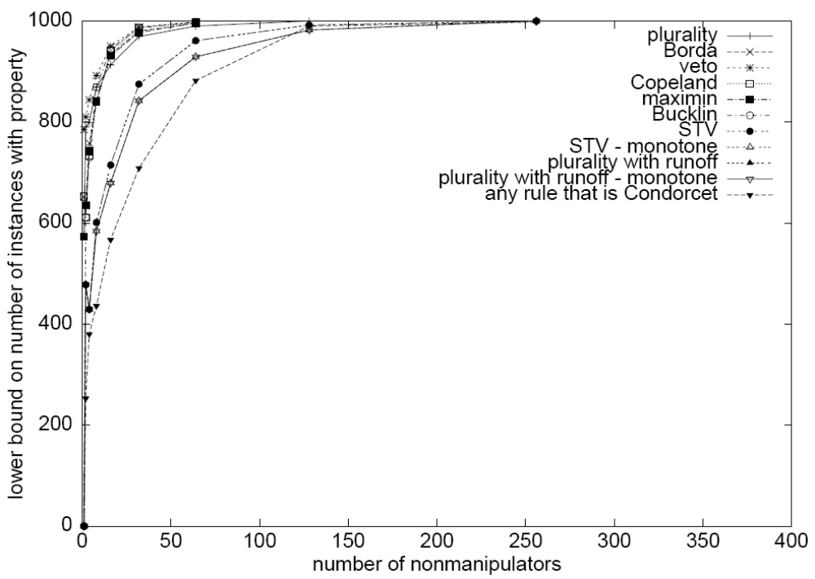
p=.6, one manipulator, 3 candidates

Slide 27
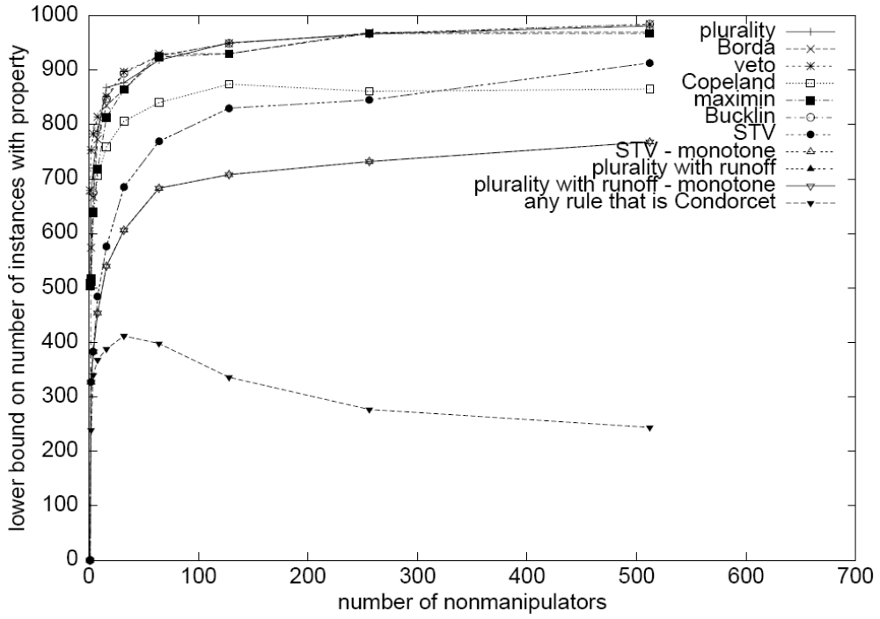
p=.5, one manipulator, 3 candidates

Slide 28
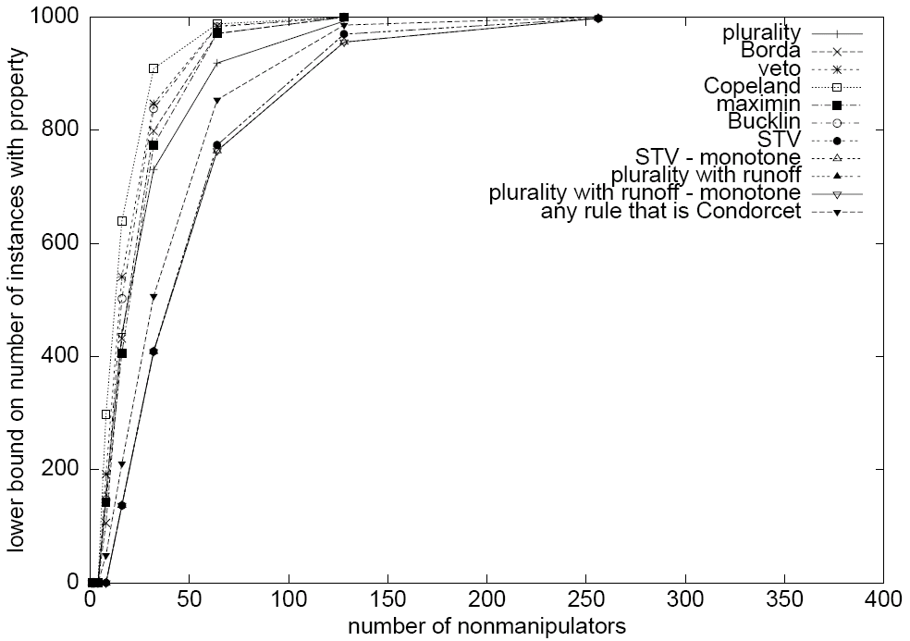
p=.6, 5 manipulators, 3 candidates

Slide 29

p=.6, one manipulator, 5 candidates

Slide 30
Can we circumvent this impossibility result?
Allow low-ranked candidates to sometimes win
  An incentive-compatible randomized rule: choose pair of candidates at random, winner of pairwise election wins whole election
Expand definition of voting rules
  Banish all pivotal voters to a place where they will be unaffected by the election’s result (incentive compatible)
  Can show: half the voters can be pivotal (for any reasonable deterministic rule)
Use voting rules that are hard to execute
  But then, hard to use them as well…

