Slide 1
Computing Kemeny and Slater Rankings
Vincent Conitzer
(Joint work with Andrew Davenport and Jayant Kalagnanam at IBM Research.)

Slide 2
Voting/rank aggregation rules
Set of m candidates (outcomes, alternatives)
n voters; each voter ranks the candidates (the voter’s vote)
  E.g. b > a > c > d
Voting rule f maps every vector of votes to a compromise ranking of the candidates

Slide 3
The Kemeny rule
Given a ranking r, a vote v, and two candidates a, b, let δ_{ab}(r, v) = 1 if r and v disagree on the relative ranking of a and b, and 0 otherwise
A Kemeny ranking r minimizes Σ_{ab}Σ_{v}δ_{ab}(r, v) [Kemeny 59]
Kemeny rule gives maximum likelihood estimate of the “correct” outcome given [Condorcet 1785]’s noise model [Young 95]
  ... though other noise models lead to other rules [Conitzer & Sandholm UAI-05]
Kemeny rule is NP-hard to compute [Bartholdi et al. 89], even with only 4 votes [Dwork et al. WWW-01]

Slide 4
Slater rule
Pairwise election between a and b: compare how often a is ranked above b vs. how often b is ranked above a in the votes to determine the winner of the pairwise election
Given a ranking r of the candidates and two candidates a, b, let δ_{ab}(r) = 1 if r ranks the winner of the pairwise election between a and b lower than the loser, and 0 otherwise
A Slater ranking r minimizes Σ_{ab}δ_{ab}(r)
  I.e. it minimizes the number of disagreements with pairwise elections

Slide 5
Pairwise election graphs
Pairwise election between a and b: compare how often a is ranked above b vs. how often b is ranked above a
Graph representation: edge from winner to loser (no edge if tie), weight = margin of victory
E.g. for votes a > b > c > d, c > a > d > b gives
a
b
a
a
2
2
2
d
c
a
a

Slide 6
Kemeny on pairwise election graphs
Final ranking = acyclic tournament graph
Kemeny ranking seeks to minimize the total weight of the inverted edges
pairwise election graph
Kemeny ranking
a
2
b
a
2
b
a
a
a
a
2
2
4
10
2
d
c
d
c
a
a
a
a
4
(b > d > c > a)

Slide 7
Slater on pairwise election graphs
Final ranking = acyclic tournament graph
Slater ranking seeks to minimize the number of inverted edges
pairwise election graph
Slater ordering
a
b
a
b
a
a
a
a
c
d
c
d
a
a
a
a
(a > b > d > c)

Slide 8
Computing Slater Rankings Using Similarities Among Candidates
[Conitzer AAAI06]

Slide 9
Sets of similar candidates
Assume no pairwise ties for simplicity
A subset S of the candidates consists of similar candidates if for any s₁, s₂ ∈ S, t ∈ C - S, s₁ wins its pairwise election against t if and only if s₂ wins its pairwise election against t
Example:
a
b
{b, d} consists of similar candidates
{a, b} does not (one beats c and the other does not)
a
a
d
c
a
a

Slide 10
A useful property of sets of similar candidates
Lemma. If S consists of similar candidates, then there exists a Slater ranking in which all candidates in S are adjacent.
Proof:
  Suppose we have a Slater ranking in which they are not all adjacent, say … > s₁ > T > s₂ > …
  If s₁ and s₂ each defeat at least half of the candidates in T then … > s₁ > s₂ > T > … gives at least as high a score
  If s₁ and s₂ each defeat at most half of the candidates in T then … > T > s₁ > s₂ > … gives at least as high a score
  Repeated application makes all candidates in S adjacent

Slide 11
How to use the lemma
Because we know all of S can be adjacent, we can replace S by a single “supercandidate”
bd
a
b
a
a
a
a
a
big edges have twice the weight
d
c
a
a
c
a
Solve the reduced instance (here: a > bd > c)
Solve S internally (here: b > d)
Obtain final ranking (here: a > b > d > c)

Slide 12
Finding a set of similar candidates
We can model this as a satisfiability instance
  in(a) means a is in the set of similar candidates
in(a) and in(b) ⇒ in(c)
in(a) and in(c) ⇒ in(b) and in(d)
in(a) and in(d) ⇒ in(b) and in(c)
in(b) and in(c) ⇒ in(a) and in(d)
in(b) and in(d) ⇒
in(c) and in(d) ⇒ in(a)
a
b
a
a
d
c
a
a
Only solutions:
  Trivial: at most 1 candidate in S, or all candidates in S
  Nontrivial (useful): S = {b, d}
Nontrivial solutions can be found in polytime

Slide 13
Using similar candidates as preprocessing step for search
Straightforward search algorithm:
  At each search tree node, decide whether or not the final ranking will be consistent with the next edge
  Apply transitivity if possible
  Admissible heuristic: number of edges for which it has been decided that the final ranking will be inconsistent with them
Preprocessing technique:
  Find a nontrivial set of similar candidates
  If found, solve reduced instances recursively
Experimental comparison between
  the straightforward search algorithm, and
  the preprocessing technique applied recursively, followed by the same search algorithm when preprocessing technique no longer applies

Slide 14
Experimental setup
Candidates and voters draw random positions in [0, 1]^{d}
  (d = number of issues)
Voters rank candidates by (Euclidean) distance to their own position
In one of the experiments, we consider parties:
  parties draw random positions in [0, 1]^{d}
  candidates randomly choose a party, then take the average of the party’s position and a random point as their own position
30 data points per instance

Slide 15
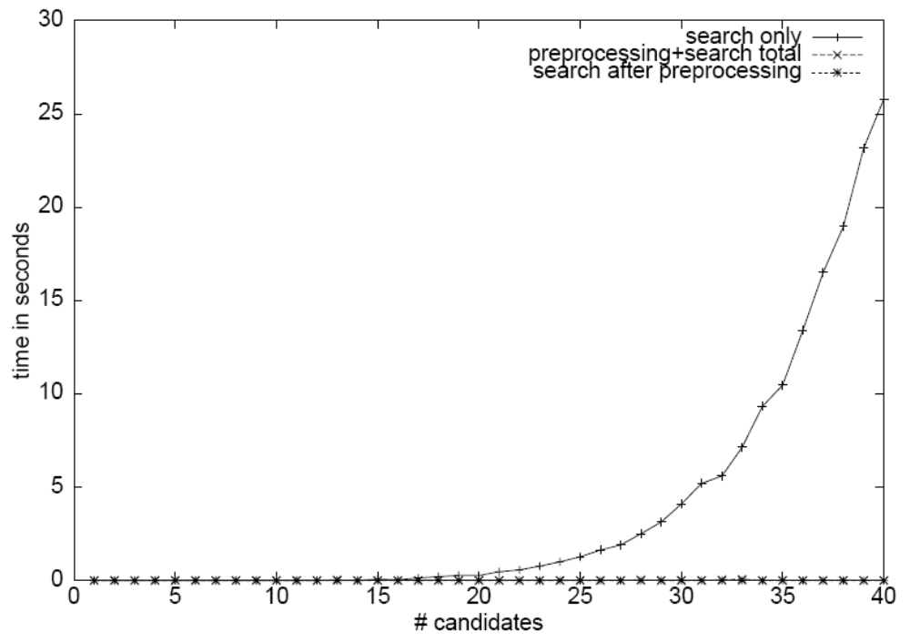
1 issue, 191 voters
Not surprising: these are single-peaked preferences, so that the graph must be acyclic

Slide 16
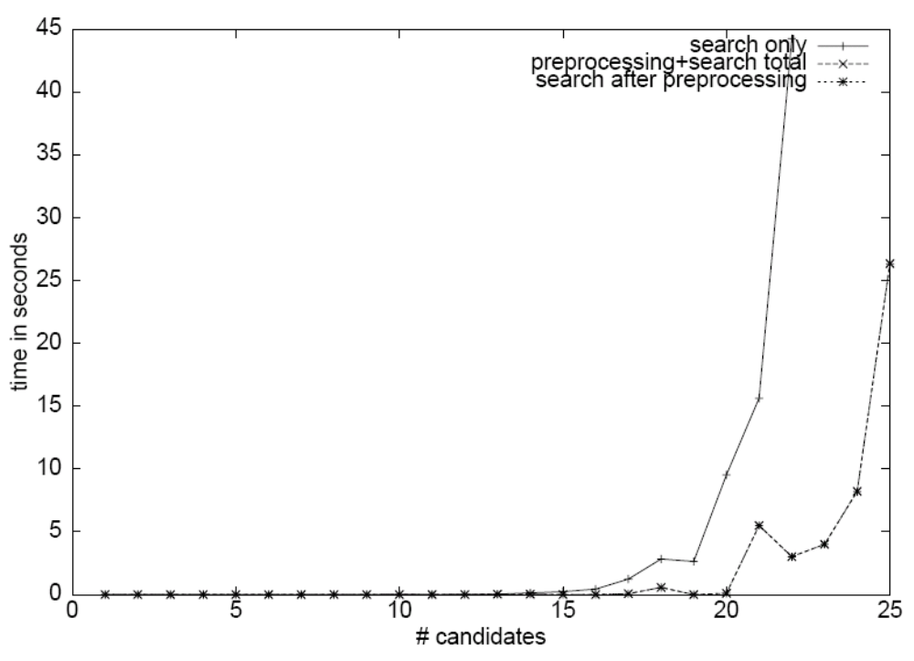
2 issues, 191 voters

Slide 17
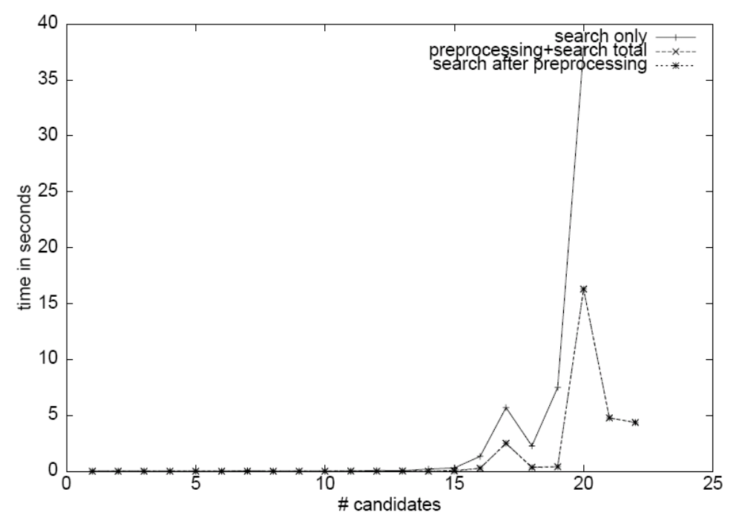
2 issues, 3 voters

Slide 18
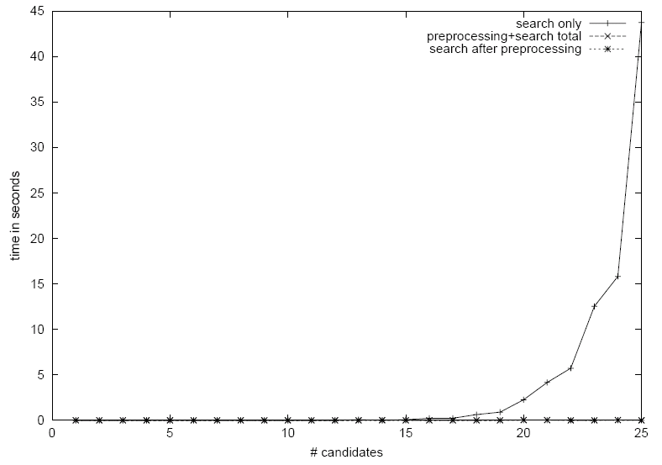
10 issues, 191 voters
Not clear why the technique is so effective here…

Slide 19

2 issues, 5 parties, 191 voters

Slide 20
NP-hardness
It was known that finding a Slater ranking is NP-hard when pairwise ties may occur
What if there are no pairwise ties?
  [Bang-Jensen & Thomassen SIAM J. of Discrete Math 92] conjectured that it remains NP-hard
  [Ailon et al. STOC 05] gave a randomized reduction
  [Alon SIAM J. of Discrete Math 06] derandomized this reduction, proving the result completely
This paper gives a direct proof of NP-hardness using observations about sets of similar candidates

Slide 21
Conclusions on computing Slater rankings using similarities among candidates
Slater rankings are NP-hard to compute
Showed: a set of similar candidates is always contiguous in some Slater ranking
Hence, can aggregate candidates in such a set into a single “supercandidate” and solve recursively (both the set of similar candidates and the instance with the aggregated candidate)
Gave an efficient algorithm for finding a set of similar candidates
Experimental results show this is effective (sometimes very effective) as a preprocessing technique
Used similar-candidates concept to give direct proof of NP-hardness without pairwise ties

Slide 22
Improved Bounds for Computing Kemeny Rankings
[Conitzer, Davenport, Kalagnanam AAAI06]

Slide 23
Edge-disjoint cycle lower bound
[Davenport & Kalagnanam AAAI-04]
If there is a cycle, we will have to flip at least one of its edges, so will lose at least the minimum weight in the cycle
  Can use multiple cycles but they should not overlap edgewise
pairwise election graph
cycle removed
a
2
b
a
b
a
a
a
a
2
2
2
4
2
10
d
c
d
c
a
a
a
a
4
4
no more cycles left, so we get a lower bound of 2

Slide 24
Overlapping cycle lower bound
In fact, we do not have to remove the entire cycle
It suffices to remove the minimum weight in the cycle from all the edges in the cycle
pairwise election graph
weight removed from cycle
a
b
a
2
b
a
a
a
a
2
2
2
4
2
2
10
8
d
c
d
c
a
a
a
a
4
4
after removing weight from both cycles we get lower bound of 4 = optimal solution value

Slide 25
A more difficult example…
a
a
f
b
a
a
e
c
a
a
d
a
all edges have weight 1
optimal solution = 2

Slide 26
Trying overlapping cycle bound
a
a
f
b
a
a
e
c
a
a
d
a

Slide 27
Trying overlapping cycle bound
a
a
f
b
a
a
e
c
a
a
d
a
no more cycles! (This happens for all other initial cycles as well)
best bound we can get = 1

Slide 28
Who says we have to subtract the minimum weight?
a
a
f
b
a
a
e
c
a
a
d
a
let’s subtract only half the weight…

Slide 29
Who says we have to subtract the minimum weight?
a
a
f
b
a
a
e
c
a
a
d
a
Light edges have only half the weight
lower bound currently at 0.5

Slide 30
Who says we have to subtract the minimum weight?
a
a
f
b
a
a
e
c
a
a
d
a
Light edges have only half the weight
lower bound currently at 1

Slide 31
Who says we have to subtract the minimum weight?
a
a
f
b
a
a
e
c
a
a
d
a
no more cycles left
lower bound = 1.5

Slide 32
LP formulation and dual
LP formulation to get the best lower bound of the type described before (letting E be the set of edges and C the set of all cycles in the graph)
maximize: Σ_{c∈C} x_{c}
subject to: for all e ∈ E, Σ_{c: e∈c} x_{c} ≤ w_{e}
Dual formulation:
minimize: Σ_{e∈E} w_{e} y_{e}
subject to: for all c ∈ C, Σ_{e∈c} y_{e} ≥ 1

Slide 33
An equivalent linear program with a polynomial number of constraints
minimize: Σ_{e∈E} w_{e} y_{e}
subject to:
  for all a, b ∈ V, y_{(a, b)} + y_{(b, a)} = 1
  for all a, b, c ∈ V, y_{(a, b)} + y_{(b, c)} + y_{(c, a)} ≥ 1
Theorem. The optimal solution value for this linear program is always identical to that of the previous one.
  [Ailon et al. STOC 05] give a similar linear program

Slide 34
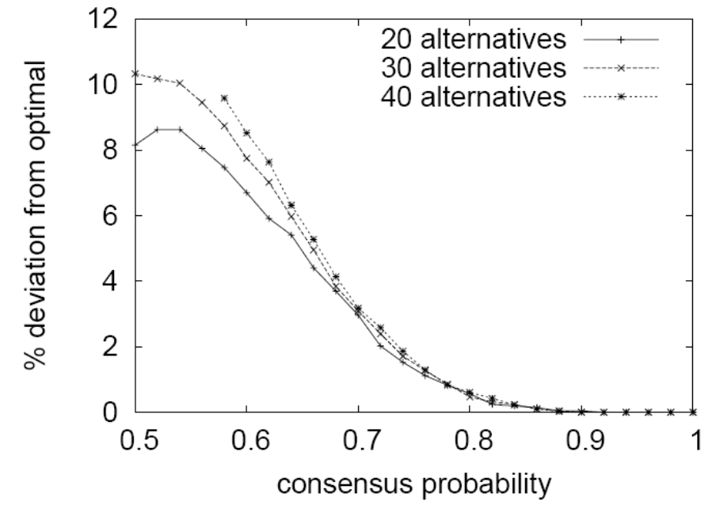
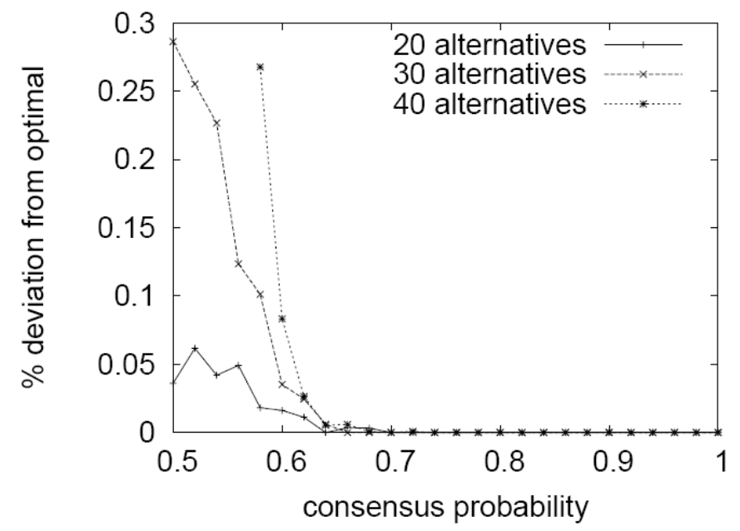
Mean deviation of bounds from optimal
edge-disjoint 3-cycle
LP

Slide 35
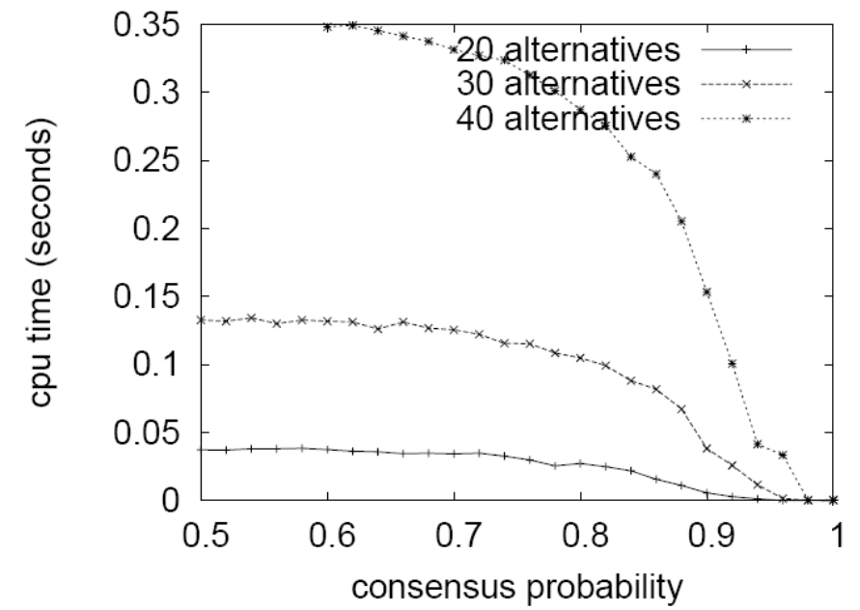
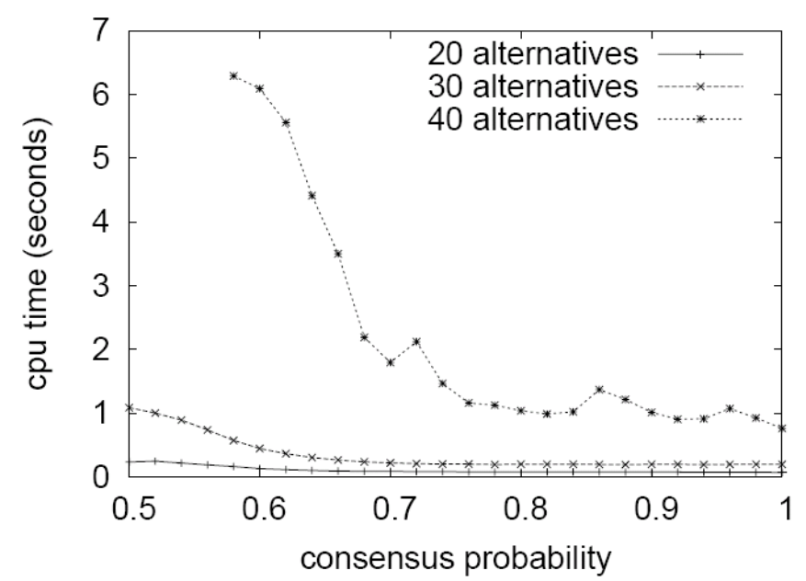
CPU time to compute bounds
edge-disjoint 3-cycle
LP

Slide 36
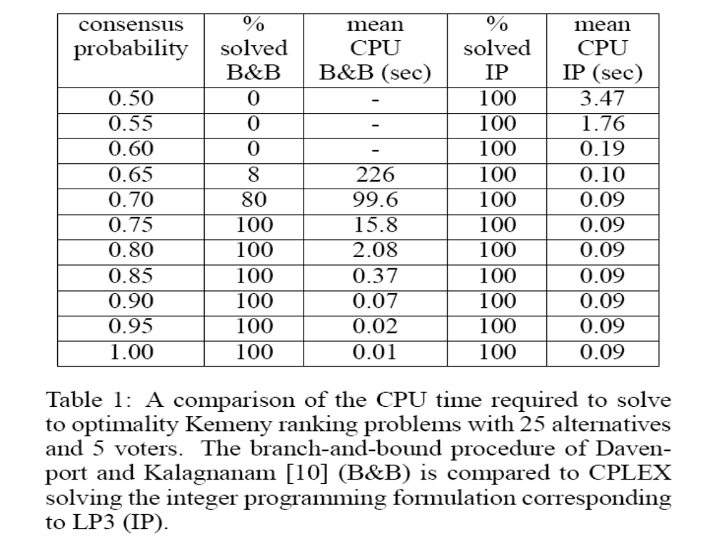
Overall computation time

Slide 37
Conclusions on bounds for computing Kemeny rankings
Kemeny rankings are NP-hard to compute
  E.g. can reduce Slater ranking problem to it
We obtained improved bounds for search techniques
  edge-disjoint cycle bound [Davenport & Kalagnanam AAAI-04] < overlapping cycle bound < overlapping partial cycle bound = LP formulation = concise LP formulation
Experimental results:
  LP bounds are much tighter, but take longer to compute
  Running CPLEX on the corresponding IP formulation is much faster than search technique with edge-disjoint cycle bound
Thank you for your attention!

