Slide 1
Aspire Dashboard
Basics, then what's new in 13.5
$ psql -U postgres
postgres=# _
Sources: aspire.dev, “Aspire 13.5 is here!” video, 13.5 release notes
Notes:
Covers dashboard and 13.5 features from “Aspire 13.5 is here!” video. Code samples from aspire.dev “What's new in Aspire 13.5”. Aspire 13.6 shipped Sept 29, 2026, so 13.5 no longer newest.

Slide 2
Agenda
1
2
3
4
Aspire fundamentals
The dashboard
What's new in 13.5
Wrap-up
What it is, what it fixes, AppHost, resources, references
Every service's logs, traces and metrics in one place
New dashboard features, code and screenshots
Upgrade, languages, links
Notes:
Audience new to Aspire. Basics first, then dashboard, then 13.5.

Slide 3
Aspire fundamentals
PART 1
What it is and how it fits together

Slide 4


Distributed apps are hard to run
Distributed app = one app split into parts that talk over network. Example: website, API, database, cache.
Without Aspire
With Aspire
Start each service by hand, in order
Run database and cache containers yourself
Copy ports and connection strings into config
Logs spread over many terminals
New teammates lose days to setup
Describe whole app once, in code
aspire run starts everything
Addresses and connection strings passed for you
One dashboard for logs, traces, metrics
Clone, run one command, code
Notes:
Ask room: how long to get new project running on your laptop? That pain is Aspire's target. Connection string = text app uses to find and log in to database (host, port, user, password).

Slide 5




What is Aspire?
Free, open-source, code-first tool to compose, run, debug and deploy distributed apps.
From Microsoft. Formerly .NET Aspire. Now works beyond .NET.
1 Compose
2 Run
3 Observe
4 Deploy
›
›
›
Describe services, containers, databases and connections in AppHost file.
aspire run starts everything, already wired.
Dashboard shows logs, traces, metrics, health from first request.
Same model produces deploy files for cloud, containers, Kubernetes.
Notes:
Four steps are how aspire.dev describes Aspire. Code-first = app described in C# or TypeScript, not YAML. Kubernetes runs containers in production. Source: https://aspire.dev/

Slide 6






Six terms
AppHost
Resource
Reference
Small C# or TypeScript program describing whole app: what runs, how parts connect. Source of truth.
Anything AppHost runs or manages: project, container (Postgres, Redis), executable, cloud service.
WithReference() = this part needs that part. Aspire hands over address or connection string.
Integration
Service defaults
Dashboard
Ready-made package for a technology, like AddPostgres() or AddRedis(). No manual config.
Shared .NET setup: telemetry, health checks, service discovery, retries. One line.
Web page that opens with aspire run. Every resource, log, trace, metric in one place.
Notes:
Terms used on every later slide. Service discovery = find service by name (catalogservice), not hard-coded address. Glossary: https://aspire.dev/hub/glossary/

Slide 7

How pieces fit
AppHost
AppHost.cs or apphost.mts
Describes every resource and connection.
Started by aspire run
catalogservice
API · process
catalogdb
Postgres · container
service discovery
frontend
Web front end · process
connection string
basketcache
Redis · container
connection string
Process
runs your code directly
Container
packaged app, like a database
Dashboard all resources send logs, traces, metrics here (OpenTelemetry)
Notes:
Sample app from aspire.dev home page: front end, catalog API, Postgres, Redis. Arrows = references. Front end needs API and cache; API needs database. All report telemetry to dashboard. Postgres and Redis run as containers, so Docker or Podman required.

Slide 8
AppHost in C#
C# · AppHost.cs
AddPostgres / AddDatabase
Runs Postgres container, creates catalogdb database.
AddRedis
Runs Redis cache container.
AddProject<…>
Runs one of your .NET projects as service.
WithReference
Gives service what it needs to reach other resource.
Build().Run()
Starts everything, opens dashboard.
var builder = DistributedApplication.CreateBuilder(args);
var postgres = builder.AddPostgres("postgres")
.AddDatabase("catalogdb");
var cache = builder.AddRedis("basketcache");
var catalog = builder
.AddProject<Projects.CatalogService>("catalogservice")
.WithReference(postgres);
builder.AddProject<Projects.Frontend>("frontend")
.WithReference(catalog)
.WithReference(cache);
builder.Build().Run();
Notes:
Replaces manual setup from problem slide. Quoted names (catalogdb, basketcache, catalogservice, frontend) appear in dashboard. Code from https://aspire.dev/

Slide 9
Same AppHost in TypeScript
TYPESCRIPT · apphost.mts
Same model
Method names match C#, in camelCase.
addNodeApp
Runs Node.js service from folder and entry file.
addViteApp
Runs Vite front end, like a React app.
Mix and match
AppHost language doesn't limit service languages.
import { createBuilder } from "./.aspire/modules/aspire.mjs";
const builder = await createBuilder();
const postgres = await builder
.addPostgres("postgres")
.addDatabase("catalogdb");
const cache = await builder.addRedis("basketcache");
const catalog = await builder
.addNodeApp("catalogservice", "./catalog", "src/index.ts")
.withReference(postgres);
await builder.addViteApp("frontend", "./frontend")
.withReference(catalog)
.withReference(cache);
await builder.build().run();
Notes:
TypeScript AppHosts GA in 13.5. Vite builds and serves JavaScript front ends. Code from https://aspire.dev/

Slide 10


What WithReference() does
Aspire passes connection details as environment variables. No copying by hand.
ENVIRONMENT VARIABLES SET BY ASPIRE
C# · INSIDE THE SERVICE
// catalogservice receives (example):
ConnectionStrings__catalogdb=Host=localhost;Port=5432;...
// frontend receives (example):
services__catalogservice__https__0=https://localhost:7099
// CatalogService/Program.cs
var builder = WebApplication.CreateBuilder(args);
builder.AddServiceDefaults();
// Reads ConnectionStrings__catalogdb for you
builder.AddNpgsqlDataSource("catalogdb");
Find services by name
Connect to databases
Any language
Front end calls "catalogservice", not a hard-coded port. Ports change; names don't.
Each service gets connection string for database or cache it references.
Node.js, Python, Go, Java can all read environment variables.
Notes:
Values are examples; real connection string also has generated user and password. Double underscore (__) = nesting in .NET config env vars. AddNpgsqlDataSource from Aspire.Npgsql package. Port 7099 matches aspire.dev example.

Slide 11


Service defaults: telemetry in one line
C# · Program.cs
OpenTelemetry
// Any .NET service · Program.cs
var builder = WebApplication.CreateBuilder(args);
// One line, from the ServiceDefaults project
builder.AddServiceDefaults();
var app = builder.Build();
// Adds the /health and /alive endpoints
app.MapDefaultEndpoints();
app.Run();
Logs, traces, metrics to dashboard
Health checks
Endpoints report alive and ready
Service discovery
Call other services by name
Resilience
Not .NET? Aspire sets OTEL_EXPORTER_OTLP_ENDPOINT, so any OpenTelemetry library reports to dashboard.
Retries and timeouts for HTTP calls
Notes:
New solutions include ServiceDefaults project; each .NET service calls AddServiceDefaults() once. OpenTelemetry (OTel) = open standard for telemetry. /health and /alive mapped in development only by default. Why dashboard has data from first request.

Slide 12
Start in three commands
TERMINAL
OUTPUT (SHORTENED)
// 1. Install the Aspire CLI
// macOS / Linux:
curl -sSL https://aspire.dev/install.sh | bash
// Windows (PowerShell):
irm https://aspire.dev/install.ps1 | iex
// 2. Create a new app from a template
aspire new
// 3. Run it: starts everything + the dashboard
aspire run
$ aspire run
AppHost: apphost.mts
Dashboard: https://localhost:17178/login?t=...
Press CTRL+C to stop the AppHost and exit.
Needs
Docker Desktop or Podman, for databases and caches.
Open dashboard
Click Dashboard link. ?t= token signs you in.
Installer now gives Aspire 13.6.0 (Sept 29, 2026)
Notes:
Install commands from https://aspire.dev/get-started/install-cli/. aspire new asks for template. // comment lines only for slide coloring; type just commands. First tutorial: https://aspire.dev/get-started/first-app/

Slide 13
The dashboard
PART 2
Everything AppHost runs, in one view

Slide 14






What dashboard shows
Browser app for run-time info about your distributed app. Opens with aspire run.
Resources
Console logs
Structured logs
Traces
Metrics
Projects, executables, containers: state, endpoints
Live output from every resource
Searchable entries: level, message, trace ID
One request across services
Charts, like HTTP request duration
No AppHost? Run dashboard as container: mcr.microsoft.com/dotnet/aspire-dashboard. UI on port 18888, OTLP telemetry in on 18889.
Notes:
AppHost starts dashboard for you. Sources: microsoft/aspire README for Aspire.Dashboard; standalone ports from Milan Jovanovic's standalone dashboard guide. OTLP = standard format for sending logs, traces, metrics.

Slide 15
What's new in Aspire 13.5
PART 3
New dashboard features, code, screenshots

Slide 16




13.5 overview
UI
UI
Experimental
Refreshed UI
Sharper filtering
Terminal view
Official Aspire branding, new design tokens, accessibility checked
Timestamp filters, exact == / != matching, console log search
WithTerminal() puts live terminal in dashboard
Stable
Stable
Experimental
File uploads
Command arguments
Progress dialogs
Commands ask user for a file
Named inputs: form in dashboard, options in CLI
Dialog during long commands, optional cancel
Notes:
Stable = rely on API. Experimental = may change; C# must suppress diagnostic warning. Also in 13.5: VS Code extension can open dashboard in side panel; AI Assistant chat removed.

Slide 17
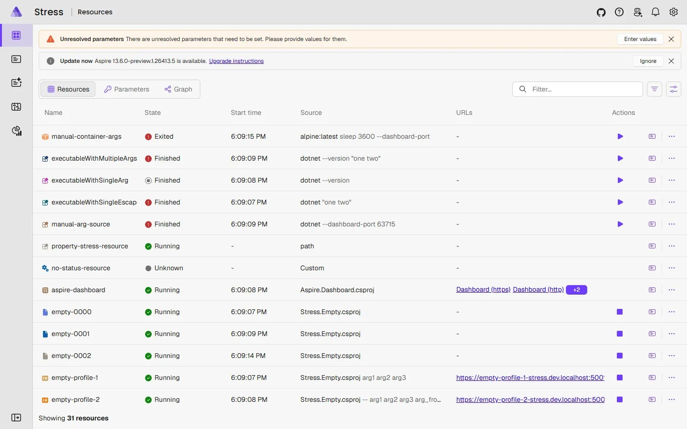



New look, better filters
Filter by timestamp
Refreshed UI
Narrow logs and traces to time range
Exact numeric matching
New == and != operators, e.g. exact status code
Search console logs
Text filter on console output, case-insensitive
Official Aspire colors and logo, light and dark
Contrast checked to WCAG AA
Same layout, nothing moved
Clearer reconnects
Clearer dialog when dashboard loses AppHost connection
Notes:
Screenshot: refreshed dashboard (Stress playground), from Aspire 13.5 blog post (devblogs.microsoft.com/aspire/whats-new-aspire-13-5/). UI only, no code: upgrade and it appears. Built on new design tokens. Also new: friendlier health-check failures, telemetry keeps streaming with resource filters on.

Slide 18

Interactive terminal: WithTerminal()
C# · AppHost.cs
What it does
Resource gets live terminal you type into from dashboard. Shells, REPLs (psql, Python), text apps.
Opens automatically
Running resource opens in terminal view. Before that, console logs.
Many viewers
Several people or tabs can attach to same session.
#pragma warning disable ASPIRETERMINAL001 // experimental API
var builder = DistributedApplication.CreateBuilder(args);
builder.AddContainer("db", "postgres")
.WithTerminal(options =>
{
options.Columns = 200; // default is 120
options.Rows = 50; // default is 30
});
builder.Build().Run();
Experimental. C# must suppress ASPIRETERMINAL001. API may change.
Notes:
Code from aspire.dev “What's new in Aspire 13.5”. TerminalOptions: Columns (default 120), Rows (default 30), ShowTerminalHost. Columns and Rows throw if ≤ 0. Old Shell property removed. Docs: https://aspire.dev/app-host/with-terminal/

Slide 19
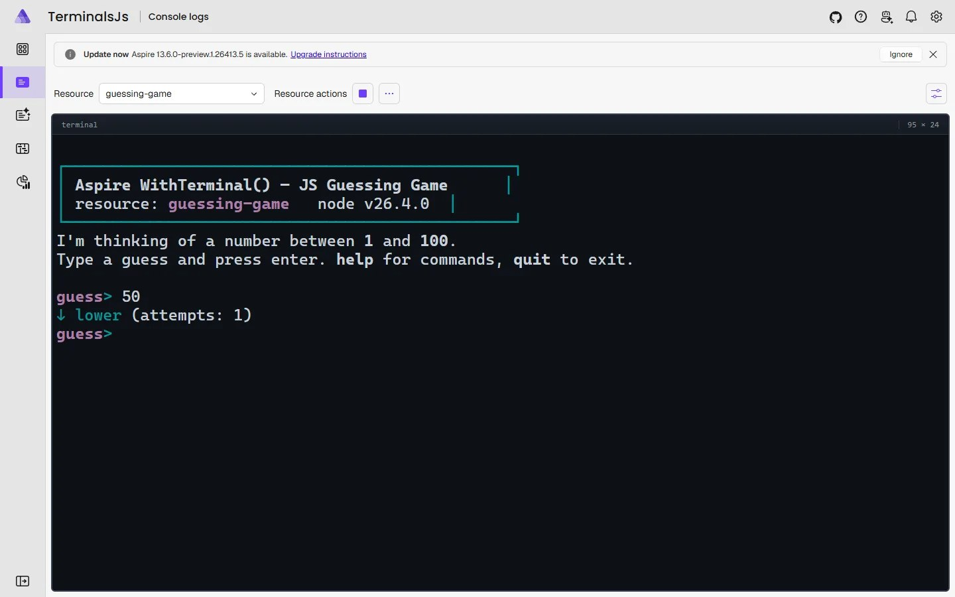
Terminal view
1
Open Console logs
Pick resource from Resource dropdown (here: guessing-game).
2
Live terminal shows
Resource with WithTerminal() gets interactive session. Switch replicas or back to logs without stopping it.
3
Type like any shell
Keys go to live session. Size shown top-right (95 × 24 here).
Screenshot: guessing-game playground. Source: Aspire blog, “Aspire 13.5: Fresh pixels and better workflows”, Aug 18, 2026.
Notes:
Screenshot from Aspire 13.5 blog post. Shows guessing-game playground (JavaScript resource, TypeScript AppHost), not postgres example from previous slide. Terminal lives on Console logs page; resource picked from dropdown. Per blog: type into it, switch replicas, back to logs without stopping; multiple viewers can attach.

Slide 20
Same terminal from TypeScript and CLI
TYPESCRIPT · apphost.mts
TypeScript AppHosts
Generally available in 13.5. No experimental opt-in for TypeScript itself.
Attach from your shell
With feature flag on, aspire terminal commands list sessions and attach from your shell.
Try it
Aspire repo has small guessing-game playground, playable in dashboard.
import { createBuilder } from './.aspire/modules/aspire.mjs';
const builder = await createBuilder();
// TypeScript exposes a parameterless withTerminal().
// Columns/Rows can only be set from C#.
await builder.addContainer('db', 'postgres').withTerminal();
await builder.build().run();
TERMINAL · Aspire CLI
// Turn on the experimental terminal commands
aspire config set features.terminalCommandsEnabled true
Notes:
Feature flag command from 13.5 release notes. Feature flag = setting that turns on feature still in testing. Docs: https://aspire.dev/app-host/with-terminal/

Slide 21
Ask user for input
C# · AppHost.cs (needs using Microsoft.Extensions.DependencyInjection;)
Interaction Service
AppHost's way to show dialogs, prompts, notifications in dashboard.
Now stable
PromptInputAsync, PromptInputsAsync, InteractionInput. No ASPIREINTERACTION001 suppression.
C# and TypeScript
Works same in both AppHost languages.
var builder = DistributedApplication.CreateBuilder(args);
var api = builder.AddContainer("api", "nginx");
api.WithCommand("configure-region", "Configure region", async ctx =>
{
var interaction = ctx.Services.GetRequiredService<IInteractionService>();
// Commands run from the CLI have no UI, so only prompt when one exists.
if (!interaction.IsAvailable) return CommandResults.Success();
var result = await interaction.PromptInputsAsync(
title: "Configure region",
message: "Choose the region to deploy to.",
inputs:
[
new InteractionInput
{
Name = "region", Label = "Region",
InputType = InputType.Choice,
Options = [ new("us", "United States"), new("eu", "Europe") ]
}
],
cancellationToken: ctx.CancellationToken);
if (result.Canceled) return CommandResults.Canceled();
var region = result.Data["region"].Value;
return CommandResults.Success();
});
builder.Build().Run();
Notes:
WithCommand adds button to resource in dashboard. This one shows dropdown with two regions. Always check IsAvailable: CLI commands run non-interactive and PromptInputsAsync would throw. Docs: https://aspire.dev/extensibility/interaction-service/

Slide 22
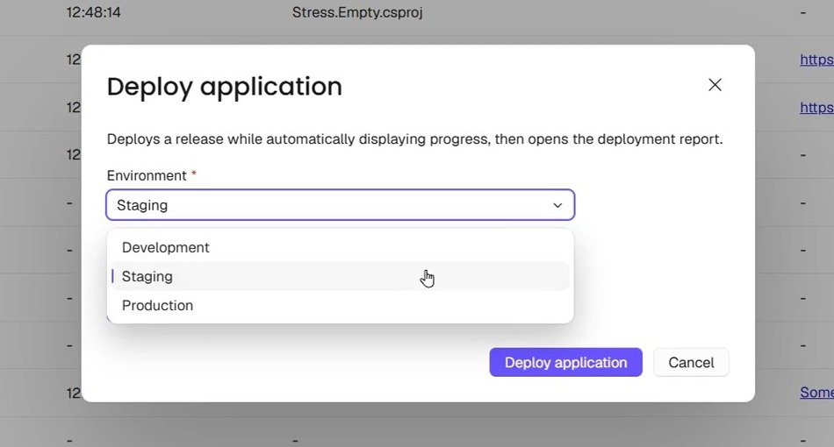
Region prompt
1
Run the command
Click ••• in Actions column, then command (Configure region in our code).
2
Dialog opens
Title and message on top, inputs below. Required inputs get red *.
3
Choice = dropdown
InputType.Choice lists its Options. Main button left of Cancel.
Frame from 13.5 blog demo video. Sample command “Deploy application”, not our region code.
Notes:
Frame from Aspire 13.5 blog demo video. Sample “Deploy application” command, not configure-region code, but Choice input renders same: dropdown with options. In our code OK returns "us" or "eu" in result.Data["region"].Value; Cancel returns CommandResults.Canceled().

Slide 23
File upload
C# · AppHost.cs
InputType.File
Dashboard shows file picker, limited by FileFilter and MaxFileSize.
Read the file
C#: ReadAllBytesAsync() or OpenRead(). TypeScript: read file.filePath with Node fs.
Stable
No suppression needed.
var importer = builder.AddContainer("importer", "nginx");
importer.WithCommand("import-data", "Import data", async ctx =>
{
var interaction = ctx.Services.GetRequiredService<IInteractionService>();
if (!interaction.IsAvailable) return CommandResults.Success();
var result = await interaction.PromptInputsAsync(
title: "Import data",
message: "Select a JSON file to import.",
inputs:
[
new InteractionInput
{
Name = "dataFile", Label = "Data file",
InputType = InputType.File,
FileFilter = ".json",
MaxFileSize = 10 * 1024 * 1024, // 10 MB
Required = true
}
],
cancellationToken: ctx.CancellationToken);
if (result.Canceled) return CommandResults.Canceled();
var file = result.Data["dataFile"].Files?[0];
if (file is null) return CommandResults.Failure("No file was uploaded.");
var bytes = await file.ReadAllBytesAsync(ctx.CancellationToken);
return CommandResults.Success();
});
Notes:
Trimmed from official sample; full version continues into progress dialog on next slide. Docs: https://aspire.dev/extensibility/interaction-service/

Slide 24
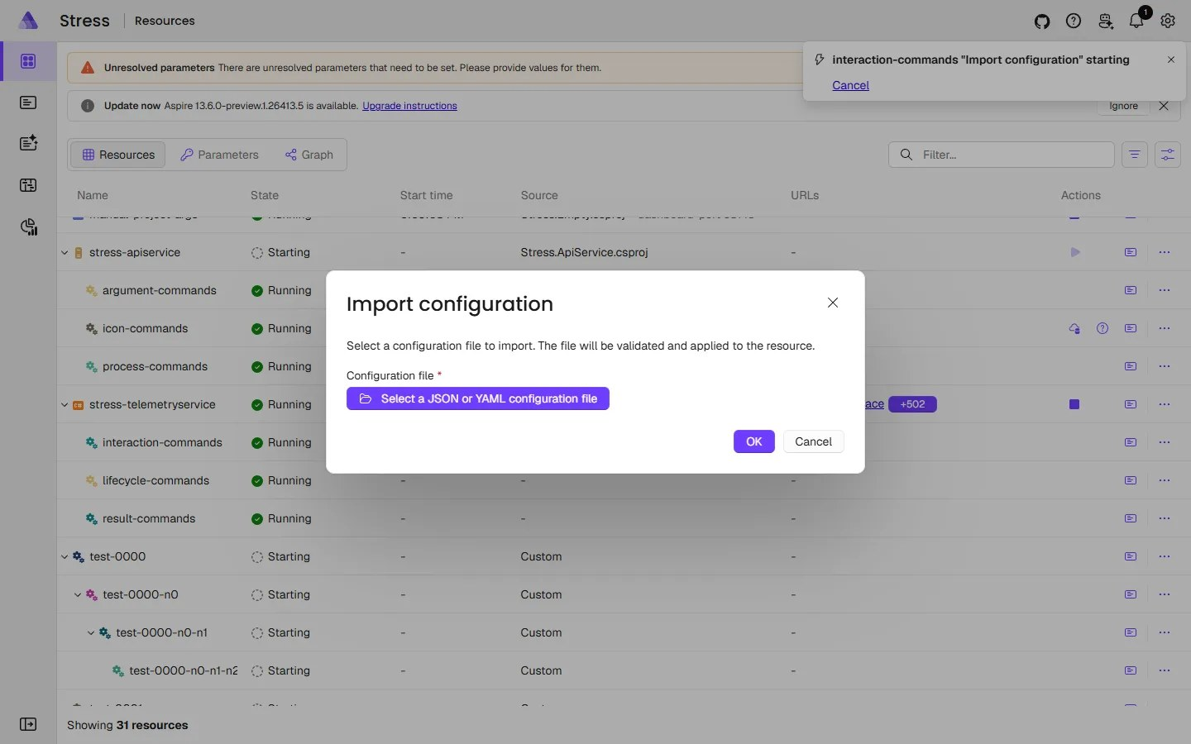
File picker
1
Run the command
Click ••• on resource, pick command. Notification shows it starting, with Cancel.
2
Dialog asks for file
Title, message, required (*) file input. Here: “Import configuration”.
3
Pick the file
Click button, choose file. FileFilter and MaxFileSize limit what's accepted.
Screenshot: “Import configuration” command. Source: Aspire blog, “Aspire 13.5: Fresh pixels and better workflows”, Aug 18, 2026.
Notes:
Screenshot from Aspire 13.5 blog post. Blog's “Import configuration” command: file picker for JSON or YAML, size limit, file sent to AppHost as stream. Our code uses “Import data”; dialog looks same. No file chosen = CommandResults.Failure.

Slide 25
Progress during long work
C# · AppHost.cs
Progress dialog
Can't be dismissed while work runs. Cancel optional.
Use Work
Slow code goes in Work. Without it, dialog stays open until token canceled.
TypeScript
interaction.promptProgress(...) with options.work callback.
#pragma warning disable ASPIREINTERACTION001 // experimental API
// ...inside the "import-data" command, after reading the file:
await interaction.PromptProgressAsync(
message: $"Processing {bytes.Length} bytes",
title: "Importing...",
options: new ProgressInteractionOptions
{
// The dialog stays open while Work runs, then closes.
Work = async progress =>
{
await Task.Delay(TimeSpan.FromSeconds(2), progress.CancellationToken);
}
},
cancellationToken: ctx.CancellationToken);
return CommandResults.Success();
Experimental: PromptProgressAsync, ProgressInteractionOptions, ProgressContext.
Notes:
Swap Task.Delay for real work. CancellationToken = how .NET tells running code to stop, e.g. user clicks Cancel. Docs: https://aspire.dev/extensibility/interaction-service/

Slide 26
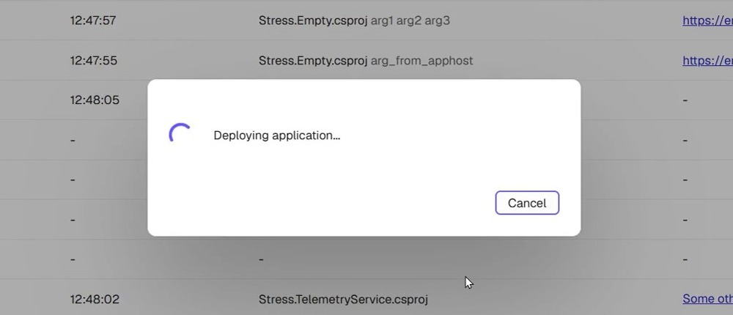
Progress dialog
1
Opens after confirm
Input dialog closes, progress dialog takes over.
2
Spinner and message
Spinner plus your message while Work runs. No close (X) button.
3
Cancel or finish
Cancel fires CancellationToken. Work done = dialog closes, command returns result.
Frame from 13.5 blog demo video. Source: Aspire blog, “Aspire 13.5: Fresh pixels and better workflows”, Aug 18, 2026.
Notes:
Frame from Aspire 13.5 blog demo video. Spinner, not progress bar. Our message would use bytes.Length. Progress dialogs still experimental (ASPIREINTERACTION001). Cancel optional; clicking it cancels progress.CancellationToken. In video, “Deployment completed” result dialog follows.

Slide 27
Named command arguments
C# · AppHost.cs
Declare once
InteractionInput items go in CommandOptions.Arguments.
Two front ends
Dashboard: form before command runs. CLI: each argument becomes option with same name.
Required
CLI errors if required option missing. Stable.
var builder = DistributedApplication.CreateBuilder(args);
builder.AddContainer("api", "nginx")
.WithCommand(
name: "echo",
displayName: "Echo",
executeCommand: ctx =>
{
var message = ctx.Arguments["message"].Value;
// Use the collected argument...
return Task.FromResult(CommandResults.Success());
},
commandOptions: new CommandOptions
{
Description = "Echo a message.",
Arguments =
[
new InteractionInput
{
Name = "message", Label = "Message",
InputType = InputType.Text, Required = true
}
]
});
builder.Build().Run();
Notes:
Read values from ctx.Arguments. TypeScript: commandOptions.arguments. Docs: https://aspire.dev/fundamentals/custom-resource-commands/

Slide 28
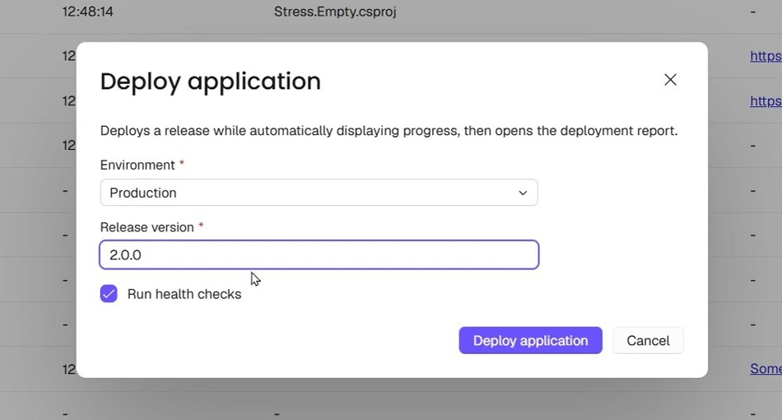
Command arguments
1
Run the command
Click ••• on resource, then command (Echo in our code).
2
Arguments first
Each argument becomes labelled input. Required get red *. Sample: dropdown, text box, checkbox.
3
Then command runs
Callback reads ctx.Arguments. In CLI, same arguments are --name options.
Frame from 13.5 blog demo video. Sample command “Deploy application”, not our Echo code.
Notes:
Frame from Aspire 13.5 blog demo video. Sample “Deploy application” declares Environment (choice), Release version (text), Run health checks (checkbox). Description sits under title; main button named after command. Our Echo shows one required Message box, read with ctx.Arguments["message"].Value. CLI: --message option.

Slide 29
Wrap-up
PART 4
Upgrade, languages, links

Slide 30
Upgrade and watch-outs
TERMINAL · Aspire CLI
Don't mix 13.4 and 13.5 packages
// 1. Update the Aspire CLI itself
aspire update --self
// 2. Update your projects (from repo root)
aspire update
// 3. Run the app + open the dashboard
aspire run
Mixed versions can fail at startup. Upgrade SDK and all Aspire.Hosting.* packages together.
Dashboard AI Assistant removed
Built-in chat gone. Use Aspire MCP server to connect AI agents.
VS Code no longer auto-opens dashboard
Opt in: Aspire: Dashboard Browser setting, or dashboardBrowser in launch.json.
13.6 is out
Released Sept 29, 2026. Dashboard now keeps telemetry from past runs.
ServiceProvider is now Services
Rename property on hosting context types in AppHost code.
Notes:
Upgrade steps and breaking changes from aspire.dev “What's new in Aspire 13.5”. 12 breaking changes total, incl. PublishAsConnectionString obsolete, aspire ps --resources removed (use aspire describe). 13.6 info from blog post “Aspire 13.6: Your dashboard gets memory”.

Slide 31
Languages and runtimes
Two choices: AppHost language (wires app) and service languages. They don't need to match.
AppHost languages
Official
App languages: official
Official
App languages: community
Toolkit
C#
TypeScript
C# and .NET
JavaScript and Node.js
Python
Go
Java
Rust
PowerShell
Aspire docs: Languages & runtimes
https://aspire.dev/languages-and-runtimes/
Notes:
Source: https://aspire.dev/languages-and-runtimes/ (checked Oct 4, 2026). Page lists Java and Rust under Community Toolkit, but 13.6 announcement says Java and Rust hosting now first-party; page may lag. Containers, databases, caches, cloud services covered under Integrations.

Slide 32




Links and sources
Video: Aspire 13.5 is here!
https://youtu.be/pEbo-qKif1U
What's new in Aspire 13.5
https://aspire.dev/whats-new/aspire-13-5/
Languages & runtimes
https://aspire.dev/languages-and-runtimes/
Dashboard docs
https://aspire.dev/dashboard/
Interactive terminals (WithTerminal)
https://aspire.dev/app-host/with-terminal/
Interaction service
https://aspire.dev/extensibility/interaction-service/
Custom resource commands
https://aspire.dev/fundamentals/custom-resource-commands/
Build your first Aspire app
https://aspire.dev/get-started/first-app/
Notes:
Links checked Oct 4, 2026.

