Slide 1
Handman
Improve your handwriting in 10 men or less.
Cedric McDougal
CCIS 2013
mcdougal.ce@gmail.com
Robert Steinbach
CCIS 2013
steinbach.r@husky.neu.edu

Slide 2
Summary
Hangman
Handwriting improvement app

Slide 3
Innovation
Makes handwriting practice fun!

Slide 4
The problem
Micrographia
A lot of people have terrible handwriting

Slide 5
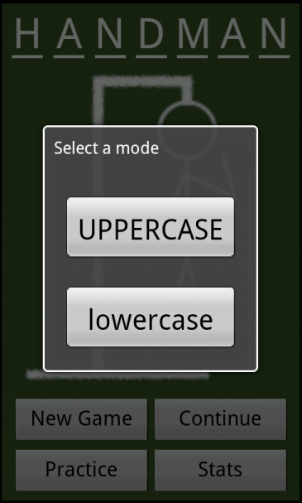
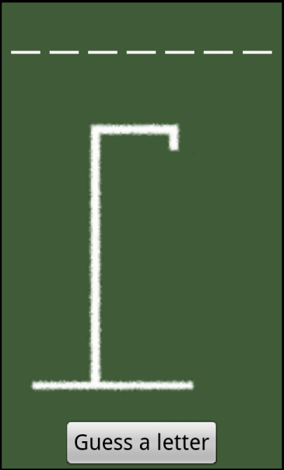
New game

Slide 6
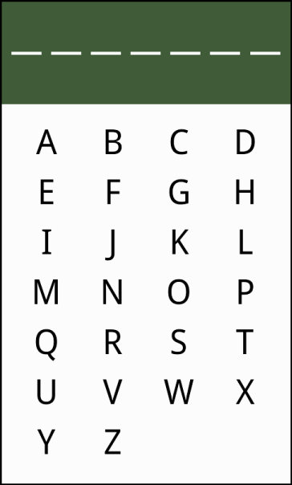
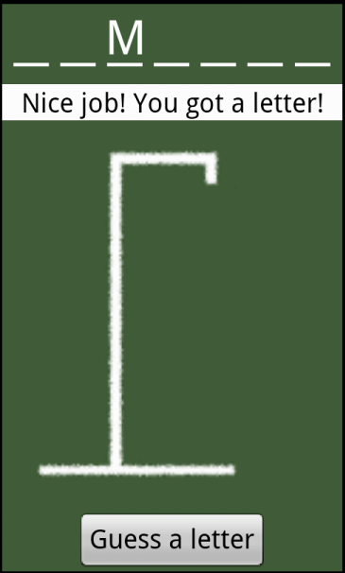
Guessing a letter

Slide 7
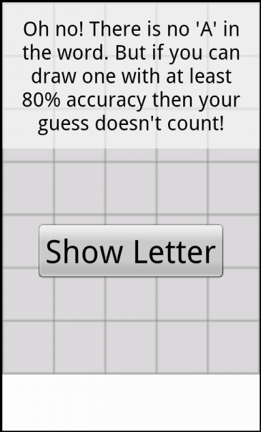

Guessing wrong

Slide 8
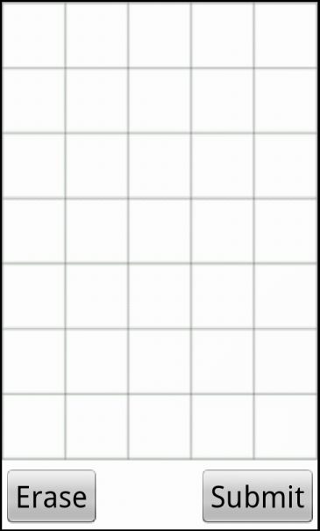
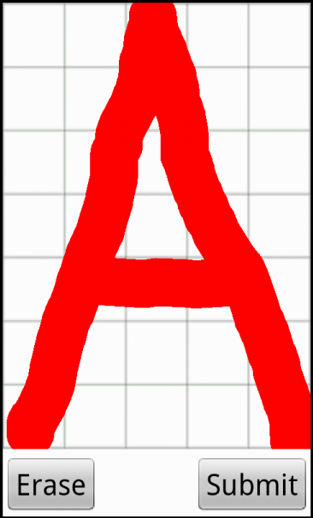
Drawing a letter

Slide 9
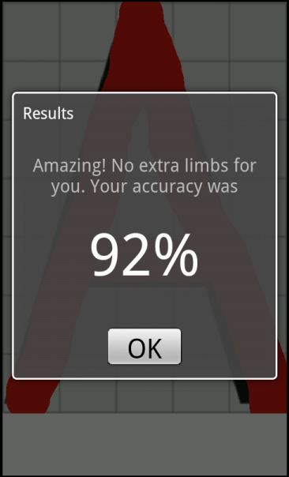
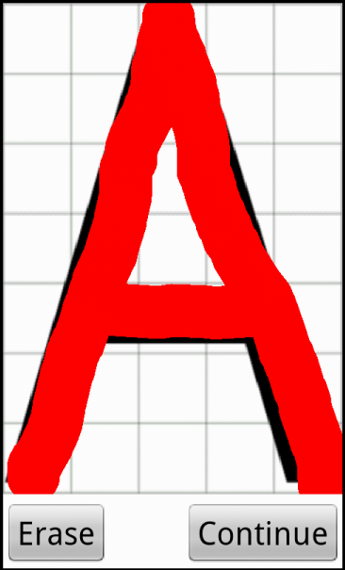
Results

Slide 10
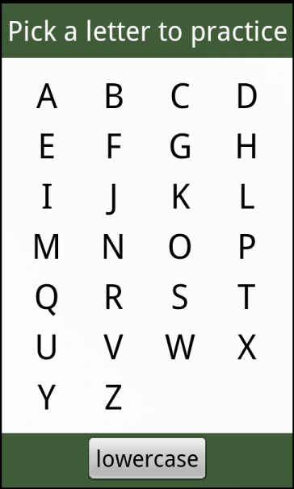
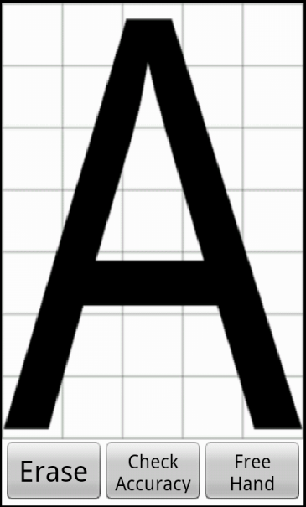
Practice

Slide 11
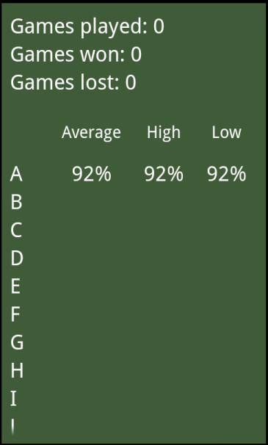
Stats

Slide 12
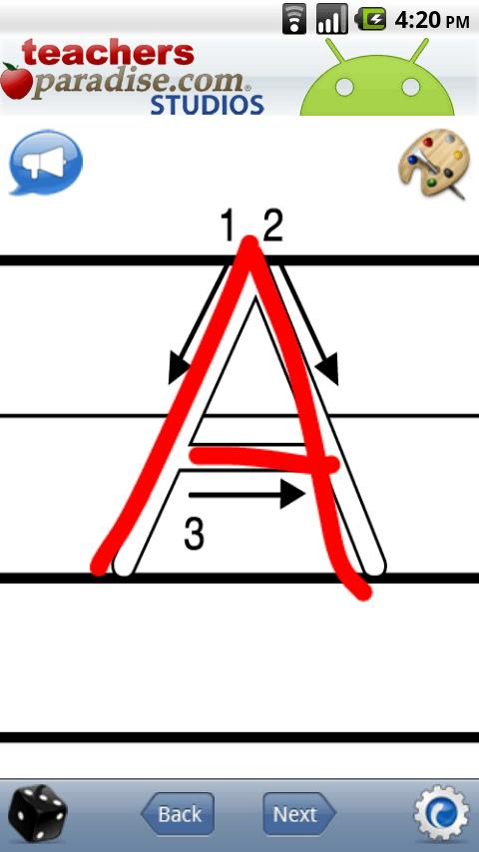
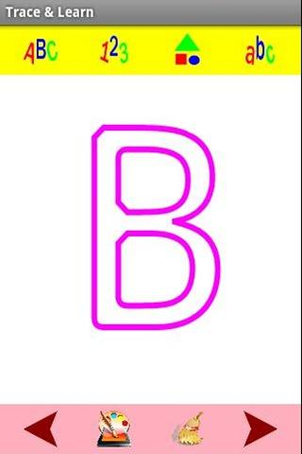
Competition
123s ABCs Handwriting Fun SET1 >
< Trace and Learn

Slide 13
Innovation
No game
No feedback
No tracking

Slide 14
Innovation
Assumes writing letters is a chore
Take user's mind off it
Means to a more immediate end

Slide 15
Tricky programming problem
Hardest challenge: accuracy checking
Representation of drawing and letter
Didn't want to do a lot of math

Slide 16
Tricky programming problem
Letter: drawable inflated to Bitmap
Drawing: Path object

Slide 17
Tricky programming problem
Draw letter to a canvas
Find number of black pixels
Draw user's drawing to same canvas
Find number of black pixels again
Find percentage difference

Slide 18
Acknowledgements
We did all graphics and sound effects
Learned from various examples online
No third-party libraries

Slide 19
The future
Accuracy detection improvement
Room for more features
Instructions on proper writing technique

Slide 20
Handman
Turns a chore into something fun
Modifies something that already works
So easy anyone can figure it out!

