Slide 1

Orange Fire Dynamics Calculator teamLanka- Charmal Damith P. Mahapatabendige
03/26/2018

Slide 2
agenda
Features
Technology stack
Android
Apple
Web
Additional feature – proof of concept
Questions

Slide 3
features
Home
List of all calculating items
Sign in
Signup
Add feedback
User list
Feedback list

Slide 4







technology stack
Android
Swift
React

Slide 5
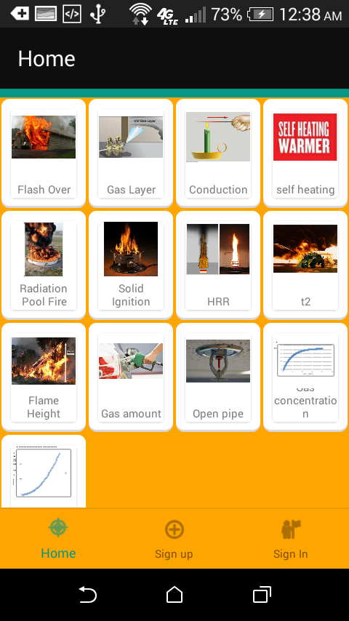
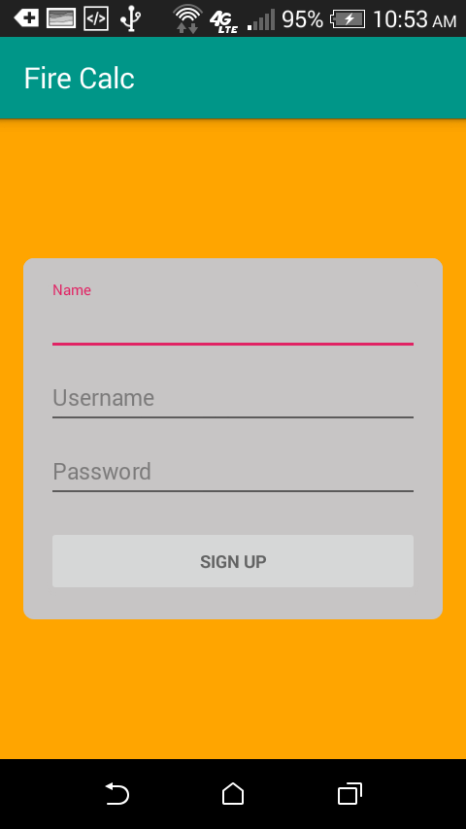
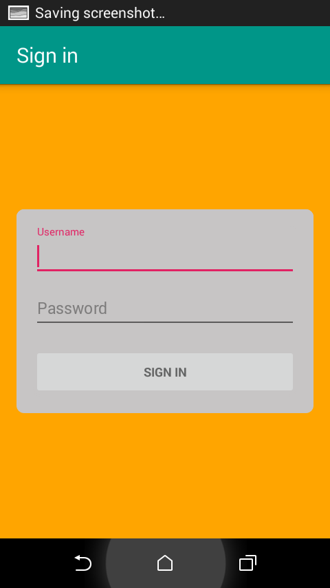
android

Slide 6
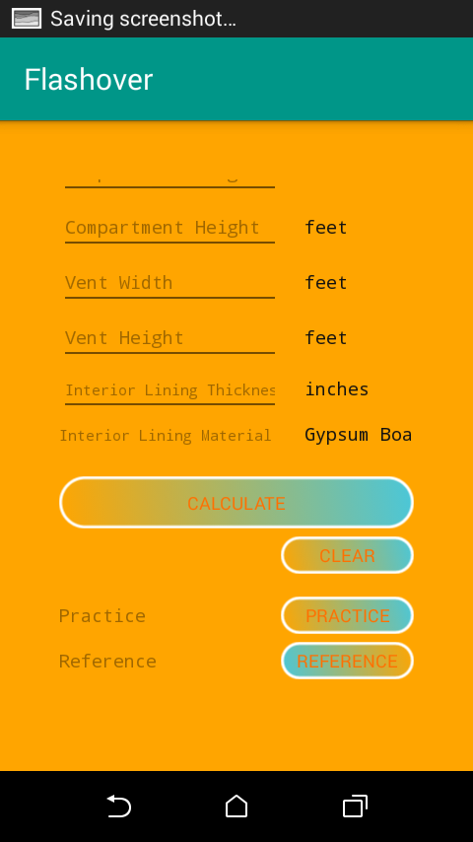
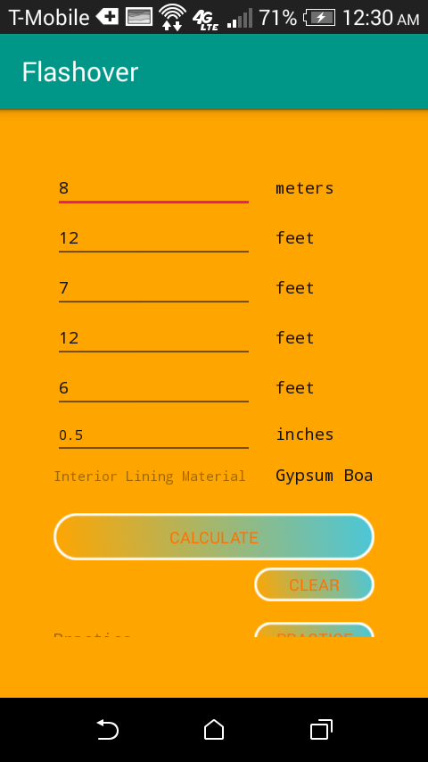
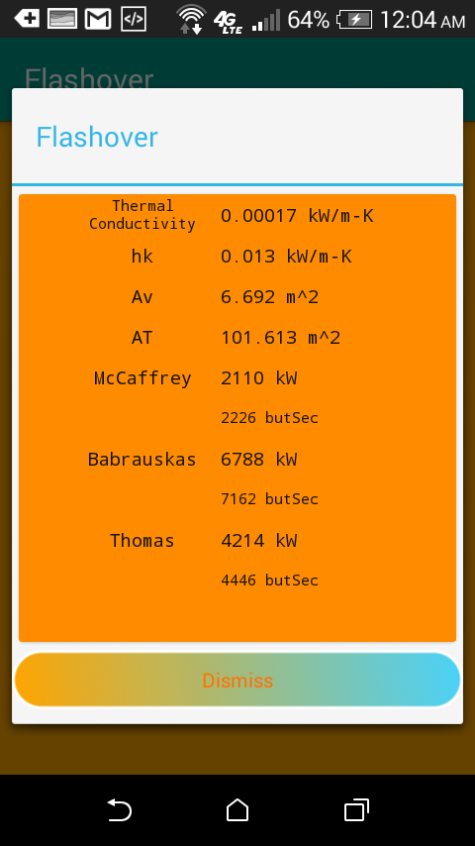

Slide 7
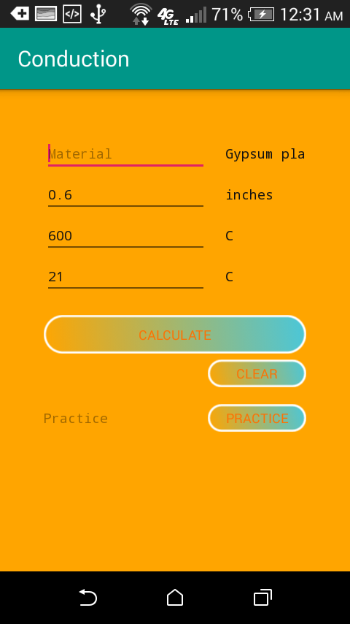
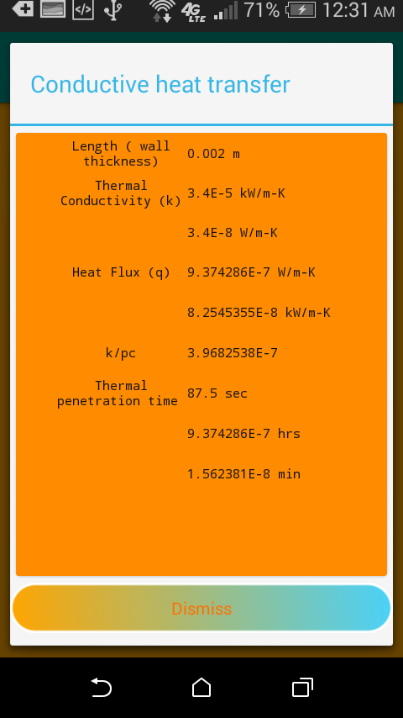
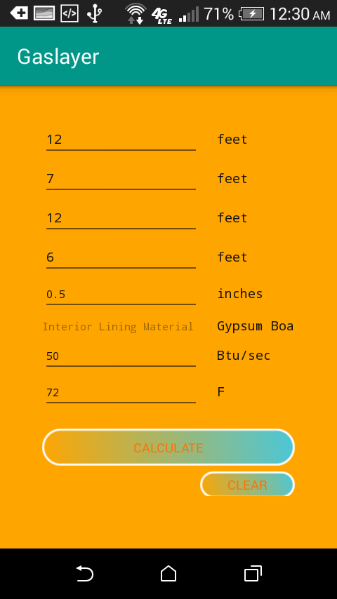
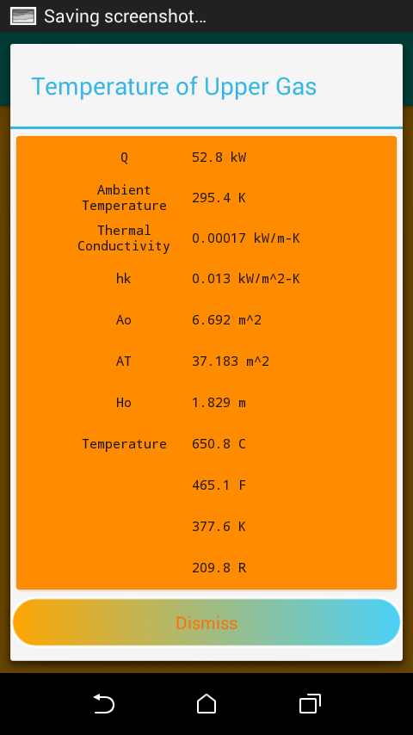

Slide 8
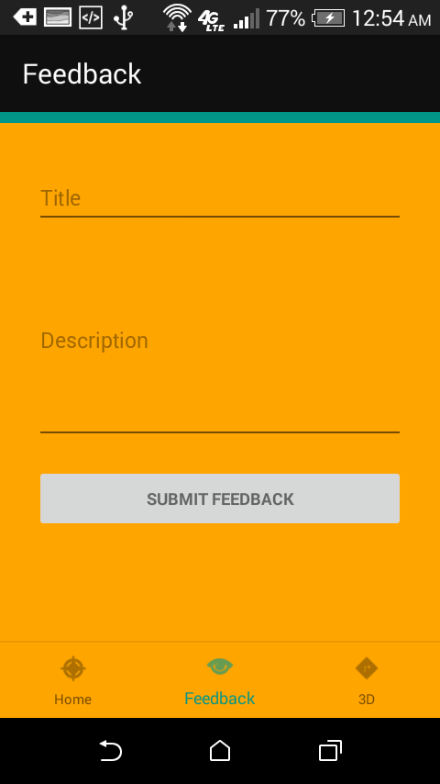
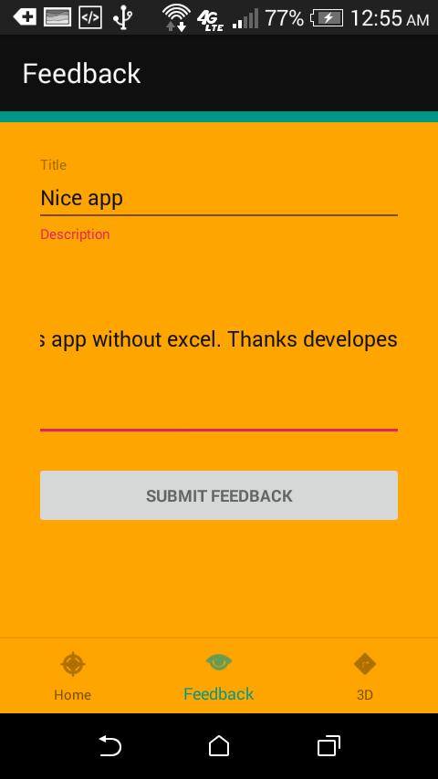
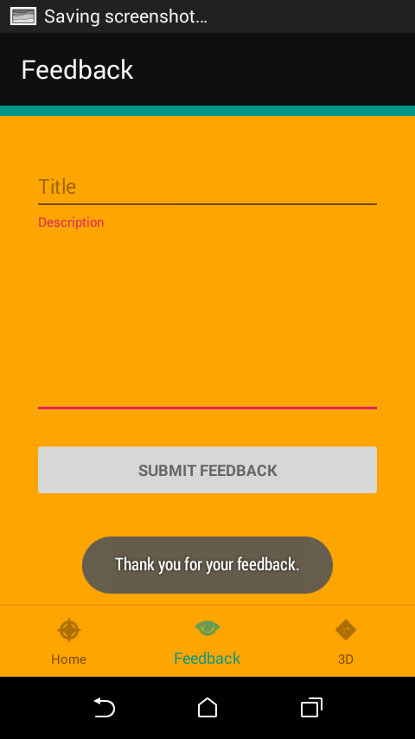

Slide 9
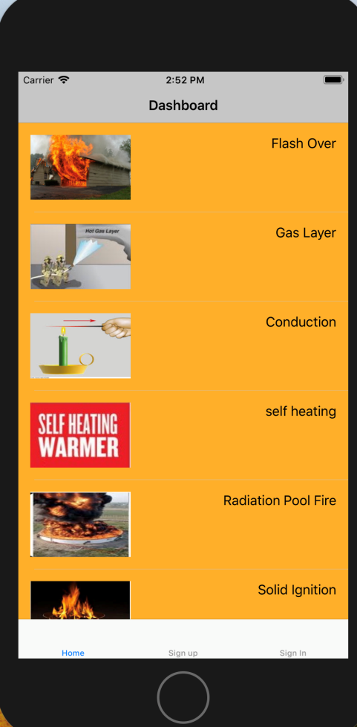
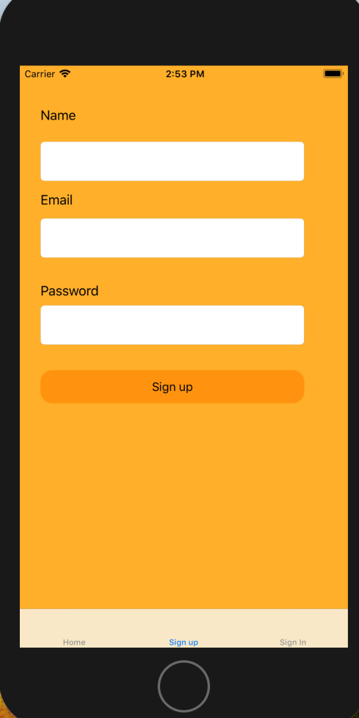
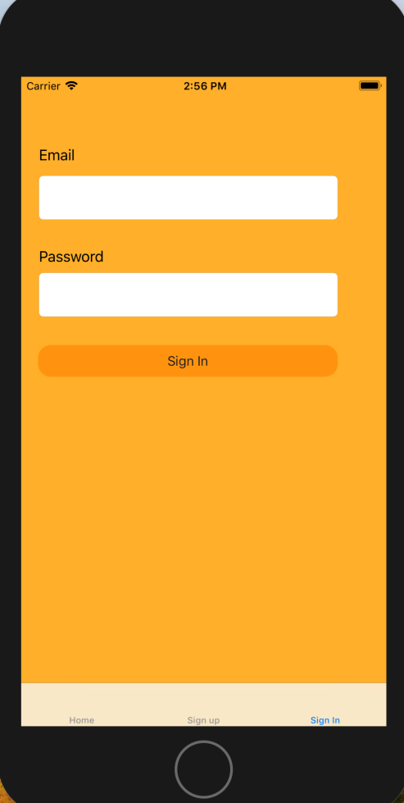
iOS (swift)

Slide 10
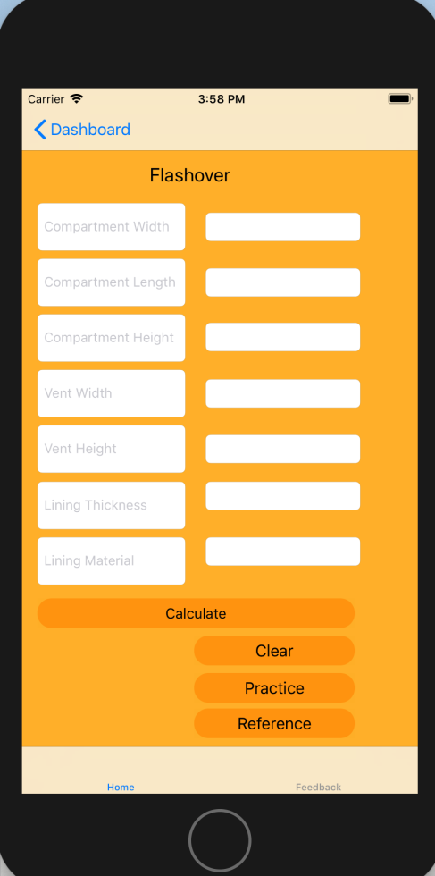
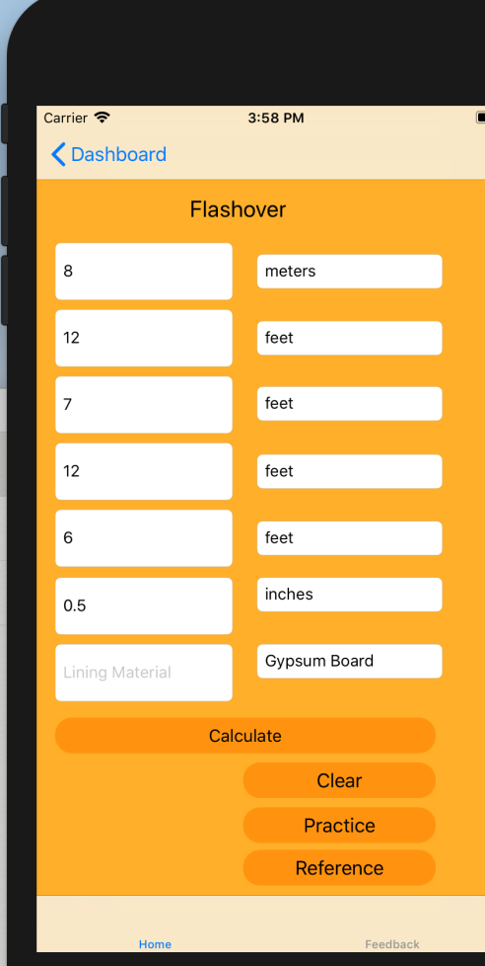
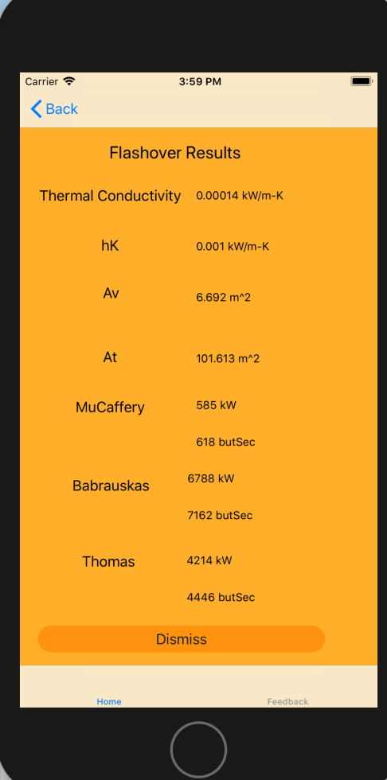

Slide 11
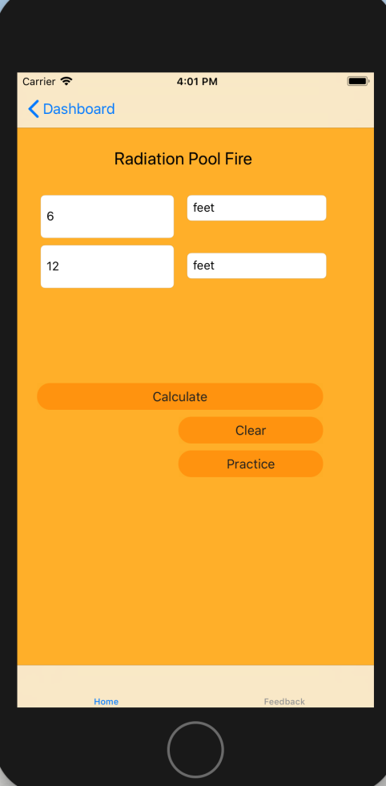
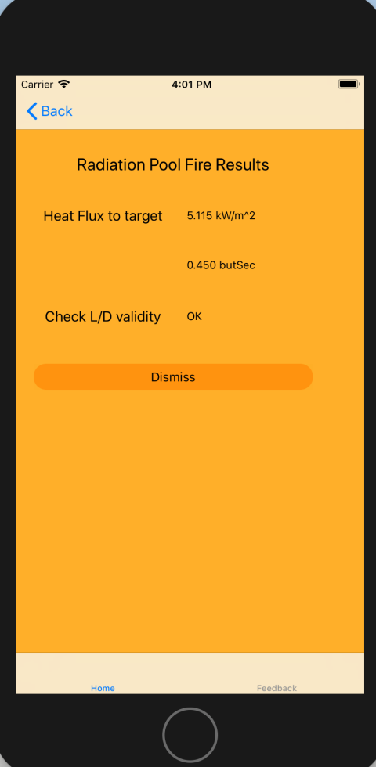
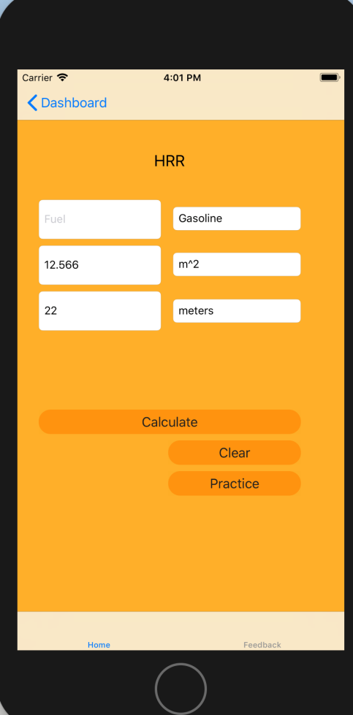
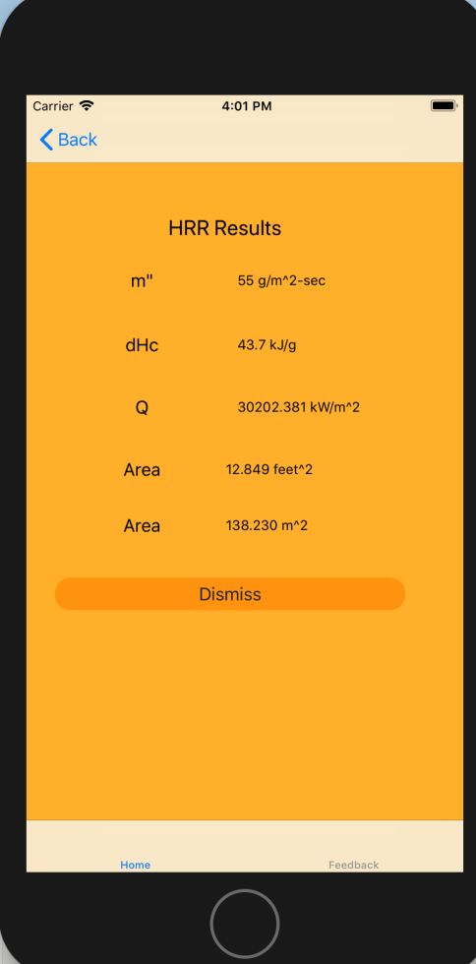

Slide 12
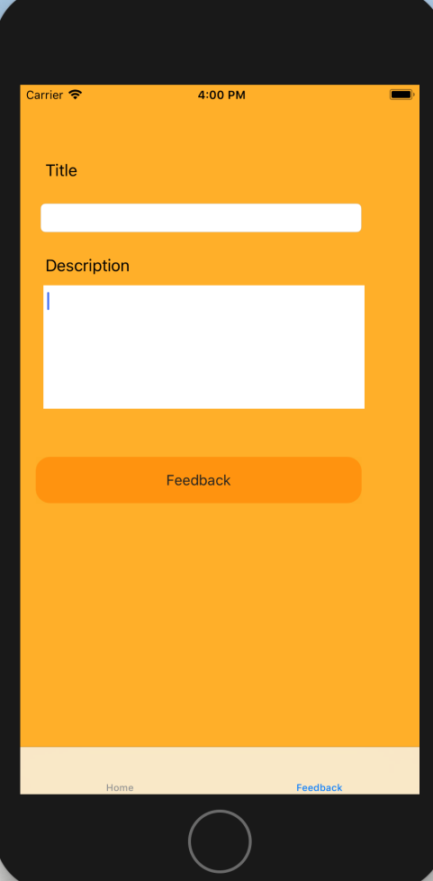
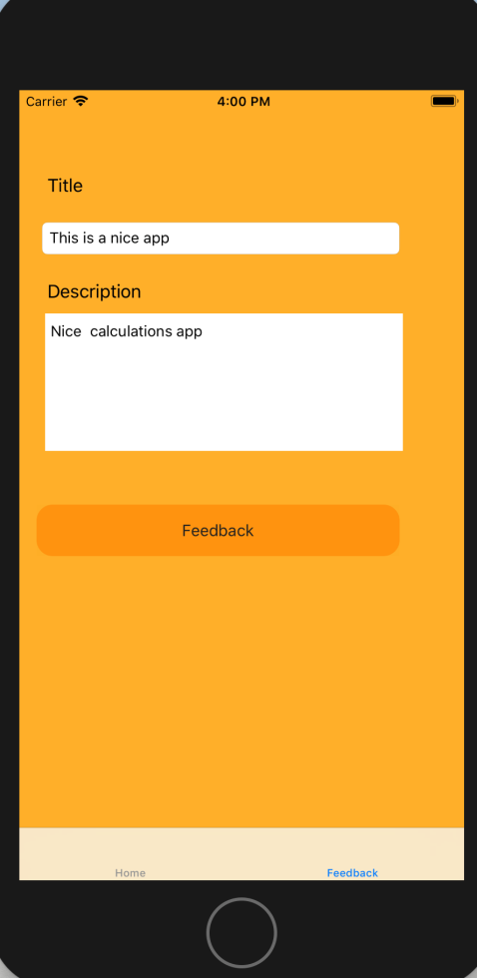

Slide 13
web (React.js)
Mainly web app can use for administrative usage.
User list
Feedback list

Slide 14
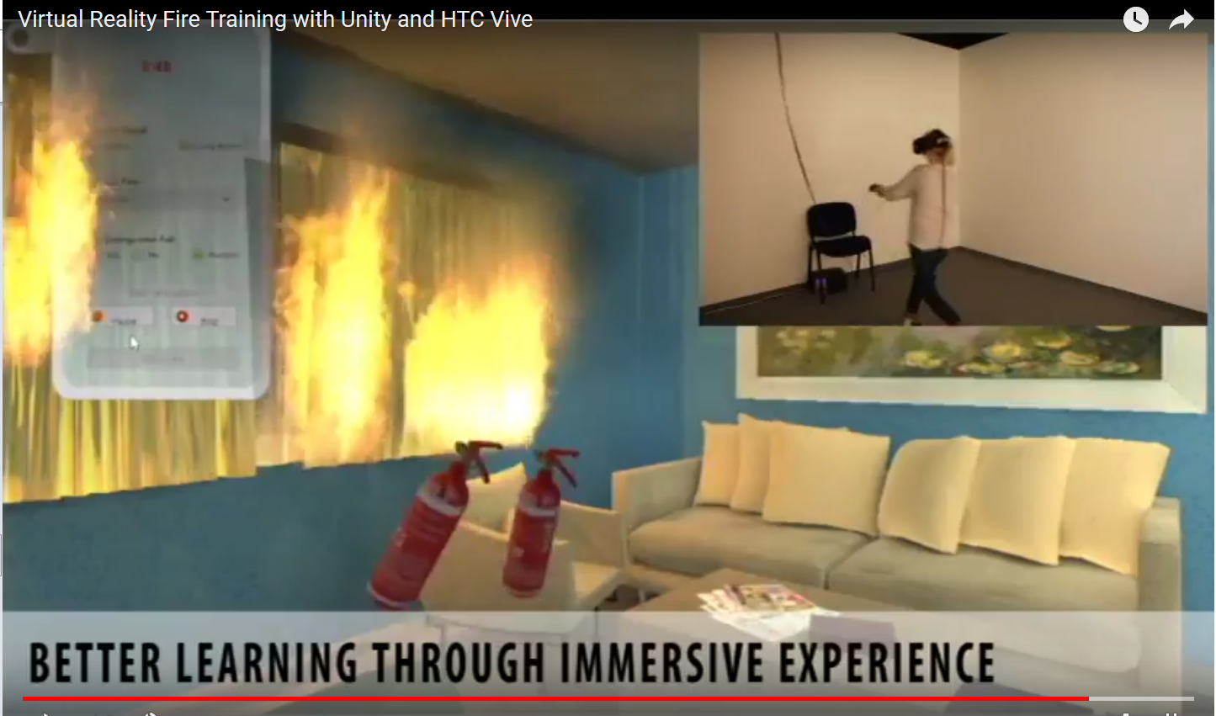
additional feature
Integrating unity 3d application
It’s not just a fire It shows that possible to integrate with it.
What can we embed (virtual reality or augmented reality)with this application
Fire dynamics calculation simulations
Fireman trainings (https://www.youtube.com/watch?v=cRpn9ohsMd4)

Slide 15
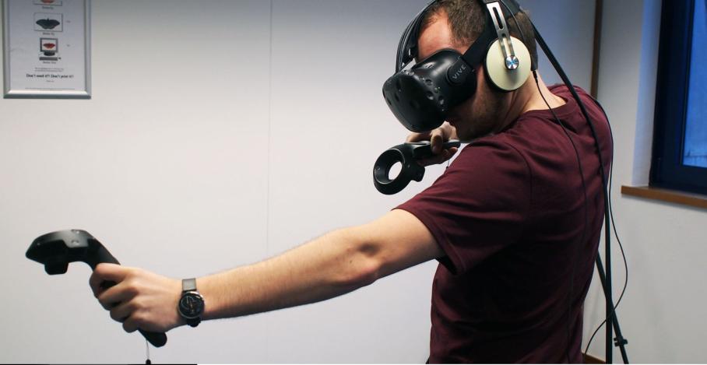
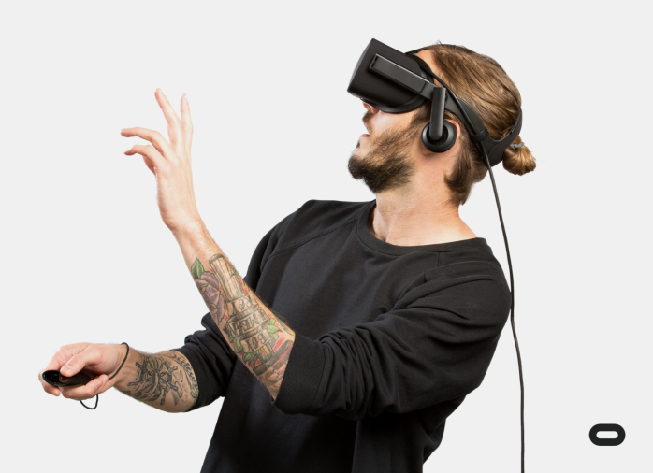
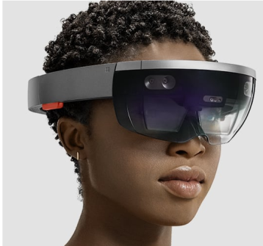
what are the benefits using mobile for VR world
If we use HTC Vive or oculus rift area is getting limited
Microsoft HoloLens it very expensive

Slide 16
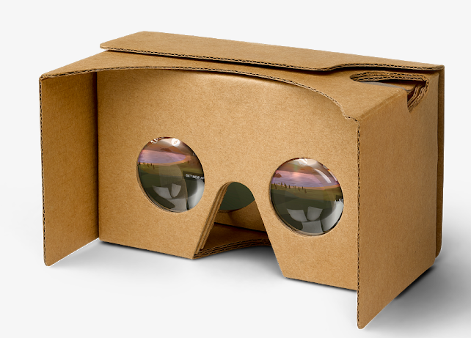
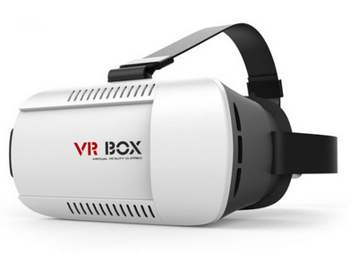
contd..
3d glass or Google cardboard very cheap and area is not limited.
Nowadays everyone have smart phone and we only need to develop a relevant application

Slide 17
questions

Slide 18
thanks

Slide 19
reference
http://www.digitalspy.com/tech/virtual-reality/news/a814426/htc-vive-really-is-the-best-gadget-in-the-world-right-now/
https://www.vrfocus.com/2017/11/7-most-wanted-virtual-reality-videogames-for-oculus-rift/
https://tech.blorge.com/2017/05/08/microsoft-hololens-vs-playstation-vr-one-get
https://store.google.com/product/google_cardboard
https://uae.souq.com/ae-en/vr-box-virtual-reality-3d-glass-for-3d-games-and-3d-movies-for-smartphone-white-9568165/i/
https://www.youtube.com/watch?v=cRpn9ohsMd4

