Slide 1




Chatbot
Team 12 | Aaron | Andrew | Bing Hong | Claudia | Jeremy | Jia Ying | Song Xuan

Slide 2
Knowledge
BOBO

Slide 3
BOBO

Slide 4

Data Structure

Slide 5




Knowledge
Read & Put
Reset
Write
Get

Slide 6
Knowledge

Slide 7
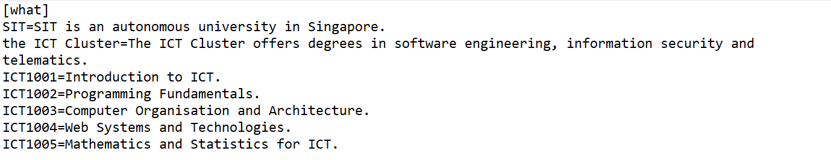
Data Structure
Intent
Response
Entity
Config.ini

Slide 8
Knowledge
Read & Put
Intent
Response
Entity
Config.ini
Get
Write
Reset

Slide 9
Data Structure
Read & Put
Entity
Response
*Next
Entity
Response
*Next
Entity
Response
*Next
Entity
Response
*Next
Entity
Response
*Next
Config.ini
Node
Node
Node
Node
Node

Slide 10
Data Structure
Read & Put
What
Entity
Response
*Next
Entity
Response
*Next
Entity
Response
*Next
Entity
Response
*Next
Entity
Response
*Next
Config.ini
Node
Node
Node
Node
Node

Slide 11
Data Structure
Read & Put
Where
When
What
Who
Why
How
Node
Node
Node
Node
Node
Node
Node
Node
Node
Node
Node
Node
Config.ini

Slide 12
Data Structure
Read & Put
Where
What
Node
Node
Node
Node
Data Structure
How
Who
Config.ini
Node
Node
Node
Node
Why
When
Node
Node
Node
Node

Slide 13
Read & Put
Where
Check for intent
Why
How
When
Who
Data Structure
Data Structure
What
Node
Node
Node
Node
Node
Node
Node
Config.ini
Node
Node
Node
Node
Node
Small Talk
Question
Commands

Slide 14
Check for intent
Data Structure
Small Talk
Question
Commands

Slide 15
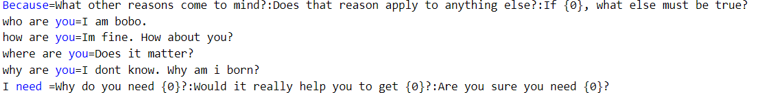
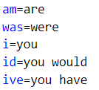
Check for intent
Data Structure
Small Talk
Entity
Response
Script.ini
Reflect.ini
Entity
Response
Question
Commands

Slide 16
Check for intent
Data Structure
Small Talk
I need
reflect.ini
smalltalk.ini
User Input: I need you
Question
Commands

Slide 17
Check for intent
Data Structure
Small Talk
User Input: I need you
smalltalk.ini
reflect.ini
I need
Why do you need {0}? :Would it really help you to get {0}?
Question
Commands

Slide 18
Check for intent
Data Structure
Small Talk
User Input: I need you
you
smalltalk.ini
reflect.ini
I need
Why do you need {0}?
Question
Commands
Would it really help you to get {0}?

Slide 19
Check for intent
Data Structure
Small Talk
you
User Input: I need you
me
smalltalk.ini
reflect.ini
I need
Why do you need {0}?
Question
Commands

Slide 20
Check for intent
Data Structure
Small Talk
you
me
User Input: I need you
me
smalltalk.ini
reflect.ini
me
Why do you need ?
Question
Commands

Slide 21
Check for intent
Data Structure
Small Talk
User Input: I need you
you
me
me
smalltalk.ini
reflect.ini
me
Bobo: Why do you need ?
Question
Commands

Slide 22
Check for intent
Data Structure
Question
Small Talk
SIT is an autonomous university in Singapore
“WHAT” link list
User Input: I need you
you
Script.ini
Reflect.ini
me
me
User Input: What is SIT
me
Bobo: Why do you need ?
Commands

Slide 23
Check for intent
Data Structure
Question
Small Talk
“WHAT” link list
User Input: I need you
you
Script.ini
Reflect.ini
me
me
User Input: What is SIT
SIT is an autonomous university in Singapore
me
Bobo: Why do you need ?
Commands

Slide 24
Check for intent
Data Structure
Question
User Input: What is SIT
“WHAT” link list
Small Talk
Bobo: SIT is an autonomous university in Singapore
Commands

Slide 25
Check for intent
Data Structure
Question
Commands
User Input: What is SIT
“WHAT” link list
Entity
Response
*Next
Entity
Response
*Next
Entity
Response
*Next
User Input: reset
Small Talk
Bobo: SIT is an autonomous university in Singapore
Node
Node
Node

Slide 26
Check for intent
Data Structure
Commands
User Input: reset
NULL
User Input: save

Slide 27
Check for intent
Data Structure
Commands
User Input: reset
NULL
Entity
Response
*Next
Entity
Response
*Next
Entity
Response
*Next
User Input: save
Node
Node
Node

Slide 28
Check for intent
Data Structure
Commands
User Input: reset
NULL
Intent
Entity
Response
*Next
Entity
Response
*Next
Entity
Response
*Next
User Input: help
User Input: save
Entity
=Response
Node
Node
new.ini

Slide 29
Check for intent
Data Structure
Commands
Intent
Entity
Response
*Next
Reset
Load
Exit
Help
Save
Entity
Response
*Next
Entity
Response
*Next
User Input: save
=Response
User Input: help
Entity
Node
Node
Small Talk
Question
new.ini
All commands

Slide 30
Check for intent
Action
Data Structure
Small Talk
Question
Commands

Slide 31

Check for intent
Action
Data Structure
Small Talk
Demo
Question
Commands

Slide 32
DEMO
Check for intent
Action
Data Structure
Small Talk
Question
Commands

Slide 33
Read & Put
Where
What
Node
Node
Node
Node
How
Who
Config.ini
Node
Node
Node
Node
Why
When
Node
Node
Node
Node

