Slide 1
edX: Programming for the Web with JavaScript
Ethan Hyatt and Nick Gonzalez
CSCI 326
Final Project

Slide 2
Project Overview
Primary Goal: To gain experience in web development using various current technologies and languages
Key Components:
Video Lectures
Homework Assignments

Slide 3
Current Status
Completed Tasks:
Homework 1 (HTML & CSS)
Homework 2 (JavaScript)
Homework 3 (jQuery)
Remaining Tasks:
Homework 4 (React)
Homework 5 (React)
Homework 6 (Node.js/ MongoDB)

Slide 4
Homework 1: HTML/CSS
Project: Refactoring an HTML page
Technologies: HTML, CSS
Applications:
Avoiding repeated code
Readability
QOL improvements for maintainers

Slide 5
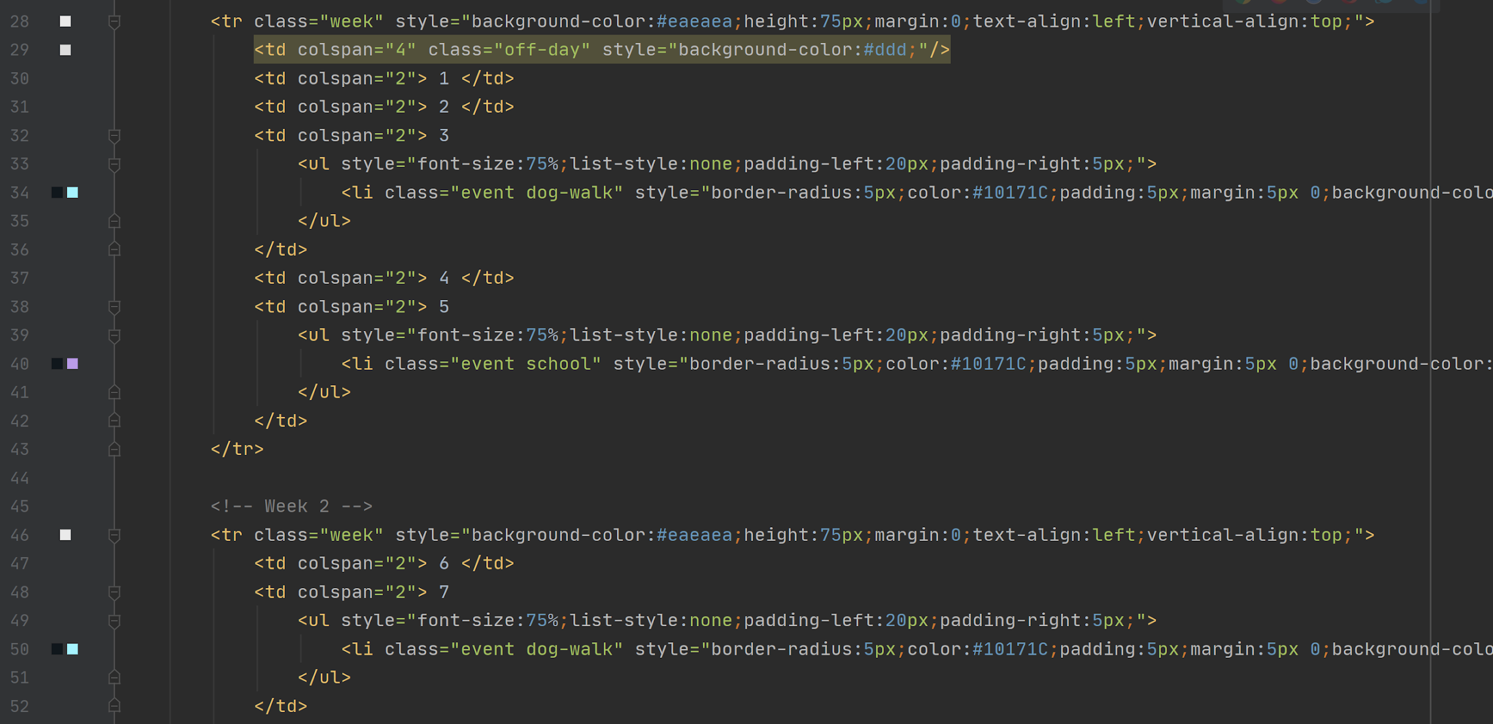

Slide 6
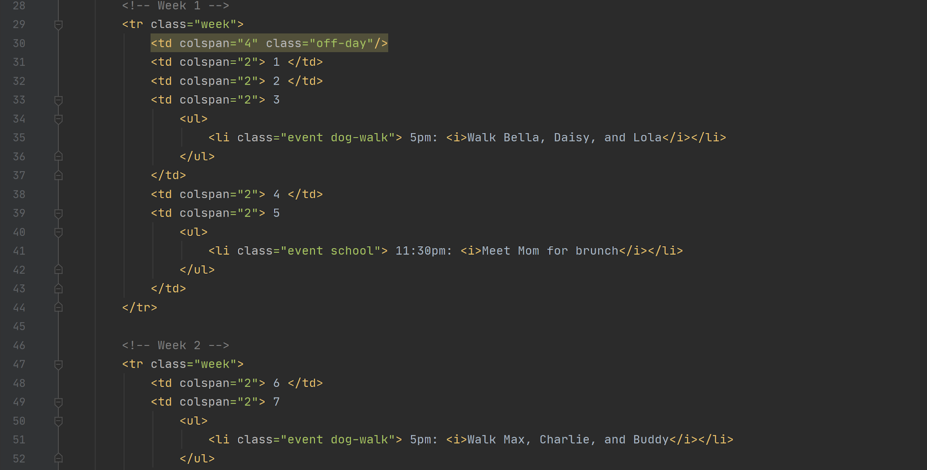

Slide 7
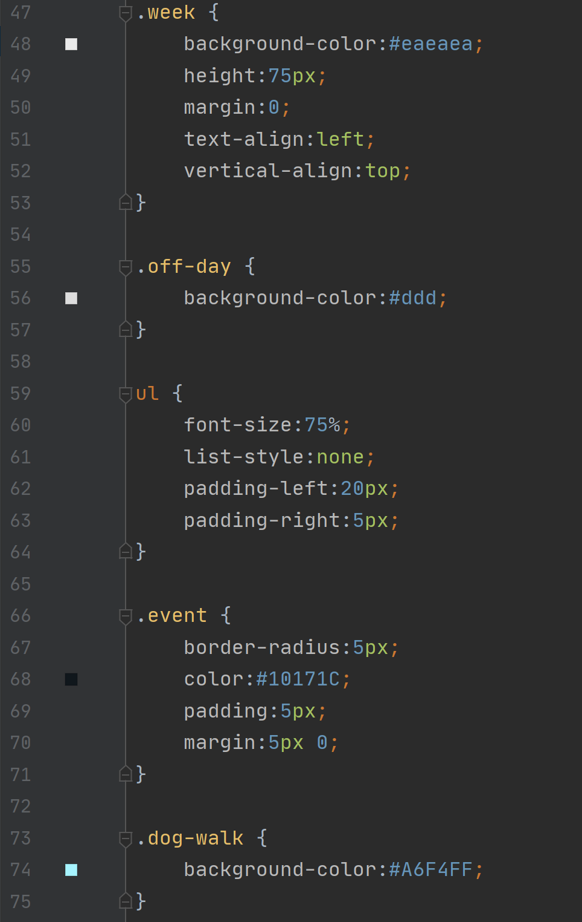

Slide 8
Homework 2: JavaScript
Project: Console functions for a pet store
Technologies: JavaScript
Applications:
Coding to Specifications
Correctness

Slide 9
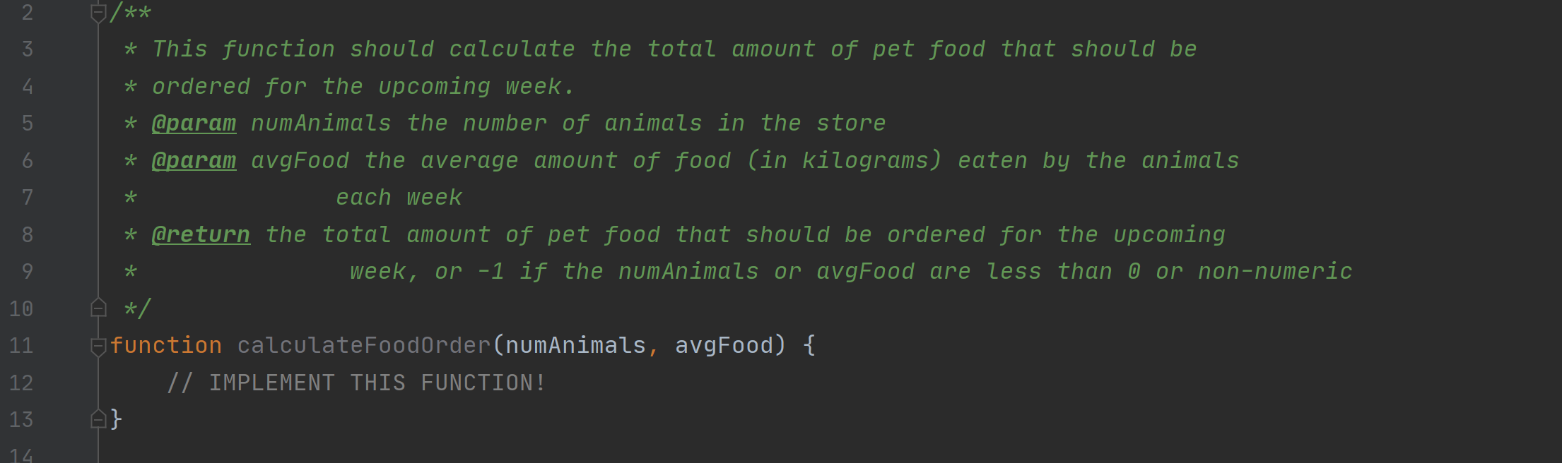

Slide 10
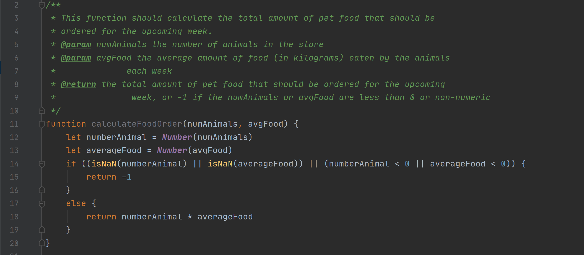

Slide 11
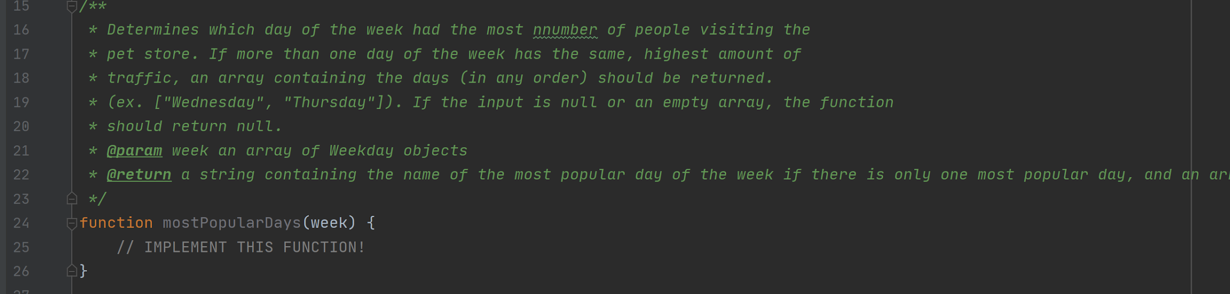

Slide 12
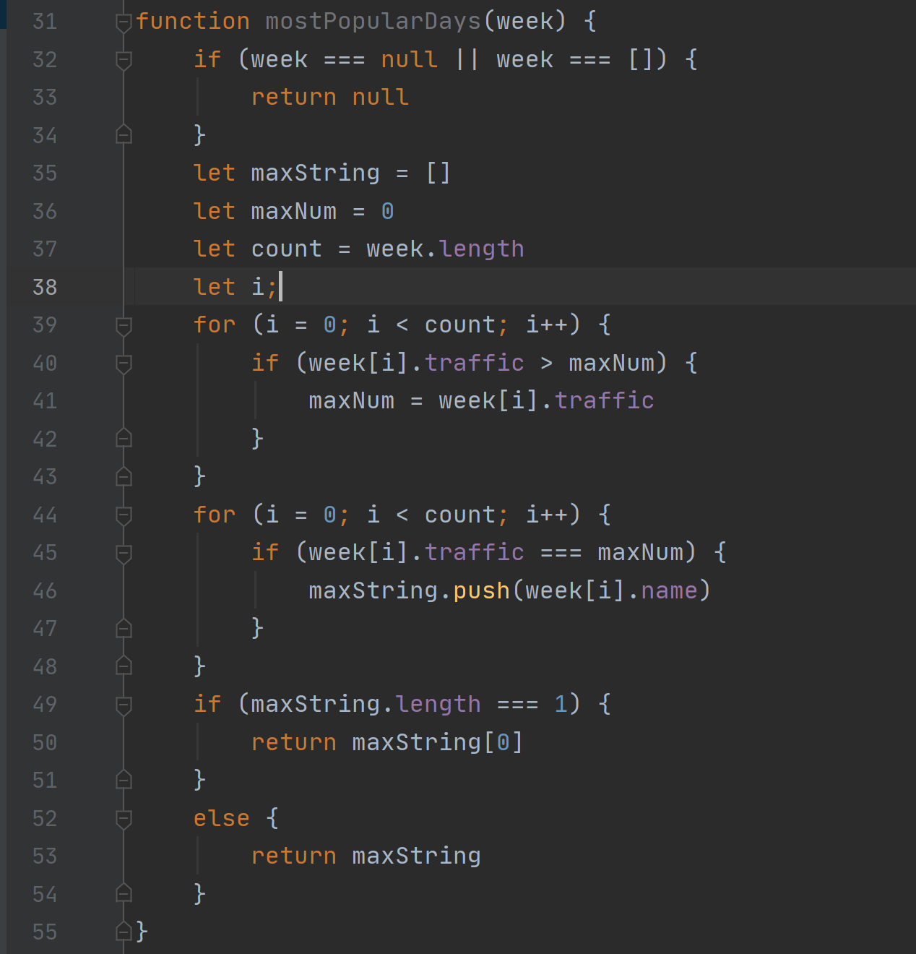

Slide 13
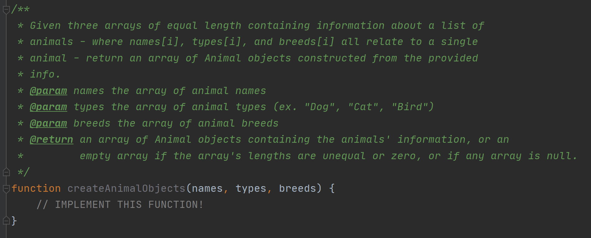

Slide 14
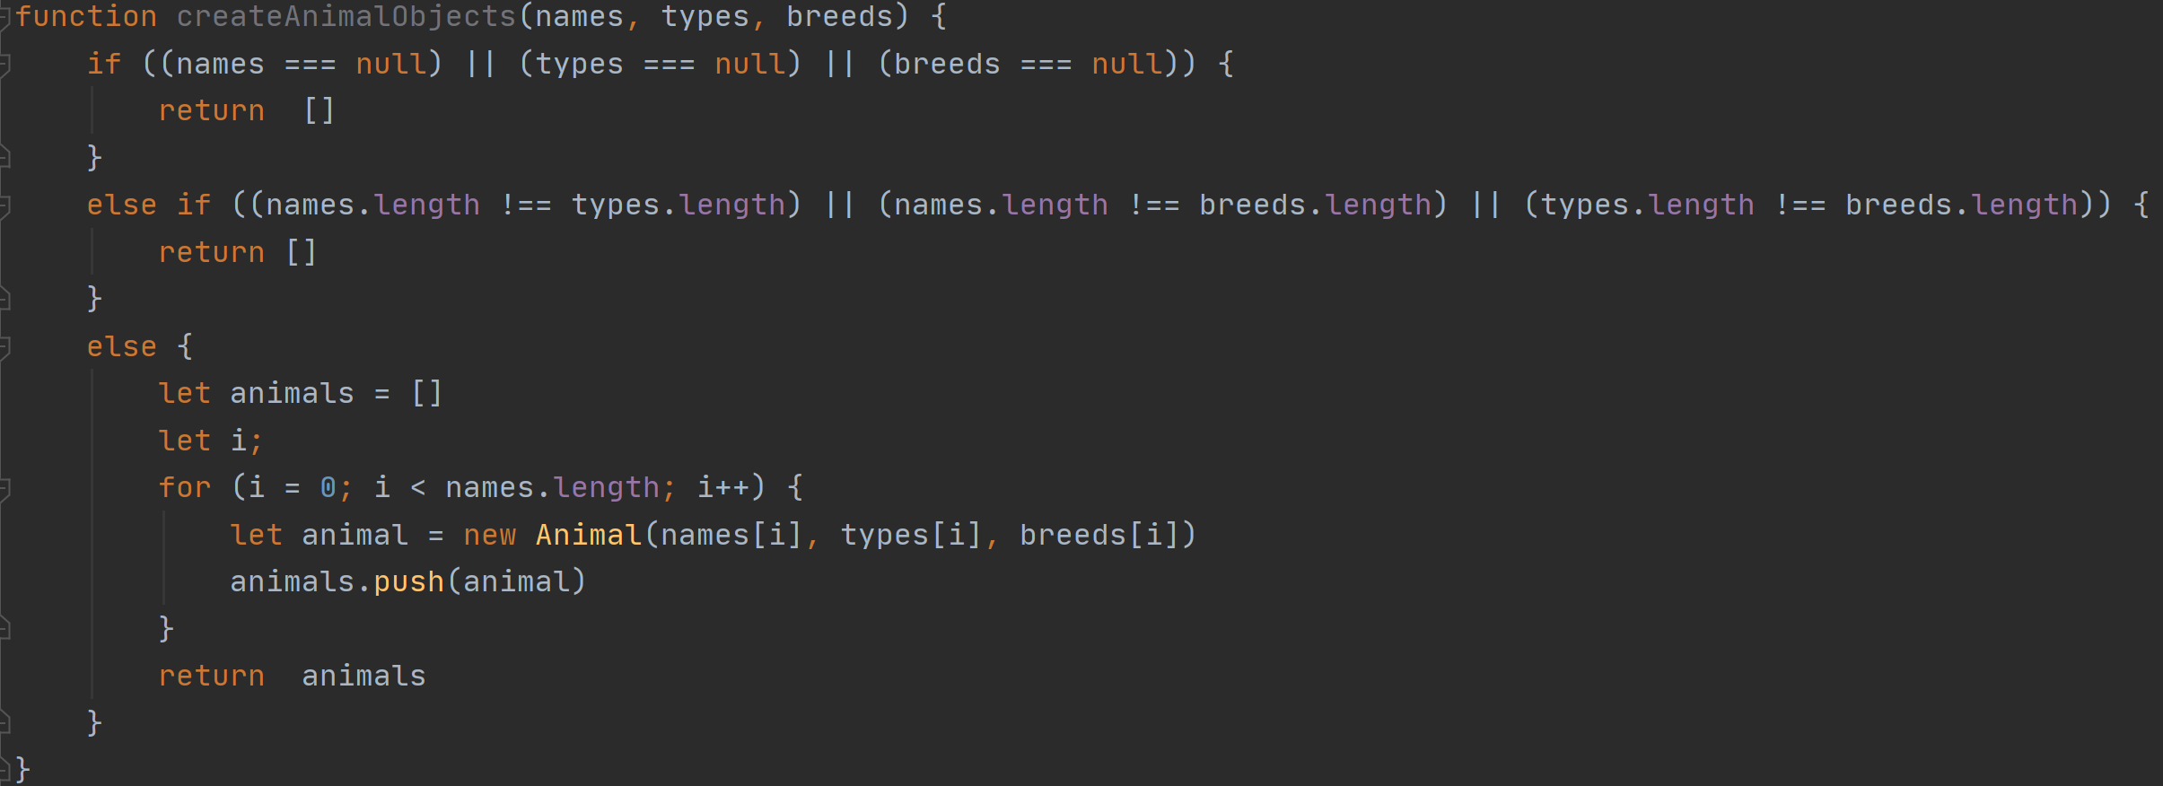

Slide 15
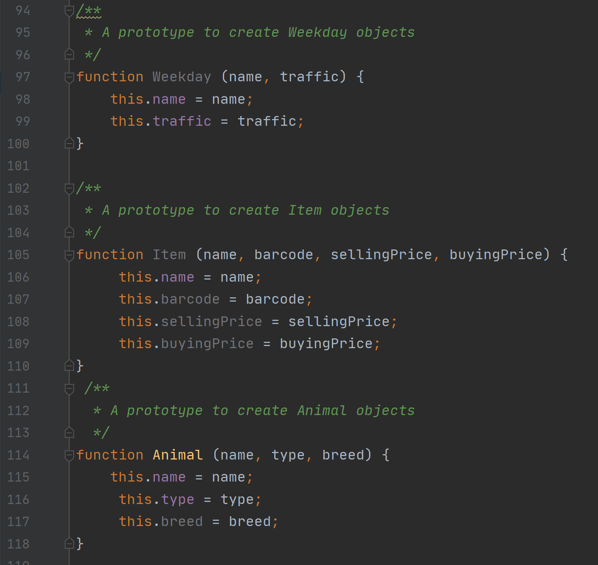

Slide 16
Homework 3: jQuery
Project: Calculator Web App
Technologies: jQuery, JavaScript, HTML
Applications:
Event-Driven Programming
Libraries

Slide 17
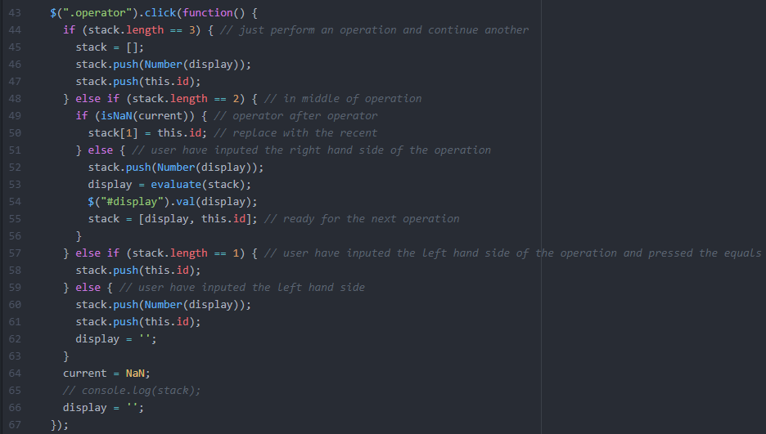

Slide 18
