Slide 1
How do borrowers find their banks The value of individuals in bank relationship formation
Marco Ceccarelli, Christoph Herpfer, Steven Ongena

Slide 2
Motivation
Starting point: Bank-borrower relationships are very important for both banks and firms
Influence the availability of credit for firms, the lending conditions & pricing
Are a transmission channel from the banks to the real economy
Open question:
How are these relationships formed?
What role do individual bankers play?
This paper:
Uses loan contracts between banks and firms to identify bankers and their client portfolio
Trace bankers across different employers

Slide 3
Empirical strategy – 1st part
Merge all syndicated loans (DScan), bonds underwriting, and SEOs (CapIQ)
Define the value of the client as the sum of all deals that the bank makes with this client over a given year
Define Initiation as an indicator for a new bank-borrower relationship (either first-time occurrence or no deals in the previous 5 years)
Compute the client portfolio of the banker by taking firm-bank interactions where the banker was one of the signatories
Rel_acq takes the value of one for every client that was in the portfolio of bankers at the old bank after the banker switches

Slide 4
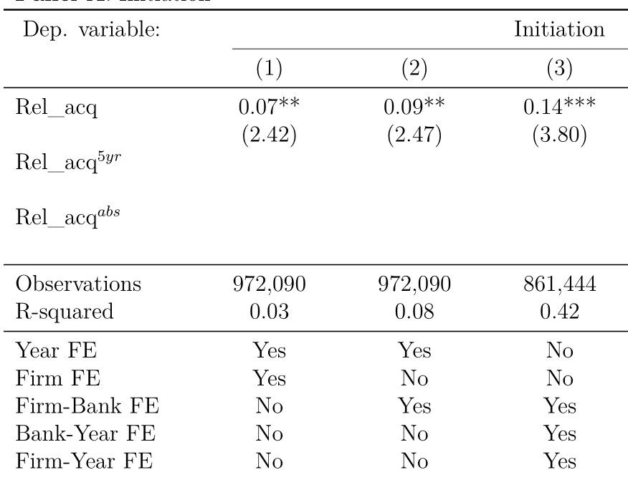
Main findings
After a banker switches, the probability of starting a new relationship with one of her old clients increases by 7% (from an unconditional probability of 5%)
Tight FE structure - within firm-bank comparison for firms where no personal relationship has been acquired

Slide 5
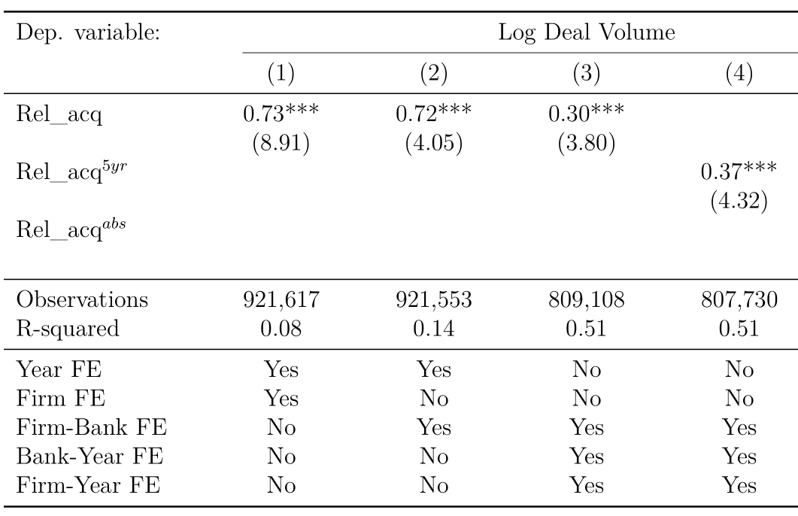
Main findings (ctd.)
The volume of deals increases for the firms where a personal relationship is acquired
Especially syndicated lending & bond under- writing

Slide 6
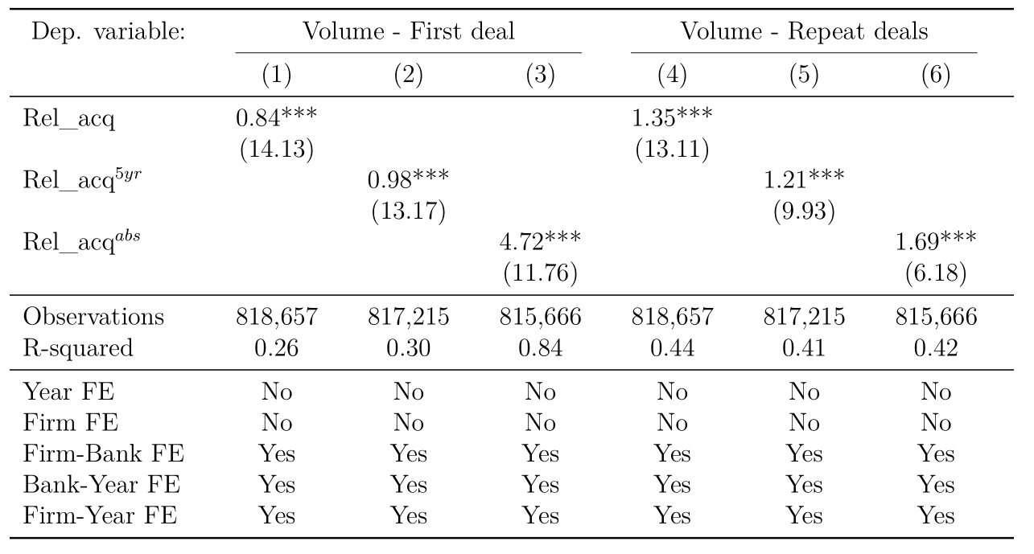
Main findings (ctd.)

Slide 7
Empirical strategy – 2nd part
Look at all SEC filings where you can see the identity of the banker
Bring the data at a bank – banker – year level
Identify the bankers that eventually get scooped and look at their client portfolio in the pre-switch period
Which bankers get scooped?
How many clients do they have when they switch?
How many deals do they close at the old bank with these clients?
For how long have they worked at the bank?
Is their client portfolio relatively more valuable?

Slide 8
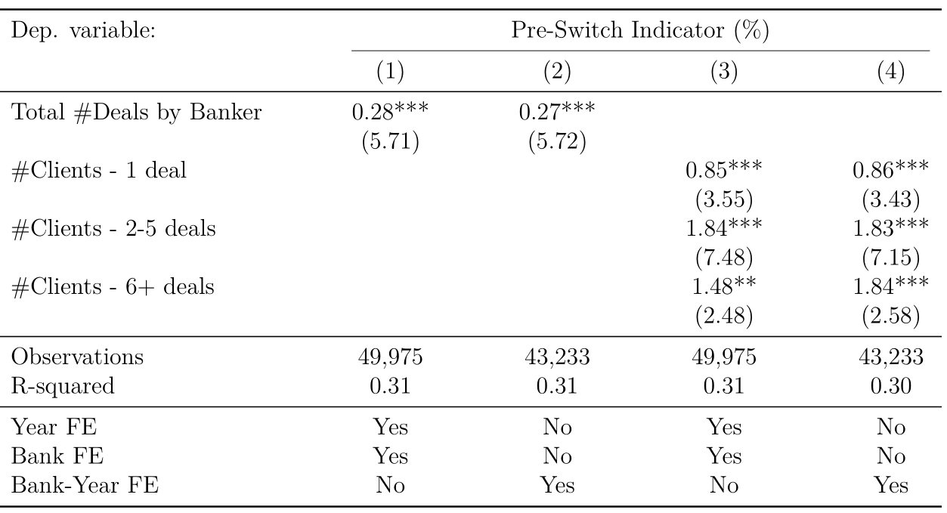
Which bankers get scooped?
Bankers that close more deals are more likely to be scooped

Slide 9
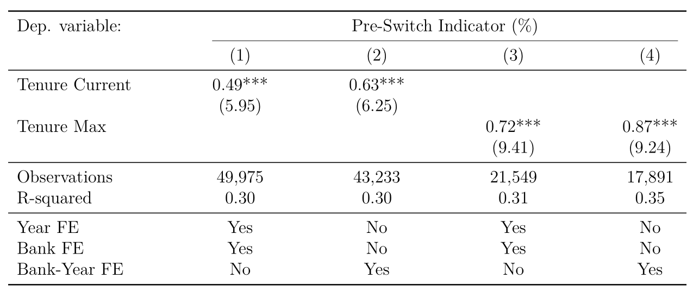
Which bankers get scooped?
Bankers that are more senior are more likely to be scooped

Slide 10
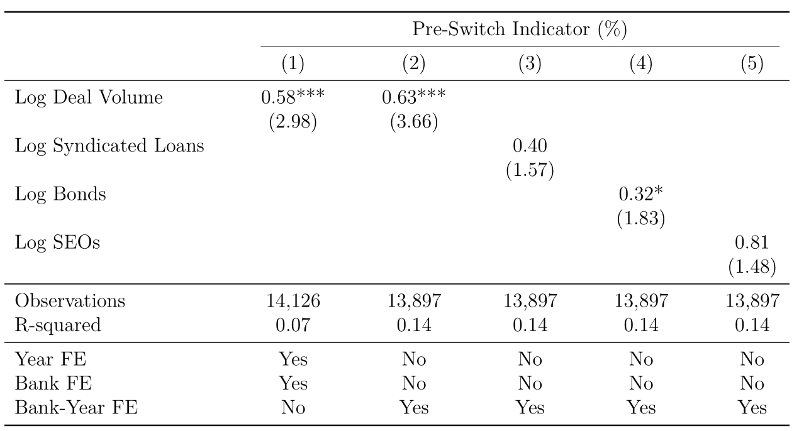
Which bankers get scooped?
Bankers that are worth more are more likely to be scooped
Notes:
No obs dops because you’re looking at only banks that can be matched with CIQ

Slide 11
Open points and next steps
Loan conditions for followers
Do the firms that follow the bankers obtain better or worse conditions post switch
Identification
Use the EU as a shock to European banks operating in the US
Use salary (changes & variable compensation) at top management level to proxy for negative salary shocks at banker level
Use time from last within-bank promotion as an instrument for proba of leaving
Write paper & submit to conferences ☺
Thanks for listening!

