Slide 1
 | a₁ | a₂ | a₃
b₁ |  |  | •
b₂ | •
b₃ |  | •

Slide 2
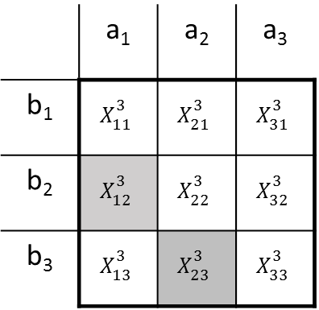
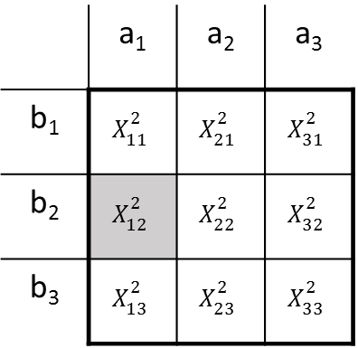
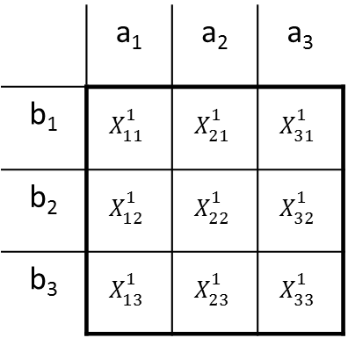
Variable capacity
 | a₁ | a₂ | a₃
b₁ | $$X_{11}^{1}$$ | $$X_{21}^{1}$$ | $$X_{31}^{1}$$
b₂ | $$X_{12}^{1}$$ | $$X_{22}^{1}$$ | $$X_{32}^{1}$$
b₃ | $$X_{13}^{1}$$ | $$X_{23}^{1}$$ | $$X_{33}^{1}$$
 | a₁ | a₂ | a₃
b₁ | $$X_{11}^{2}$$ | $$X_{21}^{2}$$ | $$X_{31}^{2}$$
b₂ | $$X_{12}^{2}$$ | $$X_{22}^{2}$$ | $$X_{32}^{2}$$
b₃ | $$X_{13}^{2}$$ | $$X_{23}^{2}$$ | $$X_{33}^{2}$$
 | a₁ | a₂ | a₃
b₁ | $$X_{11}^{3}$$ | $$X_{21}^{3}$$ | $$X_{31}^{3}$$
b₂ | $$X_{12}^{3}$$ | $$X_{22}^{3}$$ | $$X_{32}^{3}$$
b₃ | $$X_{13}^{3}$$ | $$X_{23}^{3}$$ | $$X_{33}^{3}$$

Slide 3
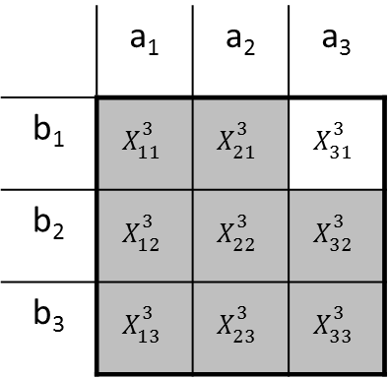
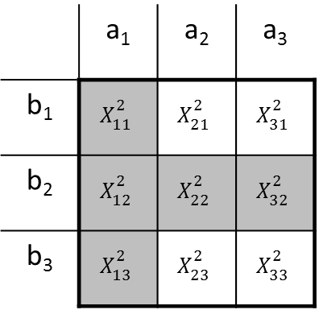
Fixed capacity
 | a₁ | a₂ | a₃
b₁ | $$X_{11}^{1}$$ | $$X_{21}^{1}$$ | $$X_{31}^{1}$$
b₂ | $$X_{12}^{1}$$ | $$X_{22}^{1}$$ | $$X_{32}^{1}$$
b₃ | $$X_{13}^{1}$$ | $$X_{23}^{1}$$ | $$X_{33}^{1}$$
 | a₁ | a₂ | a₃
b₁ | $$X_{11}^{2}$$ | $$X_{21}^{2}$$ | $$X_{31}^{2}$$
b₂ | $$X_{12}^{2}$$ | $$X_{22}^{2}$$ | $$X_{32}^{2}$$
b₃ | $$X_{13}^{2}$$ | $$X_{23}^{2}$$ | $$X_{33}^{2}$$
 | a₁ | a₂ | a₃
b₁ | $$X_{11}^{3}$$ | $$X_{21}^{3}$$ | $$X_{31}^{3}$$
b₂ | $$X_{12}^{3}$$ | $$X_{22}^{3}$$ | $$X_{32}^{3}$$
b₃ | $$X_{13}^{3}$$ | $$X_{23}^{3}$$ | $$X_{33}^{3}$$

Slide 4
Banker A
Banker B
Banking relationship strength
Banking relationship strength
Firm 1
Firm 1
Unconditional likelihood of alliance

Slide 5
Firm A
Banker 2
Firm C
Firm B
Banker 1
Banker 3
Banker network

Slide 6
Firm C
Firm network
Firm B
Banker 2
Firm A
Firm D
Banker 1
Banker 3
Banker network

Slide 7
Firm B
Firm network
Banker 2
Firm C
Firm A
Banker 1
Banker 3
Banker network

Slide 8
Bank
$
Banker
Information
Firm

Slide 9
Bank
$
Banker
Information
Firm A
Firm B
Collaboration
Alternative explanations
Industry effects?
Geographic proximity?

Slide 10
Bank a
Bank b
$
$
Banker 1
Banker 2
Information
Firm A
Firm B
Collaboration

Slide 11
Bank a
Bank b
$
$
Banker network
Banker 1
Banker 2
Banker 3
Information
Information
Firm A
Firm network
Firm B
Collaboration

Slide 12
t = 0
Banker network
Banker 3
Banker 2
Banker 4
Banker 1
Prior relationship
Prior relationship
Prior lending
Prior lending
Prior lending
Prior lending
Firm B
Firm C
Firm A
Firm D
Potential collaborations
Firm network

Slide 13
t = 1
Banker network
Banker 3
Banker 2
Banker 4
Banker 1
Prior relationship
Prior relationship
Prior lending
Prior lending
Prior lending
Prior lending
Firm B
Firm C
Firm A
Firm D
Potential collaborations
Firm network

Slide 14
t = 1
Banker network
Banker 1
Banker 2
Banker 3
Prior relationship
Prior relationship
Prior lending
Prior lending
Prior lending
Firm B
Alliance
Alliance
Firm A
Firm C
Potential alliance
Firm network

Slide 15
Bank
$
Banker
Information
Firm A
Firm B
Collaboration
Bank a
Bank b
Bank a
Bank b
$
$
$
$
Banker 1
Banker 2
Banker 1
Banker 2
Banker 3
Information
Information
Information
Firm A
Firm B
Firm A
Firm B
Collaboration
Collaboration

