Slide 1
Pal System Block Diagram
V_{s}
27MHz
Receiver
antenna
V_{s}
Bluetooth
PIC
board
V_{s}
Motor
servo
RS232
GIO
MPLAB
ICD2
GIO
Remote/Autonomous
V_{s}
ICD2
V_{s}
Steer
servo
GIO
GIO
7.2V NiMH
PWR
V_{s}
SPI
ADC
GIO
GIO
Pan
servo
7805
V_{s}
CS
MAX232
US-TX
Ultrasonic
Transmitter,
Omni-directional
Pre-Amp
gain
Ultrasonic
Receiver,
Directional, Panning
US-RX
3 SPI

Slide 2
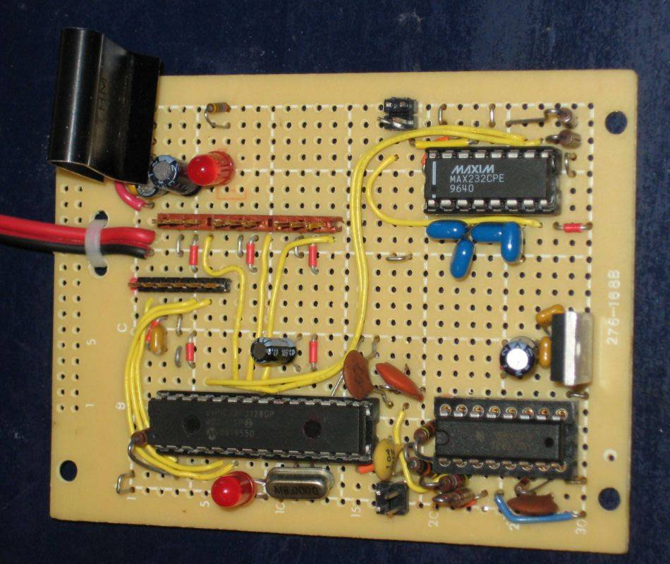
Pal Rover1 Board
5V
Trx
Str Thr Pan
ICSD
3.3V
dsp33FJ128GP802
TLV2775
Rcv

Slide 3
Pal Timer Allocation
Timer 1: 40KHz Ultrasonic Signal
Called every 12.5uS, each phase of sq wave
Enabled by Timer 4, every 100mS
Can Burst pulses, if desired
Timer 2: RC Servo Control
20mS cycle, 3 channels, always on
Timer 3: ADC Acquisition Control
50uS, for 50mS, gives 1000 data points.
Timer 4: Main Control Loop
100mS, will be optimized later…
Initiates Ultrasonic pulses
Controls overall state machine

