Slide 1
The Dicomflex
Purpose:
It is a Matlab (R2016b) based software template focusing on the creation of tools for systematic, similar image processing of image stacks (e.g.: CT, MRI, …).
Main Benefits:
quick creation and high grade of freedom in defining user input, image processing and result generation (Xls, etc.).
similar appearance (Gui) of developed tools
Additional Benefits:
undo
contour tracking
image zoom
segmentation methods
curve fitting methods
systematic version handling to update session files
automatic session saving
Image processing functions are not the focus of the framework itself. However, processing libraries or regular Matlab functions can be used to realize processing needs.
Content:
The framework consists of a predefined, yet adaptable GUI, which is similar for every developed tool. Menu bar may be modified as well as GUI element callback methods. A simple class hierarchy and two configuration files separate clearly between framework and application specific parts of the Dicomflex.
Addresses to people that:
have little to medium Matlab knowledge
know how object orientation works
work with medical images
have systematic image processing needs in the medical research setting

Slide 2
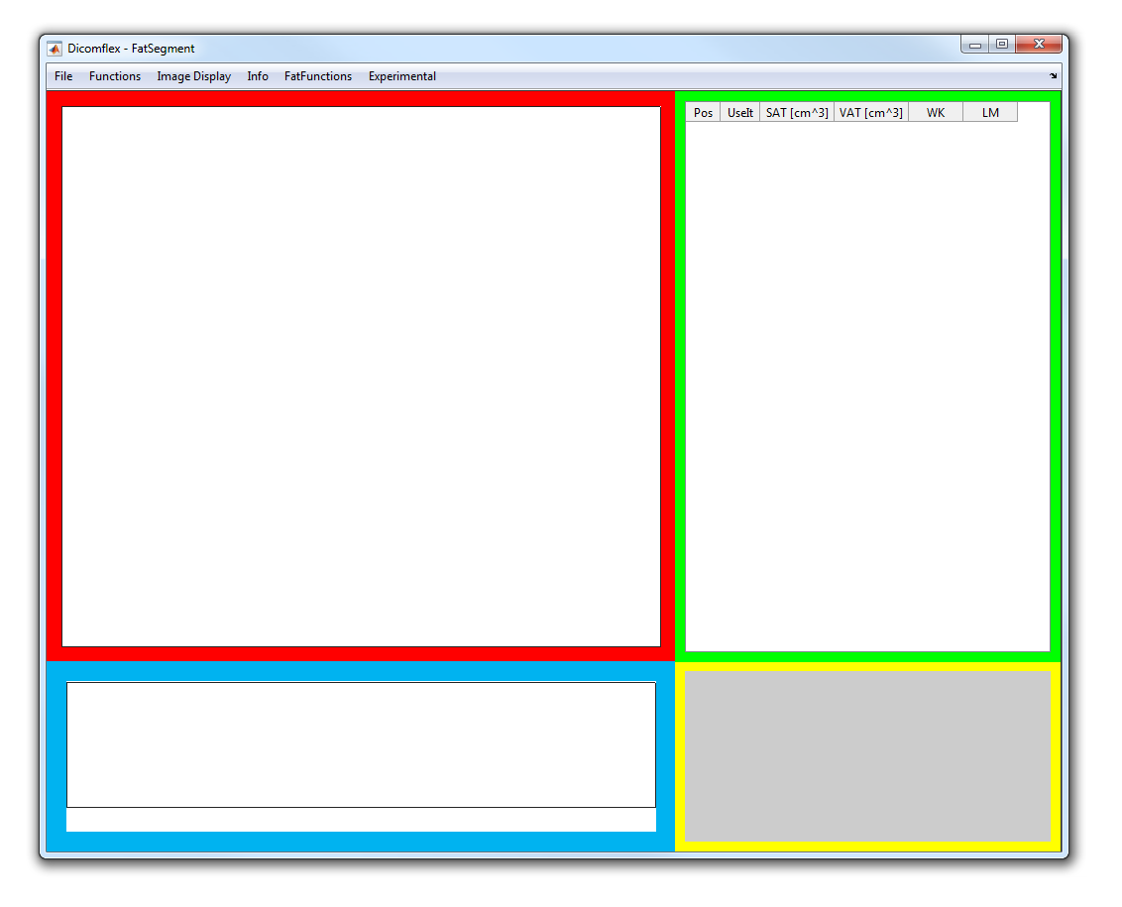
User Interface
Menu Bar
ImageArea
TableArea
GraphArea
TextArea
Table Area:
Each table row represents an image or images of a slice. Columns may vary regarding the application and may display „slice location“ or any result data.
Image Area:
display of currently selected slice
Graph Area:
display of e.g. histograms, data values as graph, fit functions, …
Text Area:
any kind of text. E.g. detailed information of the selected slice.

Slide 3
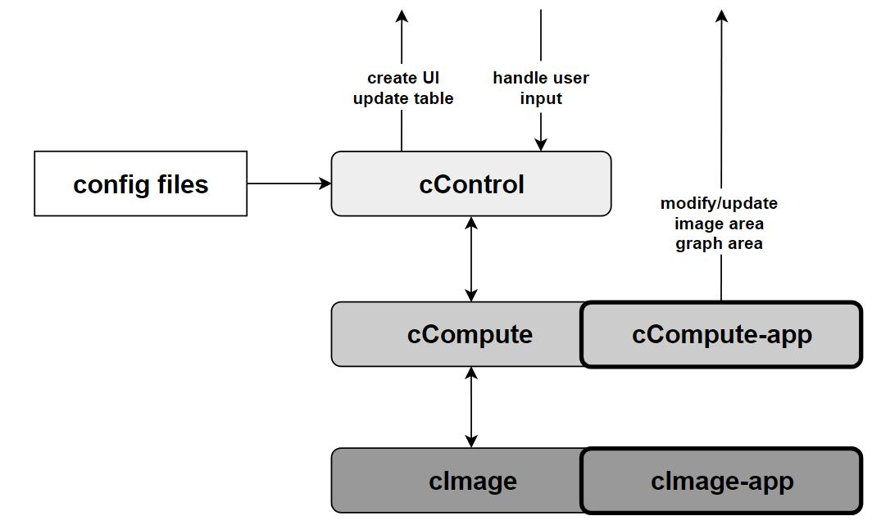
Software Structure
GUI
General Information:
Classes, methods, objects and properties are indicated by a leading prefix c, m, o and p respectively.
Besides the illustrated Classes there exists a class cBoundary.
All defined properties and methods are described in the Matlab code files.

Slide 4
Software Structure
GUI
Classes:
cControl: it is the main framework class. It is not meant to be changed when creating a new tool. It contains methods for GUI creation and user input callback catching and their distribution.
cCompute: each slice/image-data is hosted in a cCompute object. Thus each table row represents the data of a cCompute object. Besides image data and other source data it hosts generic methods (e.g.: image management, boundary/segmentation or fitting methods) or general method parts (e.g.: data loading/saving or GUI update methods) for application specific code.
cCompute-app: contains the mode specific code as well as mandatory mode specific methods called by cControl or cCompute class (e.g.: data loading/saving, GUI update/interaction methods). It is a child class of the cCompute class and thus has access to cCompute methods.

Slide 5
Software Structure
GUI
Config files:
two files in the JSON format host configuration values. They include slight GUI modification, menu bar definition and callback definitions mainly. Creation of those (cfg_framework.json and cfg_application_*.json) files is comfortably possible by using Matlab scripts (ConfigFramework_template.m and ConfigApplication_template.m).
The application config file is separated in two parts: „ mandatory app values” and „app specific values”. Description of entries is available in the *template.m files.

Slide 6
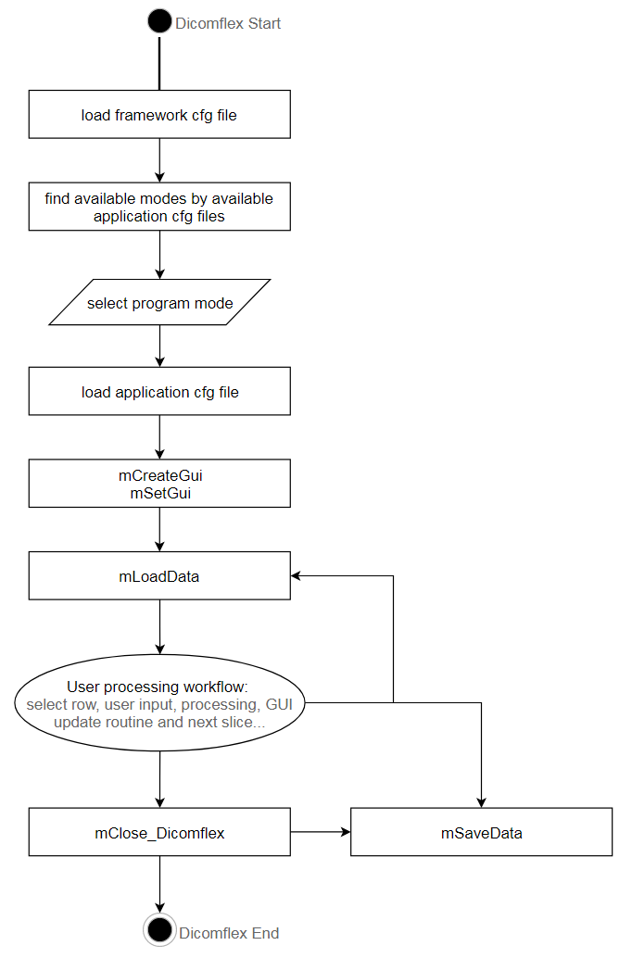
Software Workflow Dicomflex FlowChart
To start the Dicomflex from the Matlab console type cControl to create a cControl instance.

Slide 7
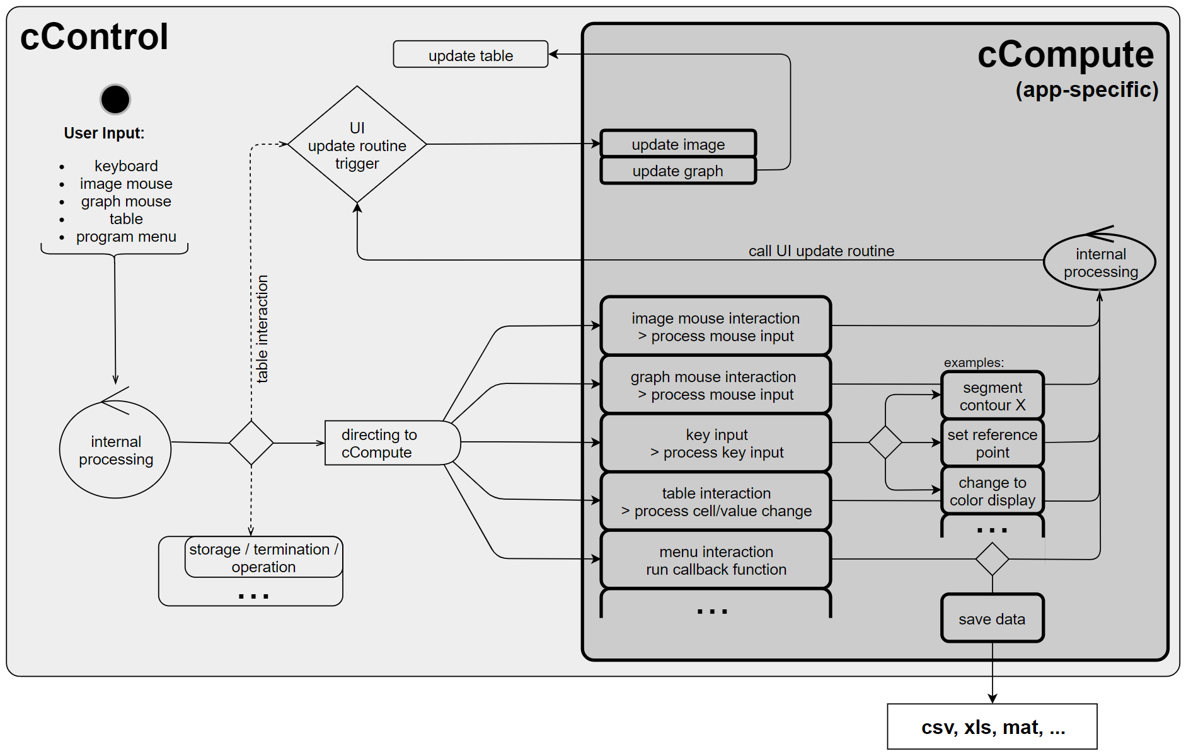
Software Workflow User Input Processing
All user input is caught by the cControl class. If not directly processed there (e.g. when selecting another slice in the TableArea), it is redirected to the appropriate method of the cCompute class. The called cCompute method might do some general things and might forward to the cCompute-app class. After processing the GUI-update routine is triggered by the cControl.
Out of framework definitions of GUI element callbacks by the cCompute-app directly to methods in cCompute-app are possible to e.g. create and control additional GUI elements available for a certain application only.

Slide 8
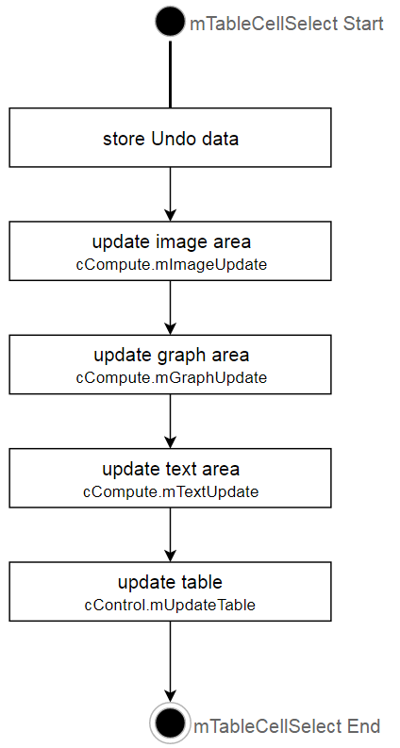
Software Workflow GUI update routine
The GUI update routine may be triggered from anywhere in the Dicomflex by calling the method cControl.mTableCellSelect

Slide 9
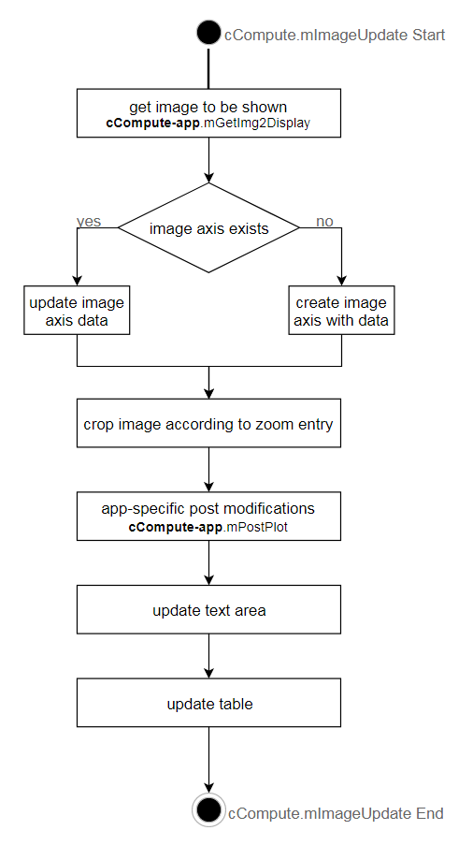
Software Workflow ImageUpdate
The image update is commonly called by the GUI update routine from cControl.mTableCellSelect. It is a framework method that calls two app-specific mandatory methods to be hosted in cCompute-app (mGetImg2Display and mPostPlot).

Slide 10
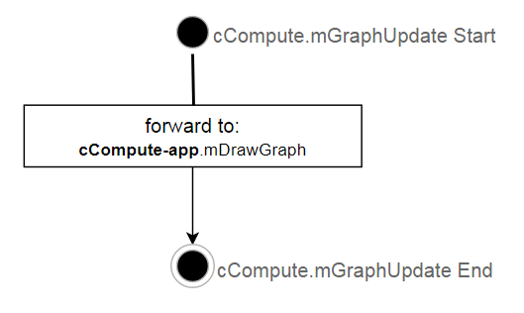
Software Workflow GraphUpdate
The graph update is commonly called by the GUI update routine from cControl.mTableCellSelect. It is directly forwarded by the cControl to the cControl-app method mDrawGraph.

Slide 11
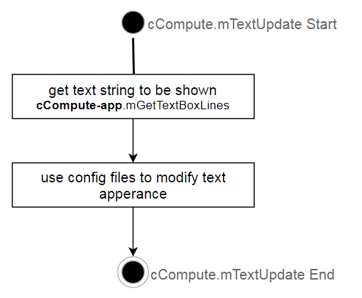
Software Workflow TextUpdate
The text update is commonly called by the GUI update routine from cControl.mTableCellSelect. It uses only one app-specific method from the cCompute-app class to get the string to be displayed.

Slide 12
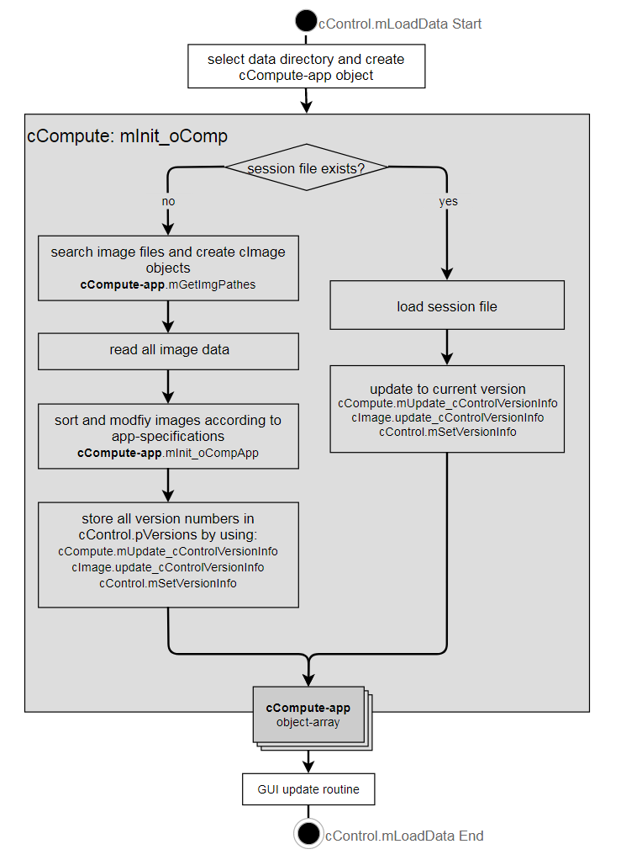
Software Workflow Load Data
mLoadData is called after program start as well after clicking the „Load data“ button of the menu bar. App-specification needs to be done in cCompute-app methods mGetImgPathes and mInit_oCompApp.

Slide 13
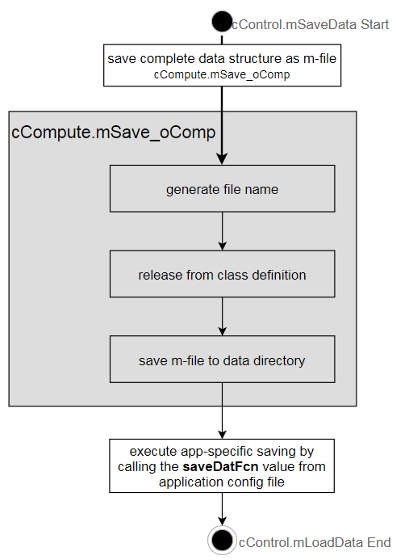
Software Workflow Save Data
mSaveData is called clicking the „Save data“ button of the menu bar. Automatic saving is repeatedly done after the time specified by the „datAutoSaveTime” value in the framework config. Additionally mSaveData may be chosen when clicking x-close at the program window. App-specification needs to be done in cCompute-app methods mGetImgPathes and mInit_oCompApp.

Slide 14
Software Workflow Version handling/SessionFile Update
Background info to Session files:
A session file consists of the following data:
saveDate - the creation date of the file
versions - a struct with all class-names, their versions and the corresponding updateFcn, as well as the version numbers of the two config files.
data - a struct array containing all oCompute-app elements as they where used in the application. They are disconnected from their class definition.
When changes where made to the Dicomflex (cControl, cCompute) and/or any application (cCompute-app) prior session files saved with a Dicomflex application might not be loadable. To overcome this, we chose the following handling of session files: If loading a session file in the cCompute.mInit_oComp, the update to current version is called by oComp = oComp.(['mUpdate_' class(oComp)])(data, saveDate);. Meaning, that in each cCompute-app class exists a method called mUpdate_cCompute-app, in which a switch-case is used to discriminate between versions of the classes used in the "old" session file. In the cases the update to the current version and the merging in the cCompute-app class as an object is done.

Slide 15
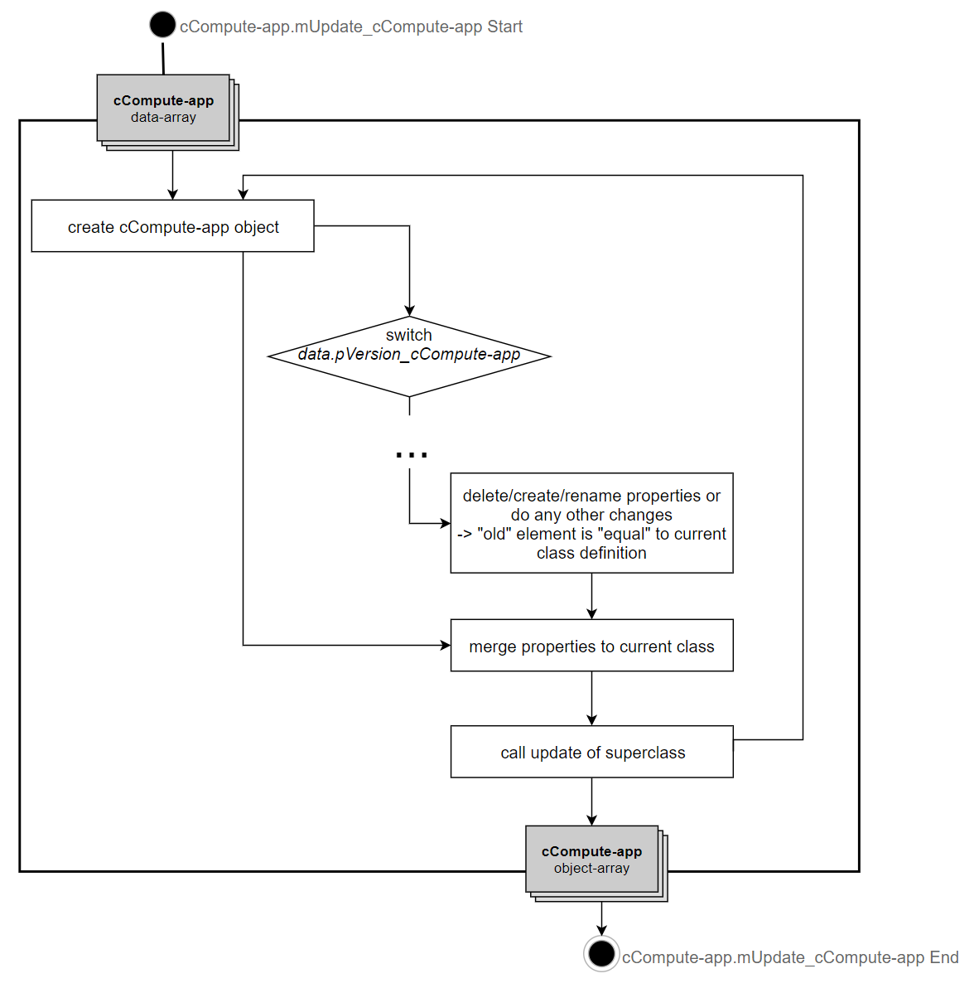
Software Workflow Versionhandling/SessionFile Update

Slide 16
App Creation overview
To create a unique, new application the following parts need to be modified:
cCompute-app.m file
customize mandatory methods called from cControl
mInit_oCompApp
mGetImg2Display
mPostPlot
mDrawGraph
mGetTextBoxLines
mTableEdit
mShowHotkeyInfo
mKeyPress
mKeyRelease
mImgAxisButtonDown
mImgAxisButtonMotion
mImgAxisButtonUp
mUpdate_oComputeT1Mapper or mUpdate_oComputeFatSegment
mTabDat2oCompApp
implement app specific properties and methods
applicationConfig.JSON: use ConfigApplication_template.m for creation.

Slide 17
App Creation cCompute-app.m
define application name. For this tutorial: Dummy
make copy of cCompute_template.m and rename to cComputeDummy.m
open in Matlab and rename classname at line 1: classdef cComputeDummy<cCompute
change property name pVersion_cCompute_template: pVersion_cComputeDummy
change method name of mUpdate_cCompute_template to: mUpdate_cComputeDummy
change object creation line in for loop to: oComp(i) = cComputeDummy;
change switch discriminator to: oCompTmp.pVersion_cComputeDummy;
change class creation method cCompute_template name to: cComputeDummy
Insert application specific code at all points indicated with %-%-% At this point it may also be good to generate the applicationConfig in parallel.
Note, that the cCompute_template.m:
uses sliceLocations value to find images and sort them to oComp objects in mInit_oCompApp
has some example code in commented form
use already existing cCompute-app.m files to reuse stuff (e.g. Boundary management or data fitting)

Slide 18
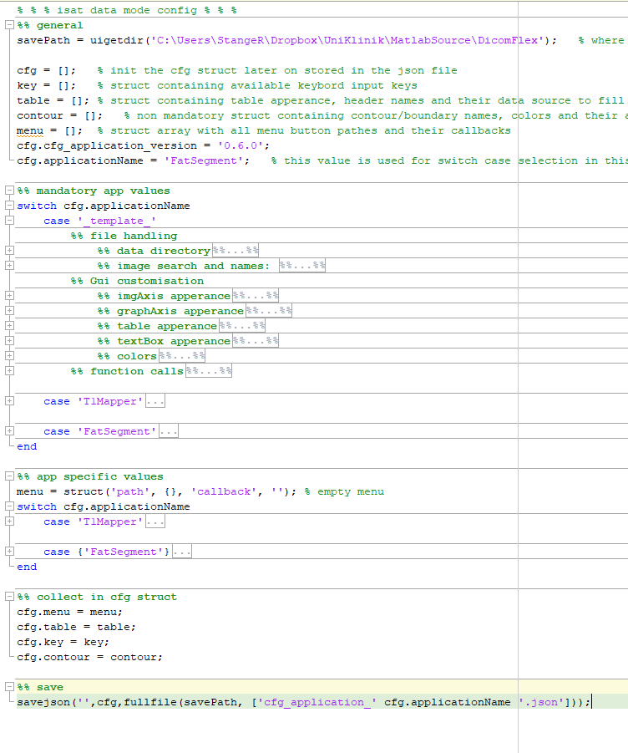
App Creation ConfigApplication_template.m
Modifications in the ConfigApplication_template.m are necessary in the mandatory app values section. A switch statement is used to discriminate between the different applications. To create a new config file do the following:
copy the _template_ case and rename it to the new application name Dummy
change the value cfg.applicationName to Dummy
customize all mandatory entrys to suite your application
additional entries may be stored in the switch statement app specific values under the Dummy case.
ask for storage path
define config file to be dreated
set mandatory entries
set additional entries
save the values to JSON file

Slide 19
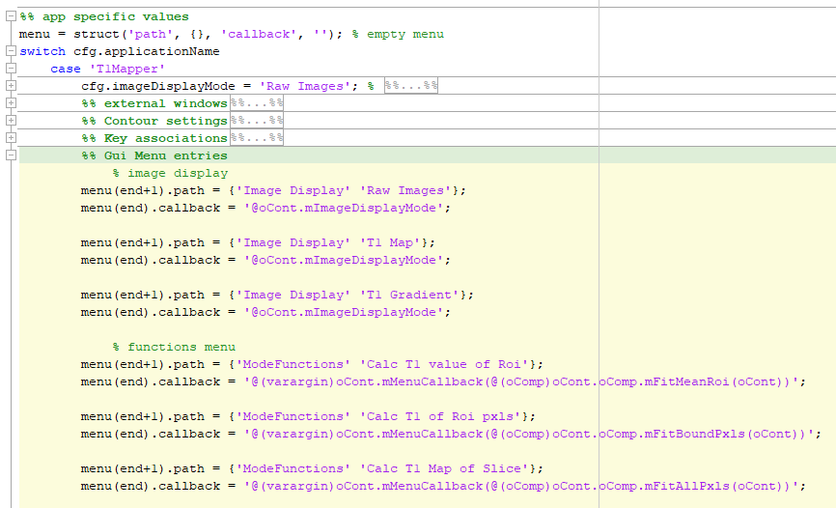
App Creation Menue Bar
There exist some menu bar entries defined in the framework config. Despite those it is possible to define more in the application config in a similar manner. To do so, use the ConfigApplication_template.m, in which all application configs are stored for creation of a config.json file. Each element of the struct array "menu" represents a menu bar entry. Each element contains a cell with strings called "path" defining the path of the menu bar button (e.g.: {'File' 'Load'} would create a button "Load" in the "File" menu). For each button exists a "callback" value stored per array element. It may directly point to a cCompute method or may be caught by the cControl.mMenuCallback method and be redirected there further.
Menu bar entries may be created and organized therewith easily. The callbacks simply need to be computable by Matlab.

Slide 20
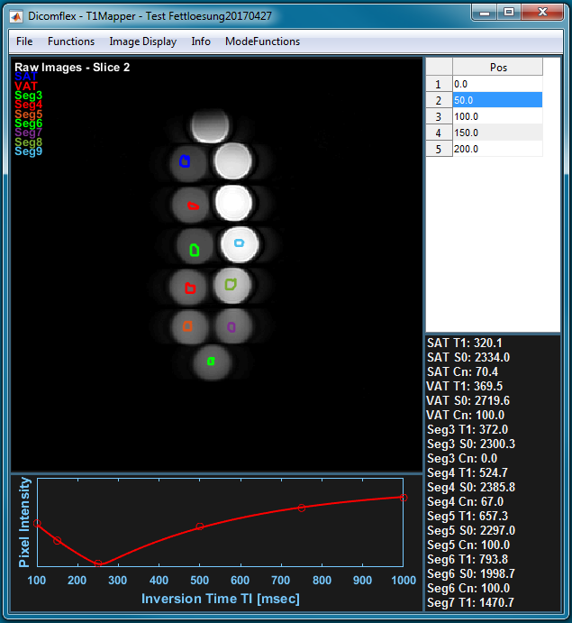
Sample Application T1Mapper
In the Git repository () you will find a phantom MRI data set. It consits of tubes filled with fatty emulsions from 0% to 100 % of fat.
0%
100%
5%
90%
10%
80%
20%
70%
30%
60%
40%
50%
You can either load the images by choosing “start new session” or load the existing dataset with already computed T1 maps in the T1Mapper mode of the Dicomflex. Fitting T1 values only makes sense for fat fractions of 50% - 100% as the fitting in this mode is limited to T1 values from 180ms to 4000ms.
Unfortunately the dataset is does not give good T1 values as the phantoms where not designed for T1 fitting. The T1 values are dramatically corrupted due to MR-artifacts.
Due to patient ethics it was not possible to upload a sample dataset of a patient were fitting and mapping would work very nice!

