Slide 2
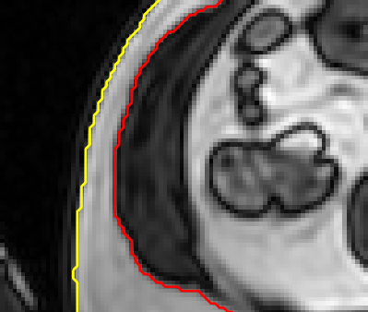
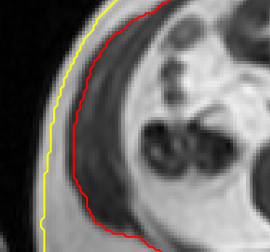
InPhase-OutPhase-Shift?!?!
outPhase
inPhase
Was ist nun echt und was soll genutzt werden?

Slide 3
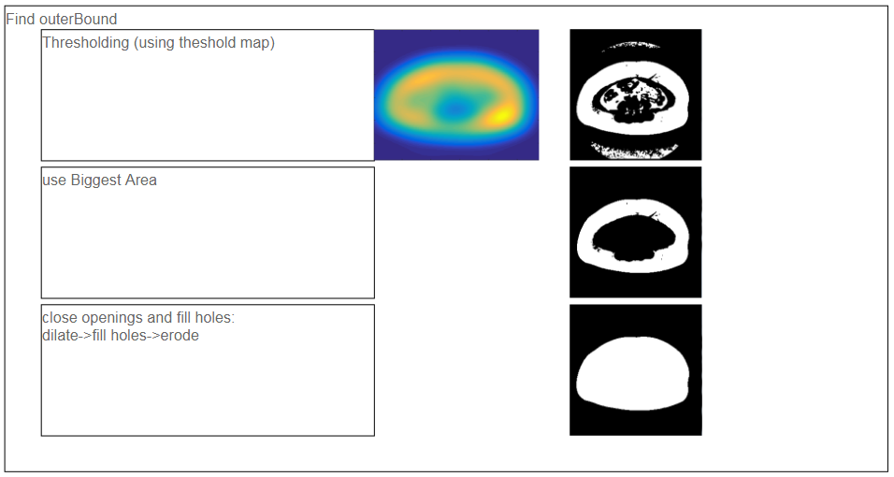
RS_BodyBounds – HowItWorks: OuterBound:

Slide 4
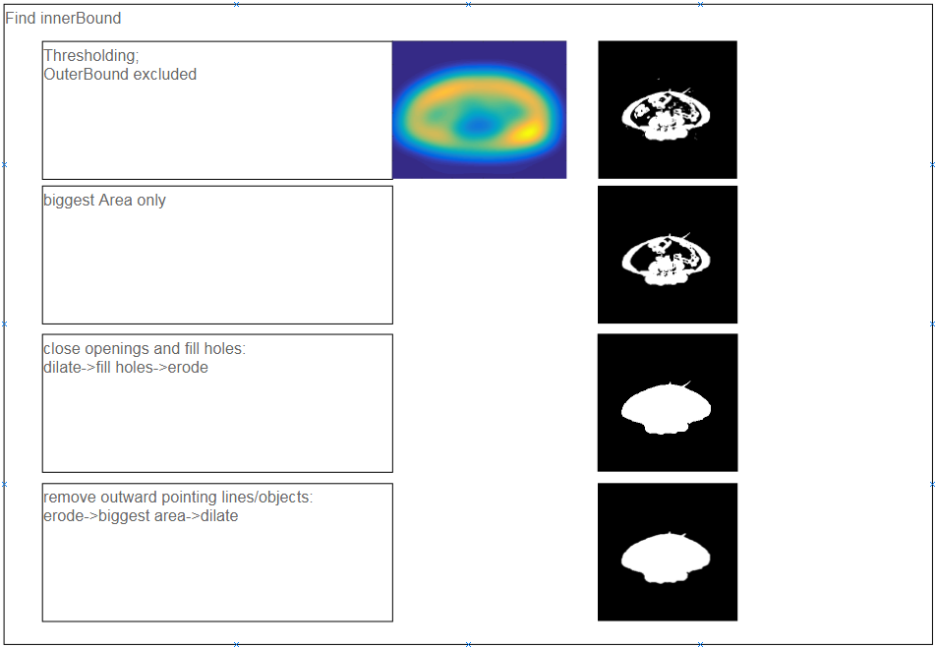
RS_BodyBounds – HowItWorks: InnerBound:

Slide 5
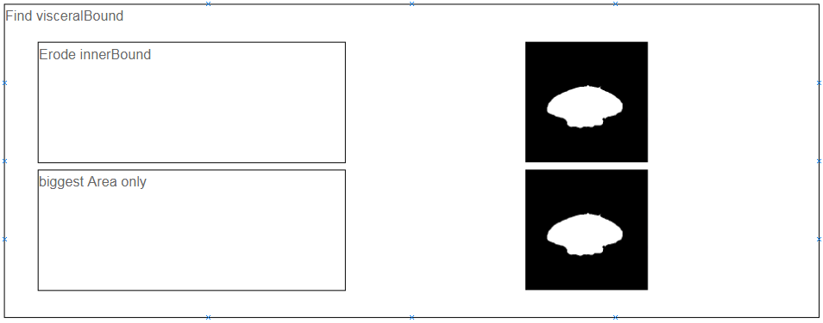
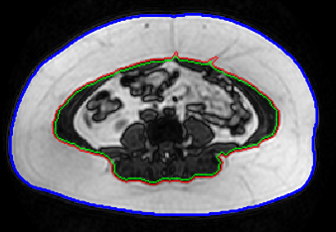
RS_BodyBounds – HowItWorks: VisceralBound:

Slide 6
RS_BodyBounds – HowItWorks: General:
Using the correct set of parameters is critical. The following parameters are currently changed to get good results:
outerBound:
thresholdMap creation:
windowSizeMultiplicator (comparable with a filter window size)
threshMultiplier (simply multiplying the thresholdMap)
innerBound:
thresholdMap creation:
windowSizeMultiplicator (comparable with a filter window size)
threshSensitivity (sensitivity value used by ‚adaptthresh‘ function)
threshMultiplier (simply multiplying the thresholdMap)
visceralBound:
none!

