Slide 1
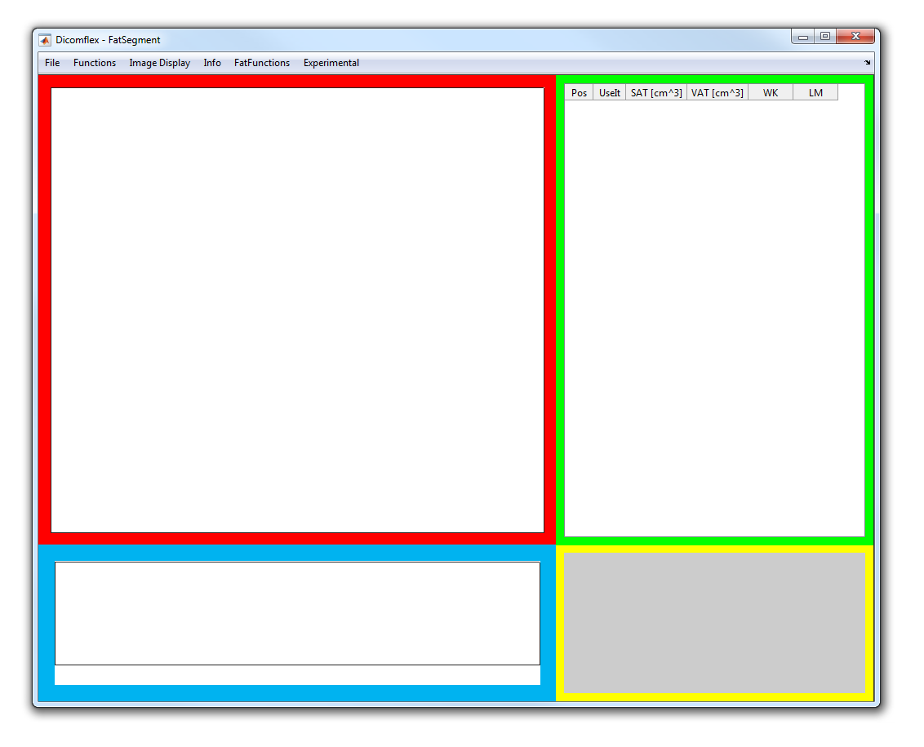
ImageArea
TableArea
GraphArea
TextArea

Slide 2
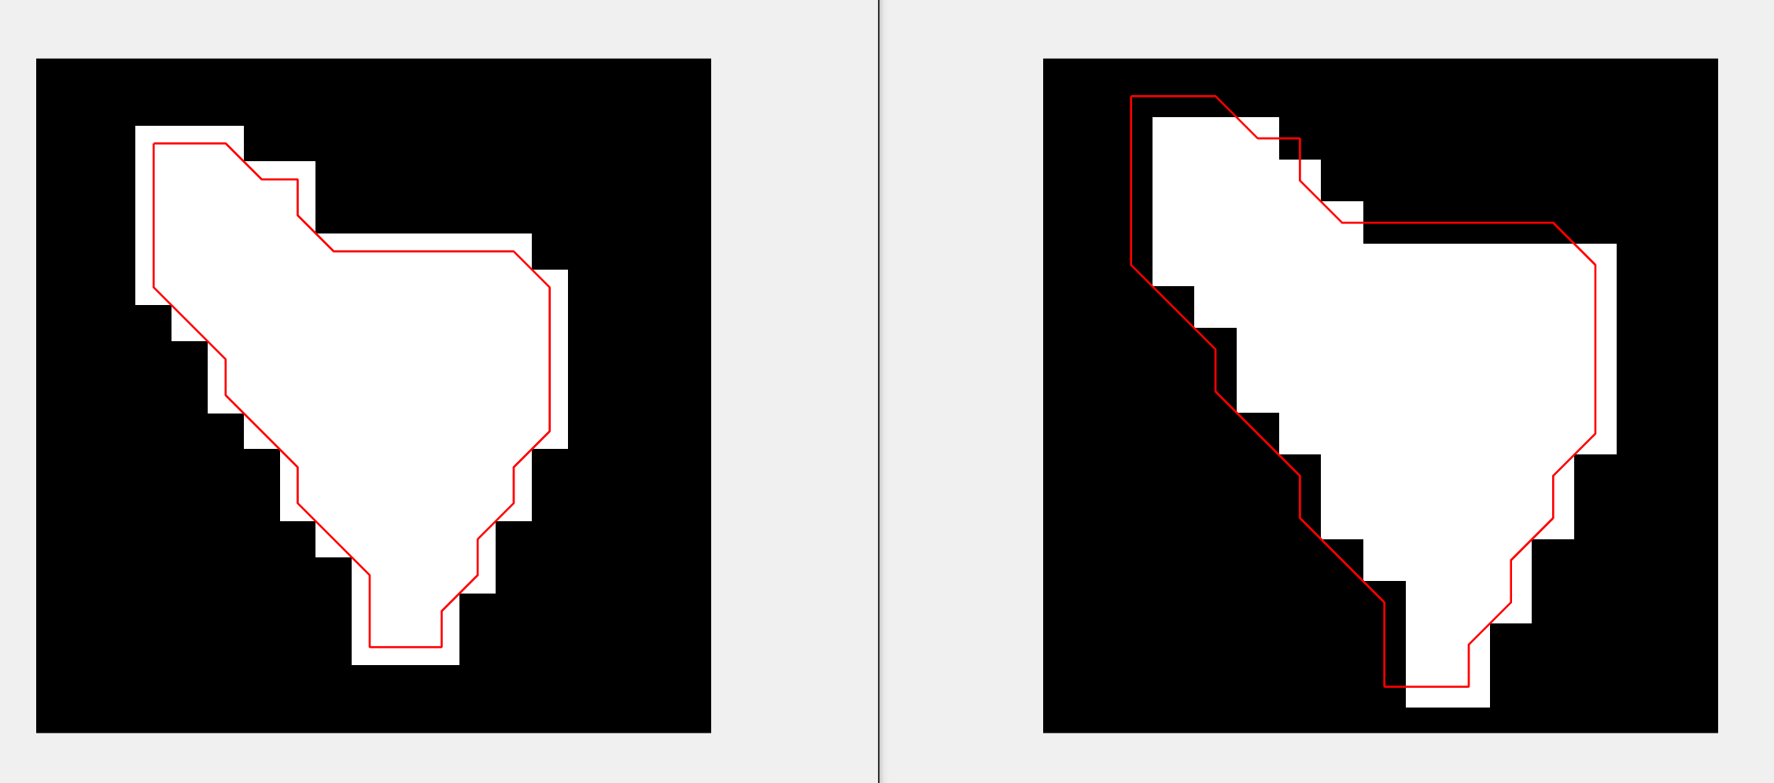
Create Mask of Coordinates:
Rolands Mask creation
boundary.getBoundMask
Matlabs Mask creation
polymask
OK
BAD

Slide 3
how to work with overlaping or non-equidistant slice locations of MRT-images for FatQuant

Slide 4
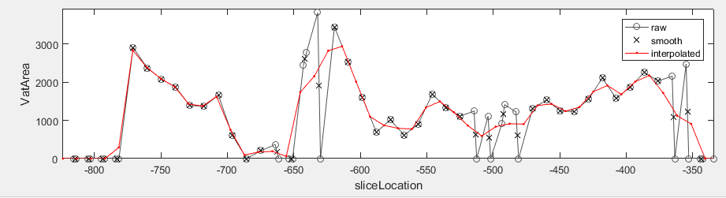
Raw data gets averaged by the DconvV2 function, which does a point wise window averaging
afterwards simple interpolation with the desired slice location points can be done

Slide 5
anatomic landmark issue:
Beispiel FemurKöpfe - FK
offset after interpolation
Img1
original offset
Img2
originally the FK lies in img3 and a little bit in img2. Thus the landmark is set on img3.
-> after interpolation, image3 lies exactly between img2 and img4. Thus the landmark-offset increased and img2 would now be the best choice for FK landmark.
Img3
Img3
Img4
FK (after interpolation)
FK (non interpolated images)
FK (real)

Slide 6
determine slice width:
${SliceWidth}_{Img1}=$ $\frac{{SliceThickness}_{Img1}}{2} + \frac{{SlicePos}_{Img2}−{SlicePos}_{Img1}}{2}$
${SliceWidth}_{Imgn}=\frac{{SlicePos}_{Imgn}−{SlicePos}_{Imgn−1}}{2}$ + $\frac{{SlicePos}_{Imgn+1}−{SlicePos}_{Imgn}}{2}$
. . .
Img1
Img2
Img3
Img4
ImgN-3
ImgN-2
ImgN-1
ImgN
${SliceWidth}_{ImgN}=$ $\frac{{SliceThickness}_{ImgN}}{2} + \frac{{SlicePos}_{ImgN}−{SlicePos}_{ImgN−1}}{2}$
code:
% find correct slice width (description available (drawIO)) for volume calculation
sliceWidth = diff(sliceLocNew);
sW1 = sliceWidth./2; sW1(end+1) = 0;
sW2 = sliceWidth./2; sW2 = [0 sW2];
sliceWidth = sW1+sW2;
% now special treatment for boundary images (1 and end)
sliceWidth(1) = sliceWidth(1)+str2num(d.dat(1).imgs(1).sliceThickness)/2;
sliceWidth(end) = sliceWidth(end)+str2num(d.dat(end).imgs(end).sliceThickness)/2;
% slice Width done!

