Slide 1
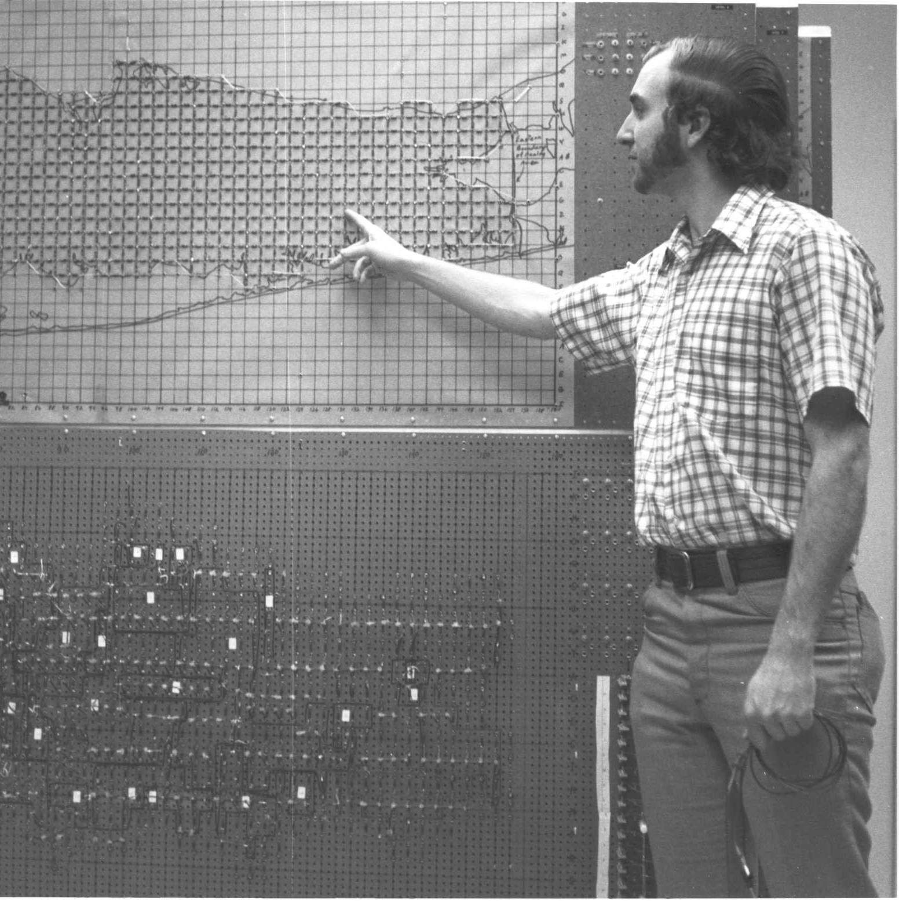
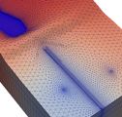
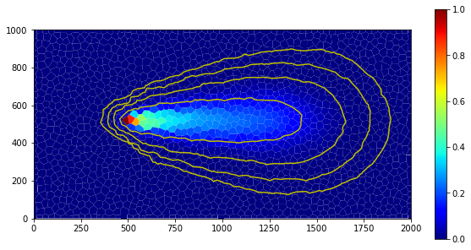
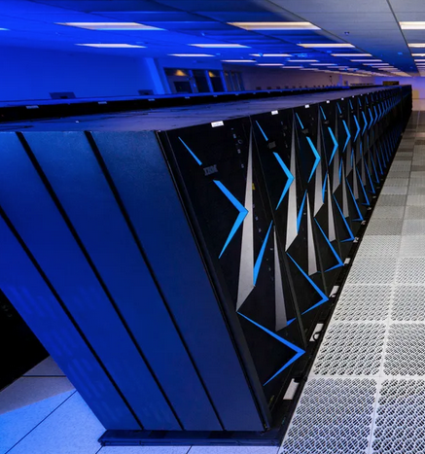


Welcome
Parallel MODFLOW Training Class, December 1st, 2023, Deltares, NL

Slide 2
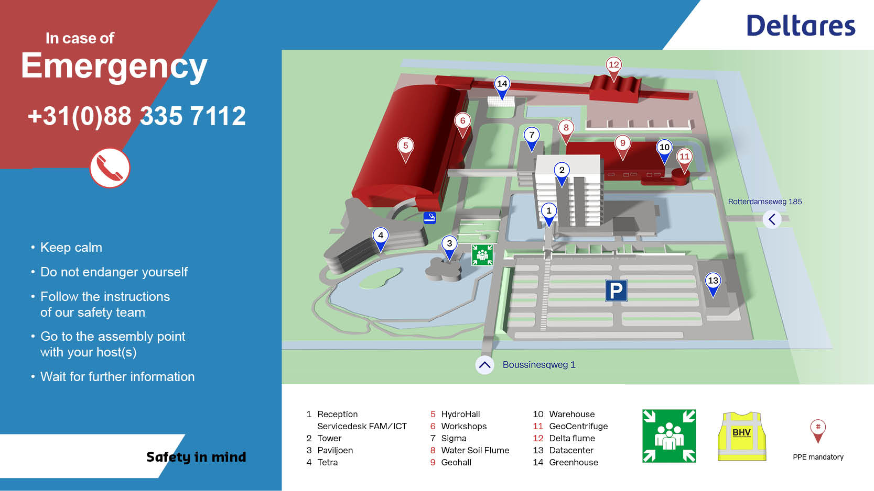

Slide 3
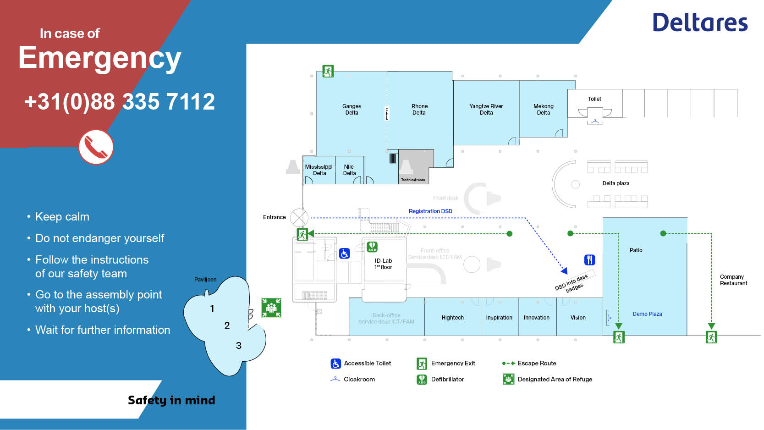

Slide 4
Introductions

Slide 5
WiFi
See email sent last Friday
Or, scan the QR code
Or, go to eduroam.deltares.nl
Pre-class Installations
E-mail about WSL
pixi installation from class github:
https://github.com/mjr-deltares/parallel-modflow-dsd23
Need laptop?

Slide 6
Badge
Please pick up your badge in the coffee break, if you haven’t already

Slide 7
Agenda
Overview of MODFLOW 6 and FloPy
Hands-on exercise I: Set up a FloPy model and run
BREAK (10:30-10:45)
Hands-on exercise I: Postprocess and partition a model
Hands-on exercise I: Running parallel MODFLOW 6
LUNCH (12:15-13:15)
Parallel MODFLOW 6: Context and Applications
Hands-on exercise II: Build and partition the watershed
BREAK (15:00-15:15)
Hands-on exercise II: Validate results and parallel performance
(Hands-on alternative: Run your own model in parallel)
Discussion and Wrap up (16:30-17:00)
DRINKS

