Slide 1
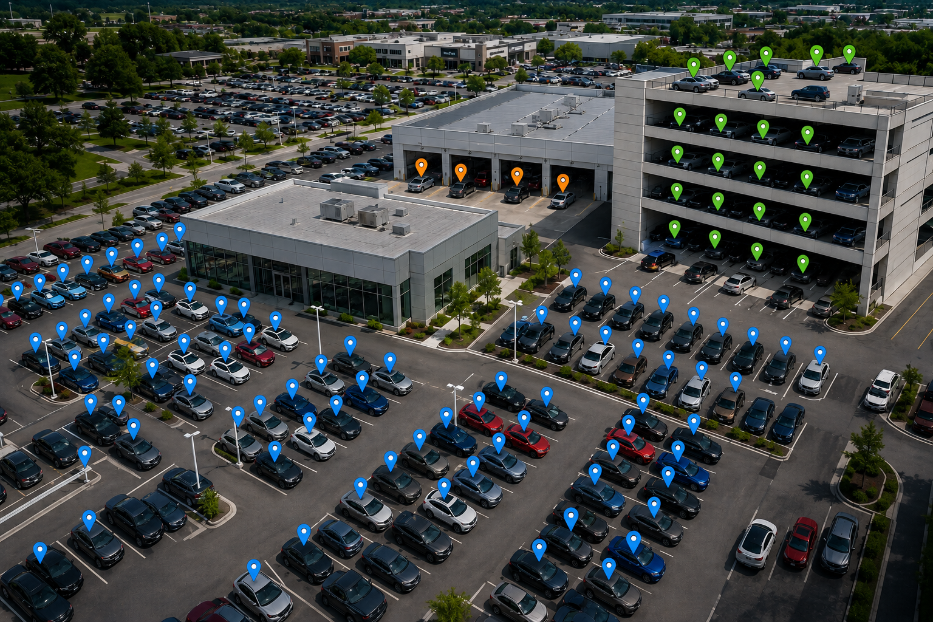

PARTNER KICKOFF · JULY 29, 2026
Mobile Dealer Data
× Ascent Dealer Services
Your focus product for the next six months.
We Find Keys & Cars™ mdd.io · 844-292-7110

Slide 2
WELCOME
You pick one product
every six months.
You picked ours.
TODAY
01
Who is MDD
02
Legacy GPS — the problems dealers already know
03
The FTC changed the math
That focus is exactly why this works — and why we're here with our whole playbook.
04
Removable by design
Today's job: give your team what you need to walk into a dealership and win the GPS conversation. Enough to sell with confidence — not so much it slows you down. The pricing guide in your hands covers the rest.
05
Reinsurance
06
Live system demo
MDD × Ascent Dealer Services
2

Slide 3
WHO IS MDD
Born at the world's largest dealerships.
250+
10+ yrs
0
dealerships on the platform
in market, built on dealer feedback
lost keys after install
One Bluetooth platform, three products:
Lot Management
Service & Recon Workflow
VehicleVault F&I
Real-time key & vehicle tracking — every unit, every key, multi-lot and multi-floor.
Powered by LocateIQ — physical location advances the workflow. No manual logging.
Theft & key protection sold or addended per vehicle. Recurring revenue, zero chargebacks.
Trusted by the best-run stores on earth: Longo Toyota (world's largest Toyota dealer) · Bill Brown Ford · Lithia (NYSE: LAD) · Penske Automotive · Morgan Automotive / Brandon Honda
MDD × Ascent Dealer Services
3

Slide 4
THE INCUMBENT
You know the legacy GPS playbook. So do your dealers.
✕
✕
✕
Hardwired install
OEM warranty exposure
Drive-off expense
Spliced into the battery on every unit. Tech labor per car, battery drain, and wiring a thief can find and cut.
Wiring into the vehicle invites warranty challenges — a fight the dealer has to have with their OEM, not the GPS vendor.
At 30% sell-through, 70% of wired devices leave in cars that never bought the product. Hardware and install labor — gone.
THE DRIVE-OFF MATH · 200-CAR STORE, 30% SELL-THROUGH
140
$8,400
$1,400
$9,800
devices drive off / mo
dead device cost (140 × $60)
dead install labor
wasted every month
MDD × Ascent Dealer Services
4

Slide 5
FTC COMPLIANCE
The FTC ended the old first pencil.
Advertising a price that excludes the addendum — then leading with the higher addendum price at the desk — doesn't survive compliance scrutiny anymore.
THE CONQUEST WINDOW
Dealers running hard-wired GPS are re-doing this math right now.
Dealers move to a compliant, transparent process
A removable device changes the equation: unsold unit, pull it, reuse it.
The addendum option keeps the product on every unit — compliantly, without requiring an F&I sale.
Penetration holds. Drive-off cost goes to zero.
↓
GPS sell-through drops
↓
More devices drive off, wired in and unrecoverable
↓
The program the dealer bought stops penciling
That's the door your team walks through.
MDD × Ascent Dealer Services
5

Slide 6
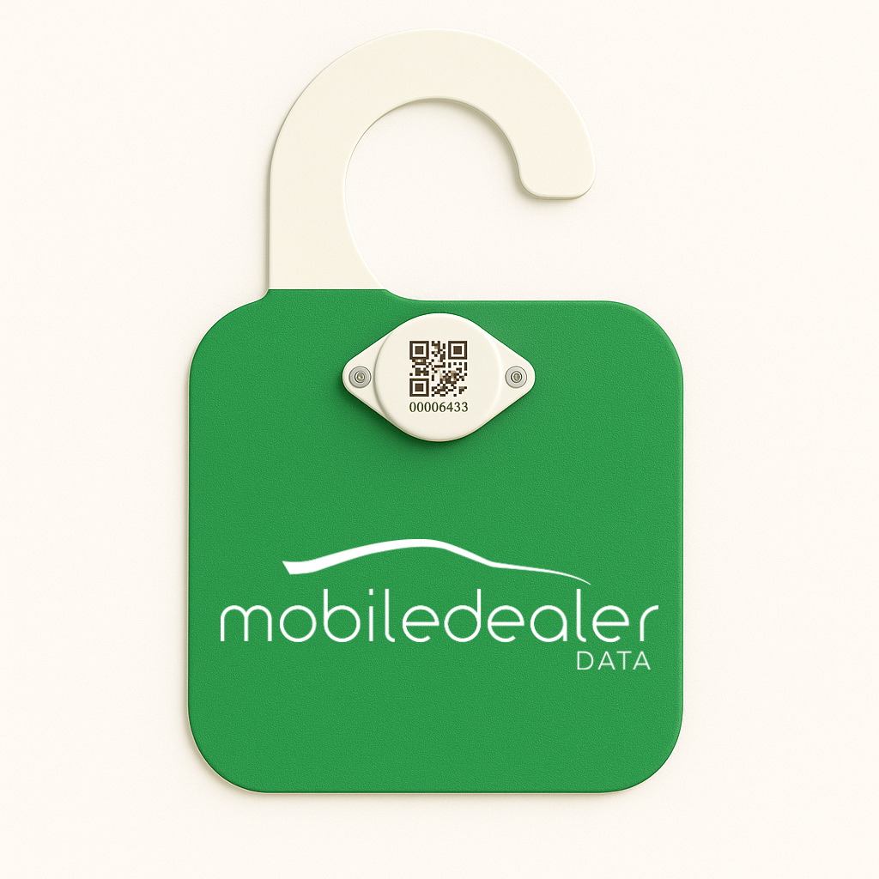
THE PRODUCT
Removable by design.
✓
Placed in seconds
No wiring, no technician, no install labor per unit.
✓
No vehicle modification
Nothing spliced, nothing drilled — no OEM warranty threat to defend.
✓
Pull it. Reuse it.
Unsold unit drives off? The device doesn't. Recycled to the next car — zero dead cost.
✓
Keys tracked too
Every key gets a Bluetooth tag — no extra hardware cost, and lost-key spend goes to zero.
✓
Addendum-ready
The placard — dealer colors, hangs on the mirror, off in seconds.
Keeps penetration on every unit without requiring an F&I sale.
MDD × Ascent Dealer Services
6

Slide 7
REINSURANCE
Built for the book.
Three numbers decide participation income. Most products get one or two. This one hits all three.
1
2
3
High penetration
Real recurring premium
Low loss ratio
Every retail delivery leaves with the device — preload on every unit, upgrade in the box.
Volume that actually moves the book, month after month — not a low-attachment add-on.
A tracking benefit rarely pays a claim. The spread between premium and claims stays in the book.
Zero chargebacks
Your structure
Your economics
across all MDD dealers — non-cancelable structure
CFC, NCFC, or DOWC — it drops into what you already run
your provider sets reserves, admin, and commissions
MDD × Ascent Dealer Services
7

Slide 8
YOUR OPPORTUNITY
What one rooftop looks like.
Illustrative model — a 200-unit store at 30% sell-through. Your program, your pricing.
FOR ASCENT
FOR THE DEALER
$5,900
$140K+
per month, per rooftop — recurring, no chargebacks
per month in total store impact — that's what keeps them sold
$70,800 / year on one store
Five rooftops ≈ $29,500 / month
You set the dealer price — your margin on the preload, your commission on the upgrade
45 min saved per sale · 15 min per RO
Recon from 10 days to under 5
$24K/mo F&I profit at 30% sell-through — plus the $9,800/mo GPS was wasting
Full pro-forma and pricing: the one-pager in your hands. Figures are a sample program — your provider builds the final numbers.
MDD × Ascent Dealer Services
8

Slide 9
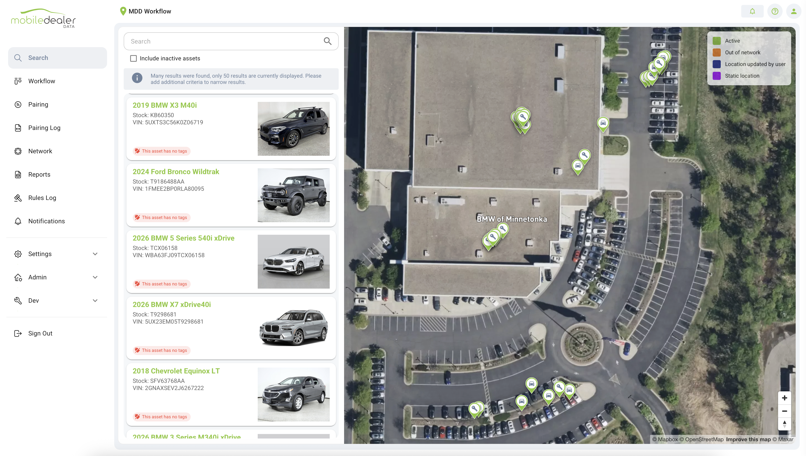
LIVE DEMO
Let's look at the system.
Every key. Every car. Real time — the lot, the service lane, and recon, live.
MDD × Ascent Dealer Services
9

Slide 10
THE NEXT SIX MONTHS
You sell it. We make it stick.
Dedicated CSM — for life
MDD handles the heavy lifting
Ready for your first pitch
One person from kickoff through the life of every dealer. No handoffs, no substitutions.
Install, pairing, role-based training, and 4-week HyperCare on every store you sign.
One-pager in hand today. Demo access and co-selling support whenever you want us in the room.
We Find Keys & Cars™ mdd.io · 844-292-7110 · 5600 Pioneer Creek Drive, Maple Plain, MN

