Slide 1



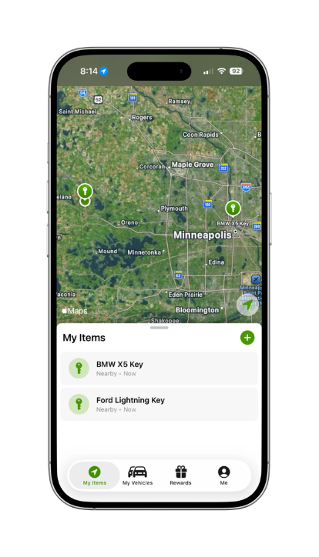
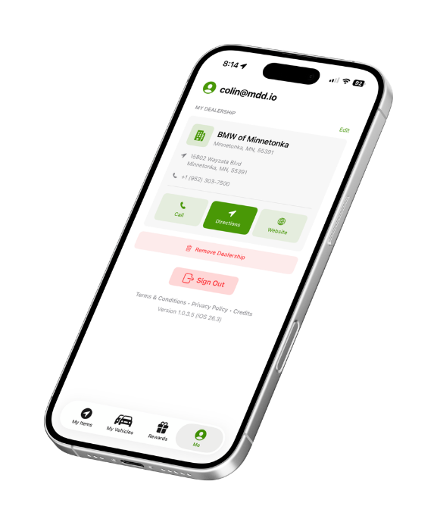








McCluskey Loyalty Program
Key and Vehicle Finder
Vehicle Value Tracker
Join Quick Service Queue
Service “Pizza” Tracker
Key trackers + vehicle management + rewards
LIFETIME CUSTOMER VALUE • ZERO CHARGEBACKS • FLEXIBLE REINSURANCE
Notes:
9

