Slide 1



Introducing
The problem no one has solved
UNTIL NOW
A new generation solution that speeds transaction time, eliminates loss key expense, improves service outcomes, and drives reinsurance performance.
Powered by
mdd.io | 844-292-7110 | We Find Keys & Cars™
Notes:
2

Slide 2

Born at the World's Largest Dealerships.
Longo Toyota
Bill Brown Ford
Lithia Automotive
Morgan Automotive
Penske Automotive
World's Largest Toyota Dealer
World's Largest Ford Dealer
3rd Largest Dealer Group | NYSE: LAD
Top 20 Dealer Group | Brandon Honda
Fortune 500
250+
10+
90%
$0
Dealerships
Years in Market
Sales Team Adoption
Lost Keys After Install
Born at Longo Toyota → Scaled to 250+ dealerships → Now in top public auto groups
Notes:
3

Slide 3

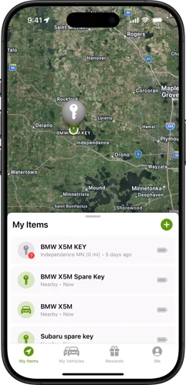
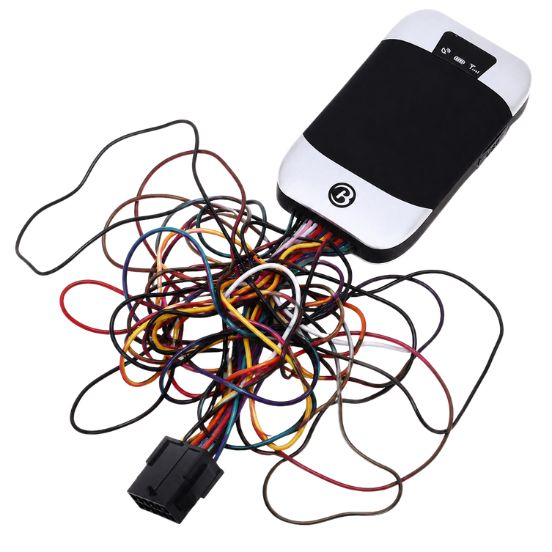
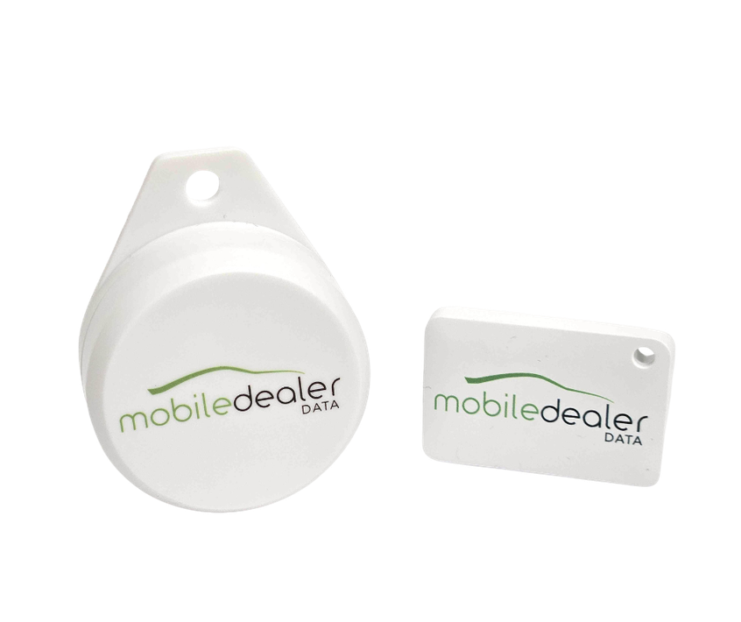
Ours
Theirs
Pairs with Bluetooth
Simple to install, no tech needed
NEXT GENERATION SOLUTION
Notes:
4

Slide 4
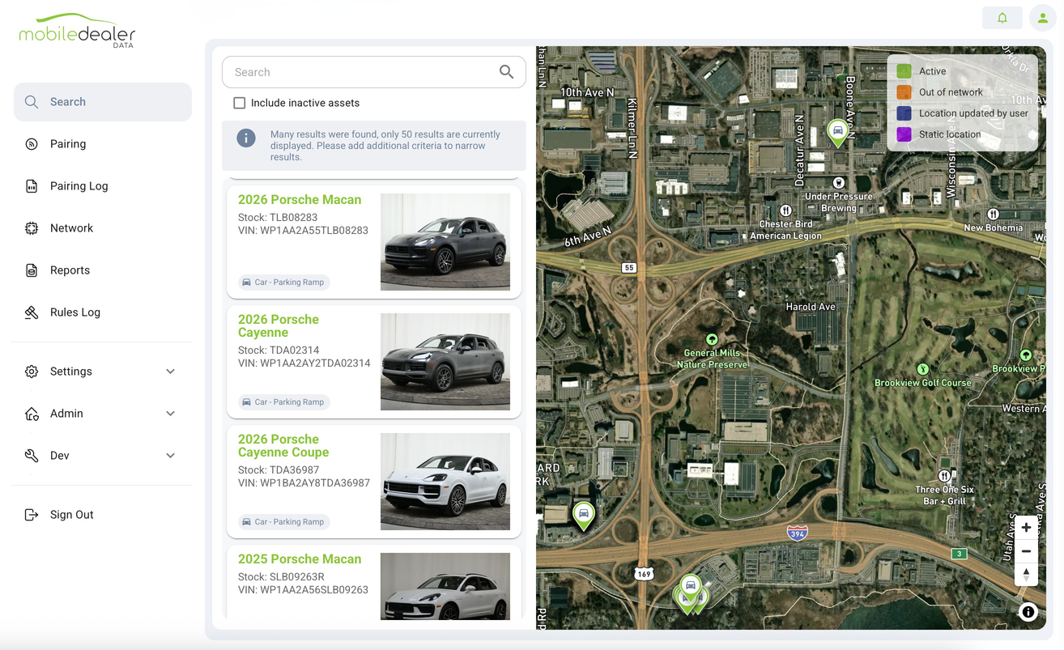





NEXT GENERATION SOLUTION
Key & Vehicle Tracking
Real-time location for every key and vehicle. Built for dealerships that lose them.
Real-time location for every key and vehicle
Instant search by VIN, stock #, or name
After-hours movement alerts & geofencing
Multi-lot tracking from one dashboard
Full key and car accountability — who had it, where it went
100,000+ ASSETS TRACKED | 90% ADOPTION | ZERO LOST KEYS
Notes:
5

Slide 5
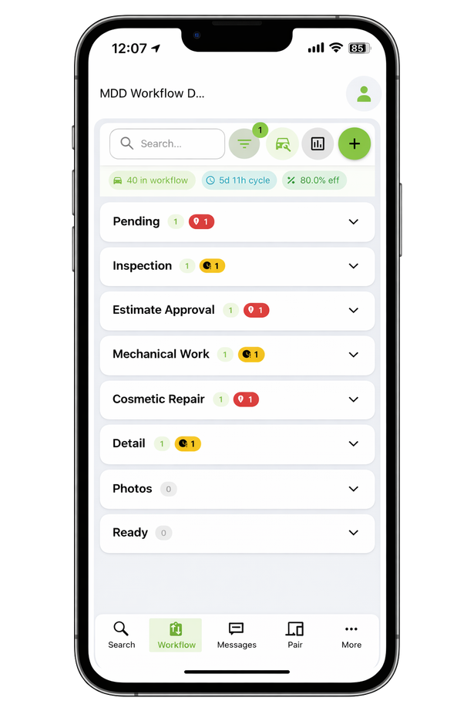
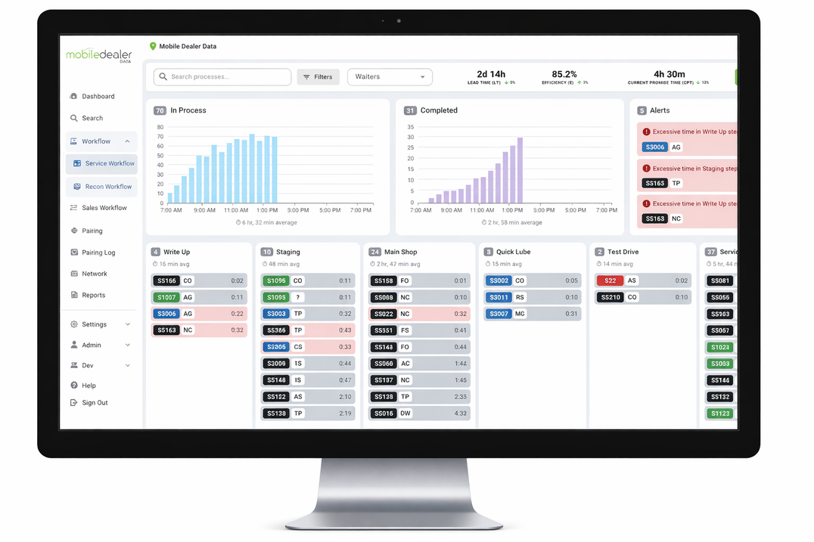
WORKFLOW
Service & Recon Workflow
Powered by LocateIQ — the only workflow that knows where the car physically is.
64% out in 60 min
15 min saved per RO
3-5 days recon turn
100% automated stages
DESKTOP + MOBILE • AUTO STAGE UPDATES • REAL-TIME BOTTLENECK ALERTS
Notes:
6

Slide 6
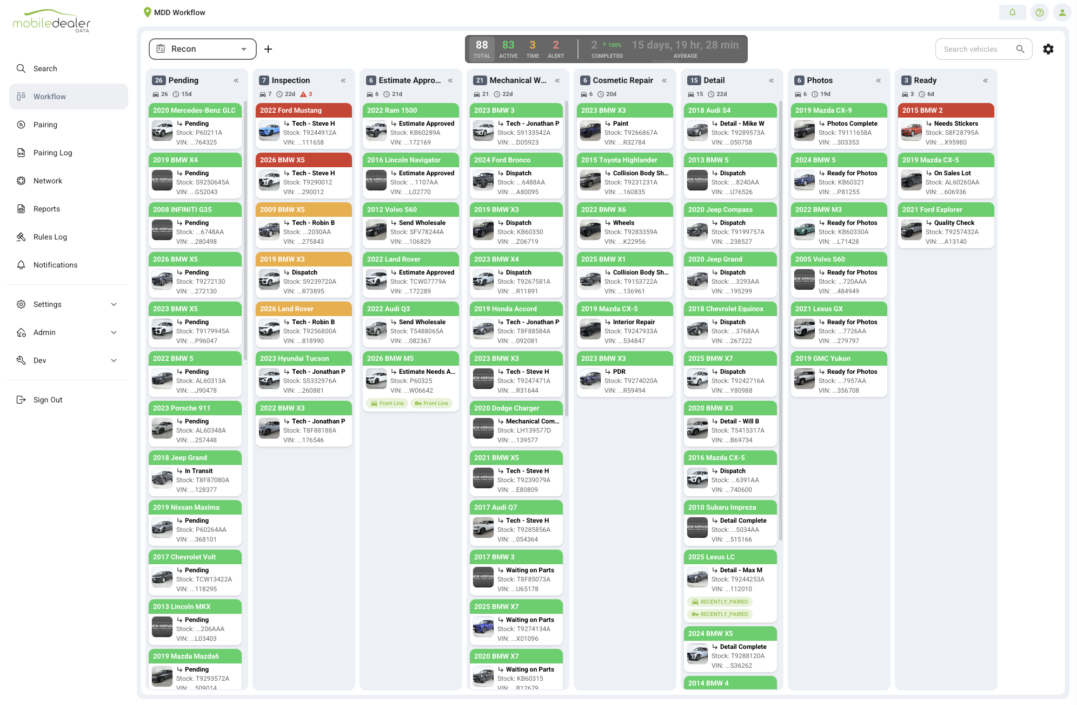
Reconditioning Workflow

Slide 7
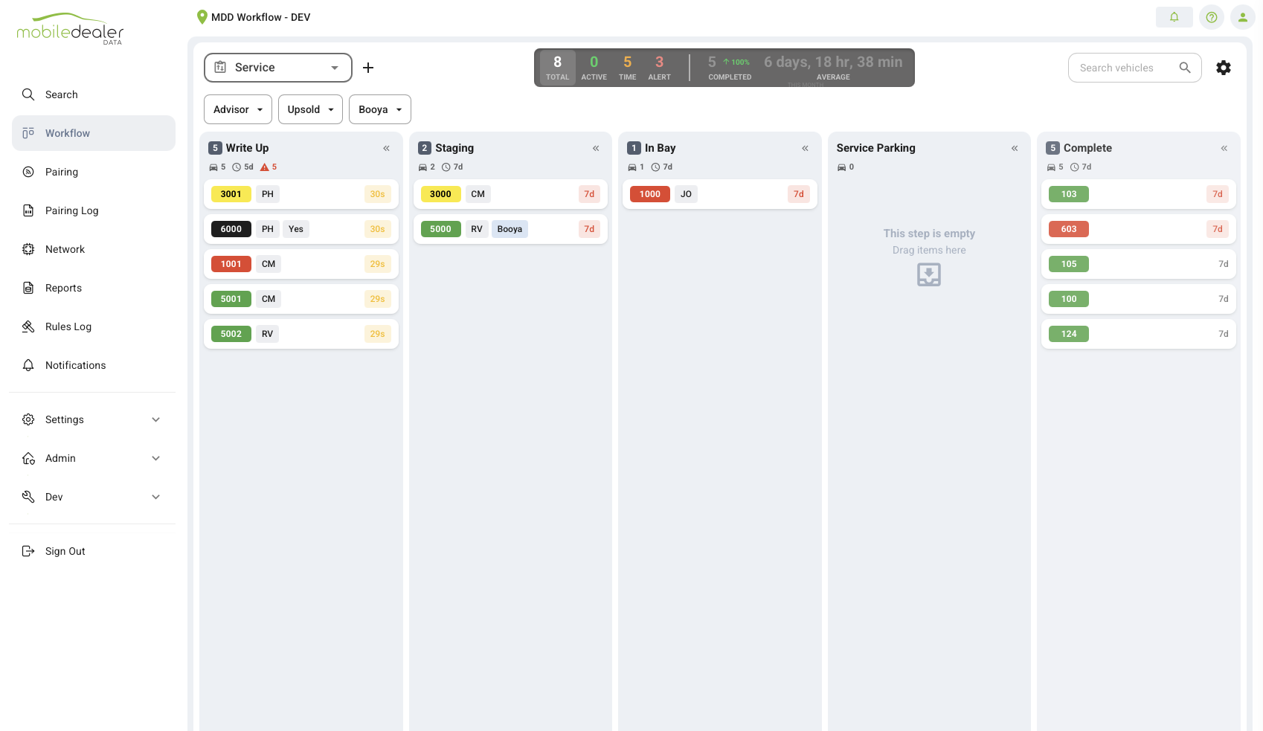
Reconditioning Workflow

Slide 8
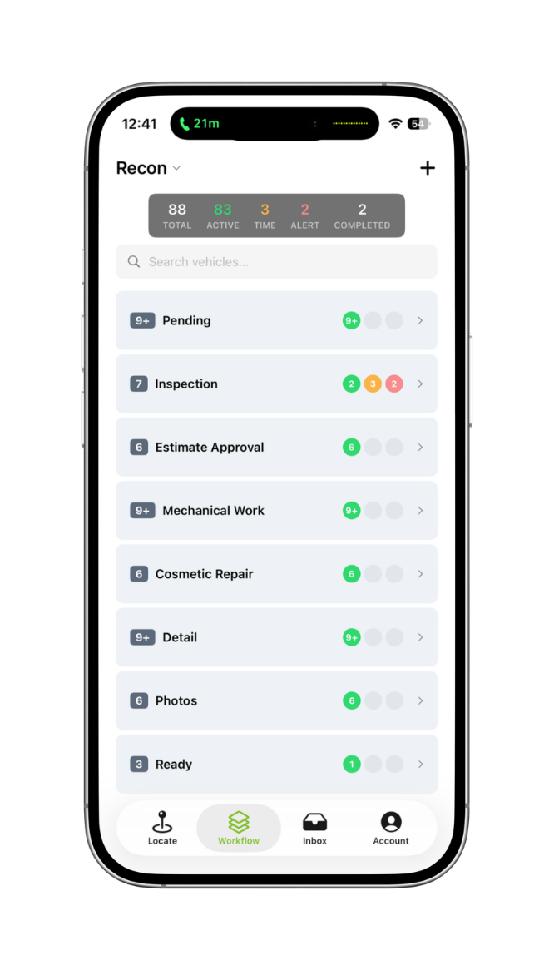
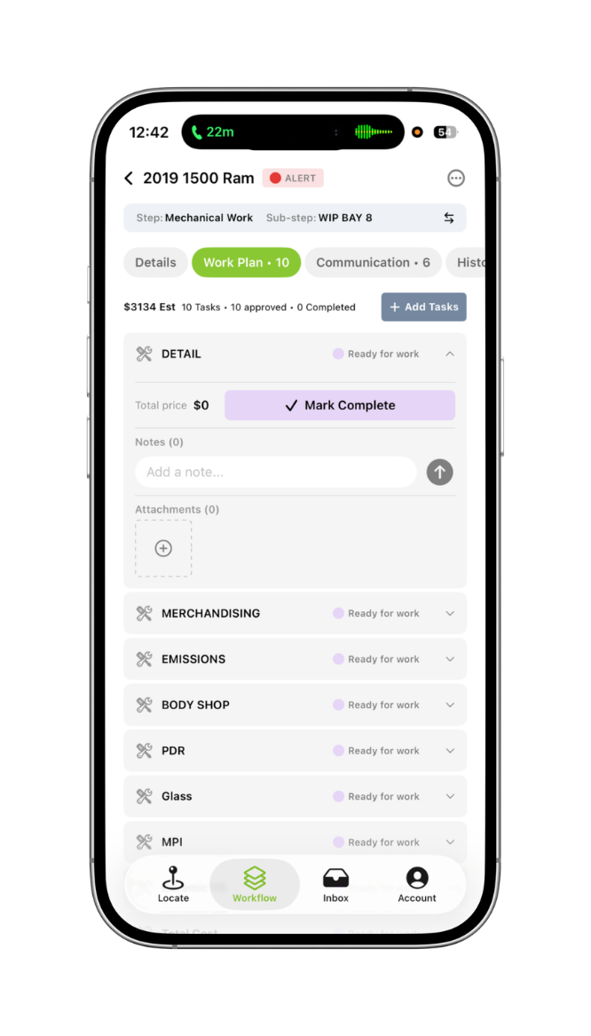
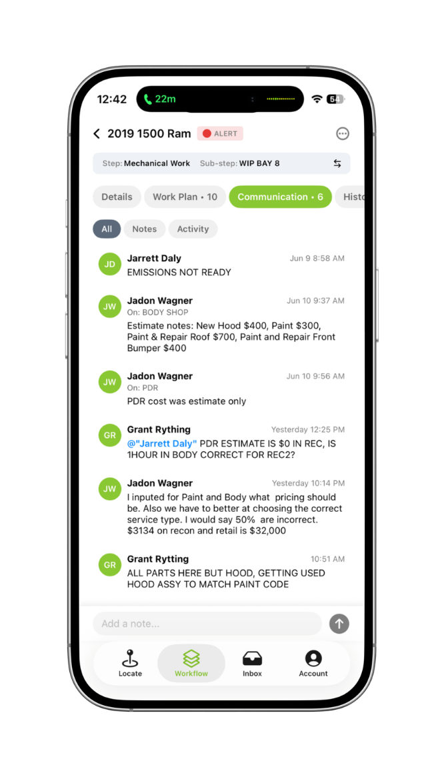
MOBILE DASHBOARDS

Slide 9
Lot Management Program Pricing
Lot management/rapid recon software bundle
$1,995/Rooftop
Devices - $65/Vehicle
Can be recycled

Slide 10

SELL THROUGH OPTIONS – BROWN AND BROWN
Retail Preload
F&I Upsell

Slide 11
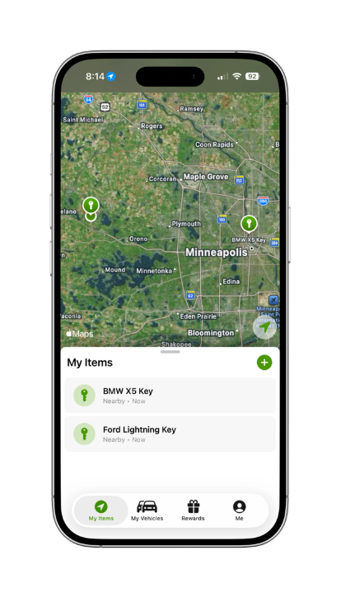
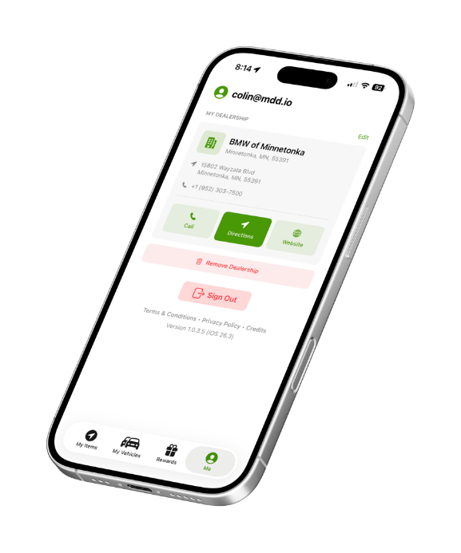

Retail Preload - Cost
Every retail delivery leaves the lot with a VehicleVault with 12 months of service/theft benefit – keys and vehicle
Preload agent net cost - $114
($99 device/service/admin fee - $15 reserve
($65 paid upfront, $49 paid at retail delivery)
5 Year upsell agent net cost - $233
($154 device/service/admin fee - $79 reserve
$65 paid upfront - $168 paid at retail delivery
Monthly software fee waived at 50 units/month
LIFETIME CUSTOMER VALUE • ZERO CHARGEBACKS • FLEXIBLE REINSURANCE

Slide 12






F&I Revenue
High-margin add-on per vehicle sold
PROOF POINT
Flexible reinsurance
$308K
Zero chargebacks
per month
Dealer app on every customer's phone
Brandon Honda
F&I sell-through
Key trackers + vehicle management + rewards
LIFETIME CUSTOMER VALUE • ZERO CHARGEBACKS • FLEXIBLE REINSURANCE
Notes:
9

Slide 13


POST-LAUNCH SUPPORT
4-week hypercare. Then a partner for life.
4-Week Hypercare
Performance Program
90-Day Money-Back Guarantee
Intensive dedicated support during the critical adoption phase.
Ongoing partnership with a dedicated Customer Success Manager.
Confident MDD delivers measurable results.
Rapid response to any questions or issues
Proactive check-ins to catch problems early
Additional training sessions as needed
Workflow optimization recommendations
Usage monitoring & adoption coaching
Dedicated CSM consultations
KPI reporting & analytics
Continuous optimization reviews
Pairing coverage tracking
System utilization & sell-through reporting
No long-term risk
No complicated terms
If it doesn't work, we make it right
MDD-backed assurance
Built on 10+ years of dealer trust
We don't just install and leave. We're invested in your long-term success.
1-DAY INSTALL → HYPERCARE → DEDICATED CSM → KPI REPORTING → 90-DAY GUARANTEE
Notes:
11

Slide 14

The world’s best dealerships already chose us.
Longo Toyota • Bill Brown Ford • Lithia Automotive • Morgan Automotive • Penske
45 min
$308K/mo
15 min
saved per sale
F&I revenue
per repair order
Powered by
mdd.io | 844-292-7110 | We Find Keys & Cars™
Notes:
2

