Slide 1


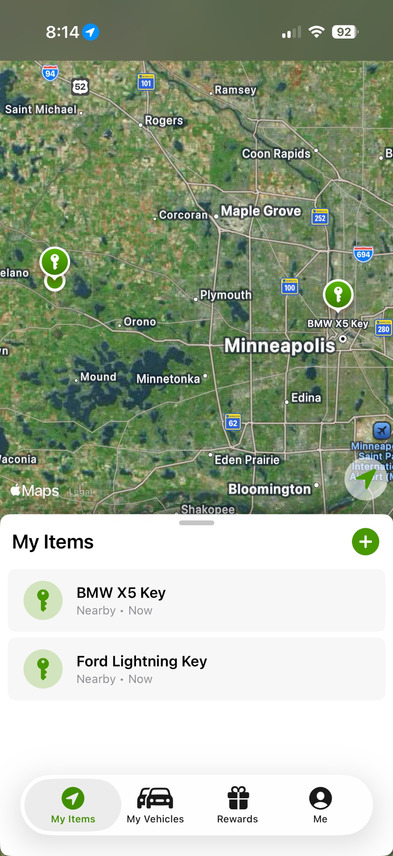

Revolutionizing Lot Management
Bluetooth Tracking
Service Workflow
F&I Integration
mdd.io | We Find Keys & Cars™

Slide 2



INTRODUCTION
A Decade of Innovation in
Automotive Solutions
Founded on Dealer Needs
Trusted by Top Dealers
Continuously Evolving
Built from the ground up with real dealership feedback, Mobile Dealer Data has spent over 10 years solving the industry's most persistent inventory and operational challenges.
From single point dealerships to the largest Publicly Traded groups, our solutions are trusted by hundreds of dealerships nationwide.
From Bluetooth lot tracking to F&I integration and service workflow tools, Vehicle Vault grows alongside the needs of modern dealerships.

Slide 3



How Does It Work?
Every vehicle and key is tagged with a Bluetooth tracking device the moment it enters inventory. Dealership staff can instantly pinpoint the location of any vehicle or key directly from their mobile app — eliminating guesswork and saving valuable time.
Tag
Track
Manage
Attach Bluetooth tracker to vehicle & key
Real-time location via mobile app
Audit, locate & organize from anywhere

Slide 4
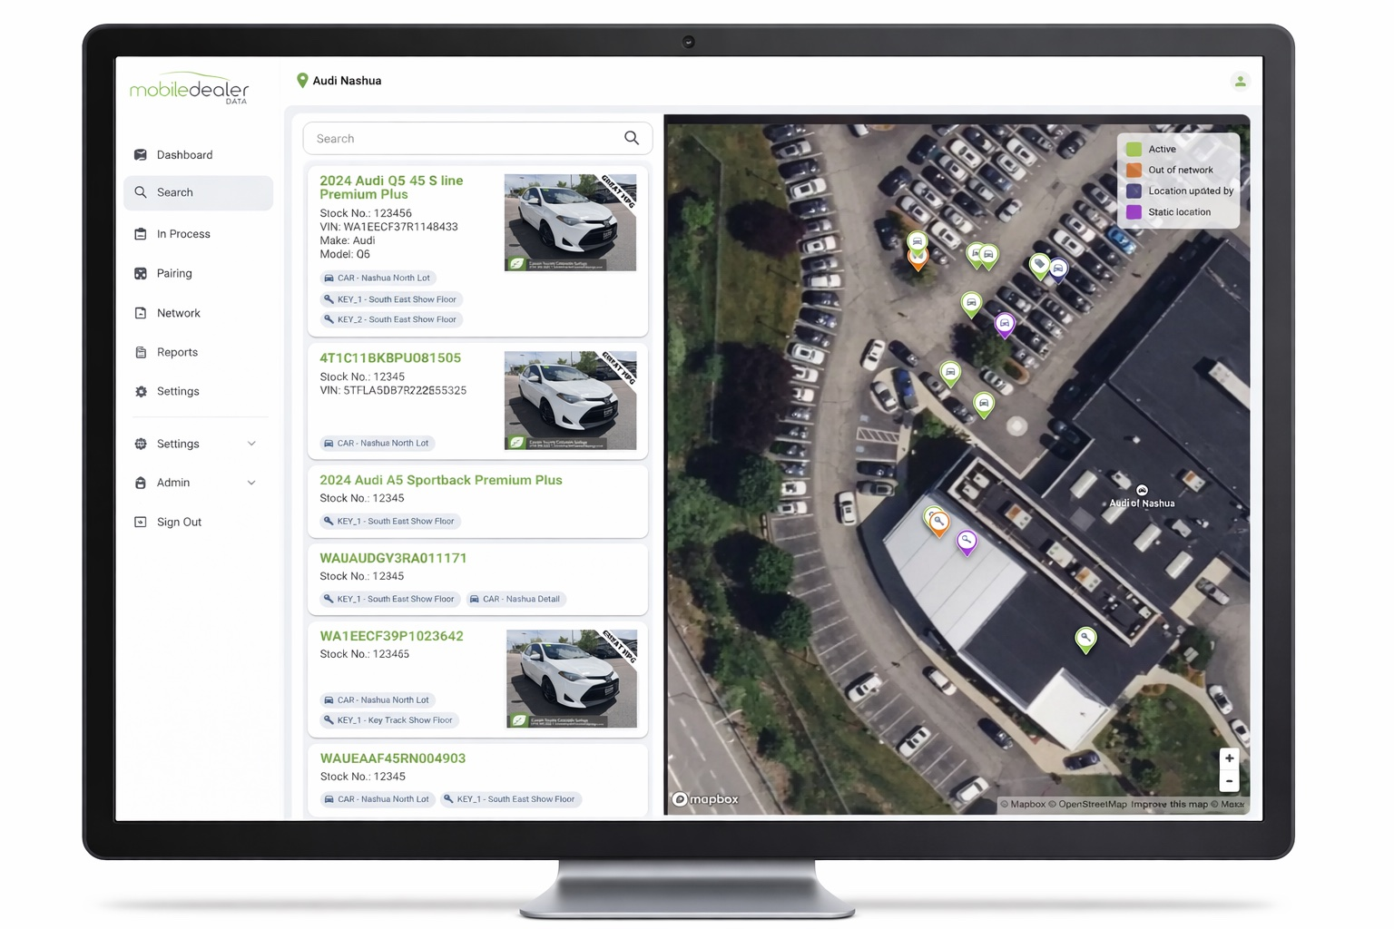


CORE SOLUTIONS
Track Every Key and Optimize Your Inventory
with Lot Management
Efficient Inventory Management
Track every key and organize your entire inventory from arrival to sale with full Bluetooth-powered visibility.
Operational Efficiencies
Simplify daily tasks and audits, creating significant time savings and reducing manual effort across the team.
* This is not an anti-theft device.

Slide 5
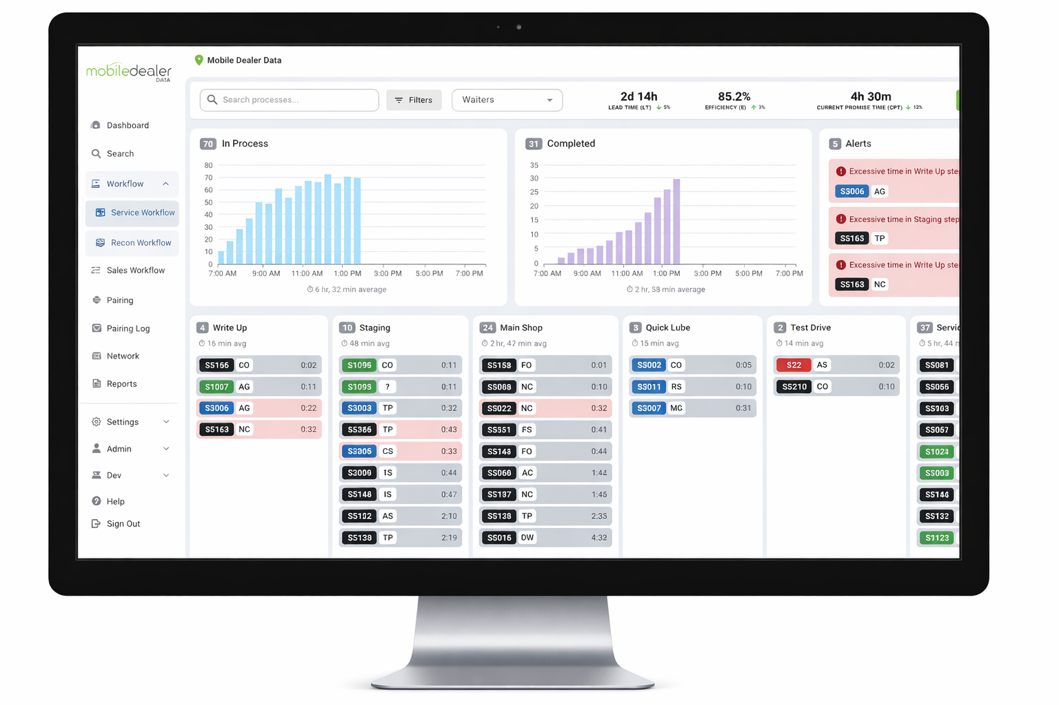




EXPANDED OFFERINGS
Seamless Service Workflow
& Reconditioning
Prompted by valuable dealer feedback, Vehicle Vault has expanded into comprehensive service workflow management.
Monitor service progress in real-time
Proactively identify and eliminate bottlenecks
Optimize reconditioning for faster turnaround
Reduce reliance on costly outside auditors

Slide 6
FINANCIAL SOLUTIONS
Unlock New Revenue Streams
with F&I Integration
1
2
3
Integrated F&I Product
High Perceived Value
Driving Gross Profit
In 2025, Vehicle Vault hardware and software became available as a standalone F&I product, seamlessly integrating into your sales process.
Insured packages offer exceptional value to consumers. Additional key fobs, theft or key replacement benefits, and a dealer-branded app enhance ownership.
Increased gross profit margins with zero chargebacks and flexible reinsured options, optimizing your dealership's financial performance.

Slide 7
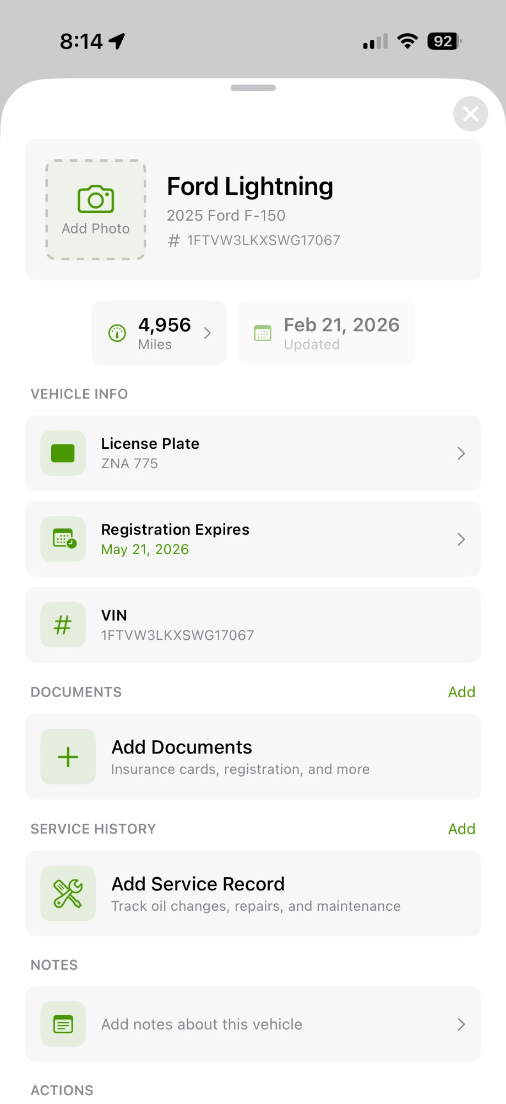
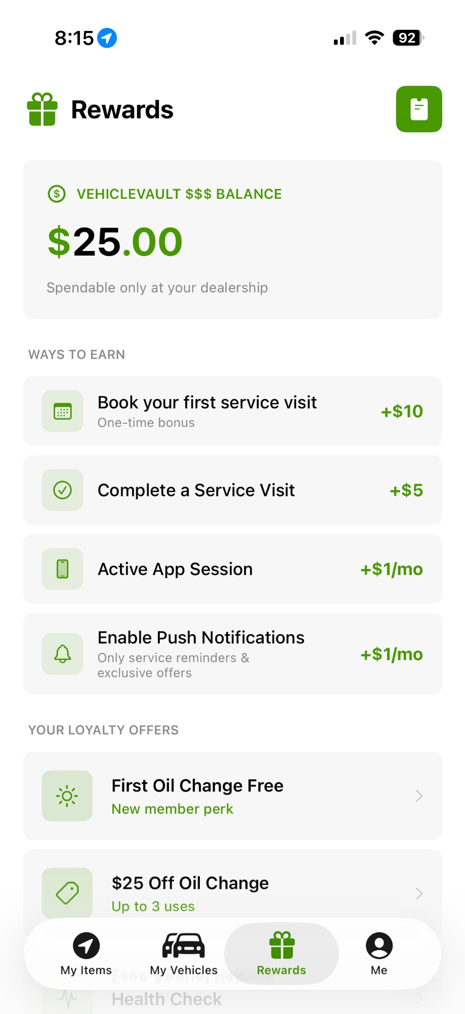
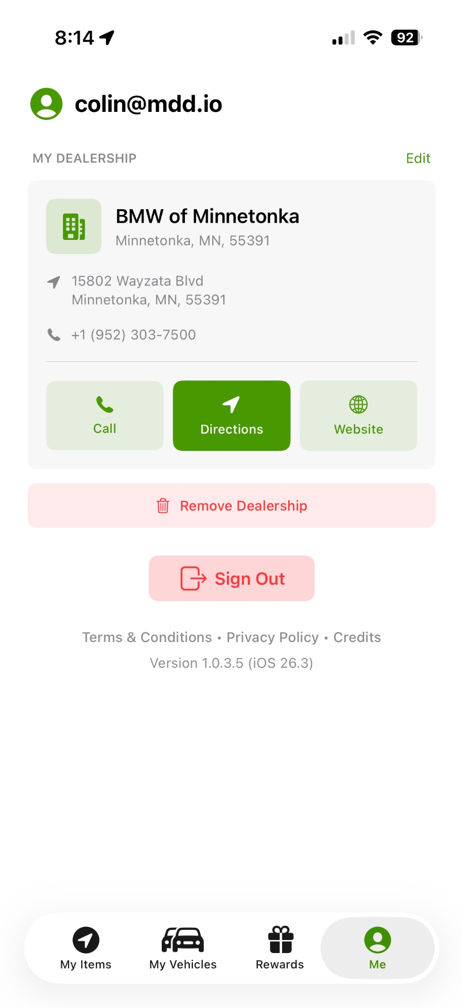
CONSUMER APP
Dealer-Branded Mobile Experience
Your customers get a powerful, branded app with key tracking, vehicle management, rewards, and direct access to your dealership.

Slide 8





KEY ADVANTAGES
Why Dealerships Choose
Vehicle Vault
Proven Track Record
Real-Time Efficiency
Optimized Workflows
Trusted by top dealers nationwide for over a decade.
Instant tracking and superior lot management capabilities.
Streamlined service and reconditioning processes.
High-Value F&I
Enhanced Customer Experience
Insured packages boosting profit with no chargebacks.
Consistent dealer-branded interactions throughout.

Slide 9

What Our Dealers Say
Trusted by the largest and most successful dealerships in the country
Longo Toyota
Bill Brown Ford
Brandon Honda
Penske Motor Group
Penske Automotive
Morgan Automotive Group
15 min
2,000+
41 min
Saved per repair order
Vehicles tracked across lots
Saved per repair order
3 days
90%
$308K/mo
Saved per car in recon
Sales team adoption
Additional F&I revenue
20 min
Instant
Zero
Saved in vehicle delivery
Pinpoint location
Lost keys
MDD delivers on its promises. Locating a vehicle went from 25 minutes to seconds. Every dealer needs these results.
MDD instantly locates 2,000 vehicles on multiple lots all over town. We get cars customer-delivered without delays.
No longer loses keys, shaved 41 minutes per RO in service, and generates an additional $308K per month selling VehicleVault.
— Mark Seipel
— Dave Bird
Fixed Operations Director
New Car Inventory Manager
Mobile Dealer Data | mdd.io | We Find Keys & Cars™

Slide 10

PRICING
Simple, Transparent Pricing
Maximum value with no hidden fees, no long-term contracts, and no integration costs.
Lot Management
Service Workflow
F&I Integration
Starting at $55
Included
Custom
per vehicle
with qualifying volume
based on term & package
Full Bluetooth tracking for vehicles and keys, real-time location via mobile app, and daily audit tools — no long-term contracts or technology fees.
Real-time reconditioning tracking and service progress monitoring to eliminate bottlenecks and reduce outside auditor costs.
Pricing varies based on term length and benefit package. Contact your Mobile Dealer Data representative for a customized quote.

Slide 11


Ready to Transform Your Dealership?
Don't miss the opportunity to improve efficiency and profitability.
Contact Mobile Dealer Data today to discover how Vehicle Vault
can be precisely tailored to your unique business needs.
Schedule a Demo
844-292-7110
Mobile Dealer Data | mdd.io | We Find Keys & Cars™

