Slide 1
Accounting for compartmental volume in BioNetGen
2021 Cell Modeling Workshop

Slide 2
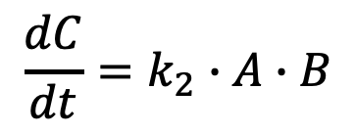
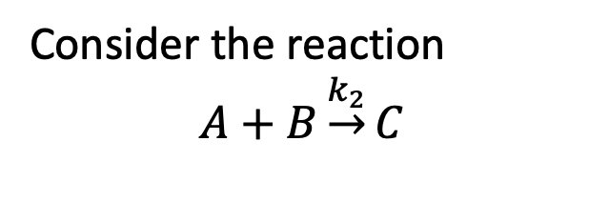
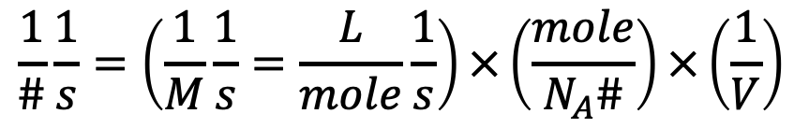
So far we have considered reaction networks in which all reactions occur in single well-mixed compartment.
Consider the reaction
$$A+B\underset{→}{k_{2}}C$$
Real cells are more complex
EC
PM
$$\frac{dC}{dt}=k_{2}∙A∙B$$
CP
EM
EN
NM
NU
What units?
$$\frac{1}{\#}\frac{1}{s}=\left(\frac{1}{M}\frac{1}{s}=\frac{L}{mole}\frac{1}{s}\right)×\left(\frac{mole}{N_{A}\#}\right)×\left(\frac{1}{V}\right)$$

Slide 3
So far we have considered reaction networks in which all reactions occur in single well-mixed compartment.
Consider the reaction
$$A+B\underset{→}{k_{2}}C$$
Real cells are more complex
EC
PM
$$\frac{dC}{dt}=k_{2}∙A∙B$$
CP
EM
EN
NM
NU
What units?
$$\frac{1}{\#}\frac{1}{s}=\left(\frac{1}{M}\frac{1}{s}=\frac{L}{mole}\frac{1}{s}\right)×\left(\frac{mole}{N_{A}\#}\right)×\left(\frac{1}{V}\right)$$

Slide 4
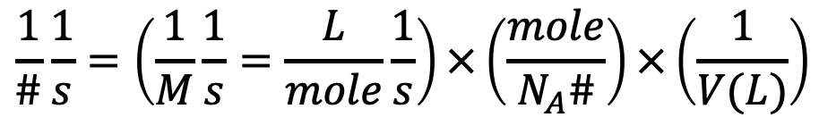
So far we have considered reaction networks in which all reactions occur in single well-mixed compartment.
Consider the reaction
$$A+B\underset{→}{k_{2}}C$$
Real cells are more complex
EC
PM
$$\frac{dC}{dt}=k_{2}∙A∙B$$
CP
EM
EN
NM
NU
What units?
$$\frac{1}{\#}\frac{1}{s}=\left(\frac{1}{M}\frac{1}{s}=\frac{L}{mole}\frac{1}{s}\right)×\left(\frac{mole}{N_{A}\#}\right)×\left(\frac{1}{V(L)}\right)$$

Slide 5
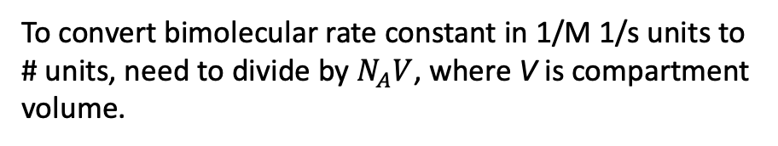
So far we have considered reaction networks in which all reactions occur in single well-mixed compartment.
Consider the reaction
$$A+B\underset{→}{k_{2}}C$$
Real cells are more complex
EC
PM
$$\frac{dC}{dt}=k_{2}∙A∙B$$
CP
EM
EN
NM
NU
What units?
$$\frac{1}{\#}\frac{1}{s}=\left(\frac{1}{M}\frac{1}{s}=\frac{L}{mole}\frac{1}{s}\right)×\left(\frac{mole}{N_{A}\#}\right)×\left(\frac{1}{V(L)}\right)$$
To convert bimolecular rate constant in 1/M 1/s units to # units, need to divide by $N_{A}V$, where V is compartment volume.

Slide 6
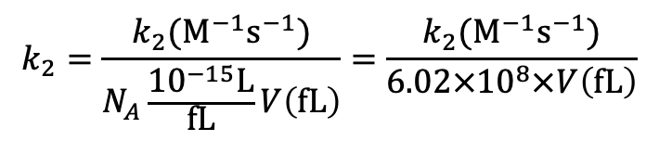
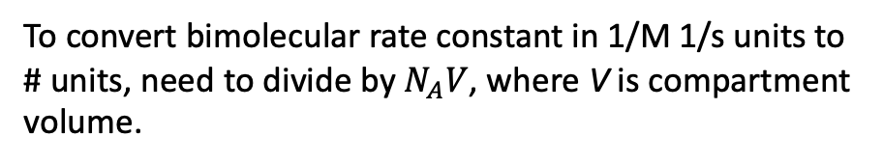
So far we have considered reaction networks in which all reactions occur in single well-mixed compartment.
Consider the reaction
$$A+B\underset{→}{k_{2}}C$$
Real cells are more complex
EC
PM
$$\frac{dC}{dt}=k_{2}∙A∙B$$
CP
EM
EN
NM
NU
To convert bimolecular rate constant in 1/M 1/s units to # units, need to divide by $N_{A}V$, where V is compartment volume.
If cell volume given in units of ${μm}^{3}=fL$, then we have
$$k_{2}=\frac{k_{2}(M^{−1}s^{−1})}{N_{A}\frac{{10}^{−15}L}{fL}V\left(fL\right)}=\frac{k_{2}(M^{−1}s^{−1})}{6.02×{10}^{8}×V\left(fL\right)}$$

Slide 7
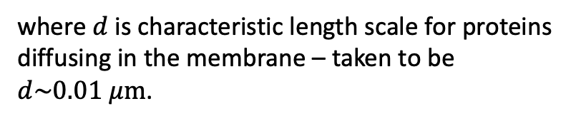

Surface reactions are treated as having an effective volume
$$V_{eff}=A∙d$$
where $d$ is characteristic length scale for proteins diffusing in the membrane – taken to be $d\sim 0.01 μm$.
EC
PM
CP
EM
The reduction of volume for 2D reactions compared to 3D can lead to several hundred-fold speedup of reactions on the membrane compared to cytoplasm.
EN
NM
NU
E.g. B. N. Kholodenko, J. B. Hoek, and H. V Westerhoff, “Why cytoplasmic signalling proteins should be recruited to cell membranes.,” Trends Cell Biol., vol. 10, no. 5, pp. 173–8, May 2000.

Slide 8
compartments block specifies compartmental topology and properties
EC
PM
CP
EM
EN
NM
NU
Key points
Must go from outer to inner
3D compartments can contain multiple 2D compartments
2D compartments can only contain 1 3D compartment
If compartments are defined, all seed species must have defined compartmental location

Slide 9
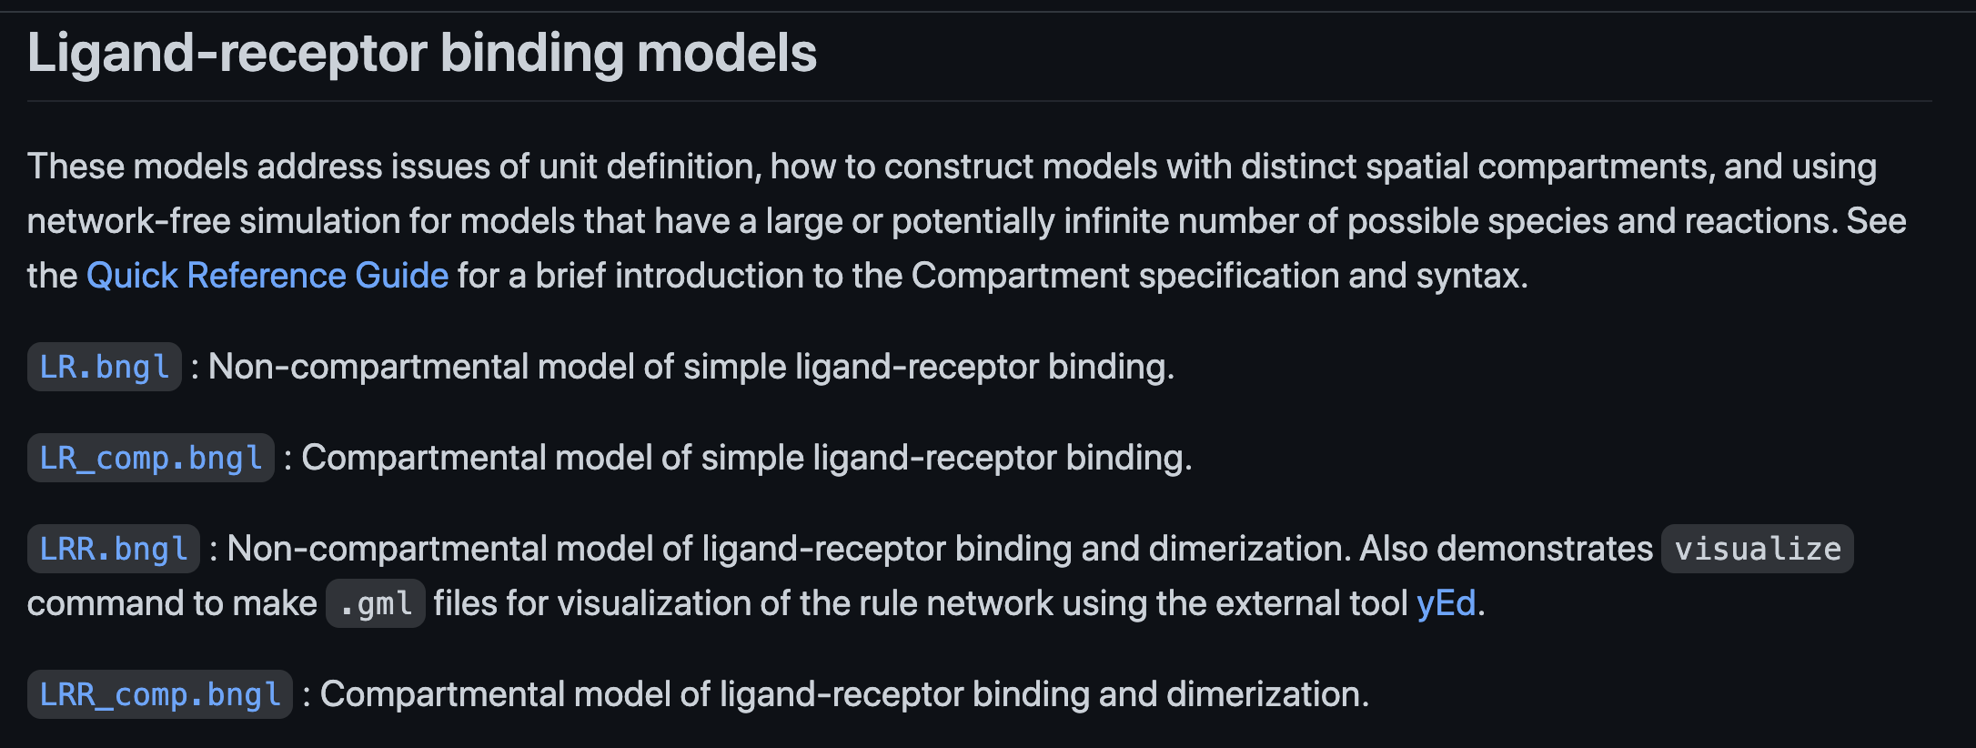
Sources of information about compartmental models
bionetgen.org – Main website for BioNetGen
bionetgen.org/tutorial – Extensive examples with documentation
Simple compartmental models are here.
Quick Reference Guide*– Handy overview of model syntax and conventions
Actions and Arguments Guide*– Full documentation of action syntax.
*Use links on bionetgen.org as they may have changed.

