Slide 1
Hands on portion

Slide 2
Lisman model for autoactivation
begin molecule types
K1(Y~0~P)
P(b)
end molecule types

Slide 3
Molecule Types
begin molecule types
K1(Y~0~P)
P(b)
end molecule types

Slide 4
Reaction Rules
begin reaction rules
R1: K1(Y~0) -> K1(Y~P) S
R1

Slide 5
Reaction Rules
begin reaction rules
R1: K1(Y~0) -> K1(Y~P) S
R2: K1(Y~0) + K1(Y~P) -> K1(Y~P) + K1(Y~P) 0.01
R2
R1

Slide 6
Reaction Rules
begin reaction rules
R1: K1(Y~0) -> K1(Y~P) S
R2: K1(Y~0) + K1(Y~P) -> K1(Y~P) + K1(Y~P) 0.01
R3: K1(Y~P) + P(b) <-> K1(Y~P!1).P(b!1) 0.4, 1
R4: K1(Y~P!1).P(b!1) -> K1(Y~0) + P(b) 1
end reaction rules
R2
R1
R4
R3

Slide 7
What we did so far
R2
R1
begin molecule types
K1(Y~0~P)
P(b)
end molecule types
Define molecules
R4
R3
begin reaction rules
R1: K1(Y~0) -> K1(Y~P) S
R2: K1(Y~0) + K1(Y~P) -> K1(Y~P) + K1(Y~P) 0.01
R3: K1(Y~P) + P(b) <-> K1(Y~P!1).P(b!1) 0.4, 1
R4: K1(Y~P!1).P(b!1) -> K1(Y~0) + P(b) 1
end reaction rules
Define rules

Slide 8
Parameters
Define parameters
begin parameters
S 0.01
end parameters
R2
R1
begin molecule types
K1(Y~0~P)
P(b)
end molecule types
Define molecules
R4
R3
begin reaction rules
R1: K1(Y~0) -> K1(Y~P) S
R2: K1(Y~0) + K1(Y~P) -> K1(Y~P) + K1(Y~P) 0.01
R3: K1(Y~P) + P(b) <-> K1(Y~P!1).P(b!1) 0.4, 1
R4: K1(Y~P!1).P(b!1) -> K1(Y~0) + P(b) 1
end reaction rules
Define rules

Slide 9
Species
Define parameters
begin parameters
S 0.01
end parameters
R2
R1
begin molecule types
K1(Y~0~P)
P(b)
end molecule types
Define molecules
R4
R3
Define initial conditions
begin species
K1(Y~0) 100
P(b) 10
end species
begin reaction rules
R1: K1(Y~0) -> K1(Y~P) S
R2: K1(Y~0) + K1(Y~P) -> K1(Y~P) + K1(Y~P) 0.01
R3: K1(Y~P) + P(b) <-> K1(Y~P!1).P(b!1) 0.4, 1
R4: K1(Y~P!1).P(b!1) -> K1(Y~0) + P(b) 1
end reaction rules
Define rules

Slide 10
Species
Define parameters
begin parameters
S 0.01
end parameters
R2
R1
begin molecule types
K1(Y~0~P)
P(b)
end molecule types
Define molecules
R4
R3
begin species
K1(Y~0) 100
P(b) 10
end species
Define initial conditions
begin reaction rules
R1: K1(Y~0) -> K1(Y~P) S
R2: K1(Y~0) + K1(Y~P) -> K1(Y~P) + K1(Y~P) 0.01
R3: K1(Y~P) + P(b) <-> K1(Y~P!1).P(b!1) 0.4, 1
R4: K1(Y~P!1).P(b!1) -> K1(Y~0) + P(b) 1
end reaction rules
Define rules

Slide 11
Obervables
Define parameters
begin parameters
S 0.01
end parameters
R2
R1
begin molecule types
K1(Y~0~P)
P(b)
end molecule types
Define molecules
R4
R3
begin species
K1(Y~0) 100
P(b) 10
end species
Define initial conditions
begin observables
Molecules K1p K1(Y~P)
end observables
Define observables
begin reaction rules
R1: K1(Y~0) -> K1(Y~P) S
R2: K1(Y~0) + K1(Y~P) -> K1(Y~P) + K1(Y~P) 0.01
R3: K1(Y~P) + P(b) <-> K1(Y~P!1).P(b!1) 0.4, 1
R4: K1(Y~P!1).P(b!1) -> K1(Y~0) + P(b) 1
end reaction rules
Define rules

Slide 12
Actions
begin model
Define parameters
begin parameters
S 0.01
end parameters
R2
R1
begin molecule types
K1(Y~0~P)
P(b)
end molecule types
Define molecules
R4
R3
begin seed species
K1(Y~0) 100
P(b) 10
end seed species
Define initial conditions
begin observables
Molecules K1p K1(Y~P)
end observables
Define observables
begin reaction rules
R1: K1(Y~0) -> K1(Y~P) S
R2: K1(Y~0) + K1(Y~P) -> K1(Y~P) + K1(Y~P) 0.01
R3: K1(Y~P) + P(b) <-> K1(Y~P!1).P(b!1) 0.4, 1
R4: K1(Y~P!1).P(b!1) -> K1(Y~0) + P(b) 1
end reaction rules
Define rules
end model
Define actions

Slide 13
Actions
begin model
Define parameters
begin parameters
S 0.01
end parameters
R2
R1
begin molecule types
K1(Y~0~P)
P(b)
end molecule types
Define molecules
R4
R3
begin seed species
K1(Y~0) 100
P(b) 10
end seed species
Define initial conditions
begin observables
Molecules K1p K1(Y~P)
end observables
Define observables
begin reaction rules
R1: K1(Y~0) -> K1(Y~P) S
R2: K1(Y~0) + K1(Y~P) -> K1(Y~P) + K1(Y~P) 0.01
R3: K1(Y~P) + P(b) <-> K1(Y~P!1).P(b!1) 0.4, 1
R4: K1(Y~P!1).P(b!1) -> K1(Y~0) + P(b) 1
end reaction rules
Define rules
end model
Define actions

Slide 14
Actions
begin model
Define parameters
begin parameters
S 0.01
end parameters
R2
R1
begin molecule types
K1(Y~0~P)
P(b)
end molecule types
Define molecules
R4
R3
begin seed species
K1(Y~0) 100
P(b) 10
end seed species
Define initial conditions
begin observables
Molecules K1p K1(Y~P)
end observables
Define observables
begin reaction rules
R1: K1(Y~0) -> K1(Y~P) S
R2: K1(Y~0) + K1(Y~P) -> K1(Y~P) + K1(Y~P) 0.01
R3: K1(Y~P) + P(b) <-> K1(Y~P!1).P(b!1) 0.4, 1
R4: K1(Y~P!1).P(b!1) -> K1(Y~0) + P(b) 1
end reaction rules
Define rules
end model
Define actions
generate_network()
simulate({method=>"ode", t_end=>100, n_steps=>200})

Slide 15
Complete file
begin model
Define parameters
begin parameters
S 0.01
end parameters
R2
R1
begin molecule types
K1(Y~0~P)
P(b)
end molecule types
Define molecules
R4
R3
begin seed species
K1(Y~0) 100
P(b) 10
end seed species
Define initial conditions
begin observables
Molecules K1p K1(Y~P)
end observables
Define observables
begin reaction rules
R1: K1(Y~0) -> K1(Y~P) S
R2: K1(Y~0) + K1(Y~P) -> K1(Y~P) + K1(Y~P) 0.01
R3: K1(Y~P) + P(b) <-> K1(Y~P!1).P(b!1) 0.4, 1
R4: K1(Y~P!1).P(b!1) -> K1(Y~0) + P(b) 1
end reaction rules
Define rules
end model
Define actions
generate_network()
simulate({method=>"ode", t_end=>100, n_steps=>200})

Slide 16
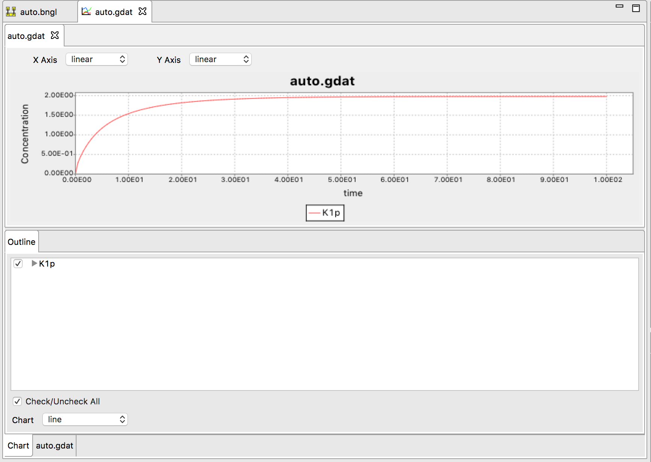
Simulation Output
RuleBender View
begin model
begin parameters
S 0.01
end parameters
R2
R1
begin molecule types
K1(Y~0~P)
P(b)
end molecule types
R4
R3
begin seed species
K1(Y~0) 100
P(b) 10
end seed species
begin observables
Molecules K1p K1(Y~P)
end observables
begin reaction rules
R1: K1(Y~0) -> K1(Y~P) S
R2: K1(Y~0) + K1(Y~P) -> K1(Y~P) + K1(Y~P) 0.01
R3: K1(Y~P) + P(b) <-> K1(Y~P!1).P(b!1) 0.4, 1
R4: K1(Y~P!1).P(b!1) -> K1(Y~0) + P(b) 1
end reaction rules
end model
generate_network()
simulate({method=>"ode", t_end=>100, n_steps=>200})

Slide 17
Parameter Scan
Use parameter_scan action in the BNGL file
parameter_scan({parameter=>"S",par_min=>1e-3,par_max=>1e-1,n_scan_pts=>50,\
method=>"ode",t_end=>10000,log_scale=>1})

Slide 18
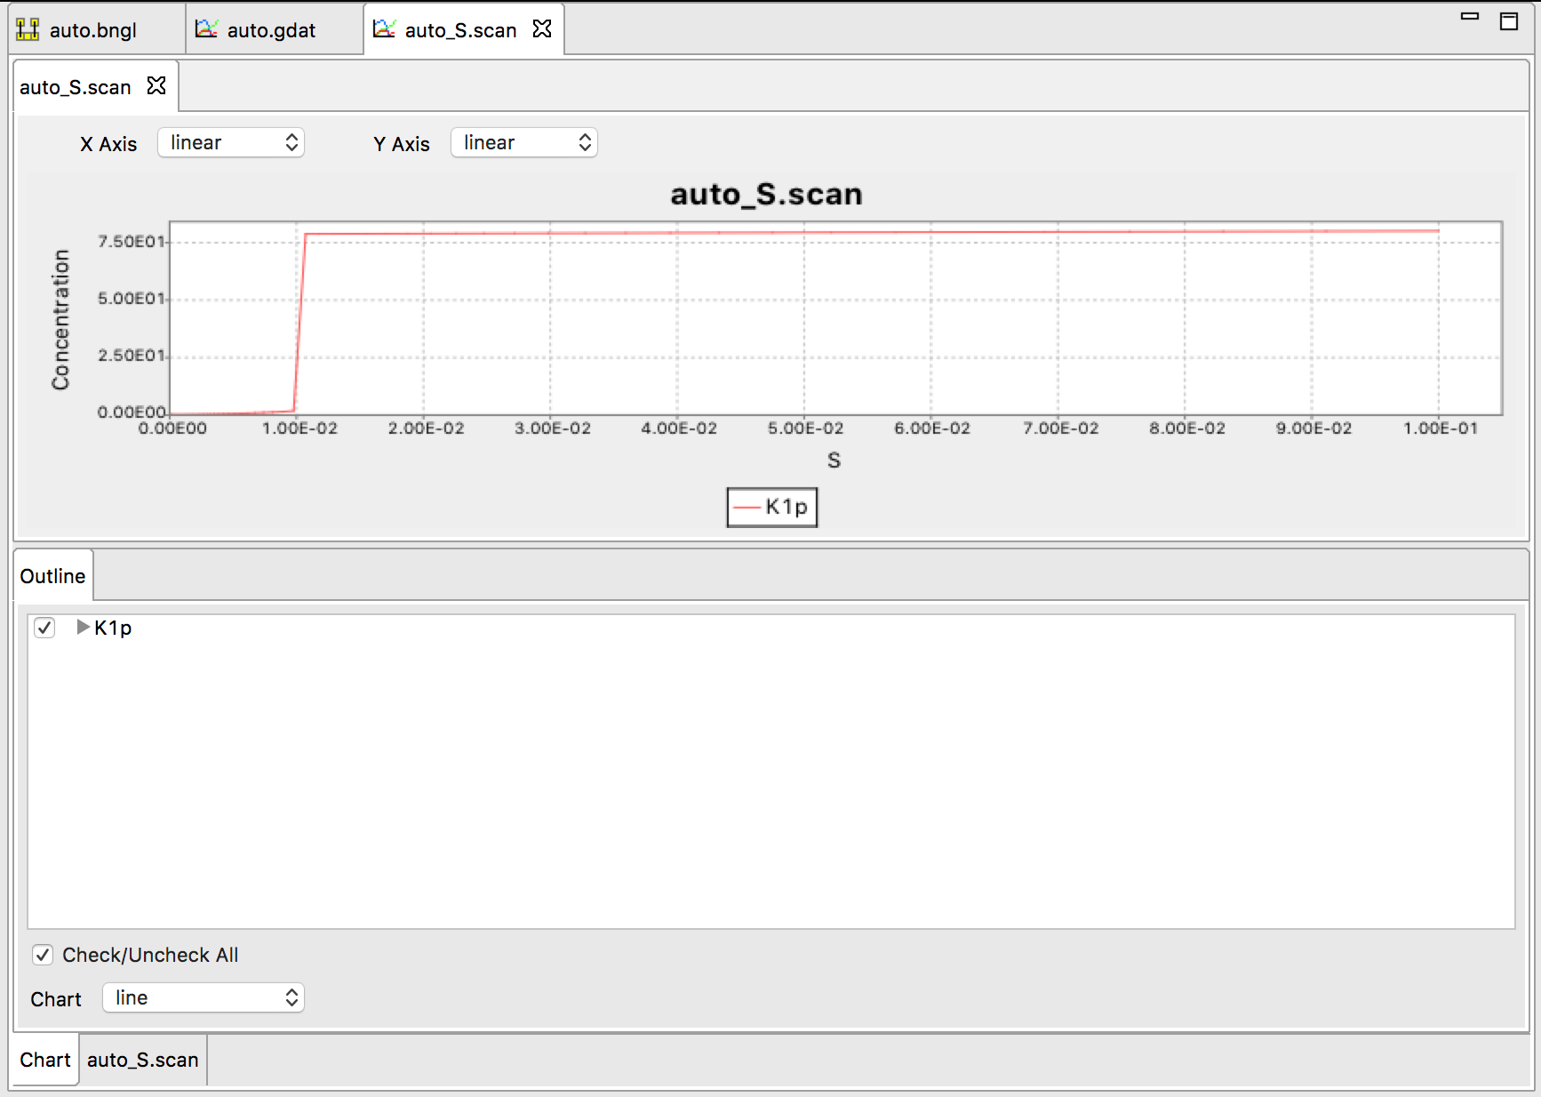
Understanding the observed switching behavior
Below the switching point, this system has two stable steady states.

Slide 19
Understanding the observed switching behavior
Below the switching point, this system has two stable steady states.
This can be shown by making a rate balance plot:

Slide 20

Understanding the observed switching behavior
Below the switching point, this system has two stable steady states.
This can be shown by making a rate balance plot:
https://www.molbiolcell.org/doi/10.1091/mbc.E20-08-0530

Slide 21
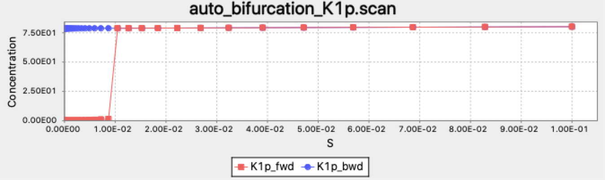
Bistability can be identified using the bifurcate action, which uses a bidirectional scan
bifurcate({parameter=>"S",par_min=>1e-5,par_max=>1e-1,n_scan_pts=>50,\
method=>"ode",t_end=>10000,log_scale=>1})
Starting point for each simulation at new parameter value along scan is end point from previous simulation.

Slide 22
Bistability can be identified using the bifurcate action, which uses a bidirectional scan
bifurcate({parameter=>"S",par_min=>1e-5,par_max=>1e-1,n_scan_pts=>50,\
method=>"ode",t_end=>10000,log_scale=>1})
Starting point for each simulation at new parameter value along scan is end point from previous simulation.
Bistable region
Note that with these parameters, the switch is irreversible

Slide 23
Stochastic effects in bistable systems
Exercise:
Run a long ssa simulation of the auto model and describe what you observe.

Slide 24
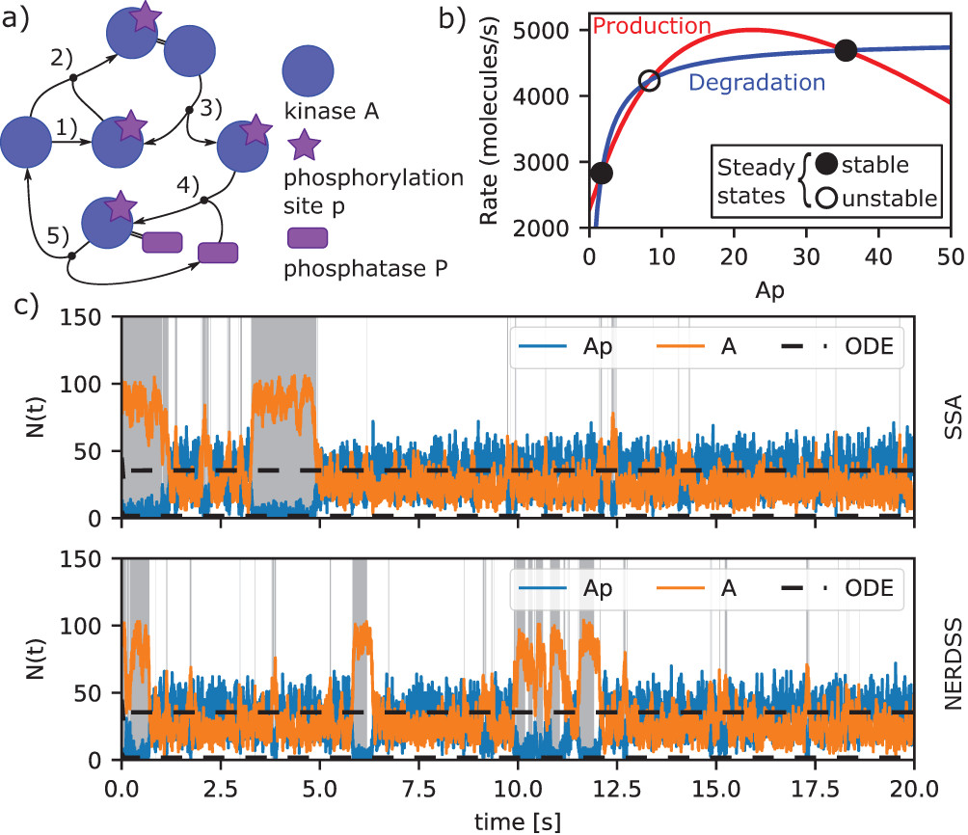
Stochastic effects in bistable systems
Exercise:
Run a long ssa simulation of the auto model and describe what you observe.
Result:
https://www.molbiolcell.org/doi/10.1091/mbc.E20-08-0530

