Slide 1
Cellular units and compartments
Cell Modeling Workshop 2022

Slide 2
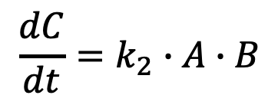
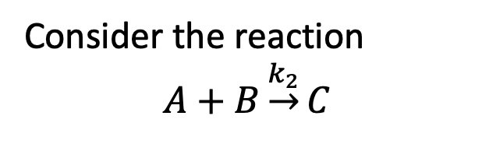
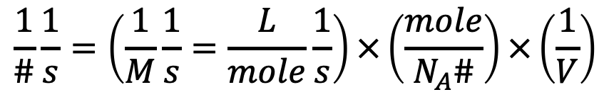
So far we have considered reaction networks in which all reactions occur in single well-mixed compartment.
Consider the reaction
$$A+B\underset{→}{k_{2}}C$$
Real cells are more complex
EC
PM
$$\frac{dC}{dt}=k_{2}∙A∙B$$
CP
EM
EN
NM
NU
What units?
$$\frac{1}{\#}\frac{1}{s}=\left(\frac{1}{M}\frac{1}{s}=\frac{L}{mole}\frac{1}{s}\right)×\left(\frac{mole}{N_{A}\#}\right)×\left(\frac{1}{V}\right)$$

Slide 3
So far we have considered reaction networks in which all reactions occur in single well-mixed compartment.
Consider the reaction
$$A+B\underset{→}{k_{2}}C$$
Real cells are more complex
EC
PM
$$\frac{dC}{dt}=k_{2}∙A∙B$$
CP
EM
EN
NM
NU
What units?
$$\frac{1}{\#}\frac{1}{s}=\left(\frac{1}{M}\frac{1}{s}=\frac{L}{mole}\frac{1}{s}\right)×\left(\frac{mole}{N_{A}\#}\right)×\left(\frac{1}{V}\right)$$

Slide 4
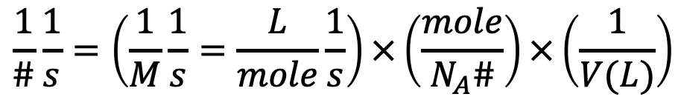
So far we have considered reaction networks in which all reactions occur in single well-mixed compartment.
Consider the reaction
$$A+B\underset{→}{k_{2}}C$$
Real cells are more complex
EC
PM
$$\frac{dC}{dt}=k_{2}∙A∙B$$
CP
EM
EN
NM
NU
What units?
$$\frac{1}{\#}\frac{1}{s}=\left(\frac{1}{M}\frac{1}{s}=\frac{L}{mole}\frac{1}{s}\right)×\left(\frac{mole}{N_{A}\#}\right)×\left(\frac{1}{V(L)}\right)$$

Slide 5
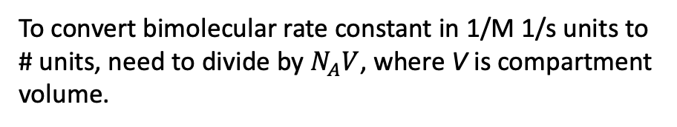
So far we have considered reaction networks in which all reactions occur in single well-mixed compartment.
Consider the reaction
$$A+B\underset{→}{k_{2}}C$$
Real cells are more complex
EC
PM
$$\frac{dC}{dt}=k_{2}∙A∙B$$
CP
EM
EN
NM
NU
What units?
$$\frac{1}{\#}\frac{1}{s}=\left(\frac{1}{M}\frac{1}{s}=\frac{L}{mole}\frac{1}{s}\right)×\left(\frac{mole}{N_{A}\#}\right)×\left(\frac{1}{V(L)}\right)$$
To convert bimolecular rate constant in 1/M 1/s units to # units, need to divide by $N_{A}V$, where V is compartment volume.

Slide 6
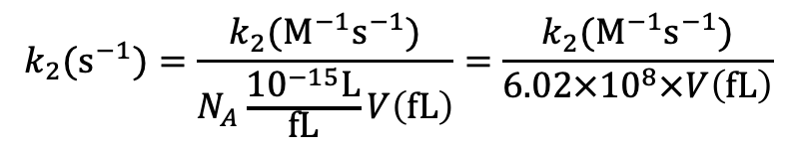
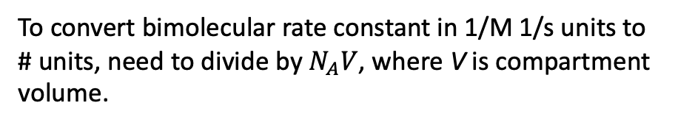
So far we have considered reaction networks in which all reactions occur in single well-mixed compartment.
Consider the reaction
$$A+B\underset{→}{k_{2}}C$$
Real cells are more complex
EC
PM
$$\frac{dC}{dt}=k_{2}∙A∙B$$
CP
EM
EN
NM
NU
To convert bimolecular rate constant in 1/M 1/s units to # units, need to divide by $N_{A}V$, where V is compartment volume.
If cell volume given in units of ${μm}^{3}=fL$, then we have
$$k_{2}(s^{−1})=\frac{k_{2}(M^{−1}s^{−1})}{N_{A}\frac{{10}^{−15}L}{fL}V\left(fL\right)}=\frac{k_{2}(M^{−1}s^{−1})}{6.02×{10}^{8}×V\left(fL\right)}$$

Slide 7

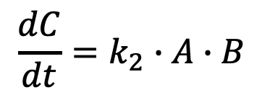
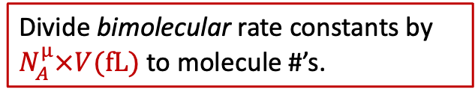
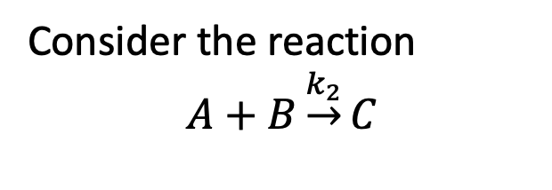
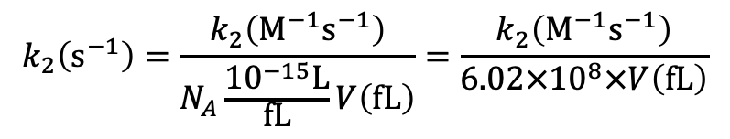
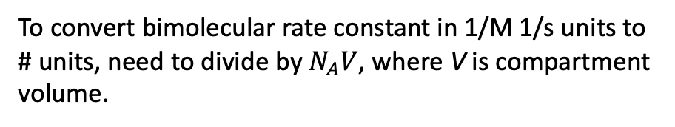
So far we have considered reaction networks in which all reactions occur in single well-mixed compartment.
Consider the reaction
$$A+B\underset{→}{k_{2}}C$$
Real cells are more complex
EC
PM
$$\frac{dC}{dt}=k_{2}∙A∙B$$
CP
EM
EN
NM
NU
To convert bimolecular rate constant in 1/M 1/s units to # units, need to divide by $N_{A}V$, where V is compartment volume.
If cell volume given in units of ${μm}^{3}=fL$, then we have
Divide bimolecular rate constants by $N_{A}^{μ}×V(\text{fL})$ to molecule #’s.
$$k_{2}\left(s^{−1}\right)=\frac{k_{2}\left(M^{−1}s^{−1}\right)}{N_{A}\frac{{10}^{−15}L}{fL}V\left(fL\right)}=\frac{k_{2}\left(M^{−1}s^{−1}\right)}{6.02×{10}^{8}×V\left(fL\right)}$$
$$N_{A}^{μ}$$

Slide 8
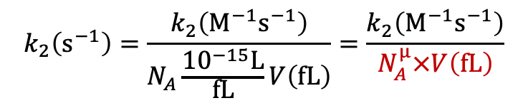
So far we have considered reaction networks in which all reactions occur in single well-mixed compartment.
Consider the reaction
$$A+B\underset{→}{k_{2}}C$$
Real cells are more complex
EC
PM
$$\frac{dC}{dt}=k_{2}∙A∙B$$
CP
EM
EN
NM
NU
To convert bimolecular rate constant in 1/M 1/s units to # units, need to divide by $N_{A}V$, where V is compartment volume.
If cell volume given in units of ${μm}^{3}=fL$, then we have
Divide bimolecular rate constants by $N_{A}^{μ}×V(\text{fL})$ to molecule #’s.
$$k_{2}\left(s^{−1}\right)=\frac{k_{2}\left(M^{−1}s^{−1}\right)}{N_{A}\frac{{10}^{−15}L}{fL}V\left(fL\right)}=\frac{k_{2}\left(M^{−1}s^{−1}\right)}{N_{A}^{μ}×V\left(fL\right)}$$

Slide 9
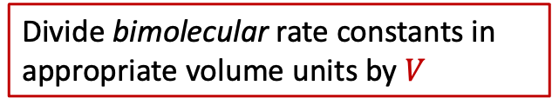
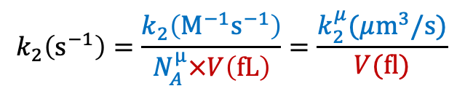
So far we have considered reaction networks in which all reactions occur in single well-mixed compartment.
Consider the reaction
$$A+B\underset{→}{k_{2}}C$$
Real cells are more complex
EC
PM
$$\frac{dC}{dt}=k_{2}∙A∙B$$
CP
EM
EN
NM
NU
To convert bimolecular rate constant in 1/M 1/s units to # units, need to divide by $N_{A}V$, where V is compartment volume.
If cell volume given in units of ${μm}^{3}=fL$, then we have
Divide bimolecular rate constants in appropriate volume units by $V$
$$k_{2}\left(s^{−1}\right)=\frac{k_{2}\left(M^{−1}s^{−1}\right)}{N_{A}^{μ}×V\left(fL\right)}=\frac{k_{2}^{μ}(μ{\text{m}}^{3}/\text{s})}{V(\text{fl})}$$

Slide 10


Going back to our simple ligand-receptor binding model….
We can parameterize the model like this
$$V_{\text{EC}}=1000×V_{\text{cell} }=1 \text{nL}$$
begin parameters
NaV 6.02e8 # Conversion constant: M -> #/um^3
Vcell 1000 # Typical eukaryotic cell volume ~ 1000 um^3
Vec 1000*Vcell # Volume of extracellular space
lig_conc 1e-8 # Ligand concentration - molar
L0 lig_conc*NaV*Vec # number of ligand molecules
R0 10000 # number of receptor molecules per cell
kp1 1e6/NaV # Forward binding rate constant in um^3
km1 0.01 # Reverse binding rate constant for L-R
end parameters
EC
PM
CP
$$V_{\text{cell}}=1000 {μ\text{m}}^{3}=1 \text{pL}$$
We also need to modify the binding rate in the rule
lrbind: L(r) + R(l) <-> L(r!1).R(l!1) kp1/Vec, km1

Slide 11
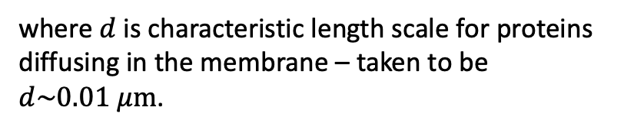

Surface reactions are treated as having an effective volume
$$V_{eff}=A∙d$$
where $d$ is characteristic length scale for proteins diffusing in the membrane – taken to be $d\sim 0.01 μm$.
EC
PM
CP
EM
The reduction of volume for 2D reactions compared to 3D can lead to several hundred-fold speedup of reactions on the membrane compared to cytoplasm.
EN
NM
NU
E.g. B. N. Kholodenko, J. B. Hoek, and H. V Westerhoff, “Why cytoplasmic signalling proteins should be recruited to cell membranes.,” Trends Cell Biol., vol. 10, no. 5, pp. 173–8, May 2000.

Slide 12

Returning to our dimerization model
EC
PM
Additional parameters:
CP
d_pm 0.01 # Effective thickness of the plasma membrane (10 nm)
Acell 1000 # Approximate area of PM
Vpm Acell*d_pm # Effective volume of PM
Modified reaction rules:
$$V_{pm}=A_{cell}×d_{cell}≈1000 μm^{2}×0.01 μm$$
lrbind1: L(r,r) + R(l) <-> L(r!1,r).R(l!1) kp1/Vec, km1
lrbind2: L(r,r!+) + R(l) <-> L(r!1,r!+).R(l!1) kp1/Vpm, km1

Slide 13
compartments block specifies compartmental topology and properties
EC
PM
CP
EM
EN
NM
NU
Key points
Must go from outer to inner
3D compartments can contain multiple 2D compartments
2D compartments can only contain 1 3D compartment
If compartments are defined, all seed species must have defined compartmental location

Slide 14
Compartmental dimerization model
Compartment specification:
begin compartments
EC 3 Vec
PM 2 Vpm EC
end compartments
EC
PM
CP
Each species must be initialized with compartment location:
begin species
@EC:L(r,r) L0
@PM:R(l) R0
end species
Volume factors automatically added to reactions generated by reaction rules:
lrbind1: L(r,r) + R(l) <-> L(r!1,r).R(l!1) kp1, km1
lrbind2: L(r,r!+) + R(l) <-> L(r!1,r!+).R(l!1) kp1, km1

Slide 15
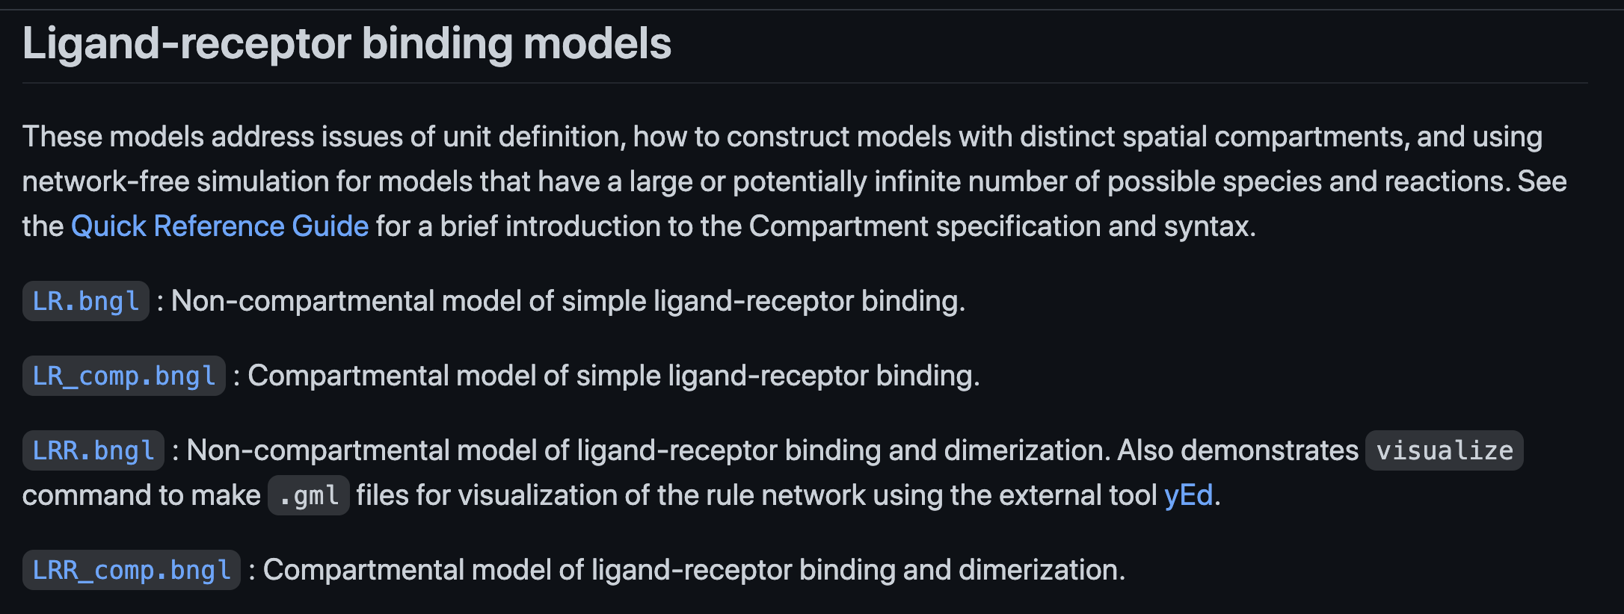
Sources of information about compartmental models
bionetgen.org – Main website for BioNetGen
bionetgen.org/tutorial – Extensive examples with documentation
Simple compartmental models are here.
Quick Reference Guide*– Handy overview of model syntax and conventions
Actions and Arguments Guide*– Full documentation of action syntax.
*Use links on bionetgen.org as they may have changed.

