Slide 1
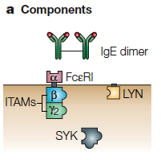
Defining Molecules
Molecules are the basic objects in a BNG model
BioNetGen Language
IgE(a,a)
FceRI(a,b~U~P,g2~U~P)
Lyn(U,SH2)
Syk(tSH2,lY~U~P,aY~U~P)
Components represent molecule elements
Domains
Motifs
Properties
Notes:
Start here – more or less.

Slide 2
Defining Molecules
Molecules are the basic objects in a BNG model
BioNetGen Language
IgE(a,a)
FceRI(a,b~U~P,g2~U~P)
Lyn(U,SH2)
Syk(tSH2,lY~U~P,aY~U~P)
Components may have different states representing
posttranslational modifications
conformational state
…
Notes:
Start here – more or less.

Slide 3
Binding
Molecules bind other molecules through components
BioNetGen Language
IgE(a,a!1).FceRI(a!1,b~U,g2~U)
Bonds are formed by linking two components. The ‘.’ indicates a set of molecules forming a complex.
Components may have both states and bonds.
Bonds may occur within a molecule.
FceRI(a,b~U!1,g2~U).Lyn(U!1)
Lyn(SH2!1,Cterm~P!1)
Notes:
Start here – more or less.

Slide 4
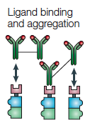

Defining Interaction Rules
BioNetGen Language
IgE(a,a)+ FceRI(a)<-> IgE(a,a!1).FceRI(a!1)
…
binding and dissociation
Transphosphorylation
Lyn(U!1).FceRI(b!1).FceRI(b~U)-> \
Lyn(U!1).FceRI(b!1).FceRI(b~P)
component state change

Slide 5
Parts of a rule
Reactants
Arrow
Products
Rate Law
IgE(a,a)+ FceRI(a)<-> IgE(a,a!1).FceRI(a!1) kp1, km1

Slide 6
Parts of a rule
Reactants
Arrow
Products
Rate Law
IgE(a,a)+ FceRI(a)<-> IgE(a,a!1).FceRI(a!1) kp1, km1
IgE(a,a)
FceRI(a,b~U,g~U)
Patterns select properties of each reactant molecule.

Slide 7
Parts of a rule
Reactants
Arrow
Products
Rate Law
IgE(a,a)+ FceRI(a)<-> IgE(a,a!1).FceRI(a!1) kp1, km1
IgE(a,a)
FceRI(a,b~U,g~U)
States of components not specified don’t affect the match.
“Don’t write, don’t care.”
FceRI(a,b~P,g~U)
Patterns select properties of each reactant molecule.

Slide 8
Parts of a rule
Reactants
Arrow
Products
Rate Law
IgE(a,a)+ FceRI(a)<-> IgE(a,a!1).FceRI(a!1) kp1, km1
IgE(a,a)+ FceRI(a,b~U,g~U)<-> IgE(a,a!1).FceRI(a!1,b~U,g~U) kp1, km1
IgE(a,a)+ FceRI(a,b~P,g~U)<-> IgE(a,a!1).FceRI(a!1,b~P,g~U) kp1, km1
Patterns select properties of each reactant molecule.
Because patterns can match many different species, each rule can generate many reactions.

Slide 9
Center and context
The center of a rule is the part that the rule changes.
bond is formed
IgE(a,a)+ FceRI(a)<-> IgE(a,a!1).FceRI(a!1) kp1, km1
The context is the part that is necessary for the rule to happen but is unchanged.

Slide 10
Center and context
The center of a rule is the part that the rule changes.
bond is formed
IgE(a,a)+ FceRI(a)<-> IgE(a,a!1).FceRI(a!1) kp1, km1
The context is the part that is necessary for the rule to happen but is unchanged.
Transphosphorylation
Context can represent complex biochemistry.
component state is changed
Lyn(U!1).FceRI(b!1).FceRI(b~U)-> \
Lyn(U!1).FceRI(b!1).FceRI(b~P)

Slide 11
Hands on portion

Slide 12
Lisman model for autoactivation
begin molecule types
K1(Y~0~P)
P(b)
end molecule types

Slide 13
Molecule Types
begin molecule types
K1(Y~0~P)
P(b)
end molecule types

Slide 14
Reaction Rules
begin reaction rules
R1: K1(Y~0) -> K1(Y~P) S
R1

Slide 15
Reaction Rules
begin reaction rules
R1: K1(Y~0) -> K1(Y~P) S
R2: K1(Y~0) + K1(Y~P) -> K1(Y~P) + K1(Y~P) 0.01
R2
R1

Slide 16
Reaction Rules
begin reaction rules
R1: K1(Y~0) -> K1(Y~P) S
R2: K1(Y~0) + K1(Y~P) -> K1(Y~P) + K1(Y~P) 0.01
R3: K1(Y~P) + P(b) <-> K1(Y~P!1).P(b!1) 0.4, 1
R4: K1(Y~P!1).P(b!1) -> K1(Y~0) + P(b) 1
end reaction rules
R2
R1
R4
R3

Slide 17
What we did so far
R2
R1
begin molecule types
K1(Y~0~P)
P(b)
end molecule types
Define molecules
R4
R3
begin reaction rules
R1: K1(Y~0) -> K1(Y~P) S
R2: K1(Y~0) + K1(Y~P) -> K1(Y~P) + K1(Y~P) 0.01
R3: K1(Y~P) + P(b) <-> K1(Y~P!1).P(b!1) 0.4, 1
R4: K1(Y~P!1).P(b!1) -> K1(Y~0) + P(b) 1
end reaction rules
Define rules

Slide 18
Parameters
Define parameters
begin parameters
S 0.01
end parameters
R2
R1
begin molecule types
K1(Y~0~P)
P(b)
end molecule types
Define molecules
R4
R3
begin reaction rules
R1: K1(Y~0) -> K1(Y~P) S
R2: K1(Y~0) + K1(Y~P) -> K1(Y~P) + K1(Y~P) 0.01
R3: K1(Y~P) + P(b) <-> K1(Y~P!1).P(b!1) 0.4, 1
R4: K1(Y~P!1).P(b!1) -> K1(Y~0) + P(b) 1
end reaction rules
Define rules

Slide 19
Species
Define parameters
begin parameters
S 0.01
end parameters
R2
R1
begin molecule types
K1(Y~0~P)
P(b)
end molecule types
Define molecules
R4
R3
Define initial conditions
begin species
K1(Y~0) 100
P(b) 10
end species
begin reaction rules
R1: K1(Y~0) -> K1(Y~P) S
R2: K1(Y~0) + K1(Y~P) -> K1(Y~P) + K1(Y~P) 0.01
R3: K1(Y~P) + P(b) <-> K1(Y~P!1).P(b!1) 0.4, 1
R4: K1(Y~P!1).P(b!1) -> K1(Y~0) + P(b) 1
end reaction rules
Define rules

Slide 20
Species
Define parameters
begin parameters
S 0.01
end parameters
R2
R1
begin molecule types
K1(Y~0~P)
P(b)
end molecule types
Define molecules
R4
R3
begin species
K1(Y~0) 100
P(b) 10
end species
Define initial conditions
begin reaction rules
R1: K1(Y~0) -> K1(Y~P) S
R2: K1(Y~0) + K1(Y~P) -> K1(Y~P) + K1(Y~P) 0.01
R3: K1(Y~P) + P(b) <-> K1(Y~P!1).P(b!1) 0.4, 1
R4: K1(Y~P!1).P(b!1) -> K1(Y~0) + P(b) 1
end reaction rules
Define rules

Slide 21
Obervables
Define parameters
begin parameters
S 0.01
end parameters
R2
R1
begin molecule types
K1(Y~0~P)
P(b)
end molecule types
Define molecules
R4
R3
begin species
K1(Y~0) 100
P(b) 10
end species
Define initial conditions
begin observables
Molecules K1p K1(Y~P)
end observables
Define observables
begin reaction rules
R1: K1(Y~0) -> K1(Y~P) S
R2: K1(Y~0) + K1(Y~P) -> K1(Y~P) + K1(Y~P) 0.01
R3: K1(Y~P) + P(b) <-> K1(Y~P!1).P(b!1) 0.4, 1
R4: K1(Y~P!1).P(b!1) -> K1(Y~0) + P(b) 1
end reaction rules
Define rules

Slide 22
Actions
begin model
Define parameters
begin parameters
S 0.01
end parameters
R2
R1
begin molecule types
K1(Y~0~P)
P(b)
end molecule types
Define molecules
R4
R3
begin seed species
K1(Y~0) 100
P(b) 10
end seed species
Define initial conditions
begin observables
Molecules K1p K1(Y~P)
end observables
Define observables
begin reaction rules
R1: K1(Y~0) -> K1(Y~P) S
R2: K1(Y~0) + K1(Y~P) -> K1(Y~P) + K1(Y~P) 0.01
R3: K1(Y~P) + P(b) <-> K1(Y~P!1).P(b!1) 0.4, 1
R4: K1(Y~P!1).P(b!1) -> K1(Y~0) + P(b) 1
end reaction rules
Define rules
end model
Define actions

Slide 23
Actions
begin model
Define parameters
begin parameters
S 0.01
end parameters
R2
R1
begin molecule types
K1(Y~0~P)
P(b)
end molecule types
Define molecules
R4
R3
begin seed species
K1(Y~0) 100
P(b) 10
end seed species
Define initial conditions
begin observables
Molecules K1p K1(Y~P)
end observables
Define observables
begin reaction rules
R1: K1(Y~0) -> K1(Y~P) S
R2: K1(Y~0) + K1(Y~P) -> K1(Y~P) + K1(Y~P) 0.01
R3: K1(Y~P) + P(b) <-> K1(Y~P!1).P(b!1) 0.4, 1
R4: K1(Y~P!1).P(b!1) -> K1(Y~0) + P(b) 1
end reaction rules
Define rules
end model
Define actions

Slide 24
Actions
begin model
Define parameters
begin parameters
S 0.01
end parameters
R2
R1
begin molecule types
K1(Y~0~P)
P(b)
end molecule types
Define molecules
R4
R3
begin seed species
K1(Y~0) 100
P(b) 10
end seed species
Define initial conditions
begin observables
Molecules K1p K1(Y~P)
end observables
Define observables
begin reaction rules
R1: K1(Y~0) -> K1(Y~P) S
R2: K1(Y~0) + K1(Y~P) -> K1(Y~P) + K1(Y~P) 0.01
R3: K1(Y~P) + P(b) <-> K1(Y~P!1).P(b!1) 0.4, 1
R4: K1(Y~P!1).P(b!1) -> K1(Y~0) + P(b) 1
end reaction rules
Define rules
end model
Define actions
generate_network()
simulate({method=>"ode", t_end=>100, n_steps=>200})

Slide 25
Complete file
begin model
Define parameters
begin parameters
S 0.01
end parameters
R2
R1
begin molecule types
K1(Y~0~P)
P(b)
end molecule types
Define molecules
R4
R3
begin seed species
K1(Y~0) 100
P(b) 10
end seed species
Define initial conditions
begin observables
Molecules K1p K1(Y~P)
end observables
Define observables
begin reaction rules
R1: K1(Y~0) -> K1(Y~P) S
R2: K1(Y~0) + K1(Y~P) -> K1(Y~P) + K1(Y~P) 0.01
R3: K1(Y~P) + P(b) <-> K1(Y~P!1).P(b!1) 0.4, 1
R4: K1(Y~P!1).P(b!1) -> K1(Y~0) + P(b) 1
end reaction rules
Define rules
end model
Define actions
generate_network()
simulate({method=>"ode", t_end=>100, n_steps=>200})

Slide 26
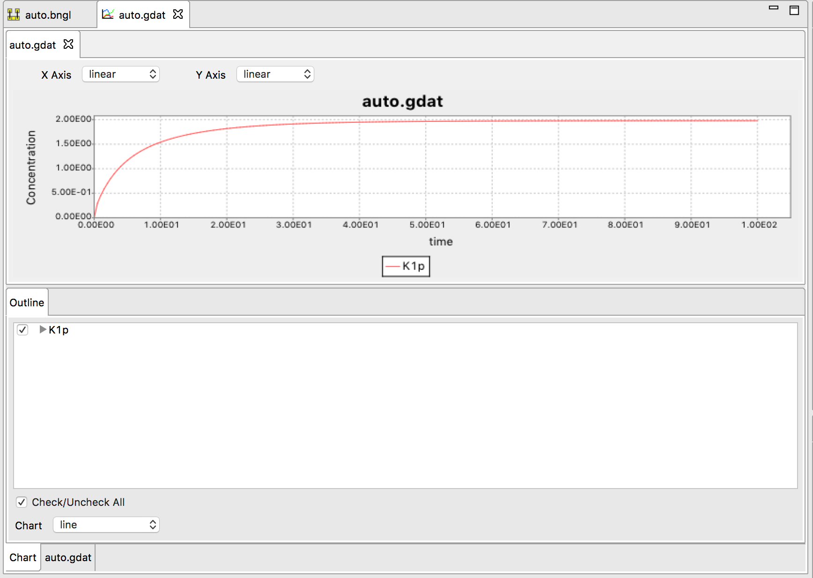
Simulation Output
RuleBender View
begin model
begin parameters
S 0.01
end parameters
R2
R1
begin molecule types
K1(Y~0~P)
P(b)
end molecule types
R4
R3
begin seed species
K1(Y~0) 100
P(b) 10
end seed species
begin observables
Molecules K1p K1(Y~P)
end observables
begin reaction rules
R1: K1(Y~0) -> K1(Y~P) S
R2: K1(Y~0) + K1(Y~P) -> K1(Y~P) + K1(Y~P) 0.01
R3: K1(Y~P) + P(b) <-> K1(Y~P!1).P(b!1) 0.4, 1
R4: K1(Y~P!1).P(b!1) -> K1(Y~0) + P(b) 1
end reaction rules
end model
generate_network()
simulate({method=>"ode", t_end=>100, n_steps=>200})

Slide 27
Parameter Scan
Use parameter_scan action in the BNGL file
parameter_scan({parameter=>"S",par_min=>1e-3,par_max=>1e-1,n_scan_pts=>50,\
method=>"ode",t_end=>10000,log_scale=>1})

Slide 28
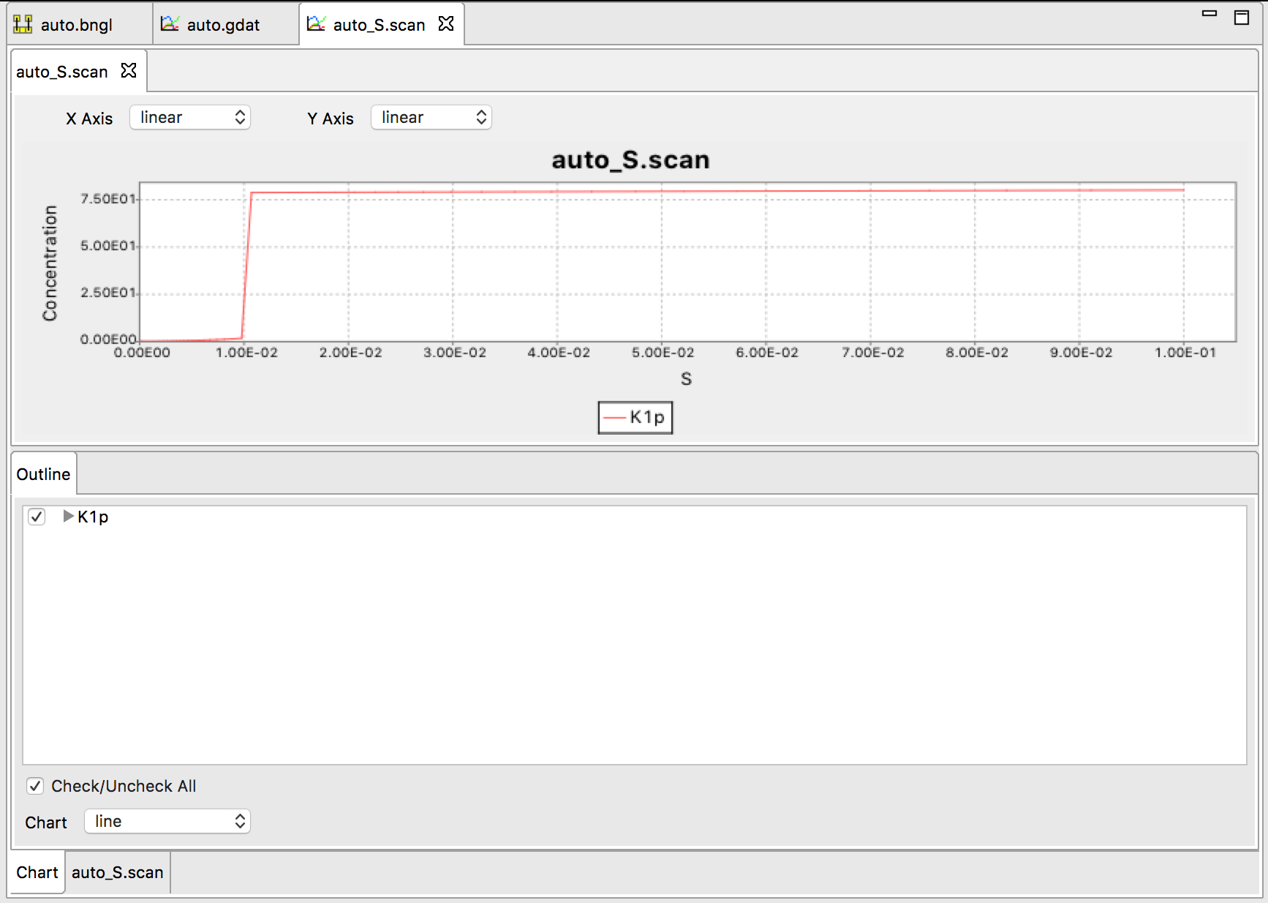
Understanding the observed switching behavior
Below the switching point, this system has two stable steady states.

Slide 29
Understanding the observed switching behavior
Below the switching point, this system has two stable steady states.
This can be shown by making a rate balance plot:

Slide 30

Understanding the observed switching behavior
Below the switching point, this system has two stable steady states.
This can be shown by making a rate balance plot:
https://www.molbiolcell.org/doi/10.1091/mbc.E20-08-0530

Slide 31
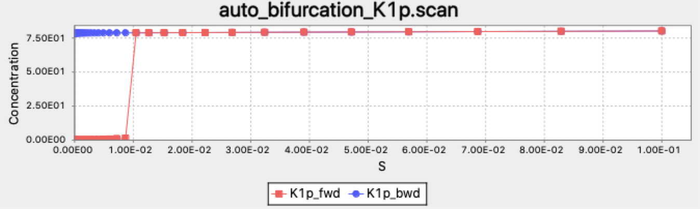
Bistability can be identified using the bifurcate action, which uses a bidirectional scan
bifurcate({parameter=>"S",par_min=>1e-5,par_max=>1e-1,n_scan_pts=>50,\
method=>"ode",t_end=>10000,log_scale=>1})
Starting point for each simulation at new parameter value along scan is end point from previous simulation.

Slide 32
Bistability can be identified using the bifurcate action, which uses a bidirectional scan
bifurcate({parameter=>"S",par_min=>1e-5,par_max=>1e-1,n_scan_pts=>50,\
method=>"ode",t_end=>10000,log_scale=>1})
Starting point for each simulation at new parameter value along scan is end point from previous simulation.
Bistable region
Note that with these parameters, the switch is irreversible

Slide 33
Stochastic effects in bistable systems
Exercise:
Run a long ssa simulation of the auto model and describe what you observe.

Slide 34
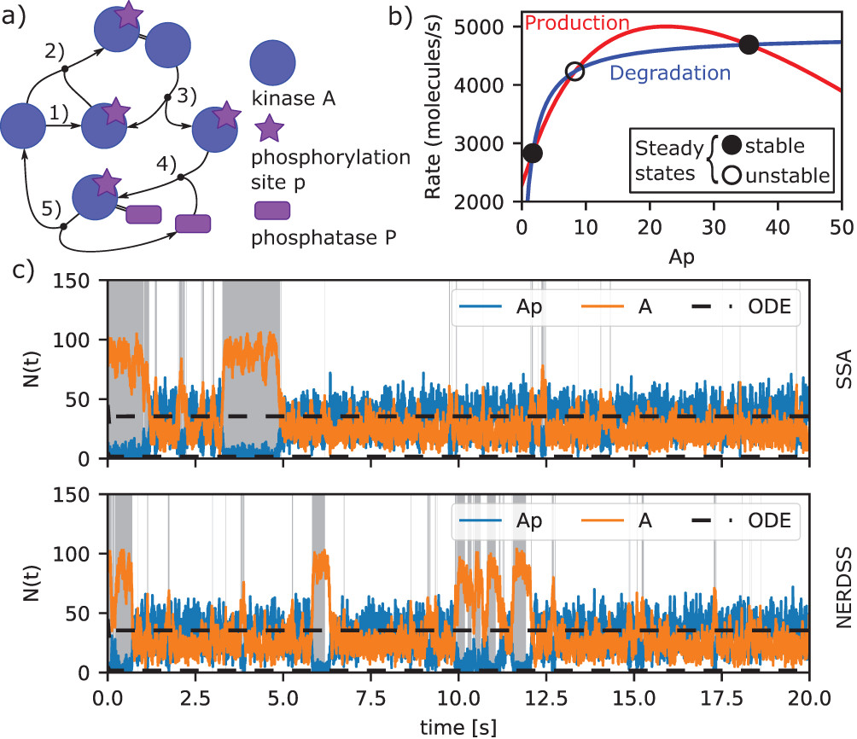
Stochastic effects in bistable systems
Exercise:
Run a long ssa simulation of the auto model and describe what you observe.
Result:
https://www.molbiolcell.org/doi/10.1091/mbc.E20-08-0530

