Slide 1
Energy Based Modeling with BioNetGen
2022 Cell Modeling Workshop

Slide 2
From Rule Based Modeling to Energy Based Models
Rule-based models are limited by:
Regulatory complexity
Detailed balance

Slide 3
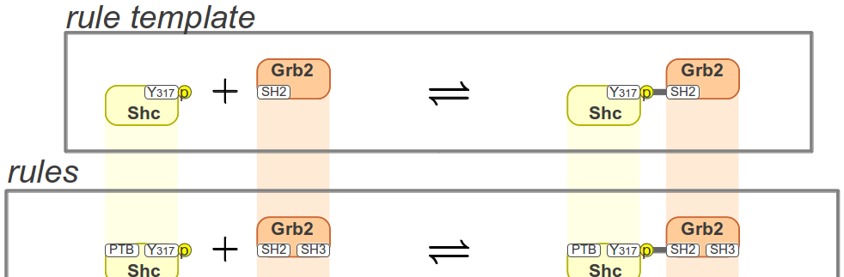
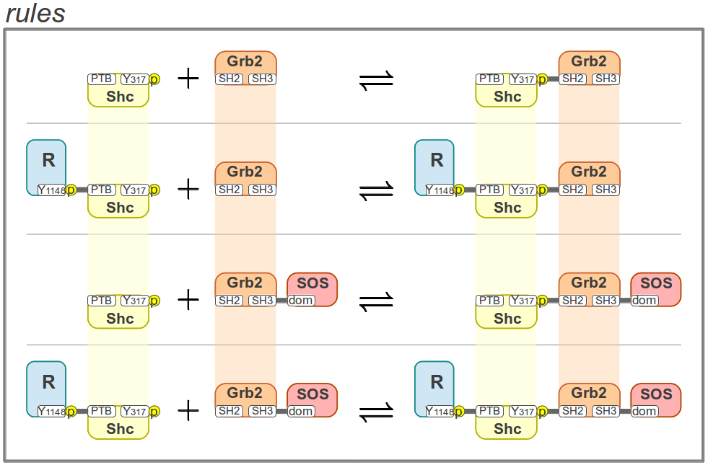
Regulatory complexity
R1
R2
R3
These rules introduce cooperative interactions
R4

Slide 4
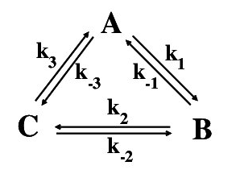
Detailed Balance
Multi-site interactions give rise to reaction loops
Reaction loops generate thermodynamic constraints
If parameter constraints are not obeyed, system will violate detailed balance.

Slide 5
Free Energy
Free energy change of a reaction:
$K_{eq}=exp⁡\left(−\frac{∆G^{0}}{RT}\right)$
R: universal gas constant
T: temperature.
Energies can be scaled by RT:
=
Detailed balance constraint:

Slide 6

Energy BioNetGen (eBNG) Overview
Builds on pioneering work of
Ollivier, Shahrezaei & Swain, PLOS Comp Biol., 6, e1000975 (2010)
Danos et al., CONCUR 2013, LNCS, 8052, 380-394 (2013)
Reformulates rule-based model as:
Basic transformations, or “Energy Rules”
Energy patterns
Advantages:
Simplifies model construction
Reaction networks satisfy detailed balance
Biophysical interpretation (cooperativity)
Fewer free parameters
Implemented in BioNetGen (bionetgen.org)

Slide 7
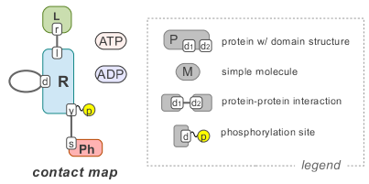




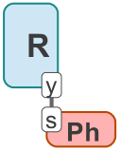


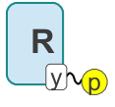
Energy Rules
specify what transitions can take place
+
$↔$
+
$↔$
+
$↔$
$↔$

Slide 8
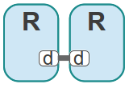

Type I energy patterns
specify free energies associated with bonds and states
Bonds
Site modifications
High energy
molecule motif
Unbound monomers with default state values have zero energy, i.e., form reference state.

Slide 9
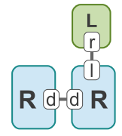
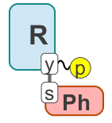
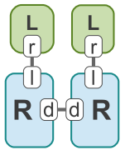
Type II energy patterns
specify energies for cooperative interactions
bond–bond cooperativity
bond–state cooperativity
higher-order cooperativity

Slide 10
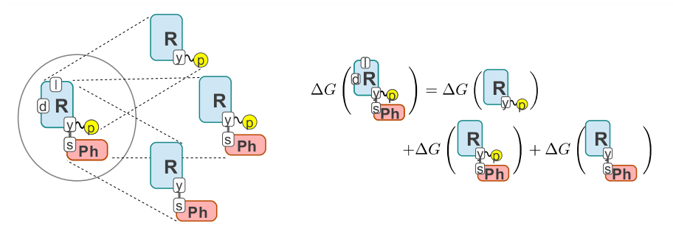
Species free energy
computed as a sum of matching energy patterns

Slide 11
Kinetic constants from Linear Transition State Theory
Requires 2 additional parameters per Energy Rule, and
is activation energy when
Only changes with
Only changes with
*J. F. Ollivier et al. (2010) PLOS Comp. Biol.
J. E. Leffler (1953) “Parameters for the Description of Transition States”, Science, 117, 340
Notes:
Combine with next slide.

Slide 12
Extensions to BioNetGen for energy modeling
Energy rules specify basic transformations with Arrhenius rate law
2. For each reaction that is generated by the system
Reaction free energies are computed from reactant and product species using energy patterns
Corresponding rate constants are computed using Linear Transition State theory
L(r) + R(l) <-> L(r!1).R(l!1) Arrhenius(phi,E0_LR)
R(d) + R(d) <-> R(d!1).R(d!1) Arrhenius(phi,E0_RR)

Slide 13
Conclusions
Advantages of Energy BioNetGen
More compact model specification
Cooperative effects more clearly indicated (and easier to analyze)
Reaction network is guaranteed to satisfy detailed balance
Facilitates systematic investigation of cooperative effects
Can be combined with regularization to facilitate parameter estimation
Drawbacks
Energy-based parameterization requires user adjustment
Simulation requires network generation

Slide 14
Related work
Ollivier, et al. (2010)
Uses two-state allosteric models
Cannot model higher order cooperative interactions
Danos et al. (2013)
Generalized to arbitrary order using energy patterns but did not provide implementation

