Slide 1

BASIC SCIENTIFIC LIBRARIES FOR BIOSIGNAL MANIPULATION
John Fredy Ochoa Gómez
Bioengineering Department
University of Antioquia

Slide 2
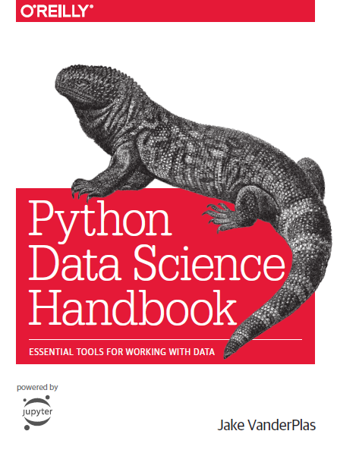
MATPLOTLIB

Slide 3
MATPLOTLIB
INTRODUCTION
Matplotlib is a multiplatform data visualization library built on NumPy arrays, and designed to work with the broader SciPy stack.
It was conceived originally as a patch to IPython for enabling interactive MATLAB-style plotting via gnuplot from the IPython command line.

Slide 4
MATPLOTLIB
INTRODUCTION
It received an early boost when it was adopted as the plotting package of choice of the Space Telescope Science Institute (the folks behind the Hubble Telescope), which financially supported Matplotlib’s development and greatly expanded its capabilities.

Slide 5
MATPLOTLIB
INTRODUCTION
Newer tools like ggplot and ggvis in the R language, along with web visualization toolkits based on D3js and HTML5 canvas, often make Matplotlib feel old-fashioned.
Recent Matplotlib versions make it relatively easy to set new global plotting styles

Slide 6
MATPLOTLIB
GENERAL MATPLOTLIB TIPS
Importing matplotlib just as we use the np shorthand for NumPy we will use some standard shorthands for Matplotlib imports:
import matplotlib as mpl
import matplotlib.pyplot as plt

Slide 7
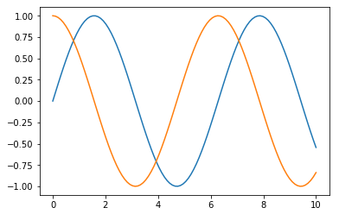
MATPLOTLIB
GENERAL MATPLOTLIB TIPS
Plotting from a script
If you are using Matplotlib from within a script, the function plt.show() is your friend.
plt.show() starts an event loop, looks for all currently active figure objects, and opens one or more interactive windows that display your figure or figures.
Example:
import matplotlib.pyplot as plt
import numpy as np
x = np.linspace(0, 10, 100)
plt.plot(x, np.sin(x))
plt.plot(x, np.cos(x))
plt.show()

Slide 8
MATPLOTLIB
GENERAL MATPLOTLIB TIPS
Plotting from a script
One thing to be aware of: the plt.show() command should be used only once per Python session, and is most often seen at the very end of the script.
Multiple show() commands can lead to unpredictable backend-dependent behavior, and should mostly be avoided.

Slide 9
MATPLOTLIB
GENERAL MATPLOTLIB TIPS
Plotting from an IPython shell
It can be very convenient to use Matplotlib interactively within an IPython shell.
IPython is built to work well with Matplotlib if you specify Matplotlib mode:
%matplotlib
import matplotlib.pyplot as plt
At this point, any plt plot command will cause a figure window to open, and further commands can be run to update the plot

Slide 10
MATPLOTLIB
GENERAL MATPLOTLIB TIPS
Plotting from an IPython notebook
The IPython notebook is a browser-based interactive data analysis tool that can combine narrative, code, graphics, HTML elements, and much more into a single executable document.
Plotting interactively within an IPython notebook can be done with the %matplotlib command, and works in a similar way to the IPython shell.

Slide 11
MATPLOTLIB
GENERAL MATPLOTLIB TIPS
Plotting from an IPython notebook
In the IPython notebook, you also have the option of embedding graphics directly in the notebook, with two possible options:
%matplotlib notebook #interactive plots embedded within the notebook
%matplotlib inline #static images embedded in the notebook

Slide 12
MATPLOTLIB
GENERAL MATPLOTLIB TIPS
Saving Figures to File
One nice feature of Matplotlib is the ability to save figures in a wide variety of formats.
You can save a figure using the savefig() command.
fig.savefig('my_figure.png')
In savefig(), the file format is inferred from the extension of the given filename.

Slide 13
MATPLOTLIB
GENERAL MATPLOTLIB TIPS
Depending on what backends you have installed, many different file formats are available.
The list of supported file types for the system can be obtained by using the following method of the figure canvas object:
fig.canvas.get_supported_filetypes()
{'eps': 'Encapsulated Postscript',
'jpeg': 'Joint Photographic Experts Group',
'jpg': 'Joint Photographic Experts Group',
'pdf': 'Portable Document Format', …

Slide 14
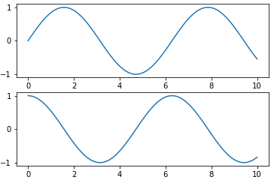
MATPLOTLIB
MATLAB-STYLE INTERFACE
Matplotlib was originally written as a Python alternative for MATLAB users, and much of its syntax reflects that fact.
The MATLAB-style tools are contained in the pyplot (plt) interface.
The following code is similar to MATLAB:
plt.figure() # create a plot figure
# create the first of two panels and set current axis
plt.subplot(2, 1, 1) # (rows, columns, panel number)
plt.plot(x, np.sin(x))
# create the second panel and set current axis
plt.subplot(2, 1, 2)
plt.plot(x, np.cos(x));

Slide 15
MATPLOTLIB
MATLAB-STYLE INTERFACE
It’s important to note that this interface is stateful: it keeps track of the “current” figure and axes, which are where all plt commands are applied.
While this stateful interface is fast and convenient for simple plots, it is easy to run into problems.
For example, once the second panel is created, how can we go back and add something to the first?

Slide 16
MATPLOTLIB
OBJECT-ORIENTED INTERFACE
The object-oriented interface is available for these more complicated situations, and for when you want more control over your figure.
Rather than depending on some notion of an “active” figure or axes, in the object-oriented interface the plotting functions are methods of explicit Figure and Axes objects.

Slide 17
MATPLOTLIB
OBJECT-ORIENTED INTERFACE
To re-create the previous plot using this style of plotting, you might do the following:
# First create a grid of plots
# ax will be an array of two Axes objects
fig, ax = plt.subplots(2)
# Call plot() method on the appropriate object
ax[0].plot(x, np.sin(x))
ax[1].plot(x, np.cos(x));

Slide 18
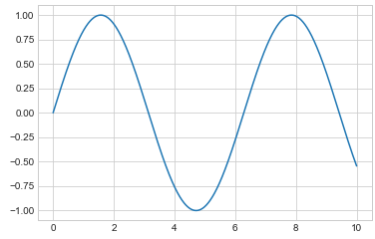
MATPLOTLIB
SIMPLE LINE PLOTS
Perhaps the simplest of all plots is the visualization of a single function y = f(x).
%matplotlib inline
import matplotlib.pyplot as plt
plt.style.use('seaborn-whitegrid')
import numpy as np
fig = plt.figure()
ax = plt.axes()
x = np.linspace(0, 10, 1000)
ax.plot(x, np.sin(x));
Alternatively, using pylab interface
plt.plot(x, np.sin(x));

Slide 19
MATPLOTLIB
SIMPLE LINE PLOTS
The figure (an instance of the class plt.Figure) can be thought of as a single container that contains all the objects representing axes, graphics, text, and labels.
The axes (an instance of the class plt.Axes) is what we see above: a bounding box with ticks and labels, which will eventually contain the plot elements that make up our visualization.

Slide 20
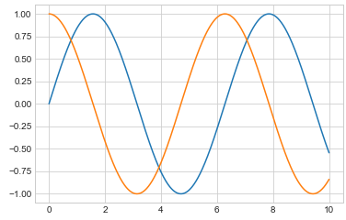
MATPLOTLIB
SIMPLE LINE PLOTS
If we want to create a single figure with multiple lines, we can simply call the plot function multiple times:
plt.plot(x, np.sin(x))
plt.plot(x, np.cos(x));

Slide 21
MATPLOTLIB
SIMPLE LINE PLOTS
Adjusting the plot: line colors and styles
The first adjustment you might wish to make to a plot is to control the line colors and styles.
To adjust the color, you can use the color keyword, which accepts a string argument representing virtually any imaginable color.

Slide 22
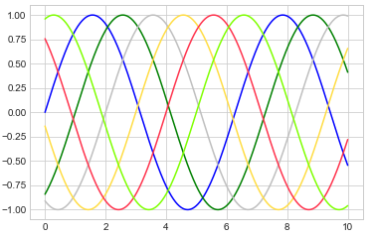
MATPLOTLIB
SIMPLE LINE PLOTS
Adjusting the plot: line colors and styles
The color can be specified in a variety of ways:
plt.plot(x, np.sin(x - 0), color='blue') # specify color by name
plt.plot(x, np.sin(x - 1), color='g') # short color code (rgbcmyk)
plt.plot(x, np.sin(x - 2), color='0.75') # Grayscale between 0 and 1
plt.plot(x, np.sin(x - 3), color='#FFDD44') # Hex code (RRGGBB from 00 to FF)
plt.plot(x, np.sin(x - 4), color=(1.0,0.2,0.3)) # RGB tuple, values 0 and 1
plt.plot(x, np.sin(x - 5), color='chartreuse'); # all HTML color names supported

Slide 23
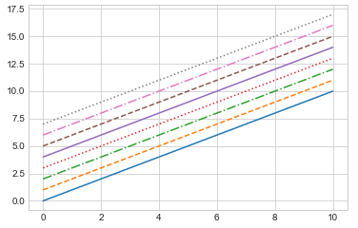
MATPLOTLIB
SIMPLE LINE PLOTS
Adjusting the plot: line colors and styles
If no color is specified, Matplotlib will automatically cycle through a set of default colors for multiple lines.
You can adjust the line style using the linestyle keyword:
plt.plot(x, x + 0, linestyle='solid')
plt.plot(x, x + 1, linestyle='dashed')
plt.plot(x, x + 2, linestyle='dashdot')
plt.plot(x, x + 3, linestyle='dotted');
# For short, you can use the following codes:
plt.plot(x, x + 4, linestyle='-') # solid
plt.plot(x, x + 5, linestyle='--') # dashed
plt.plot(x, x + 6, linestyle='-.') # dashdot
plt.plot(x, x + 7, linestyle=':'); # dotted

Slide 24
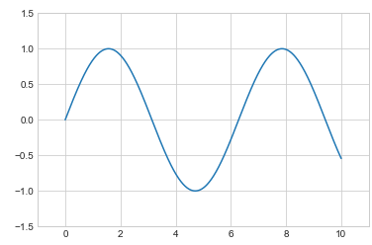
MATPLOTLIB
SIMPLE LINE PLOTS
Adjusting the plot: Axes Limits
Matplotlib does a decent job of choosing default axes limits for your plot, but sometimes it’s nice to have finer control.
The most basic way to adjust axis limits is to use the plt.xlim() and plt.ylim() methods:
plt.plot(x, np.sin(x))
plt.xlim(-1, 11)
plt.ylim(-1.5, 1.5);

Slide 25
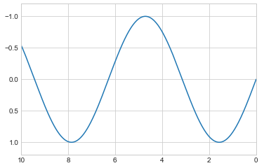
MATPLOTLIB
SIMPLE LINE PLOTS
Adjusting the plot: Axes Limits
If for some reason you’d like either axis to be displayed in reverse, you can simply reverse the order of the arguments:
plt.plot(x, np.sin(x))
plt.xlim(10, 0)
plt.ylim(1.2, -1.2);

Slide 26
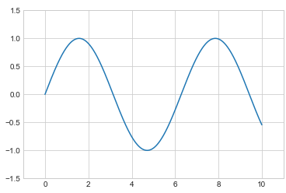
MATPLOTLIB
SIMPLE LINE PLOTS
Adjusting the plot: Axes Limits
The plt.axis() method allows you to set the x and y limits with a single call, by passing a list that specifies [xmin, xmax, ymin, ymax] :
plt.plot(x, np.sin(x))
plt.axis([-1, 11, -1.5, 1.5]);

Slide 27
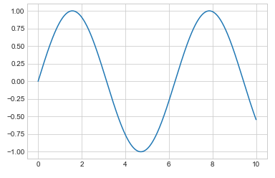
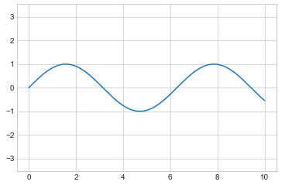
MATPLOTLIB
SIMPLE LINE PLOTS
Adjusting the plot: Axes Limits
The plt.axis() method goes even beyond this, allowing you to do things like automatically tighten the bounds around the current plot:
plt.plot(x, np.sin(x))
plt.axis('tight');
plt.plot(x, np.sin(x))
plt.axis('equal');

Slide 28
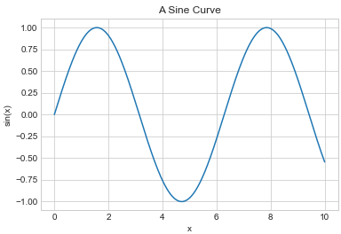
MATPLOTLIB
LABELING PLOTS
Titles and axis labels are the simplest such labels. There are methods that can be used to quickly set them:
plt.plot(x, np.sin(x))
plt.title("A Sine Curve")
plt.xlabel("x")
plt.ylabel("sin(x)");

Slide 29
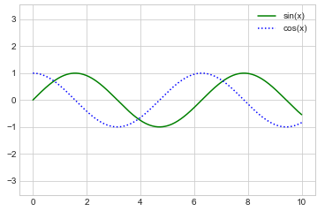
MATPLOTLIB
LABELING PLOTS
When multiple lines are being shown within a single axes, it can be useful to create a plot legend that labels each line type.
plt.plot(x, np.sin(x), '-g', label='sin(x)')
plt.plot(x, np.cos(x), ':b', label='cos(x)')
plt.axis('equal')
plt.legend();

Slide 30
MATPLOTLIB
MATPLOTLIB GOTCHAS
While most plt functions translate directly to ax methods (such as plt.plot() → ax.plot(), plt.legend() → ax.legend(), etc.), this is not the case for all commands.
In particular, functions to set limits, labels, and titles are slightly modified.
For transitioning between MATLAB-style functions and object-oriented methods, make the following changes:
plt.xlabel() → ax.set_xlabel()
plt.ylabel() → ax.set_ylabel()
plt.xlim() → ax.set_xlim()
plt.ylim() → ax.set_ylim()
plt.title() → ax.set_title()

Slide 31
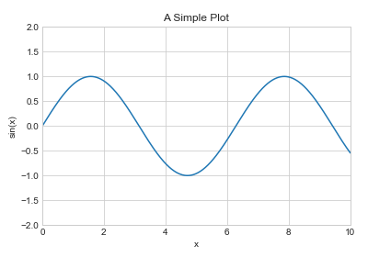
MATPLOTLIB
MATPLOTLIB GOTCHAS
In the object-oriented interface to plotting, rather than calling these functions individually, it is often more convenient to use the ax.set() method to set all these properties at once:
ax = plt.axes()
ax.plot(x, np.sin(x))
ax.set(xlim=(0, 10), ylim=(-2, 2), xlabel='x', ylabel='sin(x)', title='A Simple Plot');

Slide 32
MATPLOTLIB
SIMPLE SCATTER PLOTS
Here the points are represented individually with a dot, circle, or other shape.
plt.scatter(x, y, marker='o');
The primary difference of plt.scatter from plt.plot is that it can be used to create scatter plots where the properties of each individual point (size, face color, edge color, etc.) can be individually controlled or mapped to data.
For large datasets plt.plot should be preferred over plt.scatter.

Slide 33
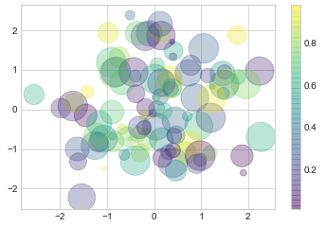
MATPLOTLIB
SIMPLE SCATTER PLOTS
rng = np.random.RandomState(0)
x = rng.randn(100)
y = rng.randn(100)
colors = rng.rand(100)
sizes = 1000 * rng.rand(100)
plt.scatter(x, y, c=colors, s=sizes, alpha=0.3, cmap='viridis')
plt.colorbar();
Notice that the color argument is automatically mapped to a color scale (shown here by the colorbar() command), and the size argument is given in pixels.
In this way, the color and size of points can be used to convey information in the visualization, in order to illustrate multidimensional data.

Slide 34
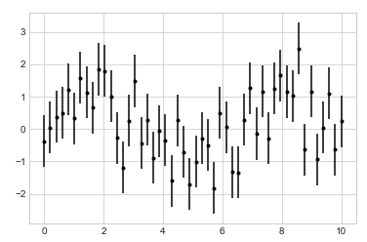
MATPLOTLIB
BASIC ERRORBARS
A basic errorbar can be created with a single Matplotlib function call:
%matplotlib
import matplotlib.pyplot as plt
plt.style.use('seaborn-whitegrid')
import numpy as np
x = np.linspace(0, 10, 50)
dy = 0.8
y = np.sin(x) + dy * np.random.randn(50)
plt.errorbar(x, y, yerr=dy, fmt='.k');

Slide 35
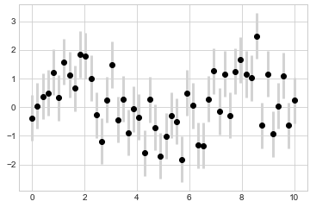
MATPLOTLIB
BASIC ERRORBARS
I often find it helpful, especially in crowded plots, to make the errorbars lighter than the points themselves:
plt.errorbar(x, y, yerr=dy, fmt='o', color='black', ecolor='lightgray', elinewidth=3, capsize=0);
In addition to these options, you can also specify horizontal errorbars (xerr), onesided errorbars, and many other variants.
For more information on the options available, refer to the docstring of plt.errorbar.

Slide 36
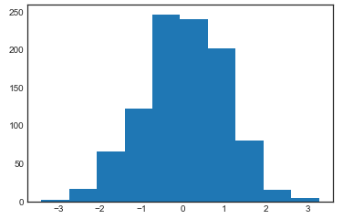
MATPLOTLIB
HISTOGRAMS, BINNINGS, AND DENSITY
A simple histogram can be a great first step in understanding a dataset.
import numpy as np
import matplotlib.pyplot as plt
plt.style.use('seaborn-white')
data = np.random.randn(1000)
plt.hist(data);

Slide 37
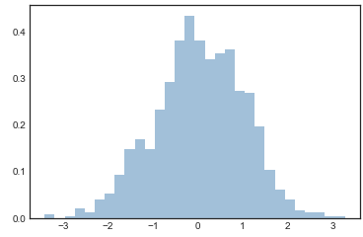
MATPLOTLIB
HISTOGRAMS, BINNINGS, AND DENSITY
The hist() function has many options to tune both the calculation and the display
plt.hist(data, bins=30, normed=True, alpha=0.5, histtype='stepfilled', color='steelblue', edgecolor='none');

Slide 38
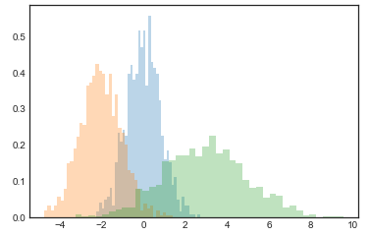
MATPLOTLIB
HISTOGRAMS, BINNINGS, AND DENSITY
The combination of histtype='stepfilled' along with some transparency alpha is very useful when comparing histograms of several distributions:
x1 = np.random.normal(0, 0.8, 1000)
x2 = np.random.normal(-2, 1, 1000)
x3 = np.random.normal(3, 2, 1000)
kwargs = dict(histtype='stepfilled', alpha=0.3, normed=True, bins=40)
plt.hist(x1, **kwargs)
plt.hist(x2, **kwargs)
plt.hist(x3, **kwargs);

Slide 39
MATPLOTLIB
HISTOGRAMS, BINNINGS, AND DENSITY
To simply compute the histogram (that is, count the number of points in a given bin) and not display it, the np.histogram() function is available:
counts, bin_edges = np.histogram(data, bins=5)

Slide 40
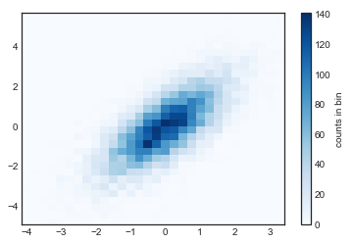
MATPLOTLIB
HISTOGRAMS, BINNINGS, AND DENSITY
Two-Dimensional Histograms and Binnings
mean = [0, 0]
cov = [[1, 1], [1, 2]]
x, y = np.random.multivariate_normal(mean, cov, 10000).T
plt.hist2d(x, y, bins=30, cmap='Blues')
cb = plt.colorbar()
cb.set_label('counts in bin')

Slide 41
MATPLOTLIB
HISTOGRAMS, BINNINGS, AND DENSITY
Two-Dimensional Histograms and Binnings
plt.hist2d has a counterpart in np.histogram2d, which can be used as follows:
counts, xedges, yedges = np.histogram2d(x, y, bins=30)

Slide 42
MATPLOTLIB
MULTIPLE SUBPLOTS
Sometimes it is helpful to compare different views of data side by side. To this end, Matplotlib has the concept of subplots: groups of smaller axes that can exist together within a single figure.
These subplots might be insets, grids of plots, or other more complicated layouts. In this section, we’ll explore four routines for creating subplots in Matplotlib.

Slide 43
MATPLOTLIB
MULTIPLE SUBPLOTS
plt.axes: Subplots by Hand
The most basic method of creating an axes is to use the plt.axes function. As we’ve seen previously, by default this creates a standard axes object that fills the entire figure.
plt.axes also takes an optional argument that is a list of four numbers in the figure coordinate system. These numbers represent [bottom, left, width, height] in the figure coordinate system, which ranges from 0 at the bottom left of the figure to 1 at the top right of the figure.

Slide 44
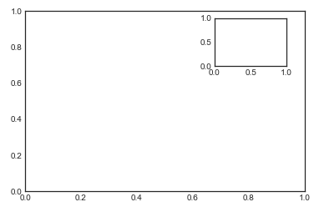
MATPLOTLIB
MULTIPLE SUBPLOTS
plt.axes: Subplots by Hand
For example, we might create an inset axes at the top-right corner of another axes by setting the x and y position to 0.65 (that is, starting at 65% of the width and 65% of the height of the figure) and the x and y extents to 0.2 (that is, the size of the axes is 20% of the width and 20% of the height of the figure).
import matplotlib.pyplot as plt
plt.style.use('seaborn-white')
import numpy as np
ax1 = plt.axes() # standard axes
ax2 = plt.axes([0.65, 0.65, 0.2, 0.2])

Slide 45
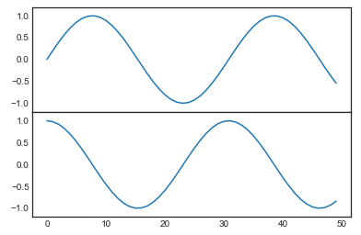
MATPLOTLIB
MULTIPLE SUBPLOTS
plt.axes: Subplots by Hand
The equivalent of this command within the object-oriented interface is fig.add_axes(). Let’s use this to create two vertically stacked axes:
fig = plt.figure()
ax1 = fig.add_axes([0.1, 0.5, 0.8, 0.4],
xticklabels=[], ylim=(-1.2, 1.2))
ax2 = fig.add_axes([0.1, 0.1, 0.8, 0.4],
ylim=(-1.2, 1.2))
x = np.linspace(0, 10)
ax1.plot(np.sin(x))
ax2.plot(np.cos(x));

Slide 46
MATPLOTLIB
MULTIPLE SUBPLOTS
plt.subplot: Simple Grids of Subplots
Aligned columns or rows of subplots are a common enough need that Matplotlib has several convenience routines that make them easy to create.
The lowest level of these is plt.subplot(), which creates a single subplot within a grid.
This command takes three integer arguments—the number of rows, the number of columns, and the index of the plot to be created in this scheme, which runs from the upper left to the bottom right

Slide 47
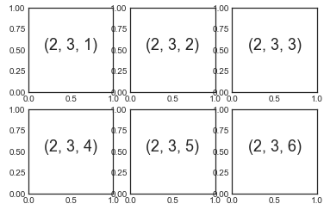
MATPLOTLIB
MULTIPLE SUBPLOTS
plt.subplot: Simple Grids of Subplots
for i in range(1, 7):
plt.subplot(2, 3, i)
plt.text(0.5, 0.5, str((2, 3, i)),fontsize=18, ha='center')

Slide 48
MATPLOTLIB
MULTIPLE SUBPLOTS
plt.subplot: Simple Grids of Subplots
The command plt.subplots_adjust can be used to adjust the spacing between these plots.
fig = plt.figure()
fig.subplots_adjust(hspace=0.4, wspace=0.4)
for i in range(1, 7):
ax = fig.add_subplot(2, 3, i)
ax.text(0.5, 0.5, str((2, 3, i)), fontsize=18, ha='center')

Slide 49
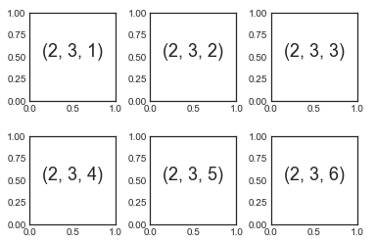
MATPLOTLIB
MULTIPLE SUBPLOTS
plt.subplot: Simple Grids of Subplots

Slide 50
MATPLOTLIB
MULTIPLE SUBPLOTS
plt.subplots: The Whole Grid in One Go
The approach just described can become quite tedious when you’re creating a large grid of subplots, especially if you’d like to hide the x- and y-axis labels on the inner plots.
For this purpose, plt.subplots() is the easier tool to use (note the s at the end of subplots).
Rather than creating a single subplot, this function creates a full grid of subplots in a single line, returning them in a NumPy array.

Slide 51
MATPLOTLIB
MULTIPLE SUBPLOTS
plt.subplots: The Whole Grid in One Go
The arguments are the number of rows and number of columns, along with optional keywords sharex and sharey, which allow you to specify the relationships between different axes.
Here we’ll create a 2×3 grid of subplots, where all axes in the same row share their y-axis scale, and all axes in the same column share their x-axis scale:
fig, ax = plt.subplots(2, 3, sharex='col', sharey='row')

Slide 52
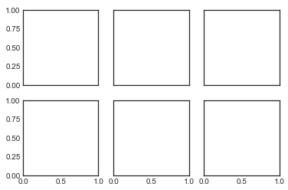
MATPLOTLIB
MULTIPLE SUBPLOTS
plt.subplots: The Whole Grid in One Go

Slide 53
MATPLOTLIB
MULTIPLE SUBPLOTS
plt.subplots: The Whole Grid in One Go
Note that by specifying sharex and sharey, we’ve automatically removed inner labels on the grid to make the plot cleaner.
The resulting grid of axes instances is returned within a NumPy array, allowing for convenient specification of the desired axes using standard array indexing notation
# axes are in a two-dimensional array, indexed by [row, col]
for i in range(2):
for j in range(3):
ax[i, j].text(0.5, 0.5, str((i, j)), fontsize=18, ha='center')
fig

Slide 54
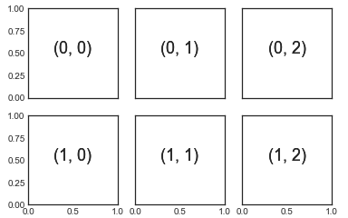
MATPLOTLIB
MULTIPLE SUBPLOTS
plt.subplots: The Whole Grid in One Go

