Slide 1
DETECTING “FAKE” TWEETS USING NLP & SENTIMENT ANALYSIS

Slide 2
THE PROBLEM
Finding “Fake” Tweets
What are “fake” Tweets?
We consider ”fake” tweets to be tweets which are generated by either software bots or humans posing as someone they are not.
Why find “fake” tweets?
As the influence of social media has grown, the amount of misleading or malicious content on it has grown as well. The growth rate of this content has out stripped the growth in social media itself
This “fake” content hurts both individual users (ie bullying) and society as a whole. It sows distrust and undermines the rigorous dialog all free societies must have.

Slide 3
OUR SOLUTION
Use emotions
Since the majority of “fake tweets” are generated by software bots, emotions expressed in those tweets should differ from tweets written by “real” humans.
Using natural language processing and sentiment analysis we want to score tweets from both “real” and ”fake” sources, based on their emotional content.
Additionally, we would like to see if our model will apply well to “fake” human account (AKA Trolls)

Slide 4
THE MODEL
Quantify Emotions
The model is based on the NRC and Afinn frameworks for natural language processing and sentiment analysis.
From the NRC framework we are looking for words which express one of ten emotions.
Specifically, we are looking at the frequency of occurrence for each emotion based on the number of times a word associated with that emotion appears in the text of a tweet.
The Afinn framework computes an overall sentiment score for each tweet.

Slide 5
QUANTIFY MODEL
Tweet-Emotion Matrix
We quantify each tweet using what we call the “Tweet-Emotion Matrix” where
the matrix rows represent individual tweets
the first ten columns represent the emotions in the NRC framework
the eleventh column represents the score from the Afinn framework
the twelfth column represents a binary classifier indicating if the tweet is real (1) or fake (0).
This “Tweet-Emotion Matrix” is then used for training various M-L algorithms

Slide 6
DATA SOURCE
Finding Data
The majority of our data came from the “Fake-Project”
They supplied data generated by genuine users, ”fake” human users, and two types of software bots. The two types of bots were “Social-Media Bots” (the one we are primarily interested in) and “Traditional Spam Bots” (older bots selling junk).
For simplicity, we grouped both types of software bots into one overall type. This was due to the small number of instances of the second bot type.
We also have data from Carverlee, Cheng, & Lee, however, it was only used for testing as it as not as well curated as out other dataset.

Slide 7
CLEANING
Dirty, Dirty data
The data we obtained from the “Fake Project” needed considerable cleaning, even prior to import.
There was an error in the way the data was encoded
The data contained null characters sprinkled throughout
Once the data was finally imported, we needed to remove
URLs
Usernames and Hashtags
Digits and punctuation
Stopwords and words not covered in our frameworks

Slide 8

BASIC STATISTICAL ANALYSIS
Overall statistics for the datasets
Looking at the basic statistics (specifically: $μ, σ$) for some simple properties (hashtags, usernames) yielded comparable means and large variances.
Other properties of the tweets themselves and the users generating them were not examined, but could make for an interesting extension.
The initial impression of the difference between “real” tweets and “fake” tweets (those generated by bots) was in the sparsity of the Tweet-Emotion Matrices as well their 2nd p-Norms and row norms.

Slide 9
TWEET-EMOTION MATRIX ANALYSIS
What do the matrices themselves tell us?
Tweet-Emotion matrices for “fake” tweets were far more sparse that those for “real” tweets. The sparsity of a Tweet-Emotion matrix directly relates to the overall number of different emotions being expressed.
The 2nd p-Norm, describes the overall emotional intensity for all tweets, while the mean of the row norms describes the average emotional intensity of individual tweets.
Additional note: all models used a 50% baseline, so any accuracy result above 50% validates the hypothesis.

Slide 10
DECSION TREES
Why use Decision Trees?
This is a traditional classifier problem, so decision trees will provide useful insight into what other machine-learning algorithms might be useful.
It will also help show which emotions are most useful in distinguishing fake “human” users or software bots from real human users.
Decision trees also provide an initial statistical analysis, allowing us to gauge if this model works well enough to continue with.
Notes:
The idea is that tweets will be sorted into different categories based on their emotional content, specifically how many emotions are expressed and how strongly those emotions are expressed.
Tweets by bots shouldn’t express many, if any, emotions and the emotions they do express should be expressed weakly.
Tweets by humans should display more emotions and express those emotions with more intensity.
Interestingly, ”fake” humans can be distinguished from real humans based on which emotions were expressed. “fake” humans were biased toward expressing more negative emotions.

Slide 11
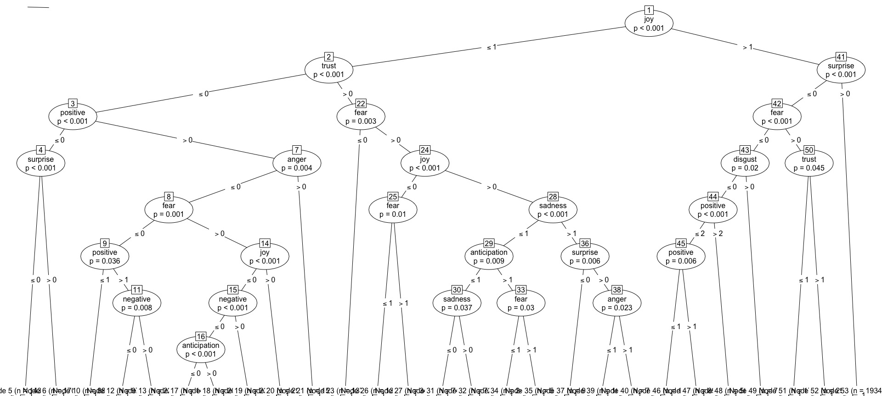
DECISION TREES
How did Decision Trees perform?

Slide 12
LOGISTIC REGRESSION
Why use a Logistic Regression?
We want to classify individuals into two categories based on independent variables.
Independent variables and dependent variables are not normally distributed and don’t have linear relationship.
Dependent variable is categorical (real/fake).

Slide 13
LOGISTIC REGRESSION
How did Logistic Regressions perform?
Model : Binomial regression
Dependent variable : Fake/Real
12 independent variables
Outputs probability of a binary response based on one or more independent variables.
Significant emotions: trust, surprise, positive & joy.
Accuracy against bots was 67.5%, against fake “humans” was 54.6%
Selected Differences from the NULL residual:
trust 6.534, fear 9.565, negative 6.755, positive 66.853, joy 36.787, anticipation 6.278

Slide 14
RANDOM FORESTS
Why use Random Forests?
We have ten columns of emotions in “Tweet-Emotion Matrix”. 10! = 3,628,800 possible decision trees at most!
Random Forests is efficient when data have many features.
It’s logical extending trees to forests!

Slide 15
RANDOM FORESTS
How did Random Forests perform?
Ntree = 250
–Each tree’s prediction score will be considered.
–Then get an overall normalized score for each tweet.
10-fold cross validation
–Accuracy 54.92% for fake “people”, 73.4157% for bots
–Recall 51.54% for fake “people”, 73.4157% for bots
–Precision 55.27% for fake “people”, 99% for bots
Just above the 50% baseline for fake “people”!
–Proved emotion is a good indicator to distinguish fake tweets even for people
-Works even better for bots! More data increased the accuracy.

Slide 16
NAÏVE BAYES
Why use Naïve Bayes?
Based on the decision tree, there are numerous statistically significant conditional probabilities we can exploit for classification.
Since separate tweet categories branch differently down the decision tree, we should see similar behavior from a Naïve Bayes machine learning algorithm.

Slide 17
NAÏVE BAYES
How did Naïve Bayes perform?
Against software bots, the Naïve Bayes algorithm had a 53.7% accuracy
Against fake “humans” the algorithm has a 51.3% accuracy.
Adding more emotions or other quantifiers should help improve this accuracy, however it will never be as accurate as ensemble methods such as random forests, bagging, or Adaboost.

Slide 18
CONCLUSIONS
Finally, the end!?
For “fake” humans, the model preforms unexpectedly well. This indicates that, if the model could be expanded, that it might be useful for detecting these types of accounts more readily.
From this result, we can see that humans acting surreptitiously express emptions differently than humans who are not.
It also suggests that human from different countries also express emotions differently.

Slide 19
MORE CONCLUSIONS
Now it’s the end
For software bots, the model performed unambiguously well. This validates the hypothesis that machines express emotions differently than humans.
Expanding and extending the model as described in the previous slide should also improve the accuracy in detecting software bots.
Additionally, as the size of the training sets increased, so did the accuracy of the machine-learning algorithms.

