Slide 1
Forest Cover Analysis
Jonathan McFadden

Slide 2
The Problem
Create an accurate big-data/machine-learning model to predict which type of trees will grow best in a certain area based on the conditions of those areas
Determine which features of a given area are most important for determine which type of tree will grow best in each area

Slide 3
The Models
Linear / Logistic Regression
Linear Regression
Logistic Regression with OVR handling of each class
Logistic Regression with multinomial handling of all classes
Decision Trees
Random Forest

Slide 4
Linear/Logistic Regression
Goals
Determine if a relationship existed in the data
Provide a baseline model
Results
 | Training Mean Accuracy | Training MSE | Testing Mean Accuracy | Testing MSE
Linear | 0.4006 (R^2) | 2.3952 | 0.4214 (R^2) | 2.3257
Logistic w/ OVR | 0.6719 | 2.9991 | 0.6711 | 2.8735
Logistic w/ Multinomial | 0.6721 | 3.0791 | 0.6653 | 3.2866

Slide 5
Decision Trees
MUCH better than Linear/Logistic Regression
Determined that Elevation was the most important determining feature.
Provided a better model with
Mean Accuracy: 0.8078
MSE: 1.7571
Plot of 3-level Decision Tree on next slide

Slide 6
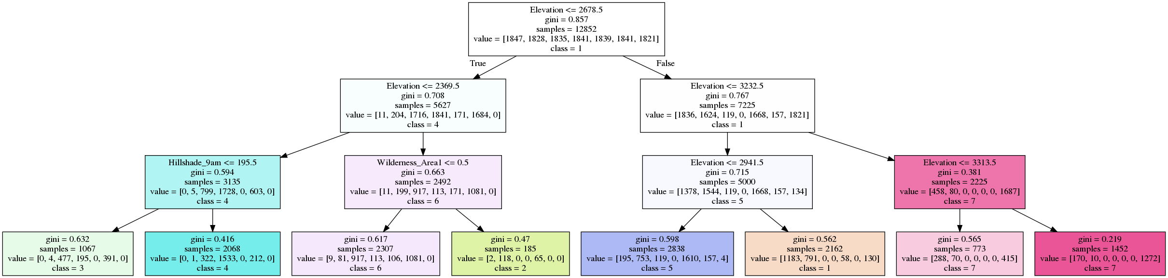
Decision Tree (plots)

Slide 7
Random Forest
Outperformed Decision Trees by > 50%
Mean Accuracy: 0.7848
MSE: 1.0044
Quantized feature importances
Elevation: 0.2264
Horiz. Dist. To Roadways: 0.0918
Horiz. Dist. To Fire Points: 0.0728
Horiz. Dist. To Hydrology: 0.0631
Vert. Dist. To Hydrology: 0.0539

Slide 8
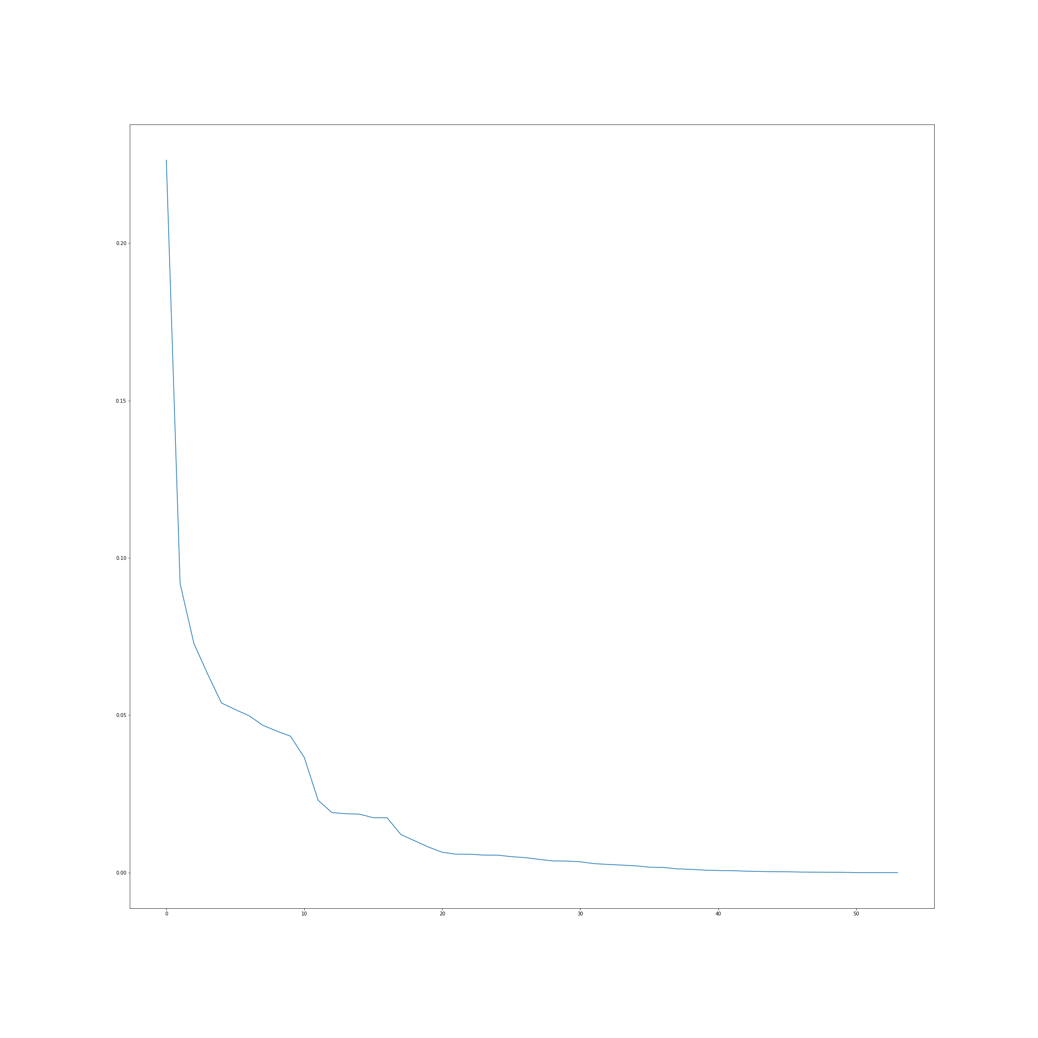
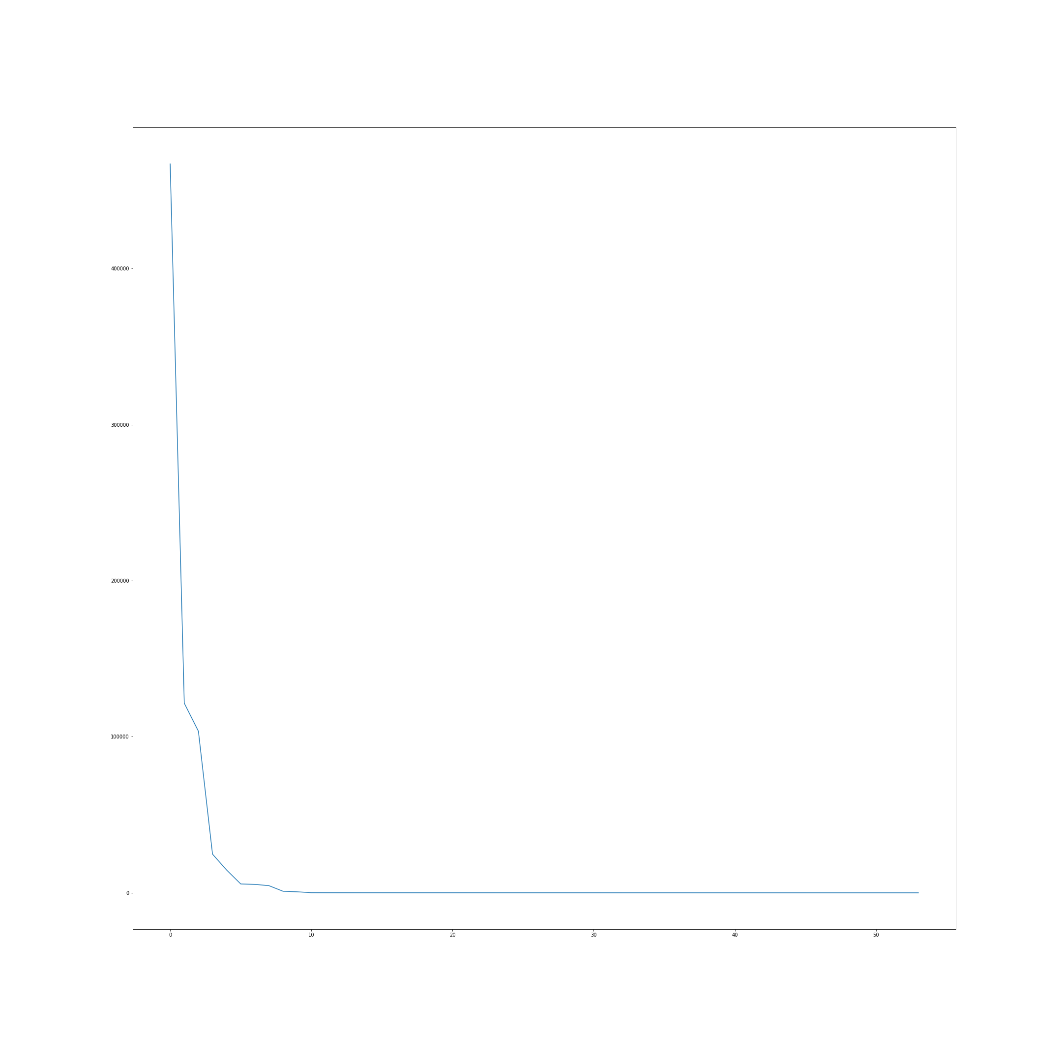
Random Forest Graphs
Random Forest Importances Graph
Singular Values from SVD Graph

