Slide 1




Sesta giornata
Alternative Software
Marcello Gallucci
Univerisità Milano-Bicocca
Bertinoro 2013

Slide 2
Il modello lineare
Regressione

Slide 3
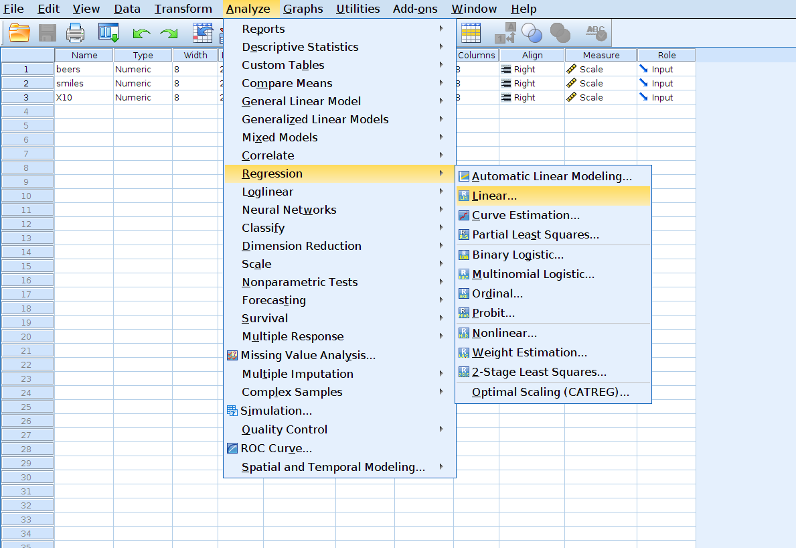
Esempio “birre-sorrisi”

Slide 4
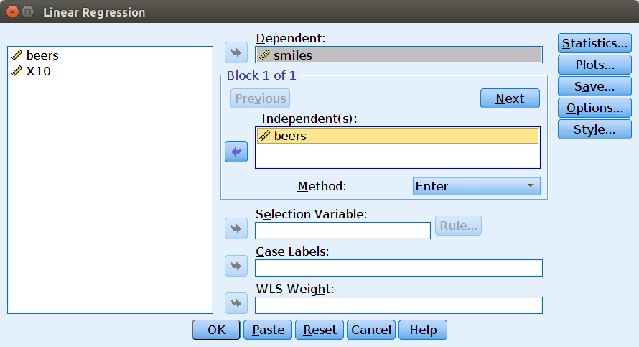
Esempio “birre-sorrisi”

Slide 5
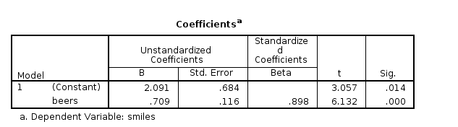
Esempio “birre-sorrisi”
Coefficienti

Slide 6
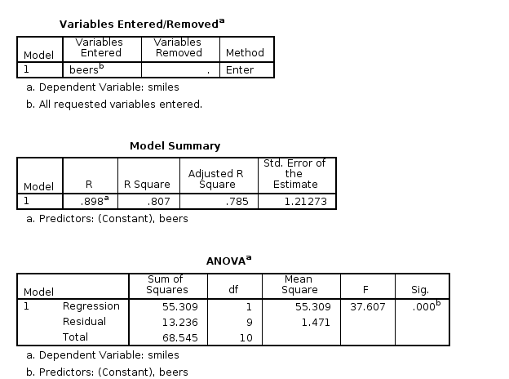
Esempio “birre-sorrisi”
Varianze

Slide 7
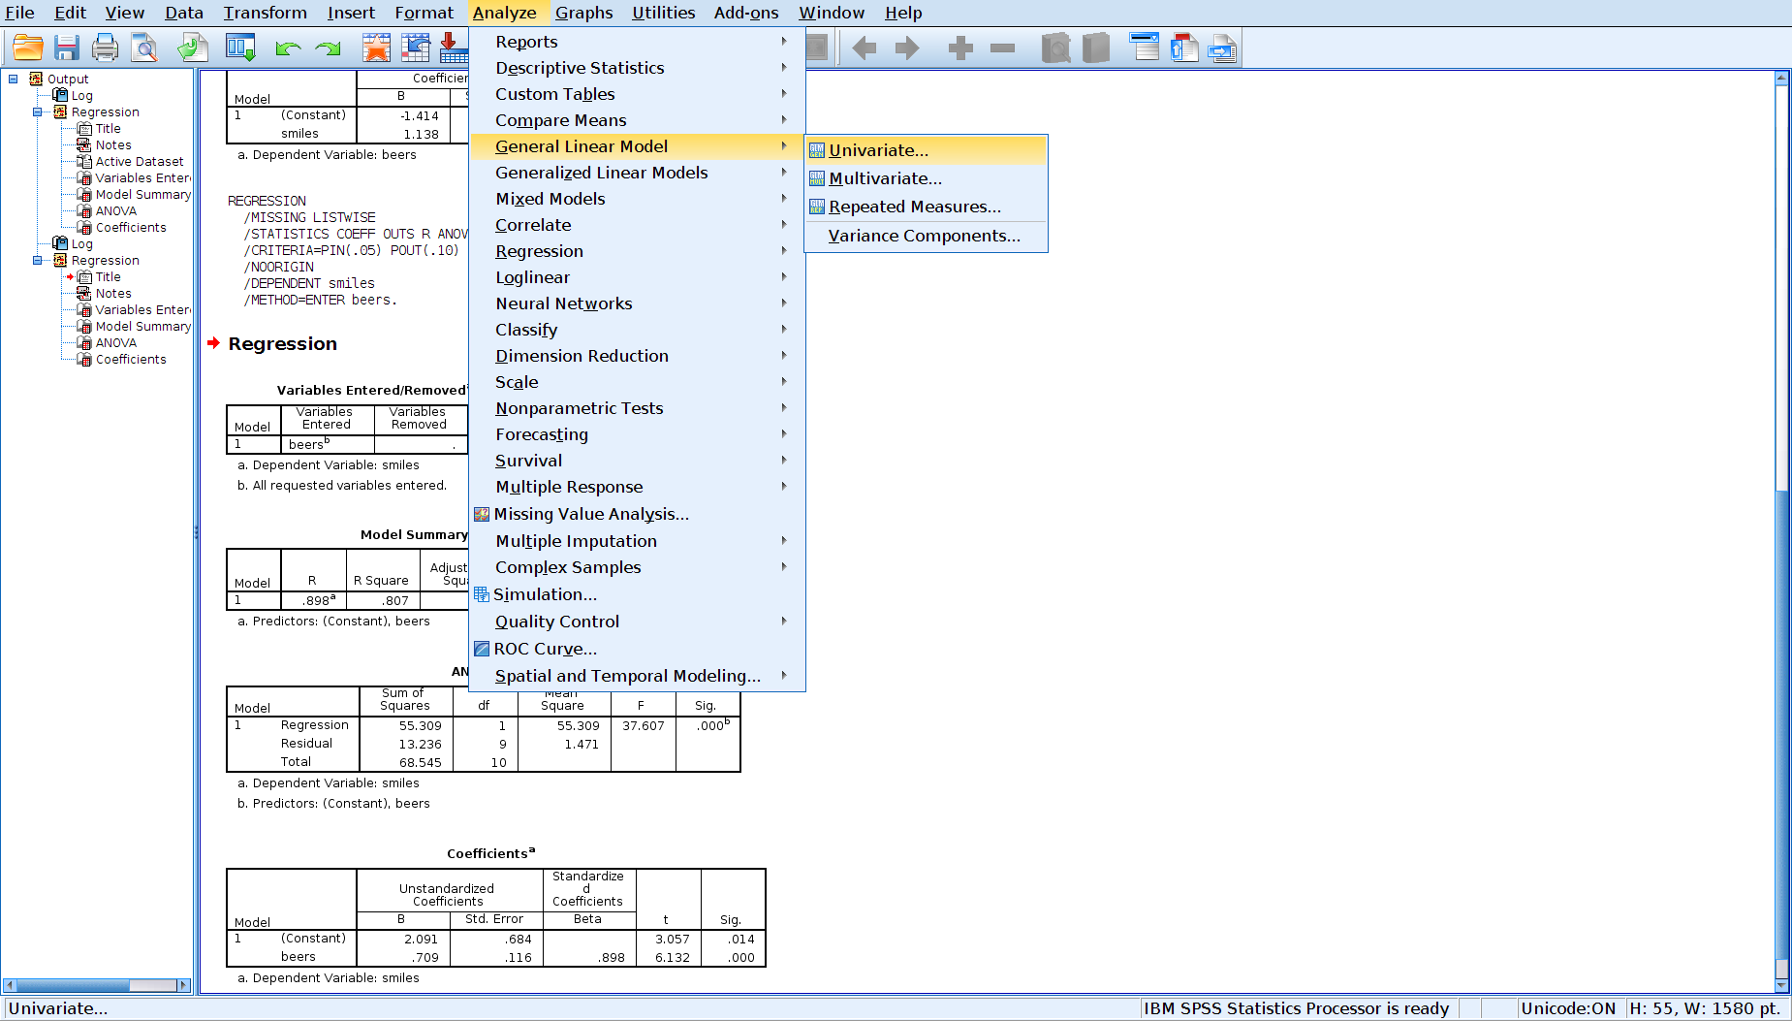
GLM

Slide 8
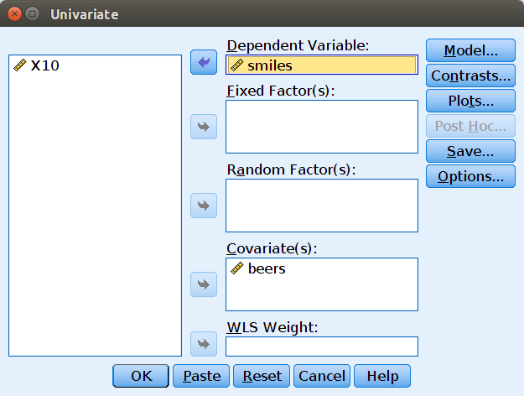
GLM

Slide 9
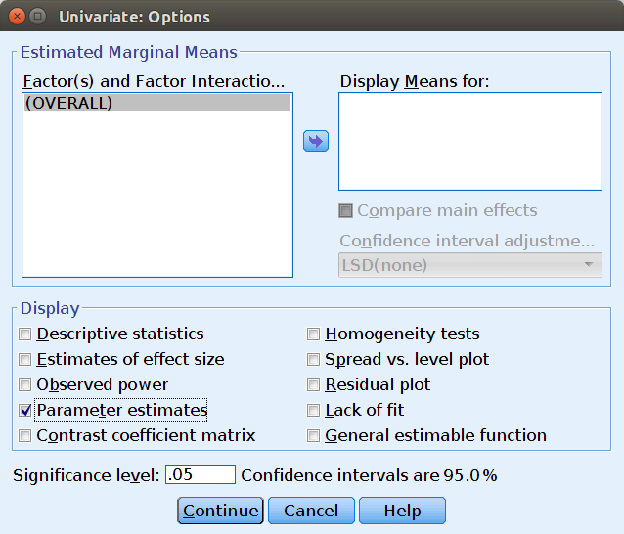
GLM

Slide 10
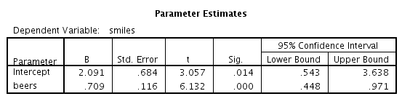
GLM
Coefficienti

Slide 11
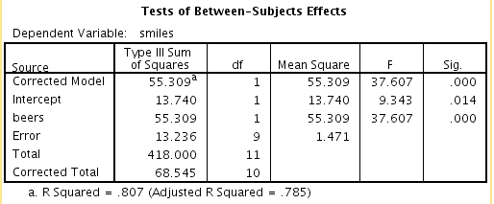
GLM
Varianze

Slide 12
Significance of R²
Test for the R-squared
R-squared
R-squared

Slide 13
F-test for the effect
Test for Beers

Slide 14
Regressione Multipla

Slide 15
GLM

Slide 16
GLM effect size

Slide 17
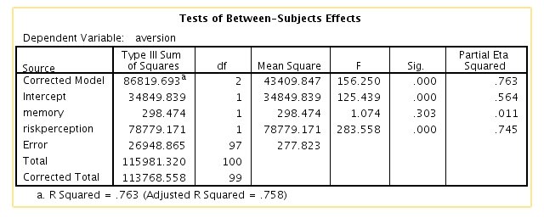
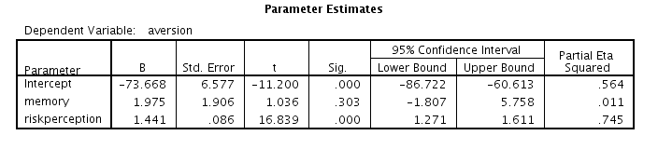
Example
Anti-smoke campaign results: The ability to remember the ads (memory), the perception of smoke-related risks (risk perception) were measured to predict smoke aversion
Tests of variances
Coefficients estimates

Slide 18
GLM Example
Anti-smoke campaign results: The ability to remember the ads (memory), the perception of smoke-related risks (risk perception) were measured to predict smoke aversion
Tests of significance for the R-squared

Slide 19
GLM Example
Anti-smoke campaign results: The ability to remember the ads (memory), the perception of smoke-related risks (risk perception) were measured to predict smoke aversion
F-Tests of for the effects

Slide 20
GLM Example
Anti-smoke campaign results: The ability to remember the ads (memory), the perception of smoke-related risks (risk perception) were measured to predict smoke aversion
B coefficients and tests and effect size indexes

Slide 21
Example
Anti-smoke campaign results: The ability to remember the ads (memory), the perception of smoke-related risks (risk perception) were measured to predict smoke aversion
Tests of variances
Coefficients estimates

Slide 22
Example
Anti-smoke campaign results: The ability to remember the ads (memory), the perception of smoke-related risks (risk perception) were measured to predict smoke aversion
Memory
Aversion
RiskPer

Slide 23
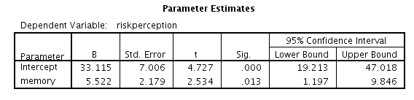
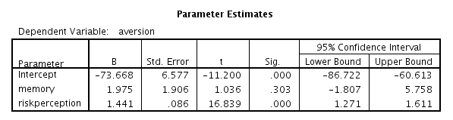
Analysis
The independent variable has an effect on the mediator,
The mediator has an effect on the dependent variable , over and beyond exp. Conditions
The product of the two is the mediated effect

Slide 24
Sobel Test
Standard errors
P<.001

Slide 25
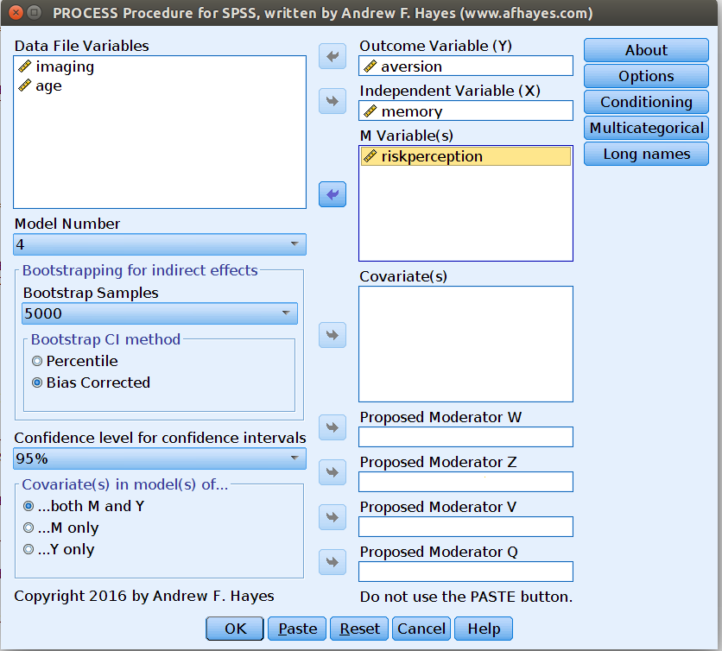
Bootstrap Process

Slide 26
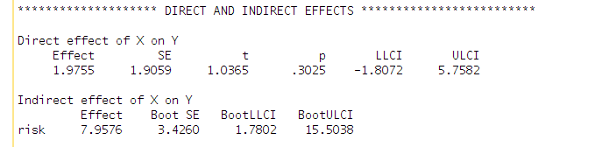
Bootstraap
By running PROCESS macro one can easily obtain the bootstrap confidence intervals and check if they contains zero

Slide 27
Moderazione

Slide 28
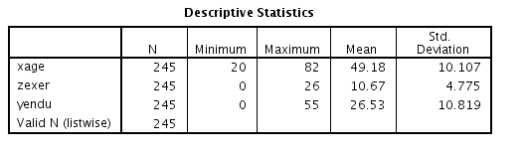
Estimating Interactions
To estimate the interaction we simply tell our software that we want to have a product term in the model
Example
We have measured physical endurance in a sample of adults, and we record their age and years of exercising.

Slide 29
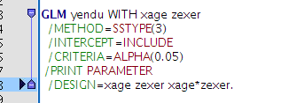
Estimating Interactions
To estimate the interaction we simply tell our software that we want to have a product term in the model
Example
This can be done with the menus as well

Slide 30
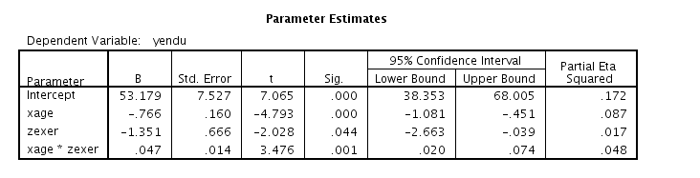
Estimating Interactions
The B (betas, sr, t-test and p.) associated with the product term gives us all the information regarding the interaction between IVs
First-order effects
Second-order effects
We reject the null B=0. We say that we there is a difference in slopes (B=.04) of age for different levels of exercising
The slopes can be considered as not parallel

Slide 31
First-order effects with interaction
When the interaction is in the regression, the first order effects become conditional to the values of the other IVs
What is B₁?
Is not the effect of X₁ while keeping constant X₂!
B₁is the effect of X₁ while the other IV X₂ is kept constant at zero

Slide 32
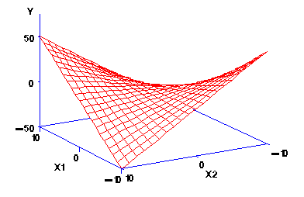
First-order effects with interaction
When the interaction is in the regression, the first order effects become the effect of the IV while keeping the other IV’s constant to zero
Effect of X₂ for X₁=0
Effect of X₁ for X₂=0

Slide 33
Meaningless zeros
In many applications, zero does not mean anything:
Physical endurance is predicted by age, years of exercise and their interaction
This is the effect of years of exercise when the participant is 0 year old (a baby)
This cannot be interpreted, and so are the other coefficients (beta, sr).

Slide 34

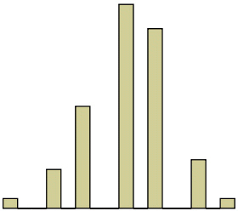
Making zero meaningful
We can always make zero a meaningful value by centering the variables before computing the product term:
For each participant, compute a new variable as the old minus the average
The new variable has mean=0
0
Mean=10
20

Slide 35
Making zero meaningful
By subtracting the mean, we create a new variable centered around 0
For each participant, compute a new variable as the old minus the average
The new variable has mean=0
After you centered the variable, you should compute the product again
-10
Mean=0
10

Slide 36
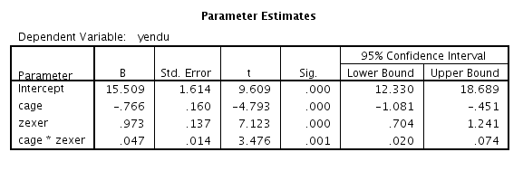
Making zero meaningful
We can always make zero a meaningful value by centering the variables before computing the product term:
For each participant, compute a new variable as the old variable minus the average
The new variable has mean=0
This is the effect of years of exercise for the average value of years of exercise: this can be interpreted

Slide 37
Centered vs no centered
Age not centered
First-order effects change
Interaction does not change
Age centered

Slide 38
Centering
The first-order effects computed on centered variables represent the average effect (the one in the middle) of the IV, across all levels of the other IV
Effect of x₂ for x₁=0
Effect of x₁ for x₂=0

Slide 39
Centering
We (almost) always center the variables, so the first-order effects have two nice characteristics:
  The B is the effect of the IV computed at the average value of the other IV
  The B is always interpretable, because every variable has an average which makes sense
  The slope of the first-order effect of one independent variable is the average slope across values of the other independent variable

Slide 40
Recap
An interaction occurs when the effect of one IV is different for different levels of the other independent variable
To estimate the interaction, we compute the product of the IVs and put the product in the regression
If the product is significant, the effects of are not constant, but conditional to the other variable values
The first-order effect is interpreted as the effect of the IV while the other variable is 0
When zero is not meaningless, we center the variables (so their mean=0) before computing the product, so we can interpret the first order effect as the effect of one IV for the average value of the other
The product term B (and rest) is not changed by the centering of the variables
The R² is not affected by centering.

Slide 41
Issues with interactions
How to interpret the interaction beyond the mere definition of conditional effect: How to picture what is going on
How to test if single regression lines are significant different from zero

Slide 42
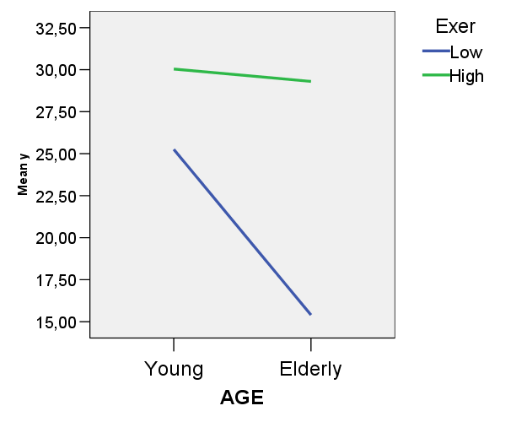
Simple slope analysis
Simple slope analysis entails to compute the regression line for one IV at some meaningful levels of the other independent variable

Slide 43
Simple slope analysis
Equivalent to pick two lines out of many in the regression plane
X₂ 1 s.dv high
X₂ 1 s.dv low

Slide 44
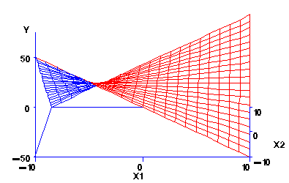
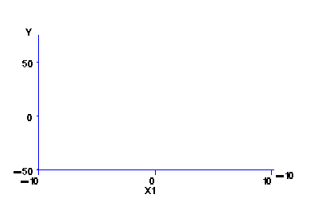
Simple slope analysis
And plot them in two dimensions
X₂ 1 s.dv high
X₂ 1 s.dv low

Slide 45
Simple slopes
We want to test of the mull hypothesis that the simple slopes are different from zero
Is the effect of Age on Endurance significant for people who exercise a lot
Is the effect of Age on Endurance significant for people who exercise a little

Slide 46
Simple slopes
Recall that when there is an interaction, the first-order effect (B of X₁) is the effect of X₁ for X₂=0
We want to know if the effect of X₁ is significant for specific values of X₂
For instance, if the effect of Age is significant for Exercise centered to 1 STD above average (and 1 STD below)
We simply center Exercise first at 4.8 lower than the mean by computing

Slide 47

Making zero meaningful
By subtracting any value, we create a new variable centered around that value
We move the 0 to 1 std.deviation above the mean
-10
Mean=0
10

Slide 48
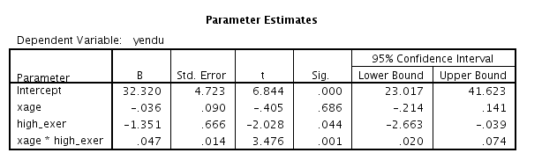
Statistical significance of simple slopes
Re run a regression with high_exer instead that the orginal variable
The effect of age for exercise=+s.dev
For high exercise, the age effect is not significant

Slide 49

Making zero meaningful
By subtracting any value, we create a new variable centered around that value
We move the 0 to 1 std.deviation below the mean
-10
Mean=0
10

Slide 50
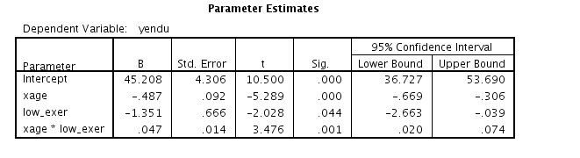
Statistical significance of simple slopes
The effect of age for exercise=-s.dev
For low exercise, the age effect is negative and significant

Slide 51
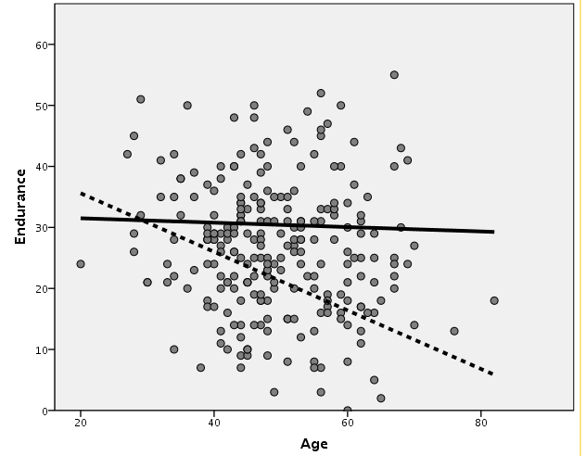
Simple slope analysis
When you have the constant terms and the B for the simple slopes, yo can build a nice simple slopes graph
___ Exer=+1std
----- Exer=-1std

Slide 52
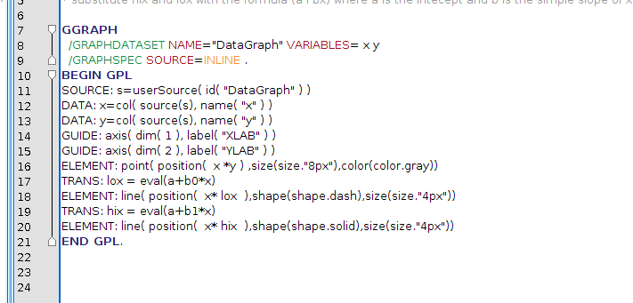
Simple slope analysis

Slide 53
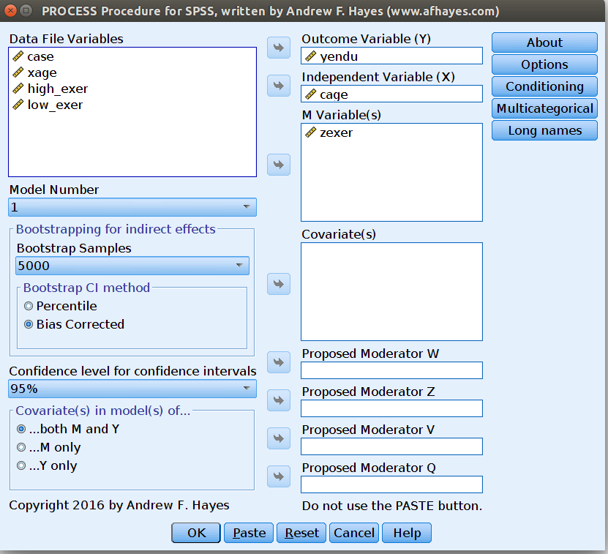
Process

Slide 54
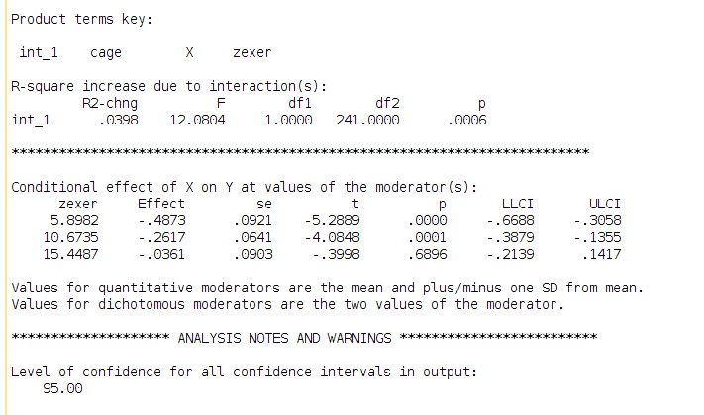
Process

Slide 55
Moderazione ANOVA

Slide 56
Interactions with Categorical IVs
  Everything simplifies for categorical IV!
  Consider the study of academic performance, focus on the deference in number of publication in men and women (sex), and in different department (sociology, psychology, history)
  We have a factorial design: 3 (department) X 2 (sex)
DEPART * SEX
2=women
Dependent Variable: PUB
95% Confidence Interval
DEPART
SEX
Mean
Std. Error
Lower Bound
Upper Bound
psychology
1
1
18.914
1.137
16.668
21.161
2
19.080
1.345
16.422
21.738
sociology
2
1
17.632
1.543
14.583
20.681
2
13.400
1.345
10.742
16.058
history
3
1
9.571
1.467
6.671
12.472
2
12.520
1.345
9.862
15.178

Slide 57
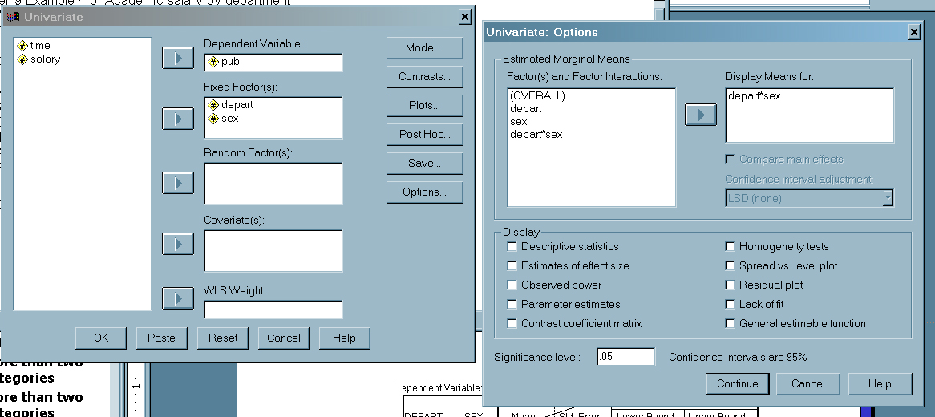
Let’s do it
Analyse->General linear model->Univariate
Carry out the analysis for overall effects
Table out the means
Plot the means
Ask for the group means
Eta Square=R²

Slide 58
Overall effects and significance
The test for significance is done with the F-test
First-order (main) effects
Variance uniquely explained
Tests of Between-Subjects Effects
Dependent Variable: PUB
Type III Sum
Partial Eta
Source
of Squares
df
Mean Square
F
Sig.
Squared
Corrected Model
1885.087
a
5
377.017
8.339
.000
.225
Intercept
33366.661
1
33366.661
738.021
.000
.837
DEPART
1619.185
2
809.593
17.907
.000
.199
SEX
5.017
1
5.017
.111
.740
.001
DEPART * SEX
290.421
2
145.210
3.212
.043
.043
Error
6510.387
144
45.211
Total
44371.000
150
Corrected Total
8395.473
149
R Squared = .225 (Adjusted R Squared = .198)
a.
R²
Interaction

Slide 59
Looking at the interaction
psychology
sociology
history

Slide 60
Moderazione moderata

Slide 61
First, look a the types of variables
Prime: Dichotomous, centered
Others: continuous, centered

Slide 62
First Question
Describe the effects (first and second order) of the independent variables on the behavioral measure (BEH)
Let start easy
First, I examined the effect of Prime, SVO and their interaction on the BEHavioral outcome. All variables used in the analysis were centered
Prime
Beh
SVO

Slide 63
SPSS (using GLM)
Prime is centered dichotomous, so I can use it as in regression
SVO is continuous, so it goes there
By default, SPSS does not compute interaction for covariates (continuous IV). We should ask for them

Slide 64
SPSS (GLM)
Define a custom model
Define main effects and interactions

Slide 65
Output
Main effect of PRIME, SVO and interaction
What does that mean: Look at the regression coefficient (parameters) below

Slide 66
First output
We observe an effect of prime, B=4.58, t(96)=3.399, p.=.001: Evaluated for average SVO, the difference between “might” and “morality” prime was 9.16 (4.58*2)
Why is that so?

Slide 67
Observed means
Not keeping constant anything
Based on the B
Mediation
ADA, Discussion

Slide 68
A mediational model
We observe an effect of SVO, B=2.042, t(96)=2.092, p.=.039, eta²=.044. Averaging across prime conditions, SVO higher levels of prosociality corresponded to more cooperation.
Mediation

Slide 69
Interaction effect
We found an interaction effect, B=2.574, t(96)=2.637, p.=.010, eta²=.068.
Mediation

Slide 70
Simple Slop Plot
When primed with morality, SVO has a strong positive effect on cooperation (?), whereas when primed with might, the effect is sensibly reduced (?)
PRIME
-1
1
80.00000
70.00000
Unstandardized Predicted Value
60.00000
We need some more info here
50.00000
-4.00000
-2.00000
0.00000
2.00000
4.00000
SVO
The difference between might and morality gets stronger for higher prosociality
ADA, Discussion

Slide 71
Testing for simple slopes
PRIME (0 vs 1)=Might
When primed with morality, SVO has a strong and significant positive effect on cooperation (B=4.61, t(96)=3.15,p.=.002) whereas when primed with might, the effect is sensibly reduced (B=-.532, t(96)=-0.412,p.=.681)
PRIME (1 vs 0)=Moral
Mediation
ADA, Discussion

Slide 72
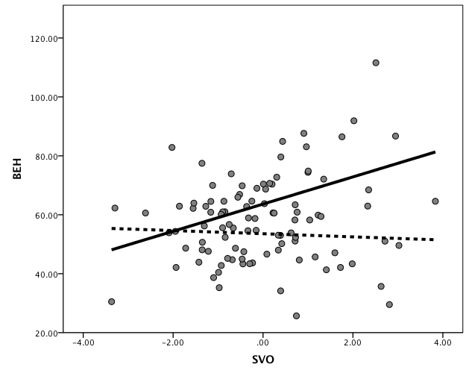
Simple Slop Plot
Morality
Might
ADA, Discussion

Slide 73
Simple Slop Plot
ADA, Discussion

Slide 74

Simple Slop Plot
intercept+b of SVO for might
ADA, Discussion

Slide 75
Simple Slop Plot
intercept+b of SVO for morality
ADA, Discussion

Slide 76
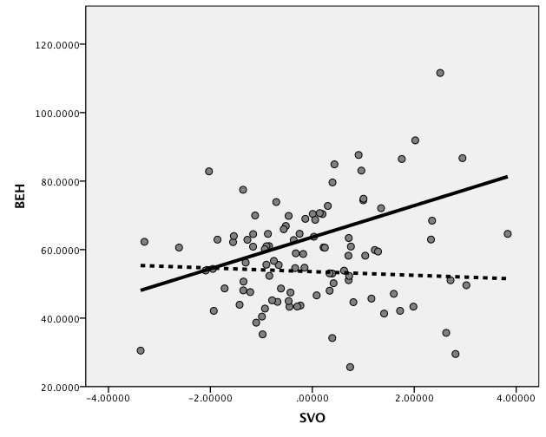
Simple Slop Plot
Double-click to edit details
ADA, Discussion

Slide 77
Simple Slop Plot
Example with PRIME as IV at SVO high (+1 sd) and low (-1 sd)
intercept+b of PRIME for SVO centered to -1 sd
ADA, Discussion

Slide 78
Simple Slop Plot
Example with PRIME as IV at SVO high (+1 sd) and low (-1 sd)
intercept+b of PRIME for SVO centered to -1 sd
ADA, Discussion

Slide 79
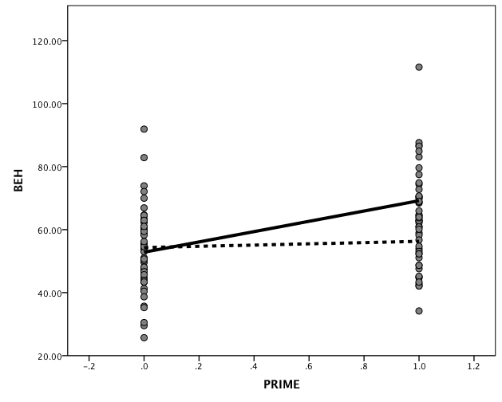
Simple Slop Plot
Example with PRIME as IV at SVO high (+1 sd) and low (-1 sd)
SVO +1 sd
SVO -1 sd
Might
Morality
ADA, Discussion

Slide 80
Moderated Mediation
Given the previous results, we wish to establish whether EXP mediates the first order effects of SVO and PRIME, or their interaction
We start simple!
First, we establish if the two IVs, and their interaction, have an effect on EXP
Mediation
ADA, Discussion

Slide 81
Effects on the mediator
We conducted an regression analysis with Prime, SVO, and their interaction as IV’s, and EXP as DV
If there is moderated mediation, must be compatible with model 3
Only prime has an effect!!
Mediation
ADA, Discussion

Slide 82
Differences among models
Only the IV has an effect!!

Slide 83
Conditional mediation: Model I
Conditional mediation can occurs when the moderator variable changes the effect of the IV on the Mediator
Moderator
X
Mediator
Y
Model 1 implies an interaction of X and MO on Mediator
We did not find it

Slide 84
Model II
A mediator can also mediated the effect of the moderator, bringing the interactive effect over the dependent variable
Moderator
Model 2 implies a direct effect of MO on ME
We did not find it
Mediator
X
Y

Slide 85
Model III
Another possibility is that the moderator affects only the mediator effect on the dependent variable
Model 3 implies a direct effect of X on ME
We find it
Moderator
X
Mediator
Y
If this is our model, the interaction between X and MO should disappear when we insert ME and ME*MO

Slide 86
Logical conditions
With mediator
The interaction disappears
Without mediator
Mediation
ADA, Discussion

Slide 87
Model III
The effects of prime seems to be mediated by expectation, although expectations have e different effect for different levels of SVO
SVO
Prime
Exp
BEH

Slide 88
Logical conditions
With mediator
Note that we still have an effect of PRIME, but it is reduced
Without mediator
Mediation
ADA, Discussion

Slide 89
Model III
The effects of Prime seems to be mediated by expectation, although expectations have e different effect for different levels of SVO
The is also a direct effect of prime on behavior, over and beyond EXP and its interaction with SVO
SVO
Prime
Exp
BEH

Slide 90
Logical conditions
With mediator
The effect of SVO remained
Without mediator
ADA, Discussion

Slide 91
Model III
The effect of Prime seems to be mediated by expectations, although expectations have e different effect for different levels of SVO
The is also a direct effect of prime on behavior, over and beyond EXP and its interaction with SVO, and a direct effect of SVO
SVO
Prime
Exp
BEH

Slide 92
Interpretation
At this point we know that Prime affects expectations (might increase expectation), which in turns has a positive effect on cooperation
We need to show how SVO changes the effect of expectations on cooperation
SVO
Prime
Exp
BEH
Mediation
ADA, Discussion

Slide 93
Simple slopes
We perform a simple slope analysis to estimates the effect of expectation for prosocial (SVO=+1 sd=1.398) and proself (SVO=-1 sd=-1.398). We rerun the regression including all the effects twice, first with SVO centered to 1.398, then to -1.398
For prosocials, the effect of expectation is strong and positive
Mediation
ADA, Discussion

Slide 94
Simple slopes
We perform a simple slope analysis to estimates the effect of expectation for prosocial (SVO=+1 sd=1.398) and proself (SVO=-1 sd=-1.398). We rerun the regression including all the effects twice, first with SVO centered to 1.398, then to -1.398
For proselfs, the effect of expectation is low and negative

Slide 95
Simple slopes

Slide 96
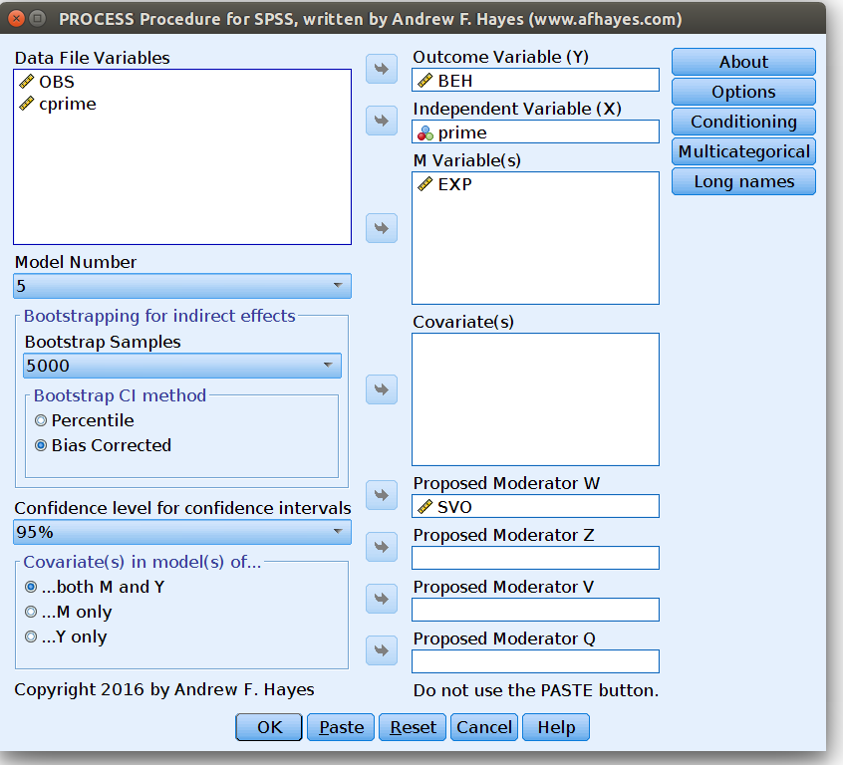
Significance

Slide 97
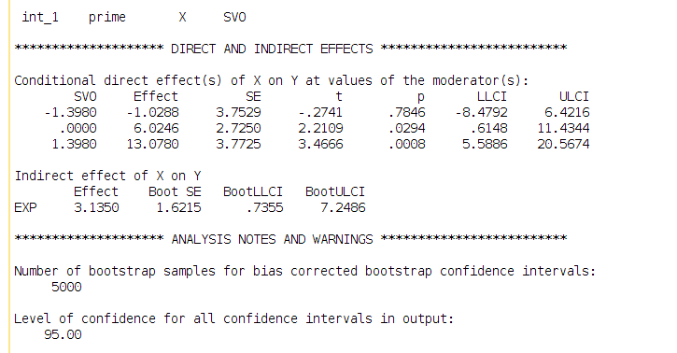
Significance

Slide 98
Modello misto

Slide 99


Beers at the bar
We define a model where each cluster is allow to have a different intercept, the rest of the model is like a standard regression
Fixed effects? Intercept and beer effect
Random effects? Intercepts
Clusters? bar
Authors and books may call this model:
Random-intercepts regression
or
Intercepts-as-outcomes model

Slide 100
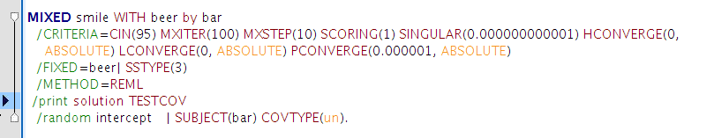
SPSS syntax
Fixed effects (intercept is included by default)
Random effects
Cluster variable

Slide 101
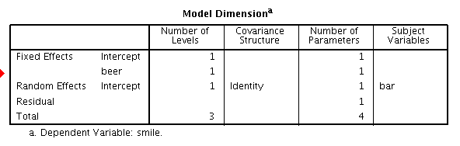
SPSS Output
Let's see if the model is how intended
OK!

Slide 102
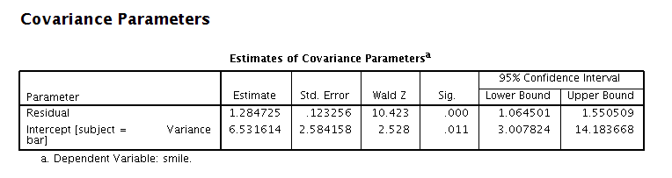
SPSS Output
We then check the variability of the random effects. If there is variability across bars, it means we were right to model the coefficients as random
Variance greater than 0

Slide 103
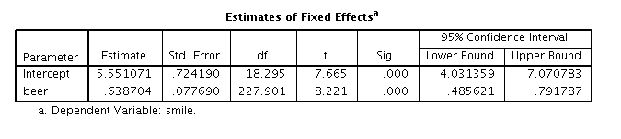
SPSS Output
If everything is fine, we interpret the fixed effects as in any other GLM (regression)
Intercept: On average, for zero beers we expect 5.5 smiles

Slide 104
SPSS Output
If everything is fine, we interpret the fixed effects as in any other GLM (regression)
B coefficient: On average,for each beer more, we expect
.638 more smiles

Slide 105
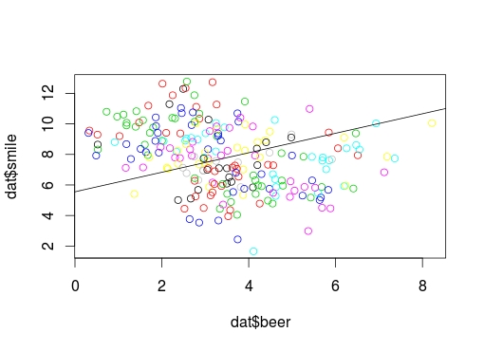
Plots
Plotting fixed effects is simply plotting the straight line as in any linear model

Slide 106
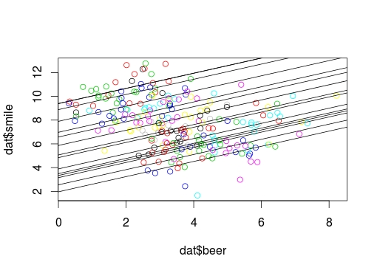
Plots
Plotting random effects effects is plotting each specific sub-model of each cluster

Slide 107
Beers at the bar 2
We can now try a model where also the b coefficients are allow to vary across clusters
Fixed effects? Intercept and beer effect
Random effects? Intercepts and b coefficients
Clusters? bar
Some authors may call this model:
Random-coefficients regression
or
Intercepts- and Slopes-as-outcomes model

Slide 108
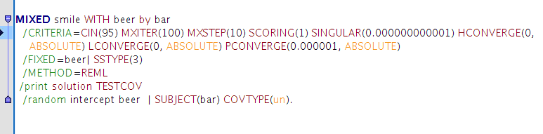
SPSS syntax
Now we have all the fixed effects and also the random effects
Fixed effects (intercept is included by default)
Random effects
Cluster variable

Slide 109
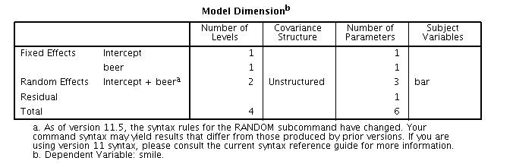
SPSS Output
Let's see if the model is how intended
OK!

Slide 110
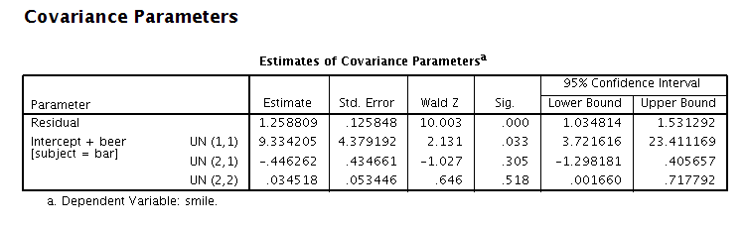
SPSS Output
We then check the variability of the random effects. If there is variability across bars, it means we were right to model the coefficients as random
Notice that the variance of beer is not significantly different from zero

Slide 111
Variance
Variances of random coefficients inform us on the variability of the effects
If they are not significant, effects may be set only as fixed, but there is no problem in keeping them as random
When variances are exactely zero (and spss gives a general warning), effects should be set only as fixed

Slide 112
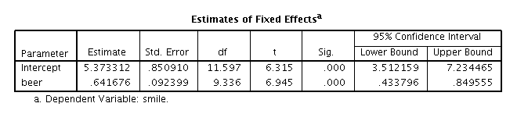
SPSS Output
If everything is fine, we interpret the fixed effects as in any other GLM (regression)
Intercept: On average, for zero beers we expect 5.37 smiles
B coefficient: On average,for each beer more, on average we expect
.641 more smiles

Slide 113
Random effect covariance
We noticed that the covariance parameters are 3

Slide 114
Random effect covariance
We noticed that the covariance parameters are 3
 | Intercept | B (beer)
Intercept | (1,1)
B (beer) | (2,1) | (2,2)
Variance of random effects

Slide 115
Random effect covariance
We noticed that the covariance parameters are 3
 | Intercept | B (beer)
Intercept | (1,1)
B (beer) | (2,1) | (2,2)
Covariance between random coefficients

Slide 116
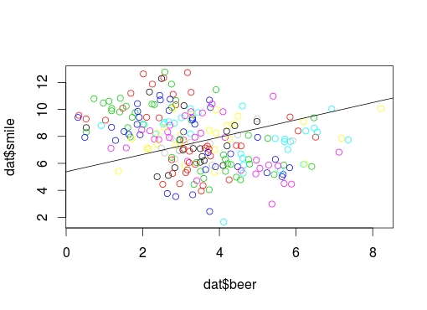
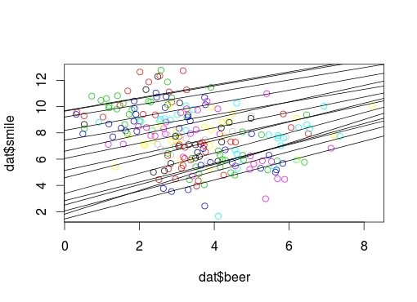
Plots
Plots
Fixed effects
Random effects

Slide 117
Repeated Measures Anova as a linear mixed model

Slide 118
A repeated measures design
Consider now a classical repeated measure design (within-subjects) the levels of the WS IV (5 different trials) are represented by different measures taken on the same person

Slide 119
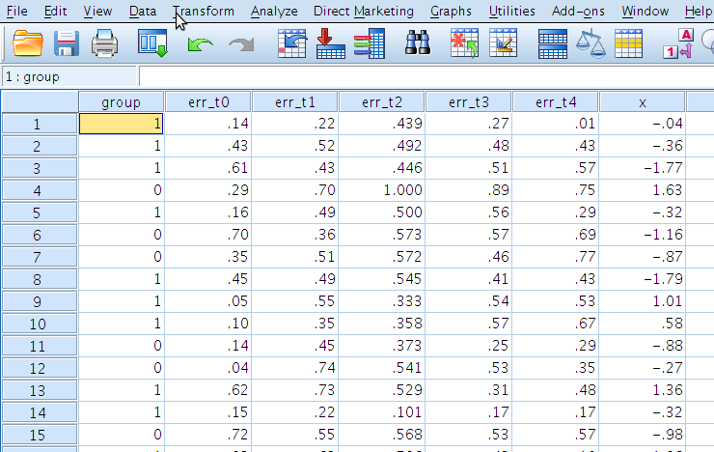
Standard file format
As for many applications of the repeated-mesure design, each level of the WS-factor is represented by a column in the file
One participant, one row

Slide 120
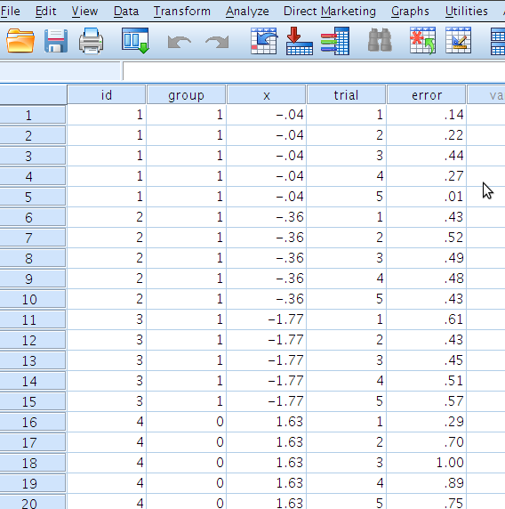
Long file format
For the mixed model we need to tabulate the data as if they came from a between-subject design
One measure, one row

Slide 121
Building the model
We translate this in the standard mixed model
Fixed effects? Intercept and trial effect
Random effects? Intercepts
Clusters? participants

Slide 122

SPSS: General mixed models
Here we put the variable which specifies to which participant the measure belongs to
Here we do not put anything: repeated measures are modelled as random effects

Slide 123

SPSS: General mixed models
Independent and dependent variables like in GLM

Slide 124

SPSS: General mixed models
Here we say we want to estimate the fixed effect of trial (effects on the means)

Slide 125

SPSS: General mixed models
Here we do not put any variable, because there is no variable with random effects
We say that we want the intercept to be random
We say that the cluster variable is “id”

Slide 126

SPSS: General mixed models
The model is as intended

Slide 127

SPSS: General mixed models

Slide 128

Interpreting the effects
As in GLM (Anova). We interpret the main effect looking at the means
Fixed effects
Means of the 5 trials

Slide 129
Dependency of scores
We can quantify the dependency of scores within clusters (participants) by computing the intra-class correlation

Slide 130
Dependency of scores
We can quantify the dependency of scores within clusters (participants) by computing the intra-class correlation

