Slide 1
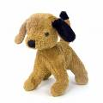
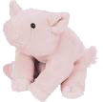
T=1
T=2
T=3
pig
dog | 1
pig
dog | 2
pig |  | 1
dog | 2
L_{R}:
L_{NR}:
 |  | 1
pig | dog | look | there’s | a
 |  | 1 | 1 | 1
pig | dog | look | there’s | a
 |  | 2 | 1 | 1
pig | dog | look | there’s | a



there’s
a
dog | X

look
dog | X

look
pig |  | X

I:
S:
Look! Dog!
There’s a dog!
Look! Pig!

