Slide 1
ISPC: an implicit statistical learning process
What is the timecourse, or “learning curve”, of ISPC effects?

Slide 2
distractor processing
target processing

Slide 3
distractor processing
1 2 … N
trial

Slide 4
distractor processing
1 2 … N
trial
behavioral index of ISPC
1 2 … N
trial

Slide 5
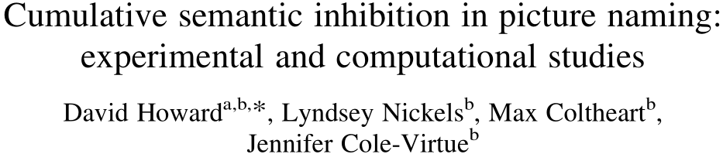
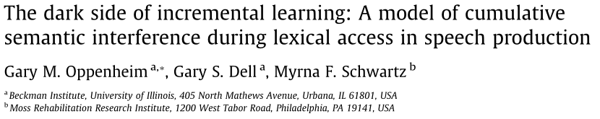
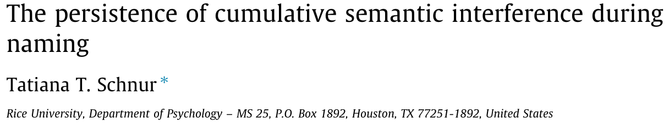

Slide 6
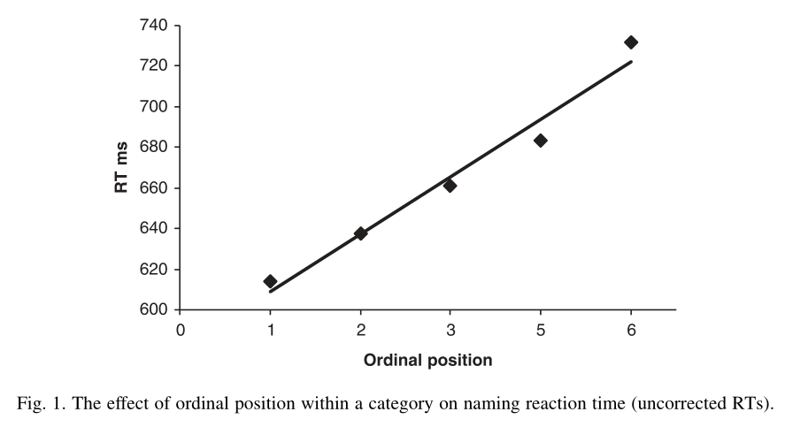

Slide 7
e.g., color blue, incongruent
MC
RT
MI
1 2 … N
number of presentations

Slide 8
e.g., color blue, incongruent
e.g., color blue, congruent
MC
MI
RT
RT
MI
MC
1 2 … N
1 2 … N
number of presentations
number of presentations

Slide 9
e.g., color blue, incongruent
e.g., color blue, congruent
MC
MI
RT
RT
MI
MC
1 2 … N
1 2 … N
number of presentations
number of presentations
potential questions
“learning rate”: how many presentations before difference emerges?
form: linear (slope?), nonlinear (time constant if exponential, inflection point if sigmoidal?)
persistence: across how many trials does effect persist? What is limiting factor—experience (number intervening trials) or time?
questions for you
Feasible?
Would this tell us something new and useful (or old and boring)?

