Slide 1
Figure sketches for stroop-rsa manuscript
Meeting, todd
2020-02-19

Slide 2
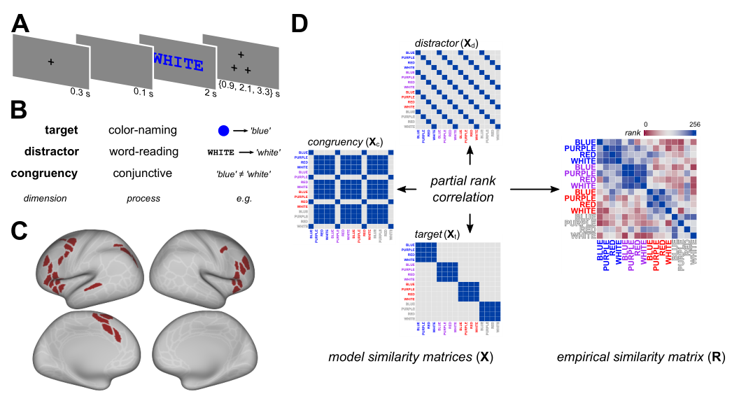
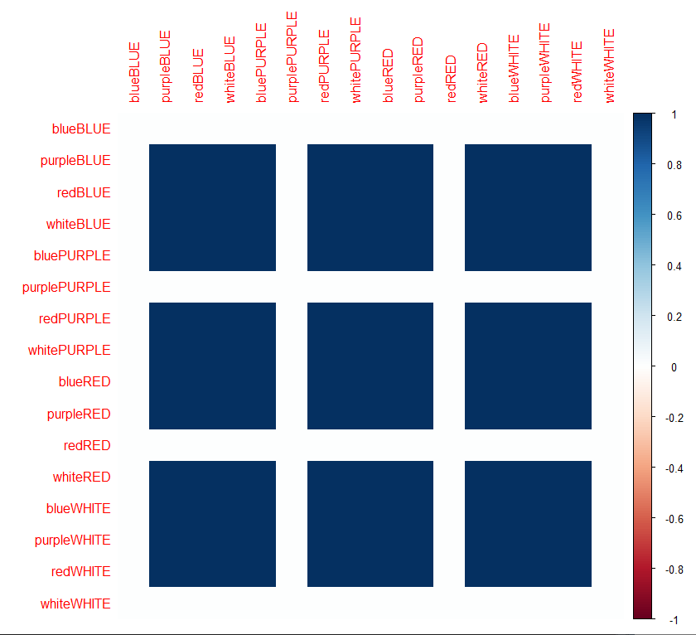
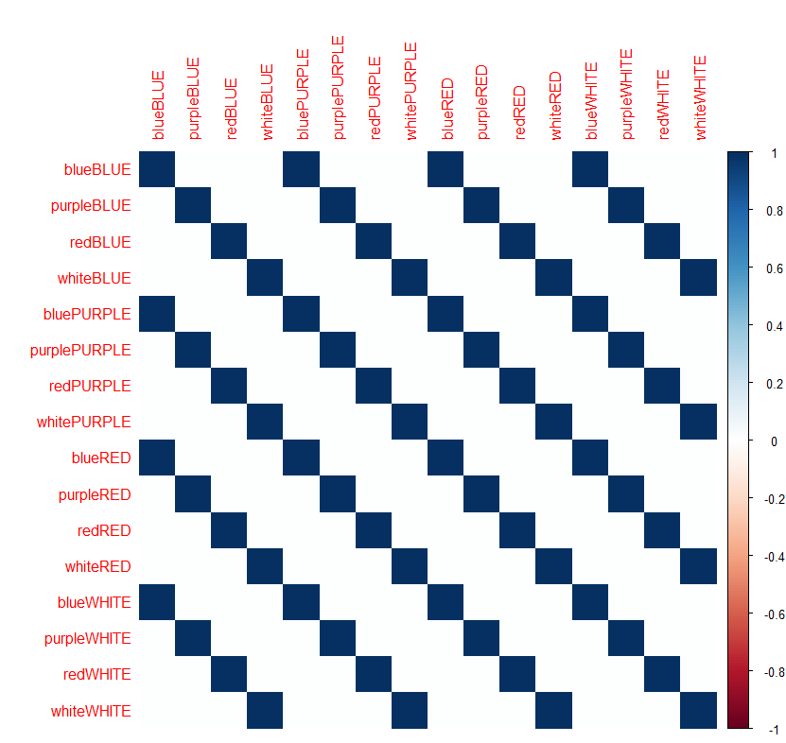
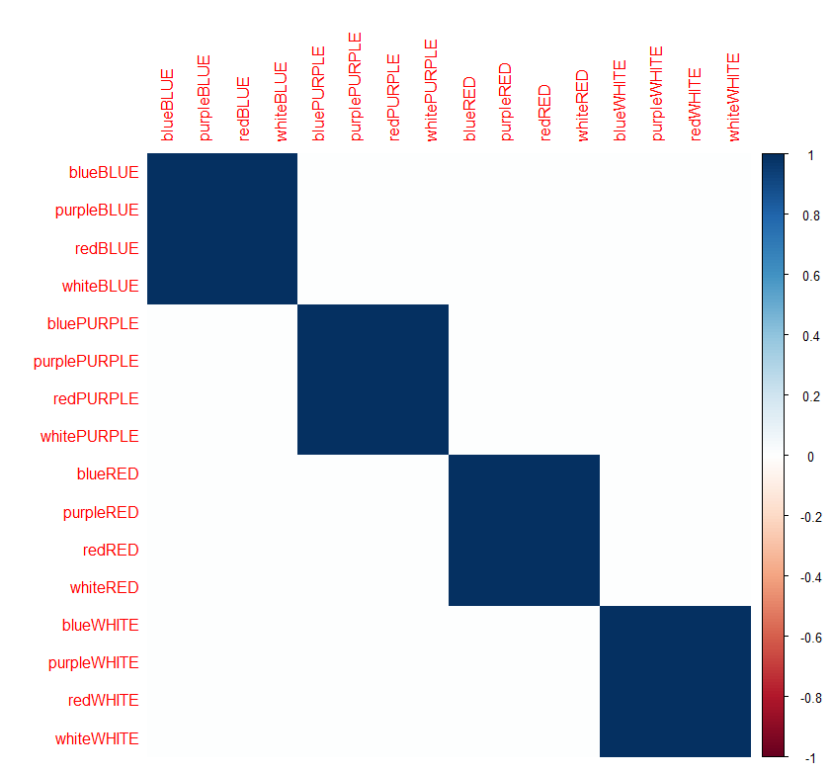
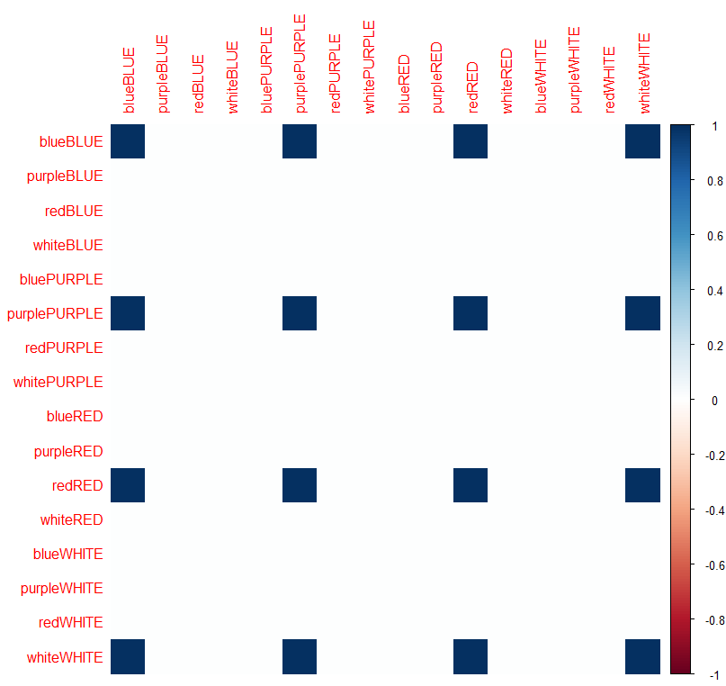
[Fig 1] METHOD
Masters fig 1
Updates: different parameterization of conflict model
‘incongruency’ / conflict
distractor
target
‘congruency’ (to regress out)

Slide 3
Section 1: group analysis

Slide 4
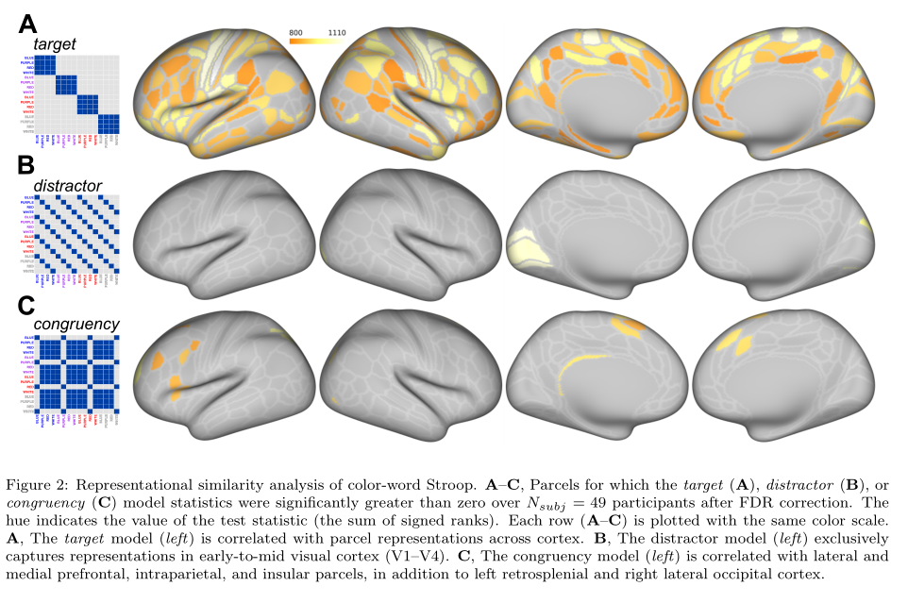
[group analysis, Fig 2] CODING RESULTS: parcels where {target | distractor | conflict} > 0
Masters fig 2
Similar format…

Slide 5
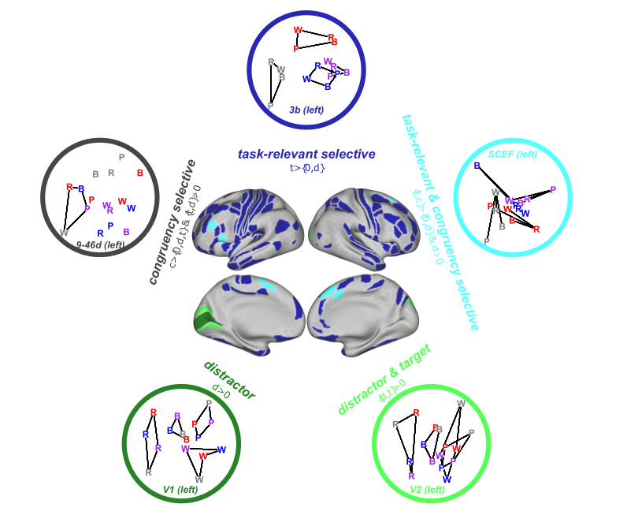
[group analysis, Fig 3] REPRESENTATIONAL PROFILES & GEOMETRY
Masters fig 3
Similar….

Slide 6
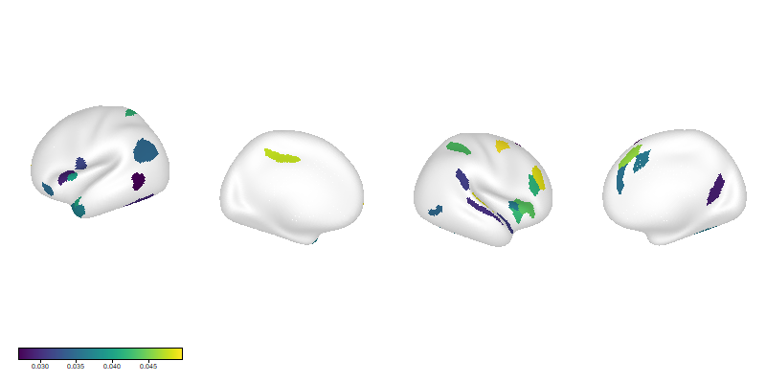
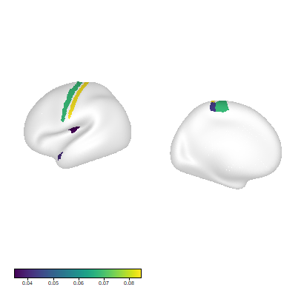
[group analysis, Fig 3] REPRESENTATIONAL PROFILES & GEOMETRY
Masters fig 3
ADDITION: a proper ‘selectivity’ analysis
Two One Sided Tests (TOST) procedure
confirmatory test for null effect via frequentist methods
Similar….
T>D, D = 0
T>C, C = 0
file:///C:/Users/mcf/Box/global/proj/stroop-rsa/analyses/coding_profiles/coding_profiles_mmp.html

Slide 7
Section 2: individual differences analysis

Slide 8
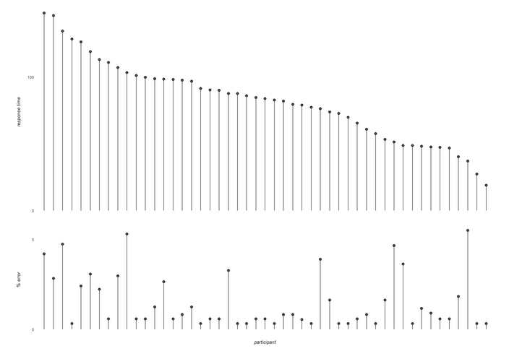
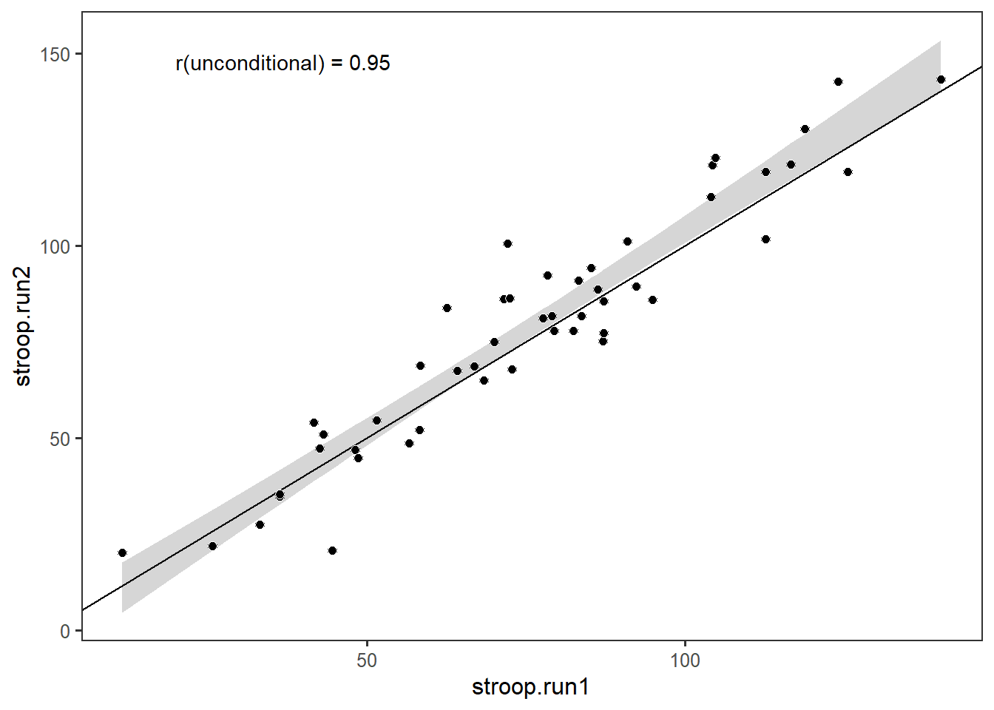
[individual differences, FIG 4] BEHAVIORAL DATA
a
b
Stroop effects estimated as posterior modes in HLM
Split-half (cross-run) reliability estimated as random-effect correlation
file:///C:/Users/mcf/Box/global/proj/stroop-rsa/old/R01_freund_stroop-rsa/stroop-rsa/r/group-201902/masters/0-1_build_behavioral_models.html
file:///C:/Users/mcf/Box/global/proj/stroop-rsa/analyses/behavior/model_development.html

Slide 9
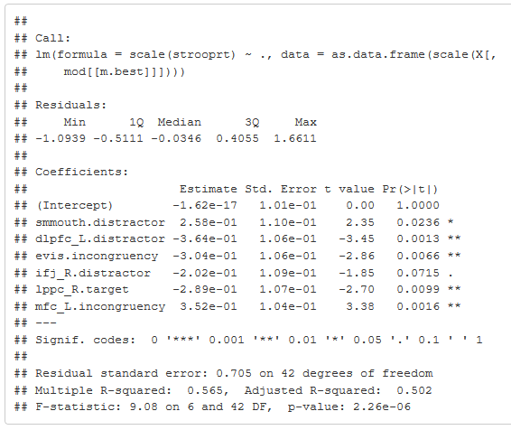
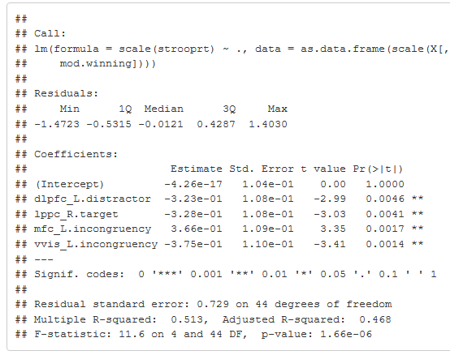
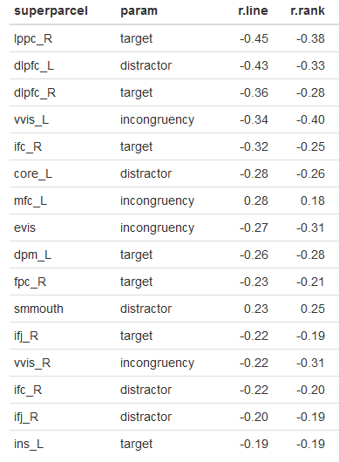
[individual differences] BEHAVIORAL MODEL COMPARISON
features selected for model comparison (on basis of bivariate R^2)
Model winning ‘1SE rule’ (more parsimonious)
Model w/ min test error
ADDITIONS:
-larger space of models compared
-Also included RSA fits from VWFA super-parcel and from an ‘MD’ superparcel (from Assem et al. 2019)
file:///C:/Users/mcf/Box/global/proj/stroop-rsa/analyses/brain-behavior/model_comparison.html

Slide 10
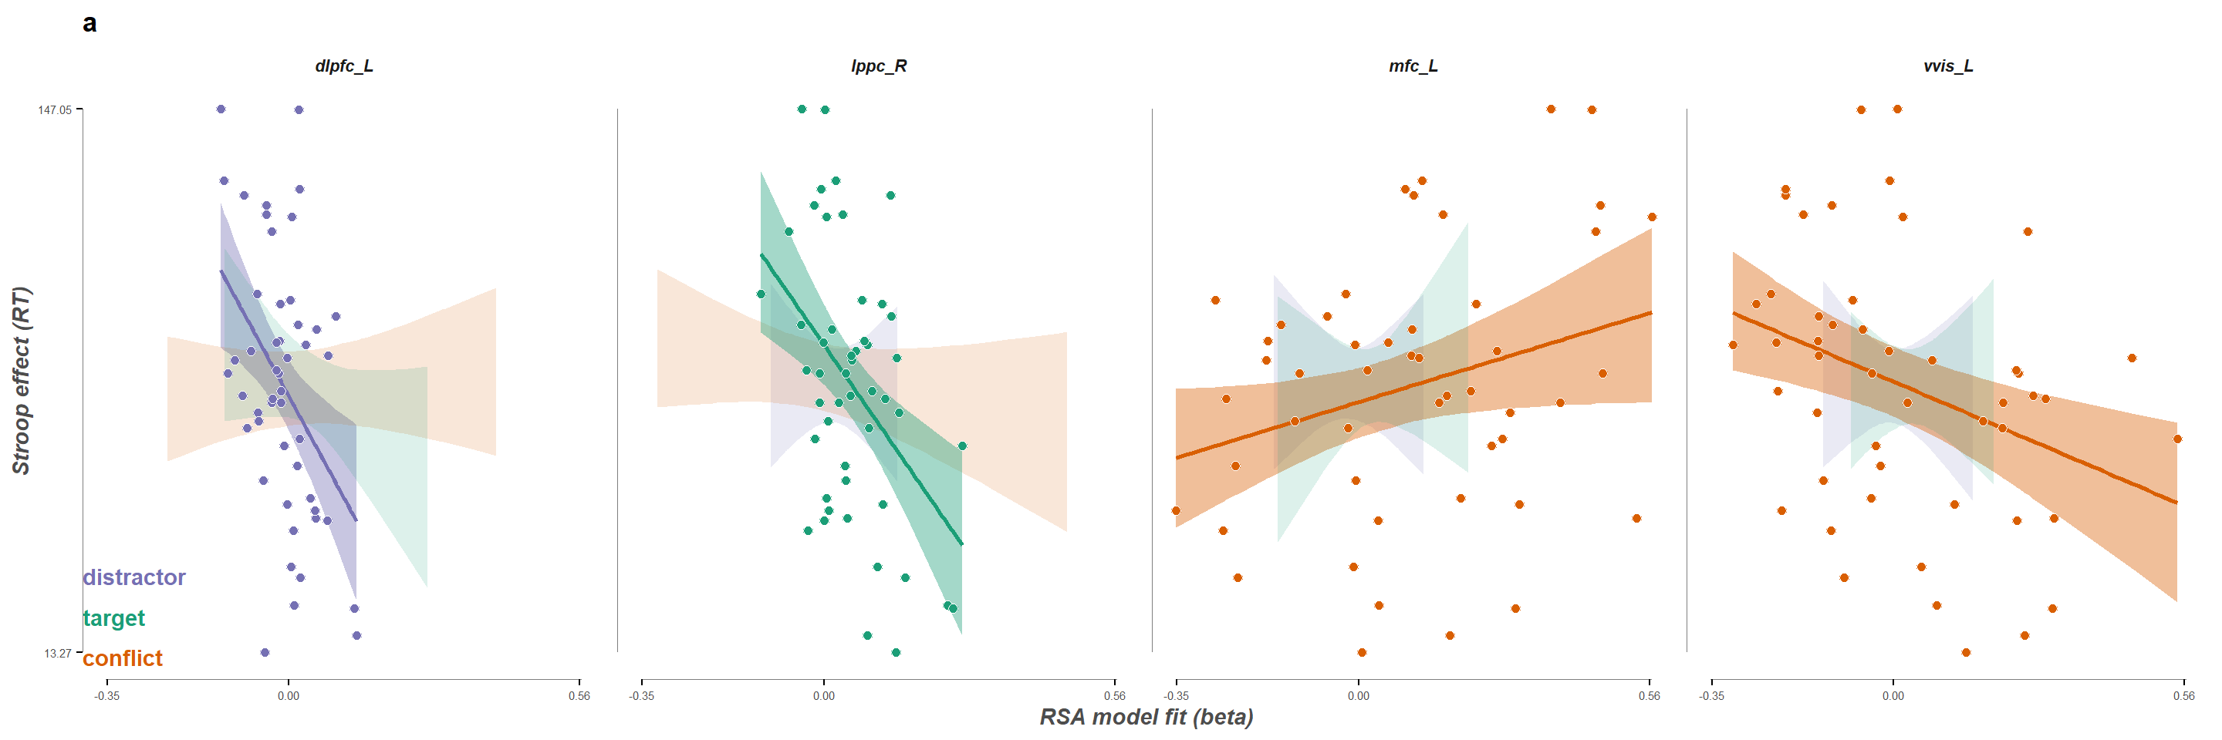
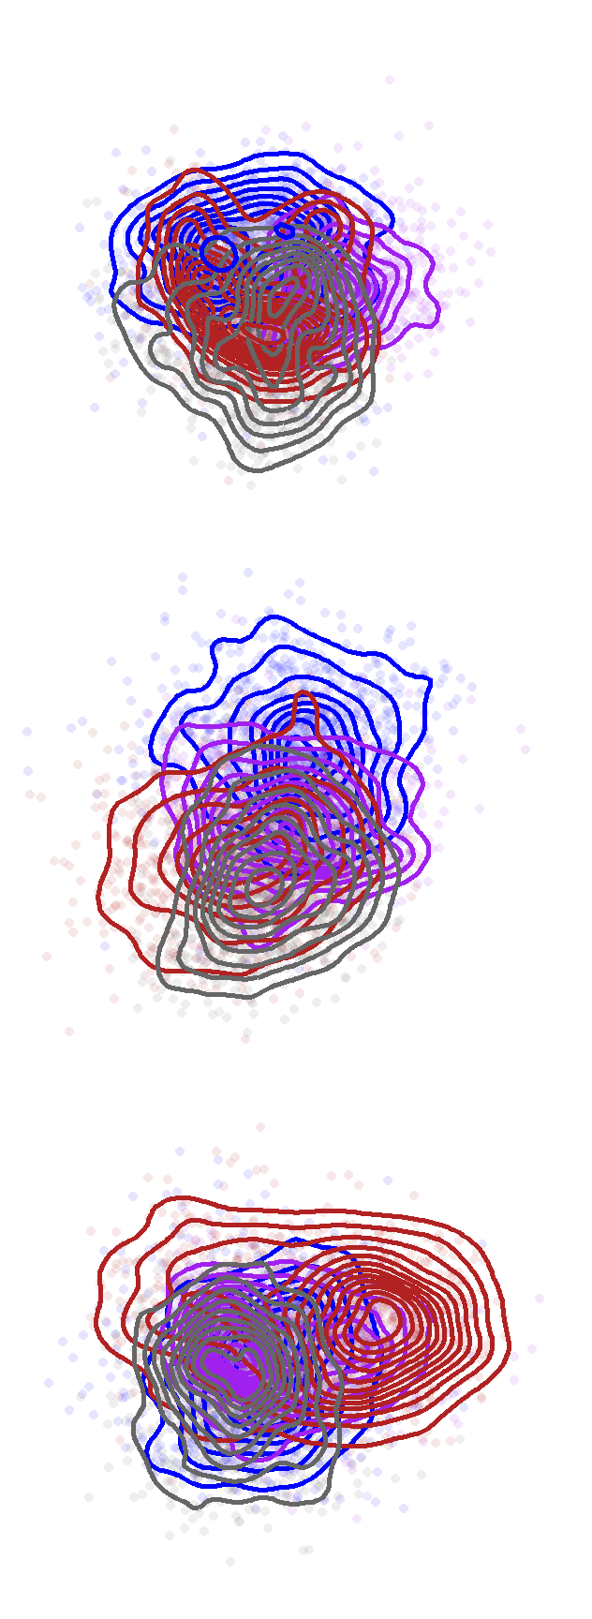
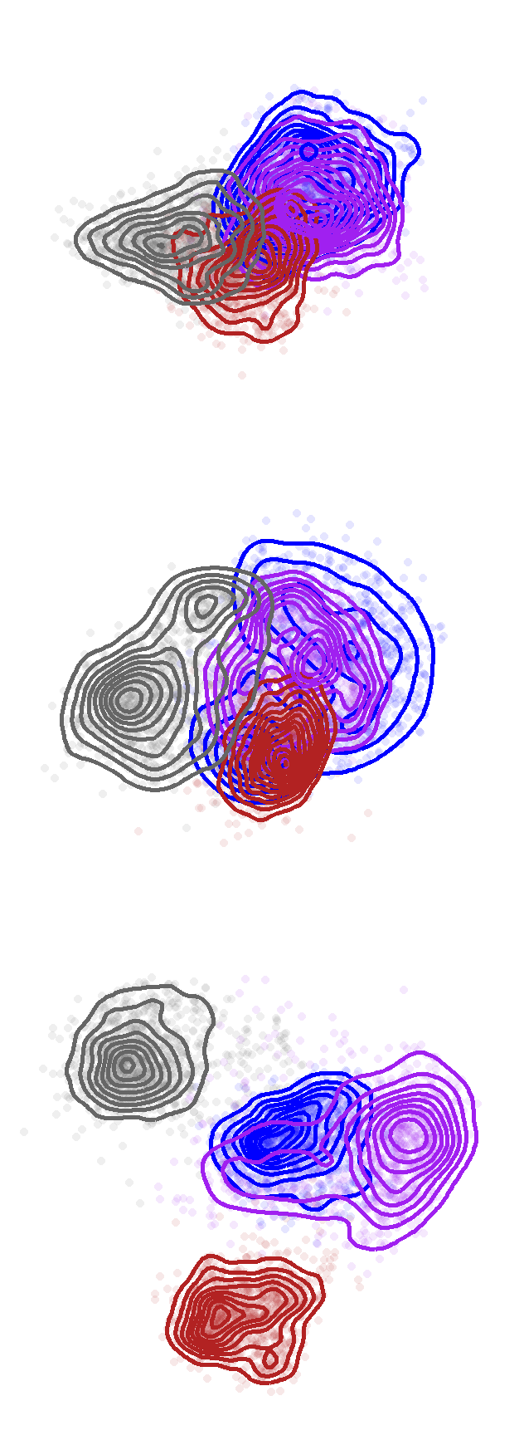
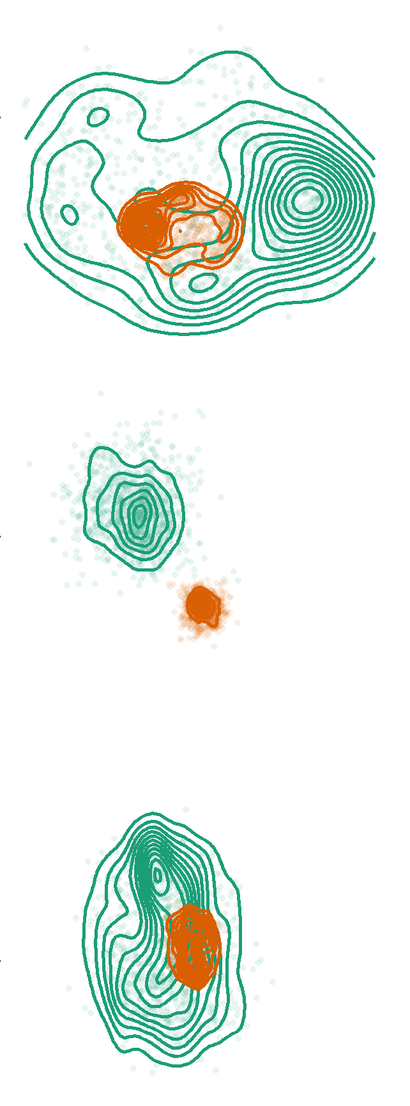
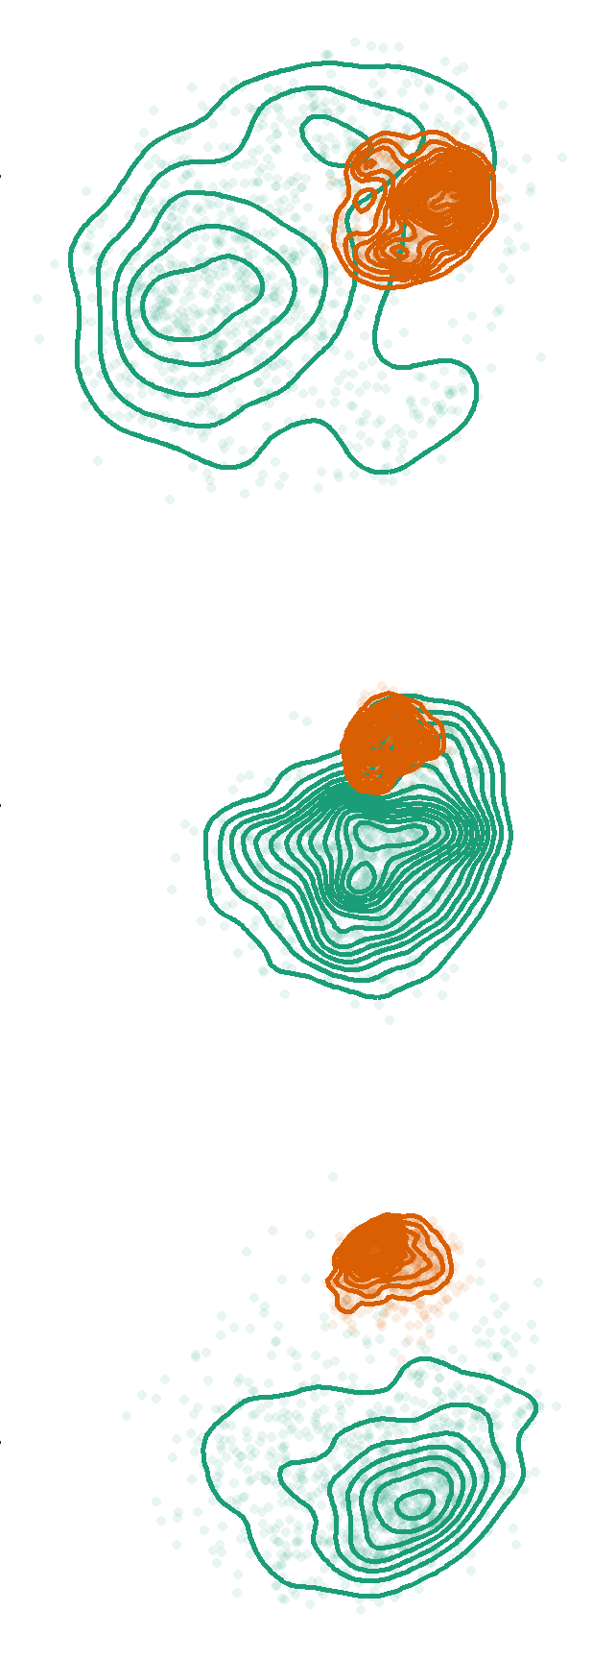
[individual differences, FIG 5] WINNING MODEL
Bivariate correlations of winning model, and trichotomized MDS solutions (w/ bootstrapped contours)
file:///C:/Users/mcf/Box/global/proj/stroop-rsa/analyses/brain-behavior/model_comparison.html

