Slide 1
Multi-Provider
Gradio Chat Pro
A compact chat application that connects to local and hosted AI providers, supports file-assisted conversations, and packages advanced controls into a clean UI.
Ollama
Gemini
OpenAI
DeepSeek
Core value
One interface for local experimentation, hosted APIs, model selection, uploads, streaming, and compact UX.
Project presentation

Slide 2
Problem and project goals
Why this app was built and what it solves
Problem
Goal
Outcome
Users often need to test different AI providers, but switching tools, credential flows, model names, and file workflows creates friction.
Create a single Gradio app that supports local and hosted providers, allows chat with files, and keeps the interface compact.
A reusable project scaffold for demos, experimentation, and side-by-side evaluation across providers and models.
Support local Ollama and hosted Gemini, OpenAI, and DeepSeek.
Enable file upload for document-aware prompting and summaries.
Include streaming responses, model discovery, and provider health checks.
Expose advanced generation controls without leaving the chat workflow.
Reduce clutter with collapsible sections and a compact layout.

Slide 3
Solution architecture
How the app routes requests and normalizes provider behavior
Provider adapter
User
Gradio UI
Maps shared app inputs to local Ollama or hosted provider request formats.
Writes prompts, uploads files, and selects a provider.
Compact interface with chat front and collapsible utilities.
File pipeline
Parses uploads, chunks content, and adds context to the current prompt.
State & diagnostics
Single user experience across multiple providers.
Shared controls for temperature, context, and system prompts.
Provider-specific details hidden behind adapter logic.
Tracks history, health checks, exports, and streaming status for the session.
Architecture emphasizes a shared UI with provider-specific adapters.

Slide 4
Key capabilities
What the application can do today
Provider switching
Streaming chat
File-assisted prompts
Move between Ollama, Gemini, OpenAI, and DeepSeek from one interface.
Show incremental responses and animated request states during generation.
Upload documents and feed extracted content into the current conversation.
Model discovery
Advanced controls
Project utilities
Fetch available models and sync the selected model into the active session.
Tune temperature, context budget, system prompt, and provider-specific options.
Run health checks and save, load, or export chats for later review.

Slide 5
UX evolution during development
The interface was refined from feature-rich to easier-to-browse
Initial direction
Refined direction
Many controls visible at once.
Wide layout consumed horizontal space.
Model and file utilities competed with the chat area.
Navigation became harder on smaller displays.
Only provider and current model stay always visible.
Model picker, files, and settings move into collapsible sections.
Chat stays central and easier to follow.
Layout feels closer to a real application than a debug console.
Compact UI
This was one of the main product improvements requested during iteration.

Slide 6
Implementation highlights
Important technical choices and engineering lessons
Message normalization
Provider abstraction
Streaming status
Multi-turn chat required careful handling of history because some frameworks return structured content, not plain strings.
A shared interface reduces UI complexity while hiding differences between local Ollama and hosted APIs.
Animated states provide user feedback during long requests and file-heavy prompts.
Gradio version differences required iterative fixes for callback signatures and component configuration.
Ollama multi-turn support needed history sanitization to avoid malformed message sequences.
The app balances a compact surface area with access to advanced model controls.
Packaging README and requirements makes the project easier to run, share, and extend.

Slide 7
Next steps
How this project can continue to improve
1
Native multimodal flow
Use direct image/PDF handling per provider where supported.
2
Better model picker
Add a cleaner dropdown-first experience with optional custom override.
3
Chat UX polish
Enter-to-send, Shift+Enter newline, retry/edit flows, and better message actions.
4
RAG upgrade
Replace simple file injection with chunking, embeddings, and retrieval scoring.
5
Observability
Show token usage, latency trends, and provider-specific response metadata.
Local + hosted
Iterative build

Slide 8
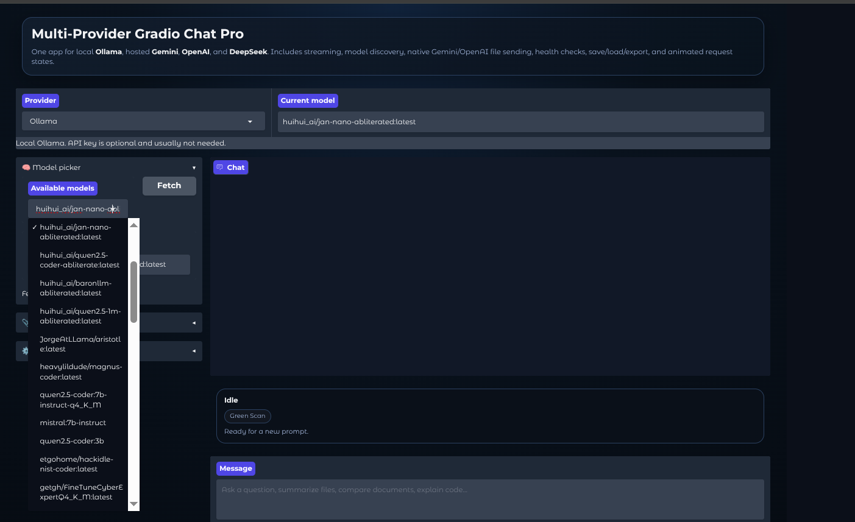

Slide 9
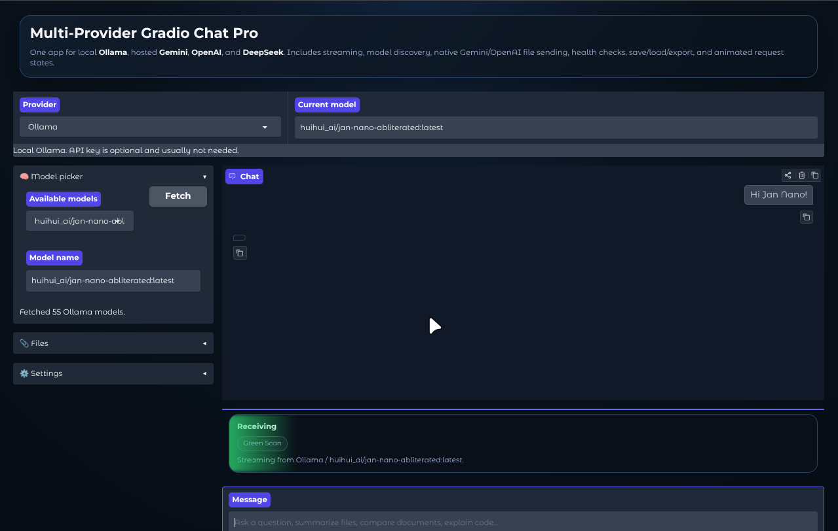

Slide 11
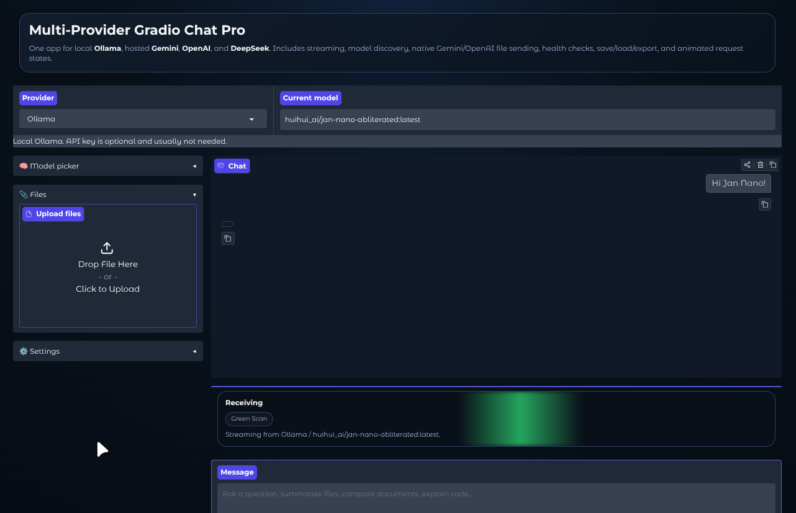

Slide 12
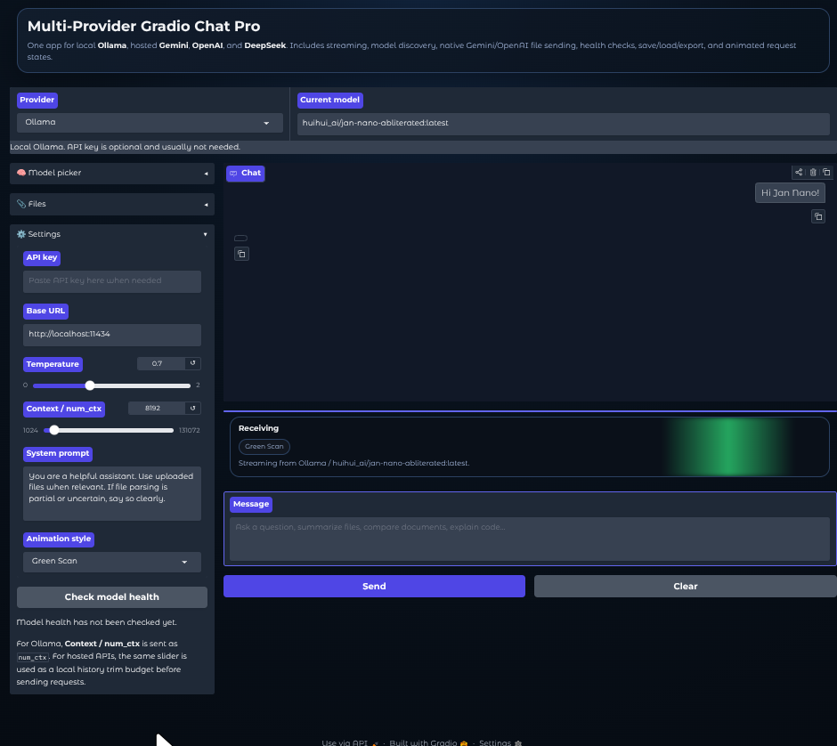

Slide 13
