Slide 1
Ollama Rocket WebTools v9
Script Analysis
Feature inventory, architecture view, command map, and implementation risks extracted from the uploaded Python CLI script.
Core stack
Ollama client
Requests + BS4
PyPDF2 / docx / pptx / xlsx
Matplotlib / Pandoc / speech tools
Local Ollama
Web-assisted
Security
Multi-model
Key finding: the script is a feature-rich local AI command center, but several commands appear unfinished or fragile.
Prepared from: ollama_rocket_webtools_v9.py

Slide 2
How the script is structured
Interactive CLI loop with command routing, model invocation, optional web tooling, and export utilities.
Input layer
Command router
Reasoning layer
Output layer
typed prompts
slash commands
voice input
file paths
main loop
if/elif command handler
mode toggles
ask_question()
ask_with_web_search()
multi-model tools
streamed answers
saved conversations
generated docs
charts / reports
State and configuration
Web subsystem
Document subsystem
global settings for temperature, top_p, max_tokens, num_ctx
mode flags: webmode, verification, security mode
conversation persisted under ~/.ollama_ai_chat
search backends: DuckDuckGo, SearXNG, Bing, Google CSE
page fetch + robots-aware crawl
last_web_search_summary cache
file upload parsing: pdf/docx/pptx/xlsx/images
export to pdf/docx/txt/md
chart rendering with matplotlib

Slide 3
Feature map by category
The script packs a wide command surface into one file.
Chat and session controls
Analysis utilities
Web and security
/help, /clear, /models, /history, /delete
/export, /load, /new, /s, /t
/summary, /prompt, /ctx
/upload, /run, /translate, /voice
/visualize, /analyze, /generate
/tool for embedding model selection
/search, /crawl, /webai, /webmode
/searchbackend, /verify, /websources
/secmode, /owasp, /securl, /zapfile, /nmapxml
Advanced reasoning workflows
Math helper workflows
/multi lets one prompt go to multiple models
/compare compares answers across chosen models
/router heuristically auto-picks a model by math / security / general intent
/doublecheck gets a reviewer model to critique a primary answer
/solve enforces step-by-step math output
/checksolution critiques a pasted student solution
Approximate command groups: 30+ user-facing commands spanning chat, web, security, documents, and orchestration.

Slide 4
Web-assisted and security workflows
V7-V9 added the most distinctive functionality: grounded web answers and defensive security analysis.
Defensive orientation, not offensive
User question
Search / fetch
Evidence summary
Grounded answer
/webai and webmode
Search backends
Defensive security tools
forced or default web-assisted responses
verification mode prints raw evidence snippets
fallback path can fetch a user-provided direct URL
DuckDuckGo API + HTML fallback
SearXNG HTML POST
Bing API
Google CSE API
OWASP prompt wrapper
security header report for a URL
ZAP and Nmap report interpretation

Slide 5
Files, document generation, and utilities
The script can ingest files, ask questions about them, and export model output into multiple formats.
Accepted uploads
Generation pipeline
Other utilities
images (.png/.jpg/.jpeg)
/generate exports the latest model answer
PDF via Pandoc + XeLaTeX or pdflatex
DOCX via python-docx
TXT and Markdown direct writes
sanitize_content() handles some math markup conversions
translation, voice input, restricted Python execution, and matplotlib charting are built in.
text (.txt)
PDF (.pdf)
DOCX (.docx)
Persistence
PPTX (.pptx)
Conversations are stored under ~/.ollama_ai_chat as JSON or Markdown, and the current chat is auto-saved on exit commands.
XLSX (.xlsx)

Slide 6
Implementation findings: strengths and gaps
The concept is strong, but the file shows several maintainability and runtime issues.
What is working well
Likely issues to fix
broad command surface in a single local CLI
multi-backend web augmentation with fallback logic
defensive security framing instead of exploit-oriented behavior
multi-model comparison, routing, and reviewer workflows
document export and chart utilities add practical value
/load and /sentiment reference missing functions
custom_prompt is set but not applied in prompting
ask_question returns before TTS playback block
PPTX upload extraction likely fails by reading slide.text directly
simple exec() restrictions are not a real sandbox
monolithic if/elif command handler is hard to maintain
Overall: strong prototype
Needs refactor + hardening

Slide 7
Recommended next steps
A practical path to turn the script from a powerful prototype into a more reliable product.
1. Stabilize
2. Secure
3. Modularize
implement missing functions
fix PPTX parsing and signal handling
move TTS before return
improve error handling for missing keys/binaries
replace raw exec with real isolation
validate URL/file sizes before fetch
separate safe defensive prompts from generic chat
add tests for security report paths
split into chat/web/security/files/docs modules
use a command registry instead of long if/elif chains
introduce config objects over globals
add unit tests and sample fixtures
Bottom line: Ollama Rocket WebTools v9 already demonstrates a compelling local-AI command center; the next milestone is reliability engineering.

Slide 8
Running the olc_webtools v9a
I use conda for my all projects as I don’t want to interfere my Linux system’s Pythton installation.
conda activate ollama_client’
and ...

Slide 9
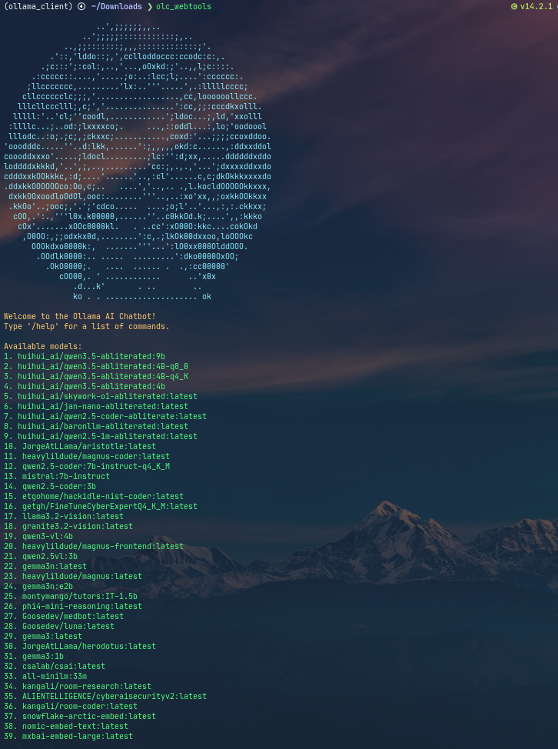
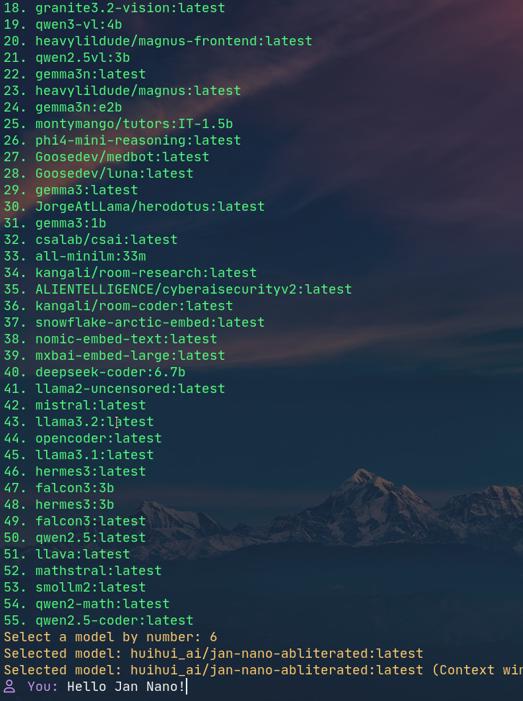

Slide 10
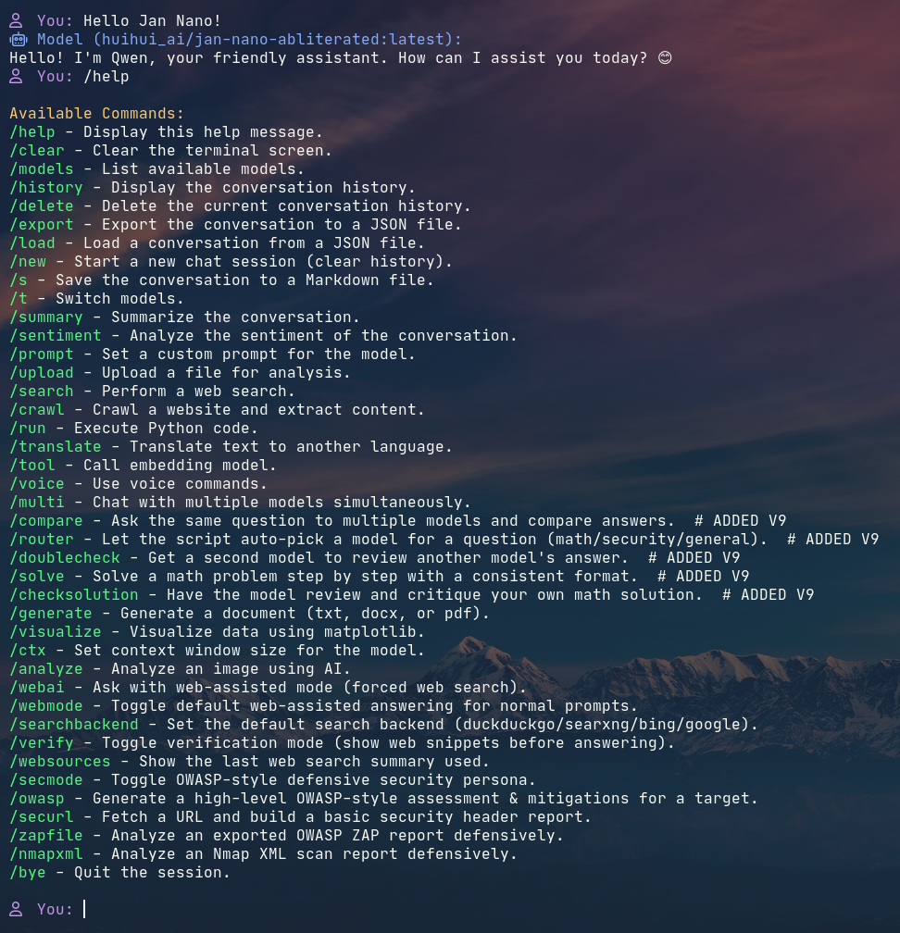

Slide 11
Downside running LLM locally,
must have powerful GPU and lots of RAM.
pros: Privacy, no cost, it is fun!

