Slide 1
APOES

Slide 2
# of sample on original graphs
Breeder | Non-Breeder(*including Apoe ¾) | Non-Breeder(without Apoe3/4)
N animals= 199 | N animals= 1749 | N animals= 11207
N weights= 1649 | N weights= 16818 | N weights= 1331
# of sample on current graphs
 | Non- Breeder |  | Breeder
 | N animals | N weights | N animals | N weights
Male Apoe 3 | 270 | 2764 | 41 | 415
Male Apoe 4 | 407 | 3651 | 56 | 497
Female Apoe 3 | 289 | 2199 | 45 | 333
Female Apoe 4 | 365 | 2593 | 57 | 404
Total: | 1331 | 11207 | 199 | 1649

Slide 3
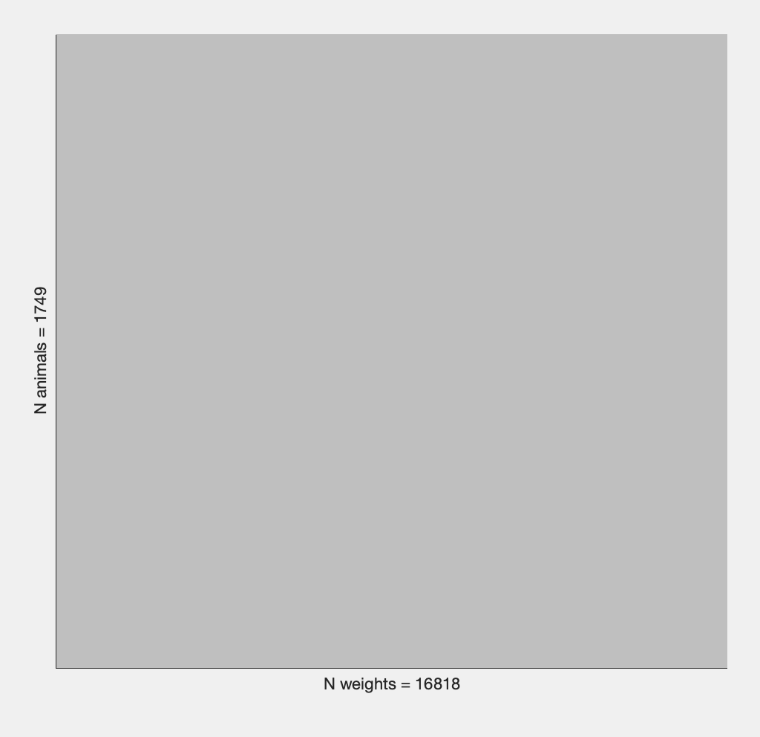
Apoes Non-Breeding

Slide 4
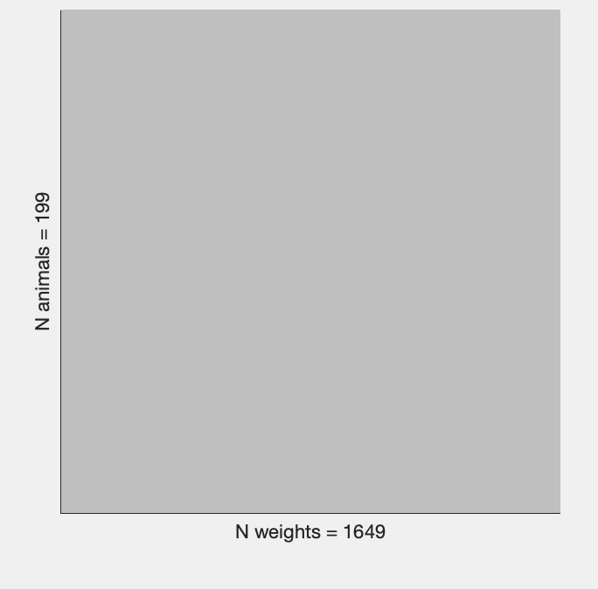
Apoes Breeding

Slide 5
In Male Apoes 3, there are more non-breeders than breeders. The non-breeders weigh 2764 g overall and have 270 mice in total. Breeders have a total weight of 415 g and a total number of 41 mice. Breeders and non-breeders have similar starting weights. As the month progresses, Breeders' weight fluctuates more than Non-Breeders' does. Breeders' data are more dispersed as the month goes on compared to non-breeders', who have a lower standard deviation and are clustered nearer to the mean. You can observe dispersion between 17- 24 months, 24 months being more scattered. This demonstrates how much variation there is among mice.
In Male Apoes 4, there are more non-breeders than breeders. The total weight of the non-breeders is 3651 g, and a total of 407 mice. Breeders weigh 497 g overall and have a total of 56 mice. The initial weights of breeders and non-breeders are comparable. Non-breeders weigh 32 g on average as the month goes on. Breeders' weight and age are correlated to each other. Non-breeder had lower standard deviation and closer to the mean compared to Breeders. There is more dispersion between the month of 17-24 in breeders similar as Male Apoe 3. There is a rise around month 22, which suggests that some mice may have been heavier than usual.

Slide 6
In Female Apoes 3, there are more non-breeders than breeders. The total weight of the non-breeders is 2199 g, and a total of 289 mice. Breeders weigh 333 g overall and have a total of 45 mice. Breeders and non-breeders start out at similar weights. The standard deviations are not far from the means, and both have similar averages. In comparison to breeders, non-breeders gain weight steadily as the month progresses.
In Female Apoes 4, there are more non-breeders than breeders. The total weight of the non-breeders is 2593 g, and a total of 365 mice. Breeders weigh 404 g overall and have a total of 57 mice. Like Female Apoes 3, the non-breeder gains weight steadily. Weight fluctuates more in breeders. Month 3 in breeders is also the only point where data is more
dispersed compared to others. Overall, both have similar standard deviation.

Slide 7
c9orf72

Slide 8
# of sample on original graphs
Breeder (Female &Male c9orf72 NT&TG) | Nonbreeder(Female &Male c9orf72 NT&TG)
N animals= 51 | N animals= 550
N weights= 404 | N weights= 4229
# of sample on current graphs
 | Non- Breeder |  | Breeder
 | N animals | N weights | N animals | N weights
Male c9orf TG | 160 | 1404 | 12 | 81
Male c9orf NT | 117 | 1082 | 23 | 151
Female c9orf TG | 140 | 874 | 13 | 133
Female c9orf NT | 133 | 869 | 9 | 39
Total: | 550 | 4229 | 51 | 404

Slide 9
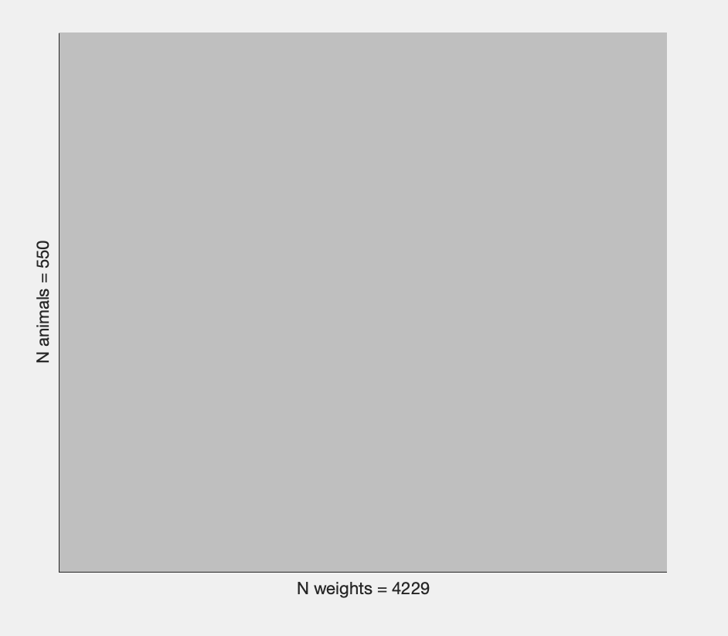
C9orf72 Non-Breeding

Slide 10
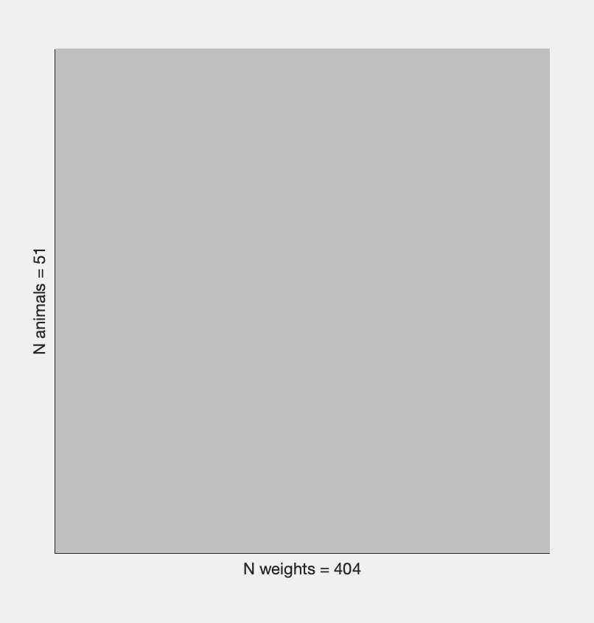
C9orf72 Breeding

Slide 11
In Male c9 TG, there are more non-breeders than breeders. The total weight of the non-breeders is 1404 g, and a total of 160 mice. Breeders weigh 81 g overall and have a total of 12 mice. As the month progresses, there is a minor variation in the weight of non-breeders. In breeders, there are a few peaks to consider. There is a surge at three months; this could be due to a number of things, including anomalies, poor data quality, etc. A curve between 14- 18 months and a tiny peak at 9 months are present. High standard deviation is dispersed between the peaks.
In Male c9 NT, there are more non-breeders than breeders. The total weight of the non-breeders is 1082 g, and a total of 117 mice. Breeders weigh 151 g overall and have a total of 23 mice. In non-breeders , an inverted exponential curve is seen between 1-9 months, after which the line begins to fluctuate. Small peaks are present, and the standard deviation is more evenly distributed. Breeders weigh more as the month goes on rather than consistently. You can also notice a significant weight gain between the months of 16 and 17.

Slide 12
In Female c9 TG, there are more non-breeders than breeders. The total weight of the non-breeders is 874 g, and a total of 140 mice. Breeders weigh 133 g overall and have a total of 13 mice. The shift in standard deviation begins to appear in non-breeders at 11 months. From then, as the month increases, the weight's standard deviation spreads away from the mean. Breeders have a few peaks that indicate inconsistency with weight gain as the month increases. Between 9 and 13 months, the standard deviation is further dispersed from the mean.
In Female c9 NT, there are more non-breeders than breeders. The total weight of the non-breeders is 869 g, and a total of 133 mice. Breeders weigh 39 g overall and have a total of 9 mice. Non-breeders exhibit a slight consistency in weight gain as the month progresses. . Even so, standard deviations also rise as the month lengthens. Numerous irregularities are present in breeders. There is spike of weight gain between 5-6 months, following a big drop at 7 months. In the period between 11 and 12 months, there is even another surge. After that, there are 2 little peaks, and between 15 and 19 months, weight remained constant. There’s definitely a big difference between two due to the population of mice. The use of small population of mice in breeders limits the accuracy of data since there’s not a lot of variation

Slide 13
HLA

Slide 14
# of sample on original graphs
Nonbreeder(Female &Male HLA TG) | Breeder(Female &Male HLA TG)
animals= 192 | N animals= 71
weights= 1709 | N weights= 458
# of sample on original graphs
 | Non- Breeder |  | Breeder
 | N animals | N weights | N animals | N weights
Male HLA TG | 106 | 952 | 34 | 226
Female HLA TG | 86 | 757 | 37 | 232
Total: | 192 | 1709 | 71 | 458

Slide 15
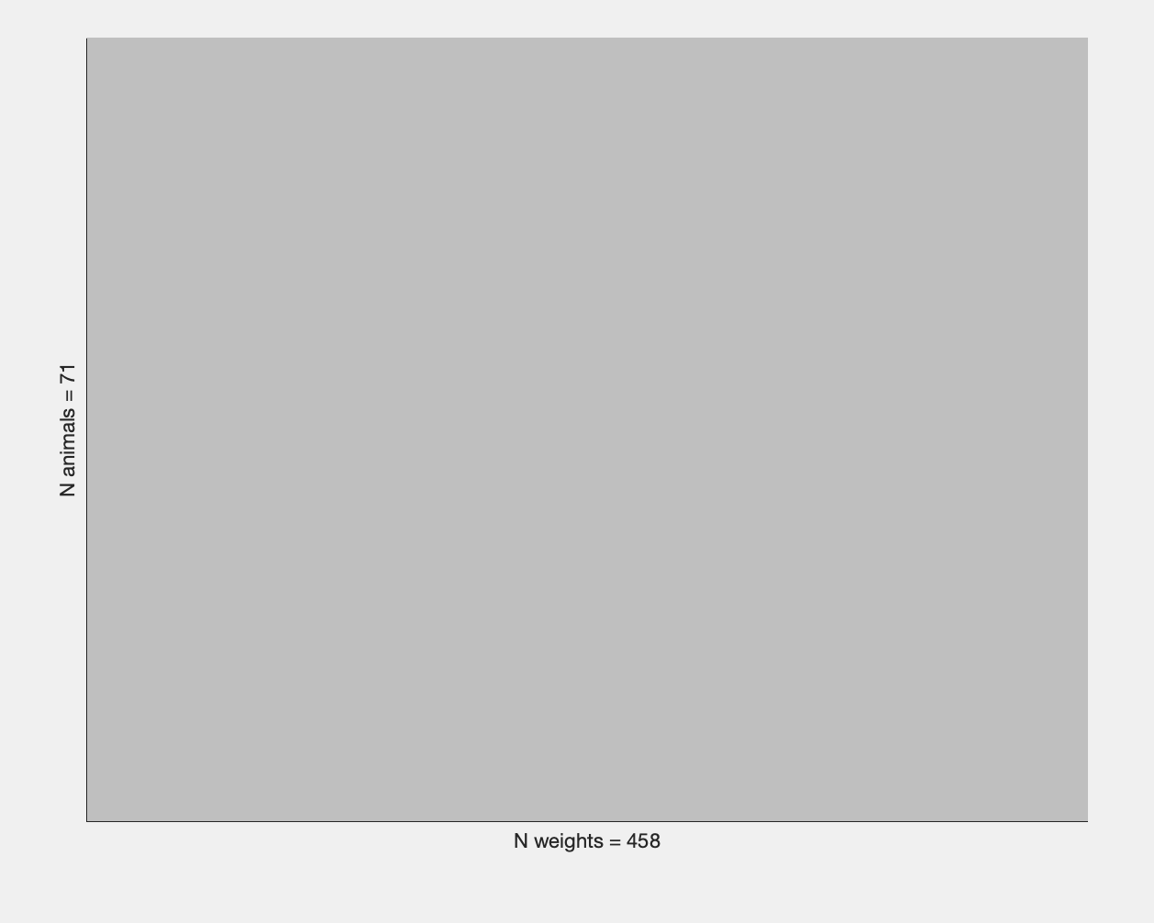
HLA Breeding

Slide 16
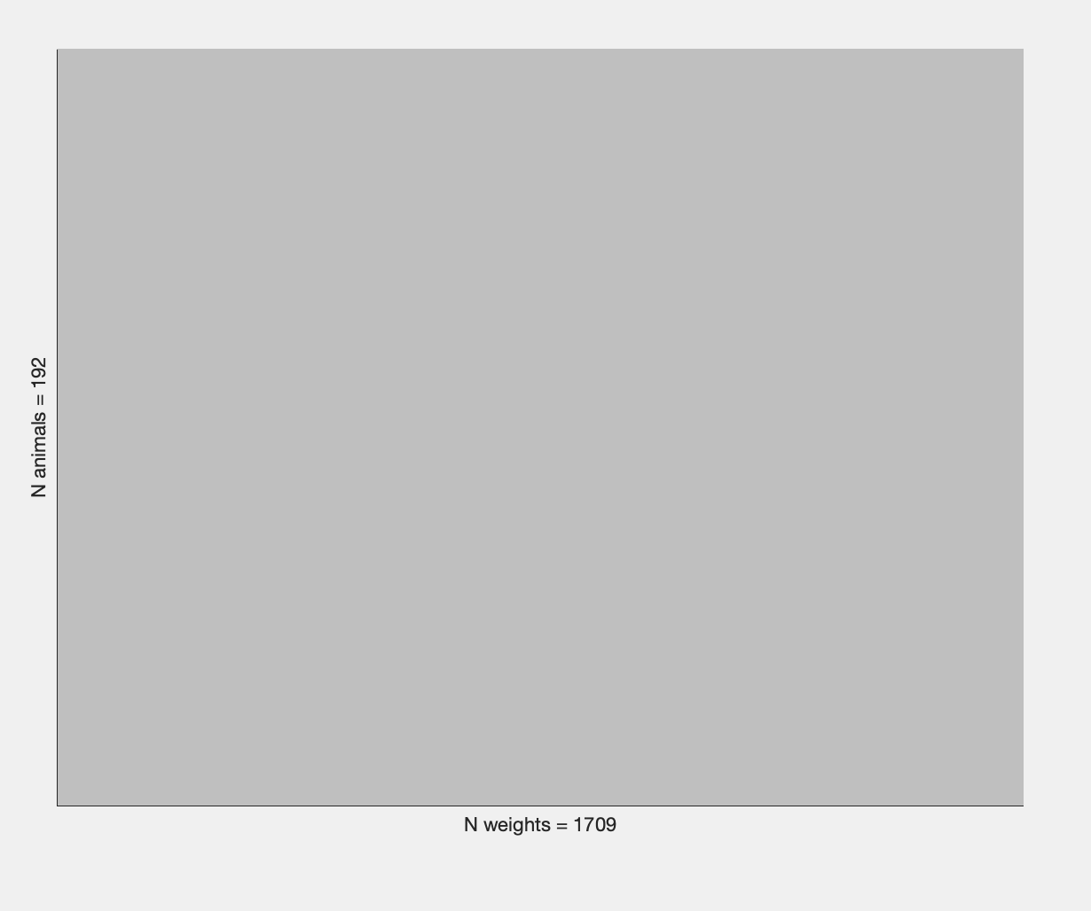
HLA Non-Breeding

Slide 17
In Male HLA TG, there are more non-breeders than breeders. The total weight of the non-breeders is 952 g, and a total of 106 mice. Breeders weigh 226 g overall and have a total of 34 mice. In non-breeders, there is a steady growth of weight from the 1st-13 month. Then, you can see two peaks afterwards. Breeders' standard deviation weight rises along with the month's length. Although, there is a significant decline in weight between the months of 15-20.
In Female HLA TG, there are more non-breeders than breeders. The total weight of the non-breeders is 757 g, and a total of 85 mice. Breeders weigh 232 g overall and have a total of 37 mice. The trends are quite similar in nonbreeders and breeders. There's an average of 5g difference of weight between 2 as the month increases. There are also more peaks in the breeders compared to non-breeders

Slide 18
GBA

Slide 19
# of sample on original graphs
Non-Breeder | Breeder
N animals= 736 | N animals= 25
N weights= 5576 | N weights= 200
# of sample on current graphs
 | Non- Breeder |  | Breeder
 | N animals | N weights | N animals | N weights
Male GBA WT | 190 | 1452 | 7 | 55
Male GBA HET | 168 | 1197 | 5 | 41
Female GBA WT | 172 | 1344 | 5 | 33
Female GBA HET | 206 | 1583 | 8 | 71
Total: | 736 | 5576 | 25 | 200

Slide 20
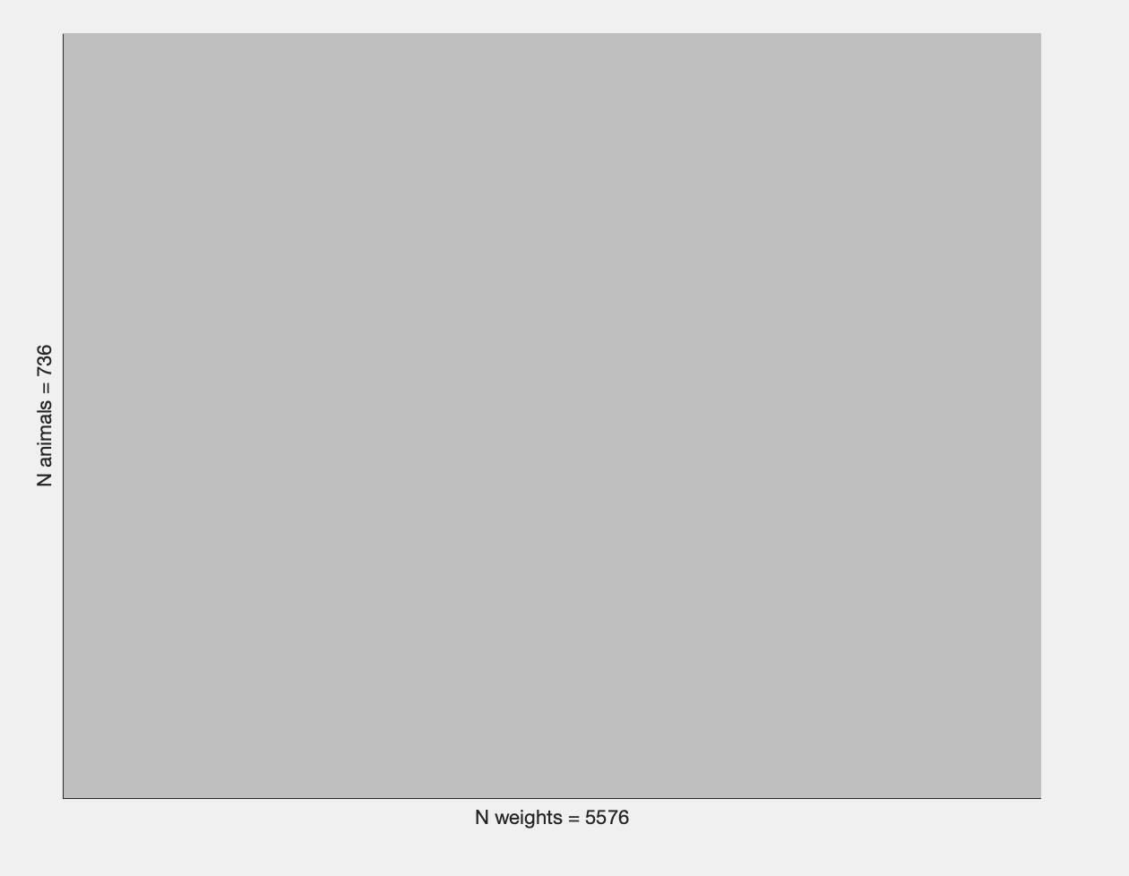
Non-Breeding GBA

Slide 21
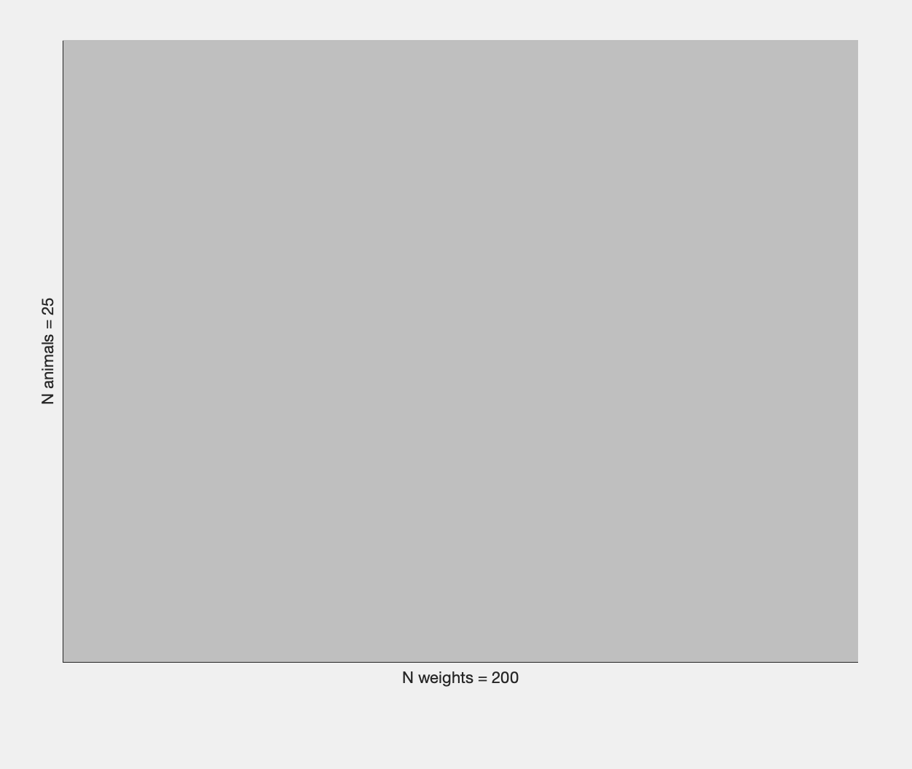
Breeding GBA

Slide 22
Male GBA WT&HET Non-Breeding vs Breeding
In Male GBA WT, there are more non-breeders than breeders. The total weight of the non-breeders is 1452 g, and a total of 190 mice. Breeders weigh 55 g overall and have a total of 7 mice. In non-breeders, there is a steady growth of weight as the month increases. The standard deviation is low and closer to the mean, indicating reliability of data. Breeders' standard deviation is up and down. There is also a sudden increase of weight at month 6- 7.
In Male GBA HET, there are more non-breeders than breeders. The total weight of the non-breeders is 1197 g, and a total of 168 mice. Breeders weigh 41 g overall and have a total of 5 mice. In non-breeders, there is a steady growth of weight as the month increase( similar pattern in Male GBA WT). Breeders' standard deviation is up and down . There is a high standard deviation at month 6, data is widely spread and less reliable. Overall, there is fluctuation in weight as month increases
*breeder has less population compared to non-breeder, data might be affected

Slide 23
Female GBA WT&HET Non-Breeding vs Breeding
In Female GBA WT, there are more non-breeders than breeders. The total weight of the non-breeders is 1344 g, and a total of 172 mice. Breeders weigh 33 g overall and have a total of 5 mice. In non-breeders, there is a steady growth of weight, there’s a small dip at month 7. Standard deviation is low, indicating accuracy of data. In Breeders, weight fluctuates as month increases
In Female GBA WT, there are more non-breeders than breeders. The total weight of the non-breeders is 1583 g, and a total of 206 mice. Breeders weigh 71 g overall and have a total of 8 mice. In non-breeders, there is a steady growth of weight from the 3rd-13 month. Breeders' standard deviation fluctuates as month increases. Highest standard deviation is at 6 month, where most mice lost weight. Along the axis, you can see 3 peaks.
*breeder has less population compared to non-breeder, data might be affected

