Slide 1
INFO 465
Projects in Information System
CI/CD (or DevOps)
April 24, 2025

Slide 2
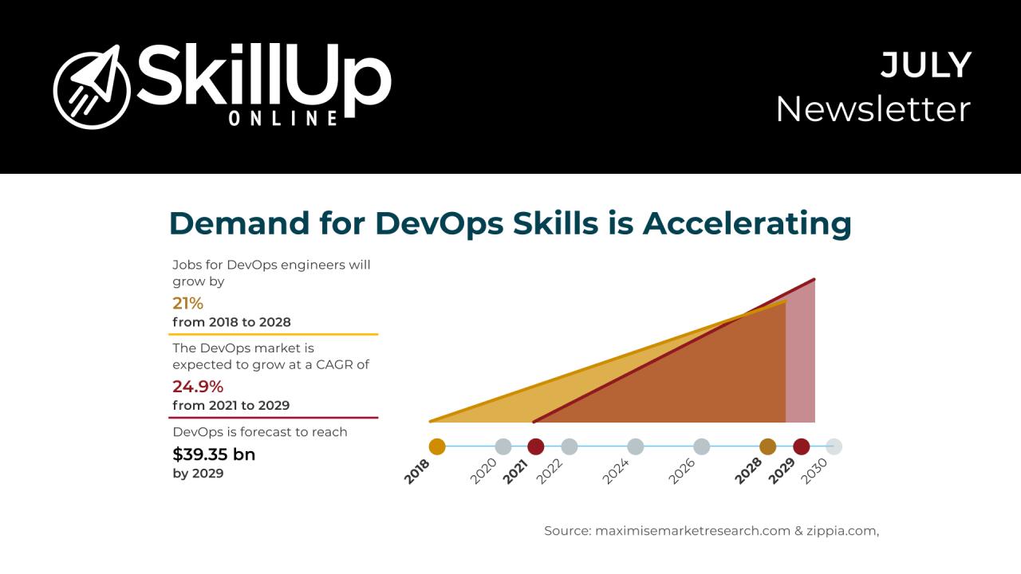
Why are we covering CI/CD (or DevOps)

Slide 3
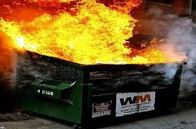
Some of my career “highlights”
A critical security patch brings all Windows servers down.
The new proxy server cannot keep up with network demand, disrupting sales.
Hardware failure within the server for a key application during peak sales time.
Firmware upgrade takes all network storage offline.
A new storage array take down our mainframe computer, critical for customer service operations, for nearly 24 hours.
An undetected bug in a new software program disrupts our ability to ship product to customers.
All of these started with a change

Slide 4
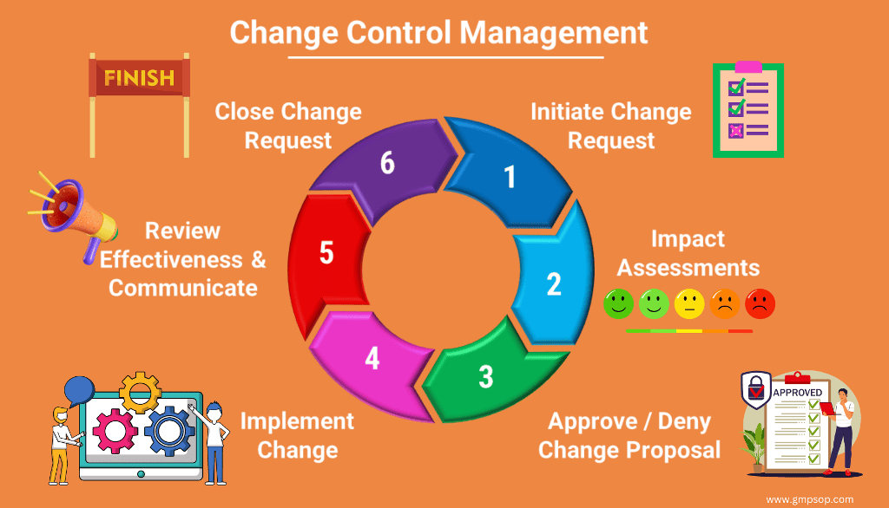
Enter change control
Change is the enemy of technology stability.
Change control in technology ensures stability by systematically managing and reviewing modifications to systems, preventing unintended disruptions and maintaining reliability.

Slide 5
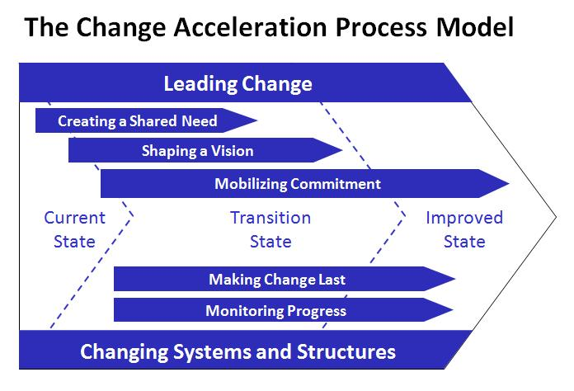
Career: eCommerce stability (last one)
Context: Promoted to CTO at GE Insurance (now Genworth)
#1 problem: (per boss) Web site availability
Solution: Monthly deployment, formal change control (from ”whenever” and ”launch and learn”))
A cultural issue rather than a technical one.
GE’s change model: Which I ignored

Slide 6
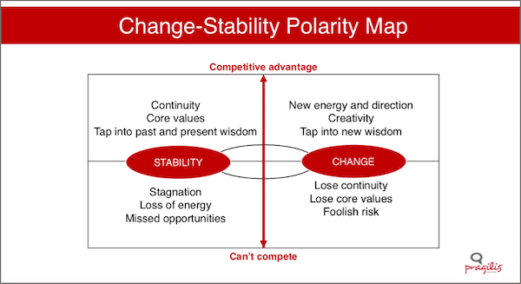
The tension: Need for change vs. stability
There is an inherent conflict between availability (which likes stability, minimal changes) and agility (which needs rapid change)

Slide 7
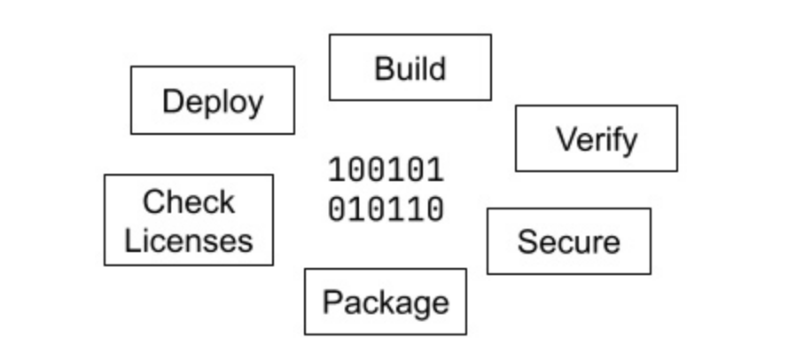
Why do changes impact availability?
Major steps in the software delivery life cycle
So, what is the problem with this process? Well, the steps are….
Error prone: Susceptible to misconfigurations, steps applied in the wrong order, and data entry mistakes. For instance, failing to configure environment variables correctly could result in application crashes after deployment.
Lend themselves to miscommunications & inconsistencies: Leads to confusion about the build’s readiness. Imagine if one team member assumes a test passed because of unclear documentation, but another finds critical errors in the same test..
They take more time than expected: (e.g. Hofstadter's law: It always takes longer than expected, even when considering Hofstadter's law)

Slide 8
Example: Deploying .js app with React
Packaging: Prepare the application
Frontend (React):
Navigate to your React project directory.
Run npm install to ensure all dependencies are installed.
Build the React app with npm run build. This creates a build folder with production-ready static files.
Backend (Node.js/Express):
Ensure all dependencies are installed with npm install.
Create environment variables to support the application
Deploying: - front end using AWS S3
Create a new bucket:
Set the bucket to public for static website hosting.
Enable static website hosting in properties.
Upload your build folder contents to this bucket:
Additional steps for instance setup, MySQL set up, domain and DNS administration.
Error prone, repetitive, time-intensive…..

Slide 9
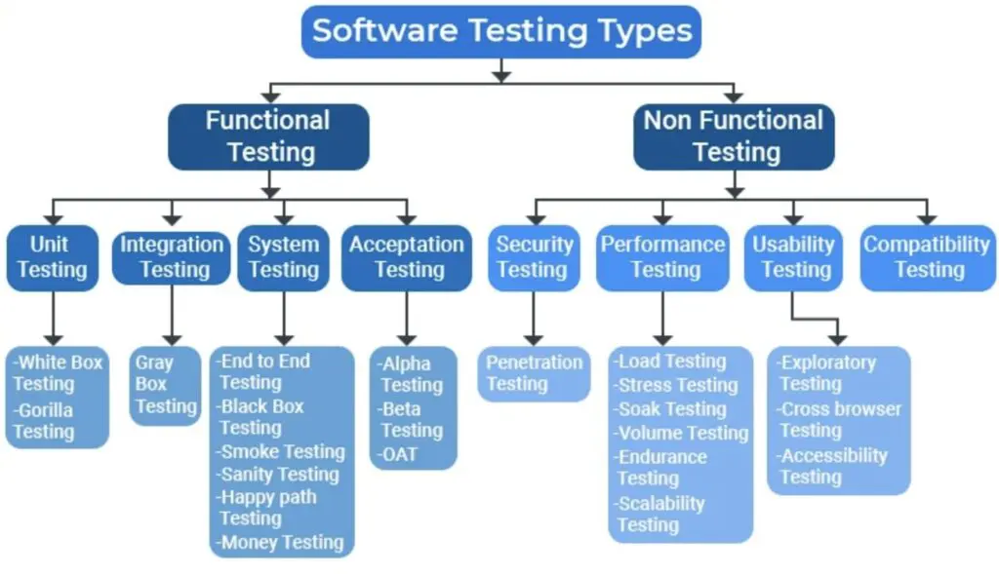
Example: Testing
Error prone, repetitive, time-intensive…..

Slide 10
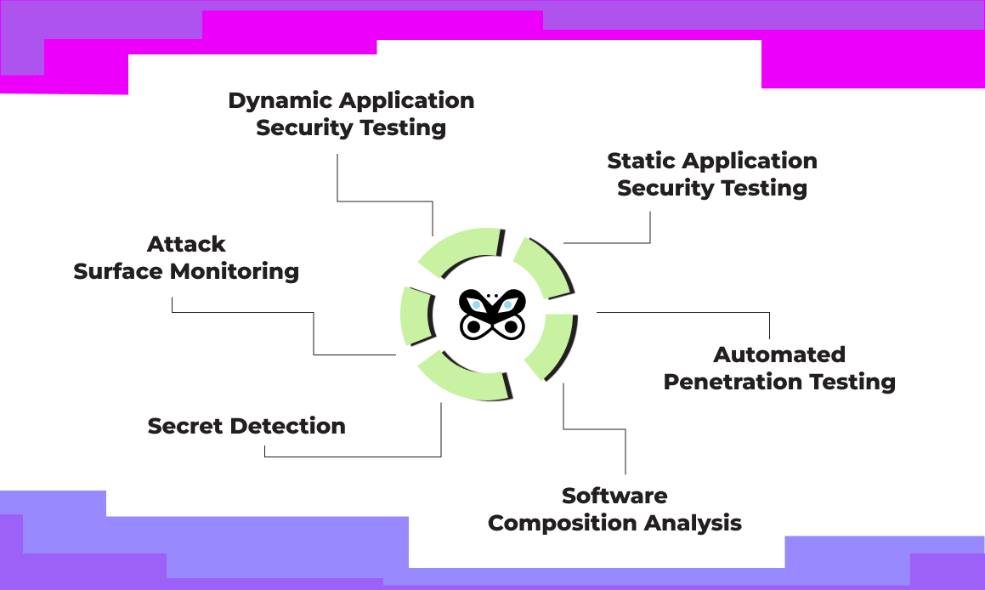
Last example: Security testing (sample)
Error prone, repetitive, time-intensive…..
But the business needs to be agile and responsive to change

Slide 11
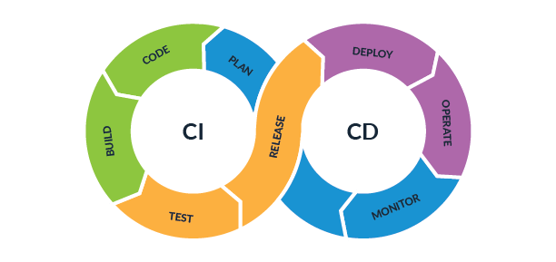
Enter CI/CD (or DevOps)
The idea: Automate the steps in the software delivery process.
Benefits: Enables frequent updates, improves quality
CI – Continuous Integration: Finding out if your code is good
CD – Continuous Delivery or Continuous Deployment: If your code is code, put it where it needs to be
Continuous Delivery: Deploy up to the production environment
Continuous Deployment: Deploy into the production environment
The series of steps in this process is referred to as the pipeline

Slide 12
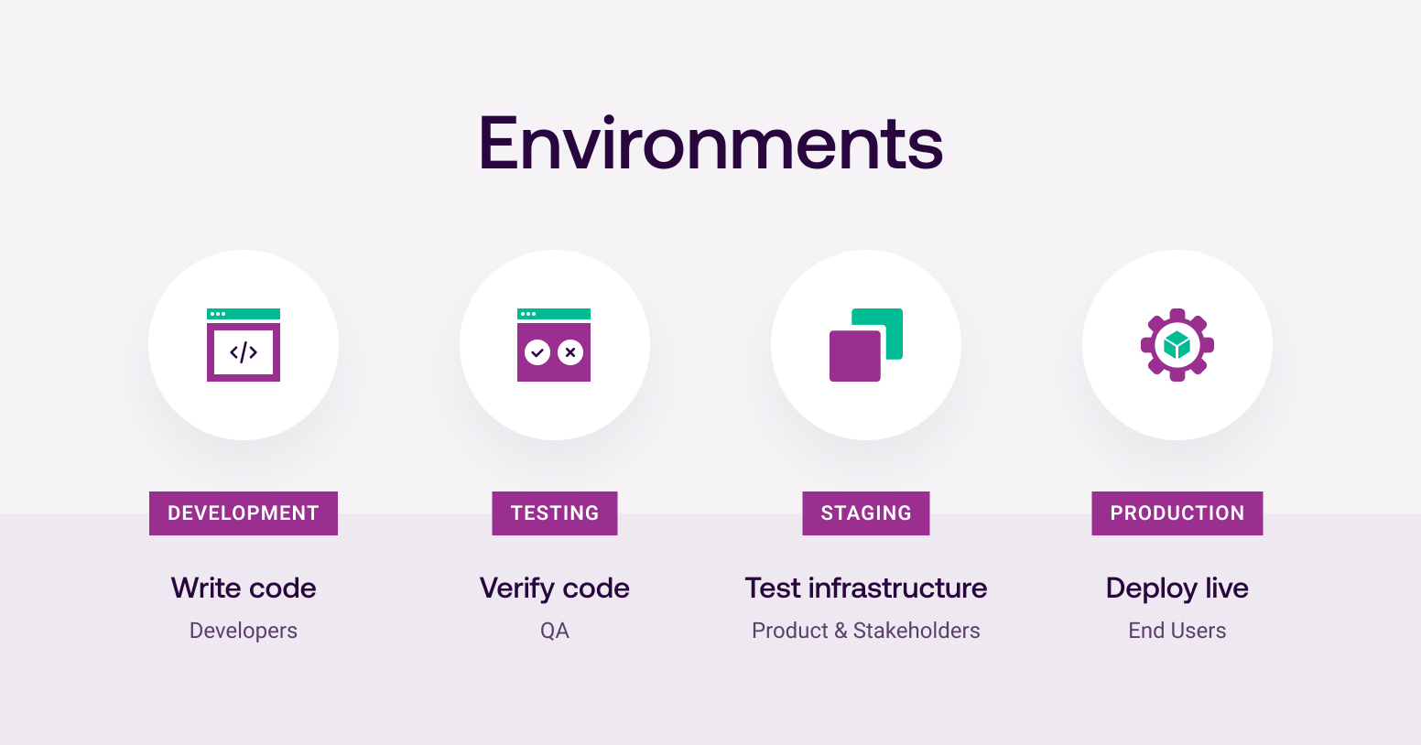
Continuous Delivery vs. Deployment
Continuous Delivery
Continuous Deployment

Slide 13
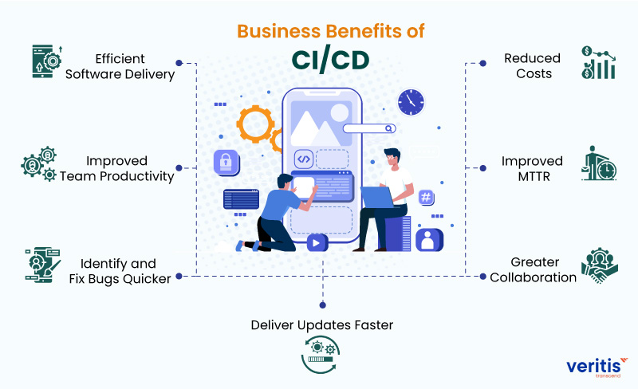
Partial list of CI/CD benefits

Slide 14
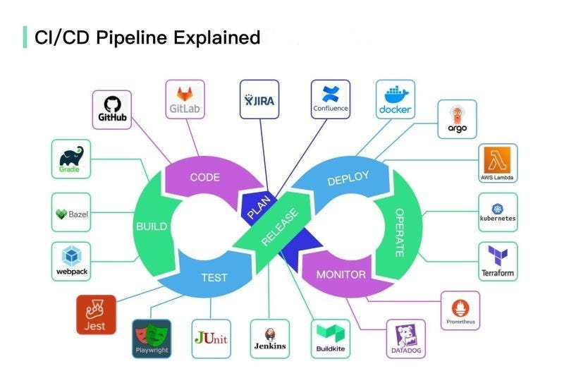
Implementing CI/CD: Tools
Notice GitHub’s place
We will be doing an assignment in GitLab

Slide 15
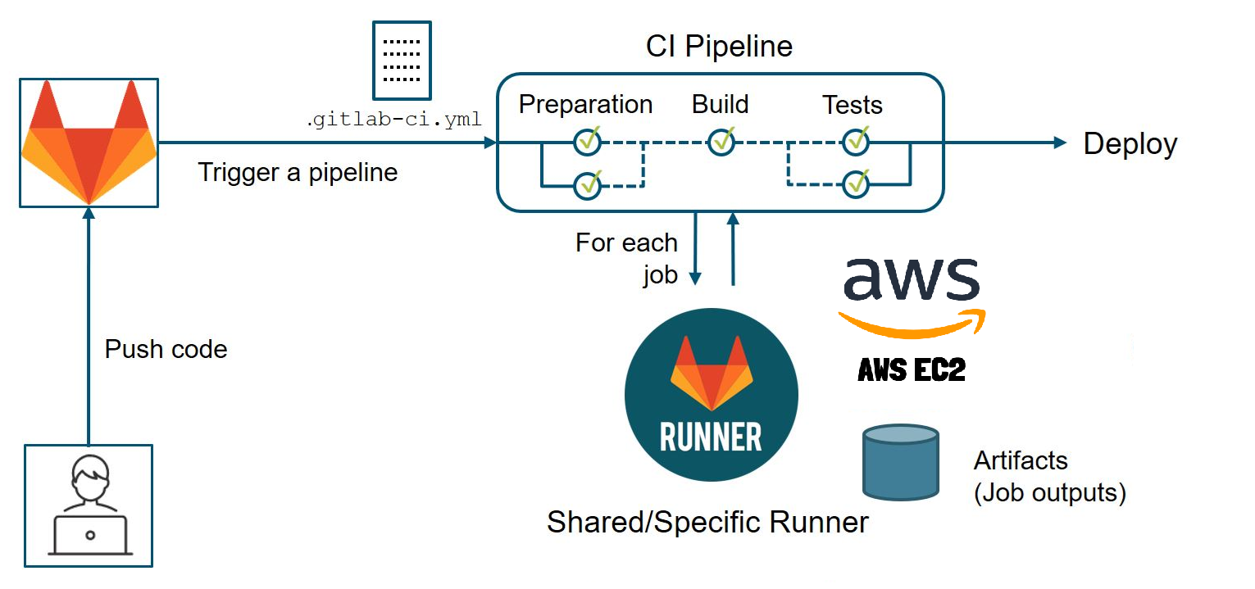
What is GitLab?
GitLab is:
A web-based application which automates the CI/CD pipeline
It provides a suite of tools for version control, continuous integration and continuous delivery (CI/CD), and security testing.

Slide 16
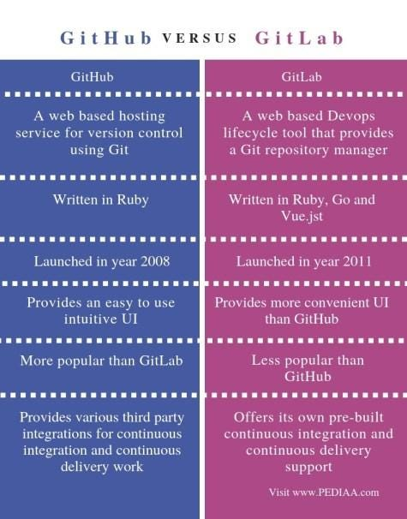
Git vs. GitHub vs. GitLab
Git: A distributed version control system.
GitHub: Collaboration and the sharing of Git Repositories
GitLab: A DevOps platform combining Git repository management and CI/CD pipelines.

Slide 17
GitLab’s Pipeline structure
Pipeline: The overarching process that runs a series of stages to build, test, deploy, or otherwise manage your code.
Stages: The phases of your CI/CD process.
Stages are executed sequentially, meaning one stage must complete before the next one begins.
Common stages include:
build: Compiling or assembling the code into an executable form.
test: Running tests to ensure the code works as expected.
deploy: Deploying the code to a staging or production environment.
Jobs: Stages have one or more jobs, which define the commands to run. Executed by GitLab runners. Jobs can have:
Scripts: The commands executed by the job.
Artifacts: Files created by the job that can be passed to subsequent jobs or downloaded.
Dependencies: Jobs can depend on artifacts from previous jobs.
Workflow: Defined in your project’s .gitlab-ci.yml file. The .yml file specifies:
The name of each stage.
The jobs within each stage, including the commands they should execute.
Any rules or conditions for when jobs should run (like branches or tags to match).

Slide 18
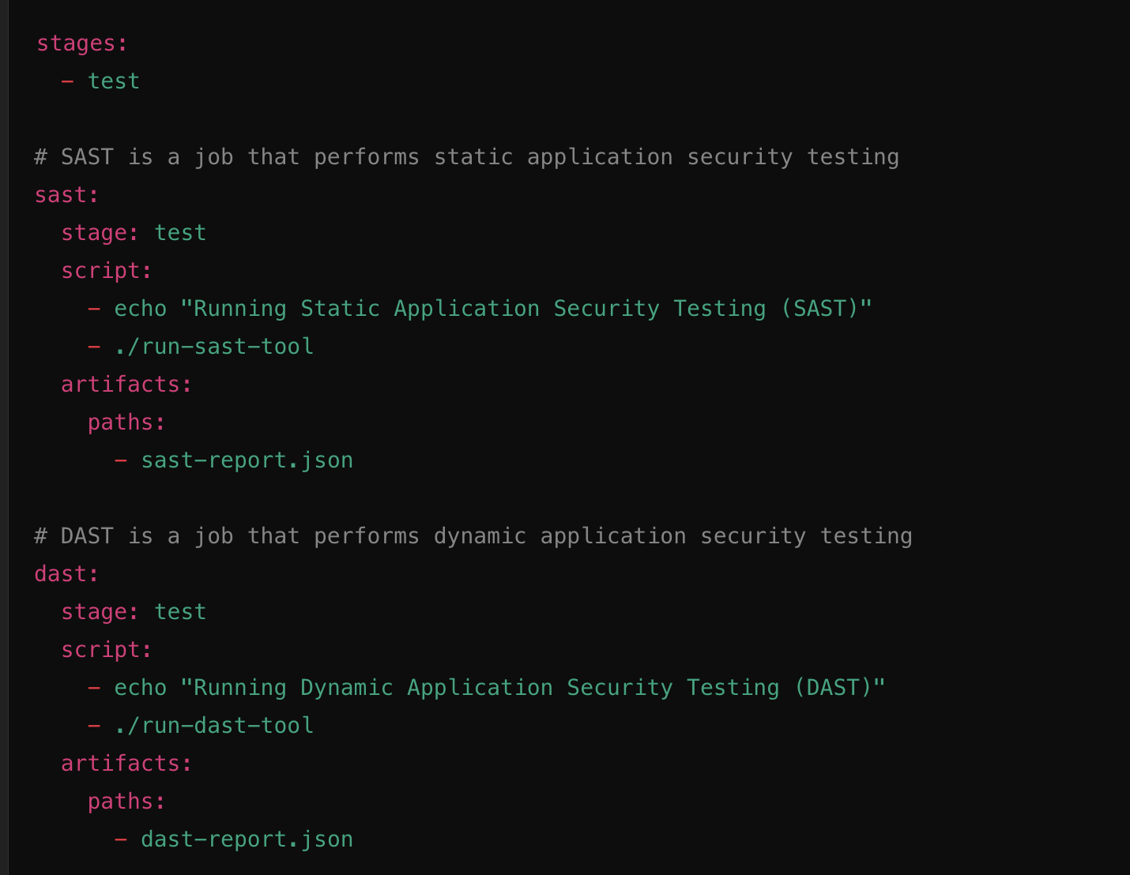
Example .gitlab-ci.yml file

Slide 19
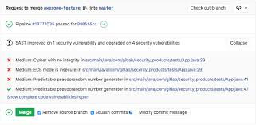
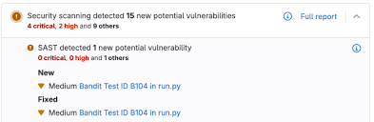
Example outputs from a SAST job

Slide 20
Closing comments
You have a pipeline build assignment due on April 29th. You will build a test stage that checks code quality and for secrets.
It is structured (somewhat) like the step-by-step instructions of our in-class activities.
The goal of this section is to introduce you to CI/CD….we could spend an entire semester on it.

Slide 21

Thank you for a great semester

