Slide 1
Security
DT211/DT228/3
Dr. Yupeng Liu

Slide 2
Introduction
Name : Yupeng Liu
Email: yupeng.liu@dit.ie
Tel: 01 402 4920
Office: KE3005A, Main Building

Slide 3
Assessment methods
Written examination – 50%
Continuous assessment – 50%

Slide 4
Course Outline
Introduction to cryptography
Number theory
Symmetric and Asymmetric Cryptograph
Public-Key Cryptography and RSA, Key management,
Steganography
Network, Internet Security, ethical hacking
System Security
Electronic Mail Security, Firewalls.
Virus, Worms etc

Slide 5
References
Cryptography and Network Security : Principles and Practices, 5th Ed, Williams Stallings (2011) Prentice Hall.
Network Security Essentials: Applications and Standards, 4th Ed, William Stallings (2011), Prentice Hall.
Network perimeter Security: Building Defense In-Depth, Cliff Riggs (2003), Auerbach Publications.

Slide 6
The future of Security threats
Cyberwar declared – Stuxnet a politically motivated attack (weaponized malware)
Advanced Persistent Threat (APT) – advanced malware attack
VoIP attacks – brute force and directory traversal class attacks against VoIP servers

Slide 7
The future of Security threats
Car hacking – cars are more connected with built-in Bluetooth, 3G internet, GPS, Onstar, and dashboard computers
The Facebook challenge - users trust of web
Manufactured-delivered malware – products arriving with infections out of the box
DLP for IP – shift from physical to digital production.

Slide 8
Current Smartphone market
iPhone 5S
Sony Ericsson Xperia Arc
Nokia E7
BlackBerry Torch
Google Nexus
Samsung Omnia

Slide 9
Cybercrime Knows No Borders
Prosecuting cybercrime is no easy task
Legal inadequacies in various jurisdictions
Uneven enforcement
Fighting internet crime does not come cheap. For example, cyber intrusions cost the British economy $43 Billion annually.
The Cyber industrial complex is emerging, which is very similar to the military industrial complex of the cold war.

Slide 10
Cloud apps a click away
Dropbox – http://www.dropbox.com/
Google Drive
Evernote - http://www.evernote.com/
GoToMyPC - http://www.gotomypc.co.uk/
Mozy - http://mozy.ie/
Buzzwords - https://acrobat.com/welcome.html
UbuntuOne - https://one.ubuntu.com/
And many more …

Slide 11
Steps for Cloud Security
Take responsibility for your own security
Ring fence your data
Think about encryption
Strong passwords for cloud services
Consider making your user devices ‘dumb’

Slide 12
Common Sense Security
Security is not a specialist subject – it’s everyone’s responsibility
The attackers only have to get lucky once and the defenders have to get it right 100% of the time

Slide 13
Why Cryptography?
Defense in Depth
RGVmZW5zZSBpbiBEZXB0aA==
00ac8a98d8f6df9d2b60b55e47a716b6e53ad4b064738ea6f9a088ab613c2d2b48bcabc68c3fc05c4e2779ca60700ac891e4e0a6c1bfb6aa7df6dafdce123acb
446566656E736520696E204465707468
Fƒ´ä`´t8è»ôê?õ»=ÄˆˆßØZ²Ûpu

Slide 14
The Adversarial Setting
The biggest difference between security systems and any other engineering is the adversarial setting.
Factors such as storms, heat, wear and tear are fairly predictable to an experienced engineer.
In security systems opponents are intelligent, clever, malicious and devious. They do things nobody ever thought before, do not play by the rules and are completely unpredictable.

Slide 15
Professional Paranoia
To work in this field, you have to become devious yourself.
You have to think like a malicious attacker to find weaknesses in your own work.
Cryptographers are professional paranoids.
Developing this mindset (security mindset) will help you observe things about systems and your environment that most other people do not notice

Slide 16
Why Cryptography?
Cryptography can be compared to locks in the Physical world. A lock by itself is a singularly useless thing.
Cryptography is just a small part of a much larger security system.

Slide 17
Why Cryptography?
Cryptography as a Mathematical Science vs Cryptography as an Engineering discipline.
Security is only as strong as the weakest link, and the Mathematics of Cryptography is almost never the weakest link.

Slide 18
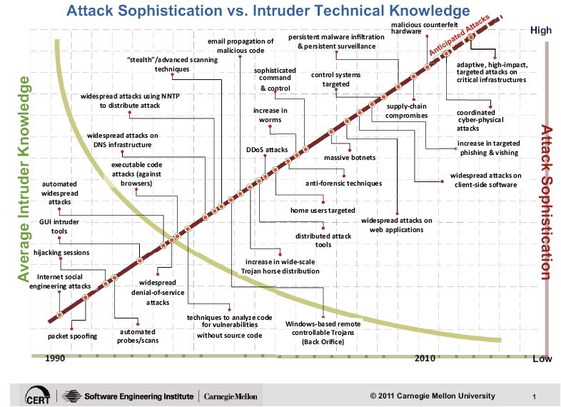
The Evolution of attack techniques/technologies

Slide 19
Security Threats
Spyware and Ad ware
Viruses
Phishing and Pharming
Worms, Bots
SQL injection
Sophisticated targeted attacks
Politically motivated attacks (Weaponized malware) - Stuxnet

Slide 20
Security Certification
International Information Systems Security Certification Consortium (ISC)²
Certified Information System Security Professional (CISSP)
Global Information Assurance Certification
Cisco Certified Security Professional (CCSP)
etc

Slide 21
It’s going to get worse - 1
Explosive growth of the Internet continues
continues to double in size every 10-12 months
where will all the capable system administrators come from?
Market growth will drive vendors
time to market, features, performance, cost are primary
“invisible” quality features such as security are secondary

Slide 22
It’s going to get worse - 2
More sensitive applications connected to the Internet
low cost of communications, ease of connection, and power of products engineered for the Internet will drive out other forms of networking
hunger for data and benefits of electronic interaction will continue to push widespread use of information technology

Slide 23
It’s going to get worse - 3
The death of the firewall
traditional approaches depend on complete administrative control and strong perimeter controls
today’s business practices and wide area networks violate these basic principles
no central point of network control
more interconnections with customers, suppliers, partners
more network applications
“the network is the computer”
who’s an “insider”and who’s an “outsider”

Slide 24
Before it gets better - 1
Strong market for security professionals will eventually drive graduate and certificate programs.
Increased understanding by technology users will build demand for quality security products; vendors will pay attention to the market.
Insurance industry will provide incentives for improved business security practices.

Slide 25
Before it gets better - 2
Technology will continue to improve and we will figure out how to use it
encryption
strong authentication
survivable systems
Increased collaboration across government and industry.

Slide 26
Good news
Our research has shown pay for information security and security jobs, skills and certifications have been above average for two years straight … The writing is on the wall: If you are not in that business, you might want to point your career toward that …. Security has not been a sexy place to work. It has not been funded well. But clearly when the smoke clears it will be funded, and it will be funded well.
Source: David Foote – President and chief research officer at Foote partners (www.footepartners.com)

Slide 27
Computer Security
the protection afforded to an automated information system in order to attain the applicable objectives of preserving the integrity, availability and confidentiality of information system resources (includes hardware, software, firmware, information/data, and telecommunications)
Notes:
The NIST Computer Security Handbook [NIST95] defines the term computer security as shown on this slide. This definition introduces three key objectives that are at the heart of computer security as we see on the next slide.

Slide 28
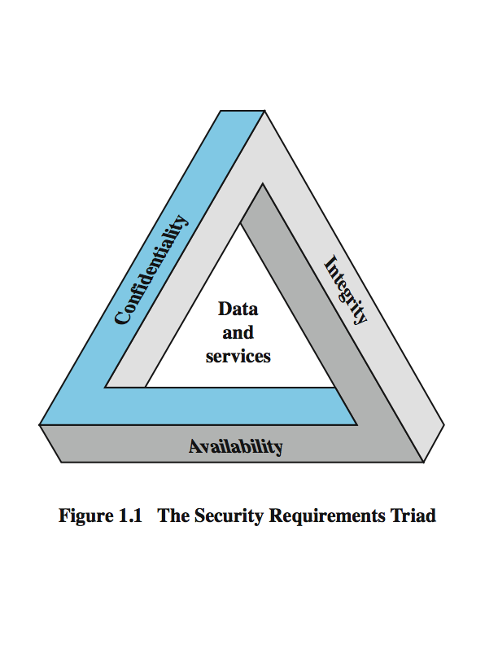
Key Security Concepts
Notes:
These three concepts form what is often referred to as the CIA triad (Figure 1.1). The three concepts embody the fundamental security objectives for both data and for information and computing services. FIPS PUB 199 provides a useful characterization of these three objectives in terms of requirements and the definition of a loss of security in each category:
• Confidentiality (covers both data confidentiality and privacy): preserving authorized restrictions on information access and disclosure, including means for protecting personal privacy and proprietary information. A loss of confidentiality is the unauthorized disclosure of information.
• Integrity (covers both data and system integrity): Guarding against improper information modification or destruction, and includes ensuring information non-repudiation and authenticity. A loss of integrity is the unauthorized modification or destruction of information.
• Availability: Ensuring timely and reliable access to and use of information. A loss of availability is the disruption of access to or use of information or an information system.
Although the use of the CIA triad to define security objectives is well established, some in the security field feel that additional concepts are needed to present a complete picture. Two of the most commonly mentioned are:
• Authenticity: The property of being genuine and being able to be verified and trusted; confidence in the validity of a transmission, a message, or message originator.
• Accountability: The security goal that generates the requirement for actions of an entity to be traced uniquely to that entity.

Slide 29
Levels of Impact
can define 3 levels of impact from a security breach
Low
Moderate
High
Notes:
We can define three levels of impact on organizations or individuals should there be a breach of security (i.e., a loss of confidentiality, integrity, or availability). These levels are defined in FIPS PUB 199:
• Low: The loss could be expected to have a limited adverse effect on organizational operations, organizational assets, or individuals. A limited adverse effect means that, for example, the loss of confidentiality, integrity, or availability might (i) cause a degradation in mission capability to an extent and duration that the organization is able to perform its primary functions, but the effectiveness of the functions is noticeably reduced; (ii) result in minor damage to organizational assets; (iii) result in minor financial loss; or (iv) result in minor harm to individuals.
• Moderate: The loss could be expected to have a serious adverse effect on organizational operations, organizational assets, or individuals. A serious adverse effect means that, for example, the loss might (i) cause a significant degradation in mission capability to an extent and duration that the organization is able to perform its primary functions, but the effectiveness of the functions is significantly reduced; (ii) result in significant damage to organizational assets; (iii) result in significant financial loss; or (iv) result in significant harm to individuals that does not involve loss of life or serious, life-threatening injuries.
• High: The loss could be expected to have a severe or catastrophic adverse effect on organizational operations, organizational assets, or individuals. A severe or catastrophic adverse effect means that, for example, the loss might (i) cause a severe degradation in or loss of mission capability to an extent and duration that the organization is not able to perform one or more of its primary functions; (ii) result in major damage to organizational assets; (iii) result in major financial loss; or (iv) result in severe or catastrophic harm to individuals involving loss of life or serious life threatening injuries.

Slide 30
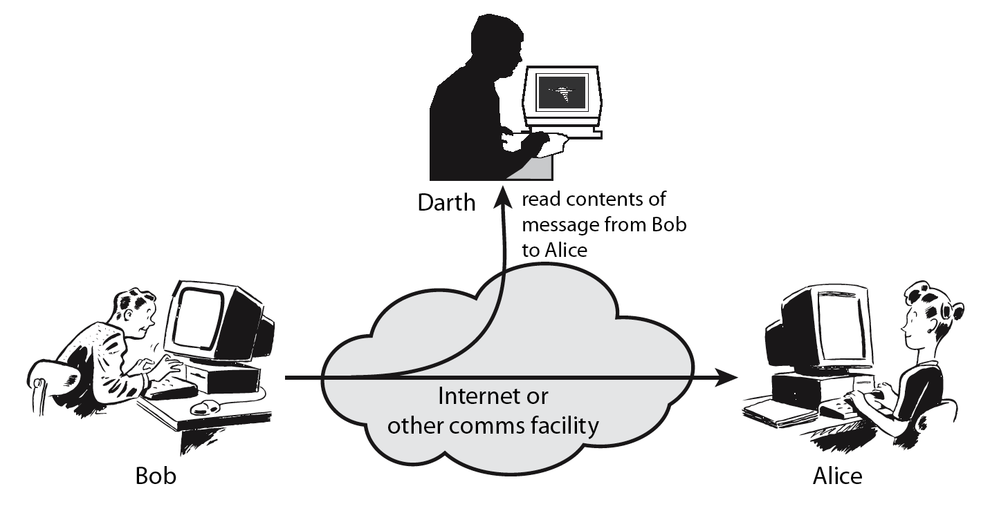
Passive Attacks
Notes:
A useful means of classifying security attacks, used both in X.800 and RFC 2828, is in terms of passive attacks and active attacks. A passive attack attempts to learn or make use of information from the system but does not affect system resources.
Passive attacks are in the nature of eavesdropping on, or monitoring of, transmissions. The goal of the opponent is to obtain information that is being transmitted. Two types of passive attacks are:
+ release of message contents - as shown above in Stallings Figure 1.2a here
+ traffic analysis - monitor traffic flow to determine location and identity of communicating hosts and could observe the frequency and length of messages being exchanged
These attacks are difficult to detect because they do not involve any alteration of the data.

Slide 31
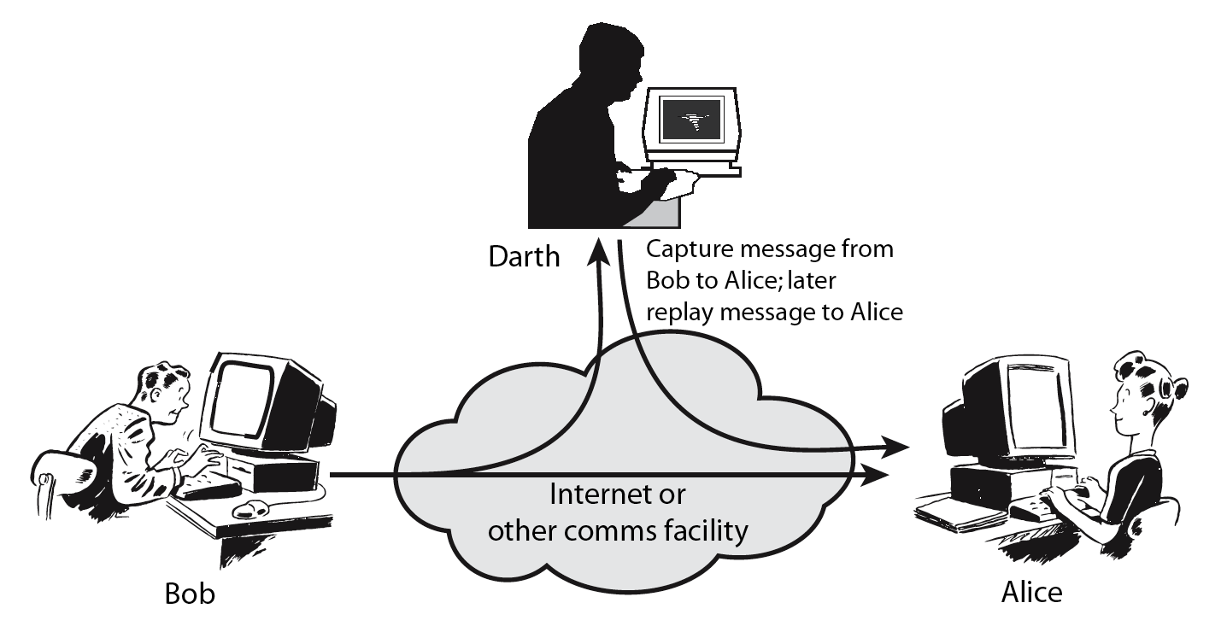
Active Attacks
Notes:
Active attacks involve some modification of the data stream or the creation of a false stream and can be subdivided into four categories: masquerade, replay, modification of messages, and denial of service:
masquerade of one entity as some other
replay previous messages (as shown above in Stallings Figure 1.3b)
modify/alter (part of) messages in transit to produce an unauthorized effect
denial of service - prevents or inhibits the normal use or management of communications facilities
Active attacks present the opposite characteristics of passive attacks. Whereas passive attacks are difficult to detect, measures are available to prevent their success. On the other hand, it is quite difficult to prevent active attacks absolutely, because of the wide variety of potential physical, software, and network vulnerabilities. Instead, the goal is to detect active attacks and to recover from any disruption or delays caused by them.

Slide 32
Security Mechanism
feature designed to detect, prevent, or recover from a security attack
no single mechanism that will support all services required
however one particular element underlies many of the security mechanisms in use:
cryptographic techniques
Notes:
Now introduce “Security Mechanism” which are the specific means of implementing one or more security services. Note these mechanisms span a wide range of technical components, but one aspect seen in many is the use of cryptographic techniques.

Slide 33
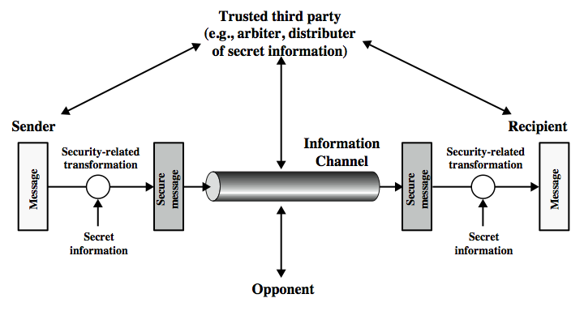
Model for Network Security
Notes:
In considering the place of encryption, its useful to use the following two models from Stallings section 1.6.
The first, illustrated in Figure 1.4, models information being transferred from one party to another over an insecure communications channel, in the presence of possible opponents. The two parties, who are the principals in this transaction, must cooperate for the exchange to take place. They can use an appropriate security transform (encryption algorithm), with suitable keys, possibly negotiated using the presence of a trusted third party. Parts One through Four of this book concentrates on the types of security mechanisms and services that fit into the model shown here.

Slide 34
Model for Network Security
using this model requires us to:
design a suitable algorithm for the security transformation
generate the secret information (keys) used by the algorithm
develop methods to distribute and share the secret information
specify a protocol enabling the principals to use the transformation and secret information for a security service
Notes:
This general model shows that there are four basic tasks in designing a particular security service, as listed.

Slide 35
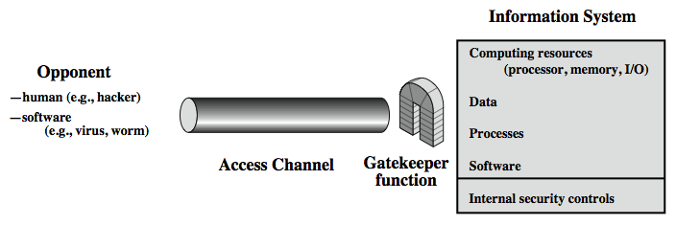
Model for Network Access Security
Notes:
The second, illustrated in Figure 1.5, model is concerned with controlled access to information or resources on a computer system, in the presence of possible opponents. Here appropriate controls are needed on the access to and within the system, to provide suitable security.
The security mechanisms needed to cope with unwanted access fall into two broad categories (as shown in this figure). The first category might be termed a gatekeeper function. It includes password-based login procedures that are designed to deny access to all but authorized users and screening logic that is designed to detect and reject worms, viruses, and other similar attacks. Once either an unwanted user or unwanted software gains access, the second line of defense consists of a variety of internal controls that monitor activity and analyze stored information in an attempt to detect the presence of unwanted intruders. These issues are explored in Part Four.

Slide 36
Model for Network Access Security
using this model requires us to:
select appropriate gatekeeper functions to identify users
implement security controls to ensure only authorised users access designated information or resources
Notes:
Detail here the tasks needed to use this model.

Slide 37
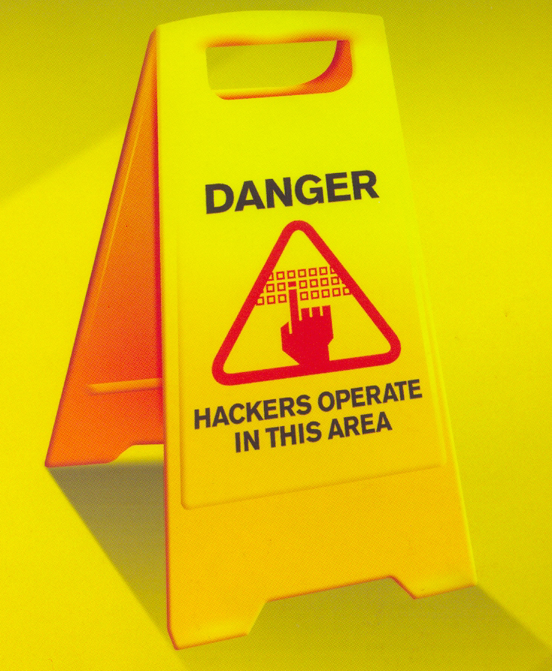
Security and Cryptography

Slide 38
The bottom line
You are all ‘digital natives’ and the rest of us are ‘digital immigrants’.
However, are you ‘digitally competent’
It is projected that by 2015 the professional ICT shortage in EU will be approximately 700,000
Source: Enterprise & Industry Magazine, European Commission, Issue 13, July 2012.

Slide 39
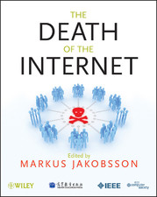





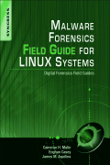





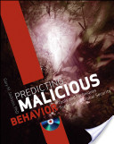
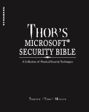



Security Books you may want to read

