Slide 1
Security
DT228/211/3
Dr. Yupeng Liu

Slide 2
Importance of Number Theory
Before the dawn of computers, many viewed number theory as last bastion of “pure math” which could not be useful and must be enjoyed only for its aesthetic beauty.
No longer the case. Number theory is crucial for encryption algorithms. Of utmost importance to everyone from Bill Gates, to the CIA, to Terrorists.

Slide 3
Importance of Number Theory
The encryption algorithms depend heavily on modular arithmetic. We need to develop various machinery (notations and techniques) for manipulating numbers before can describe algorithms in a natural fashion.
First we start with divisors.

Slide 4
Divisors
DEF: Let a, b and c be integers such that
a = b ·c .
Then b and c are said to divide (or are factors) of a, while a is said to be a multiple of b (as well as of c). The pipe symbol “|” denotes “divides” so the situation is summarized by:
b | a ∧ c | a .
NOTE: Students find notation confusing, and think of “|” in the reverse fashion, perhaps confuse pipe with forward slash “/”

Slide 5
Divisors. Examples
Q: Which of the following is true?
77 | 7
7 | 77
24 | 24
0 | 24
24 | 0

Slide 6
Divisors. Examples
A:
77 | 7: false bigger number can’t divide smaller positive number
7 | 77: true because 77 = 7 · 11
24 | 24: true because 24 = 24 · 1
0 | 24: false, only 0 is divisible by 0
24 | 0: true, 0 is divisible by every number (0 = 24 · 0)

Slide 7
Formula for Number of Multiples up to given n
Q: How many positive multiples of 15 are less than 100?

Slide 8
Formula for Number of Multiples up to given n
A: Just list them:
15, 30, 45, 60, 75, 90.
Therefore the answer is 6.
Q: How many positive multiples of 15 are less than 1,000,000?

Slide 9
Formula for Number of Multiples up to Given n
A: Listing is too much of a hassle. Since 1 out of 15 numbers is a multiple of 15, if 1,000,000 were were divisible by 15, answer would be exactly 1,000,000/15. However, since 1,000,000 isn’t divisible by 15, need to round down to the highest multiple of 15 less than 1,000,000 so answer is ⎣1,000,000/15⎦.
In general: The number of d-multiples less than N is given by:
|{m ∈ Z⁺ | d |m and m ≤ N }| = ⎣N/d⎦

Slide 10
Divisor Theorem
THM: Let a, b, and c be integers. Then:
a|b ∧ a|c → a|(b + c )
a|b → a|bc
a|b ∧ b|c → a|c
EG:
17|34 ∧ 17|170 → 17|204
17|34 → 17|340
6|12 ∧ 12|144 → 6 | 144

Slide 11
Divisor Theorem. Proof of no. 2
In general, such statements are proved by starting from the definitions and manipulating to get the desired results.
EG. Proof of no. 2 (a|b → a|bc ):
Suppose a|b. By definition, there is a number m such that b = am. Multiply both sides by c to get bc = amc = a (mc ). Consequently, bc has been expressed as a times the integer mc so by definition of “|”, a|bc 

Slide 12
Prime Numbers
DEF: A number n ≥ 2 prime if it is only divisible by 1 and itself. A number n ≥ 2 which isn’t prime is called composite.
Q: Which of the following are prime?
0,1,2,3,4,5,6,7,8,9,10

Slide 13
Prime Numbers
A: 0, and 1 not prime since not positive and greater or equal to 2
2 is prime as 1 and 2 are only factors
3 is prime as 1 and 3 are only factors.
4,6,8,10 not prime as non-trivially divisible by 2.
5, 7 prime.
9 = 3 · 3 not prime.
Last example shows that not all odd numbers are prime.

Slide 14
Fundamental Theorem of Arithmetic
THM: Any number n ≥ 2 is expressible as as a unique product of 1 or more prime numbers.
Note: prime numbers are considered to be “products” of 1 prime.
We’ll need induction and some more number theory tools to prove this.
Q: Express each of the following number as a product of primes: 22, 100, 12, 17

Slide 15
Fundamental Theorem of Arithmetic
A: 22 = 2·11, 100 = 2·2·5·5,
12 = 2·2·3, 17 = 17
Convention: Want 1 to also be expressible as a product of primes. To do this we define 1 to be the “empty product”. Just as the sum of nothing is by convention 0, the product of nothing is by convention 1.
➔Unique factorization of 1 is the factorization that uses no prime numbers at all.

Slide 16
Primality Testing
Prime numbers are very important in encryption schemes. Essential to be able to verify if a number is prime or not. It turns out that this is quite a difficult problem. First try:
boolean isPrime(integer n)
if ( n < 2 ) return false
for(i = 2 to n -1)
if( i |n ) // “divides”! not disjunction
return false
return true

Slide 17
Primality Testing
A: Assuming divisibility testing is a basic operation –so O (1) (this is an invalid assumption)– then above primality testing algorithm is O (n).
Q: What is the running time in terms of the input size k ?

Slide 18
Primality Testing
A: Consider n = 1,000,000. The input size is k = 7 because n was described using only 7 digits. In general we have
n = O (10^{k} ). Therefore, running time is O (10^{k} ). REALLY HORRIBLE!
Q: Can we improve algorithm?

Slide 19
Primality Testing
A:
Don’t try number bigger than n/2
After trying 2, don’t try any other even numbers, because know n is odd by this point.
In general, try only smaller prime numbers
In fact, only need to try to divide by prime numbers no larger than as we’ll see next:

Slide 20
Division
Remember long division?
117 = 31·3 + 24
a = dq + r
q the quotient
d the divisor
a the dividend
r the remainder

Slide 21
Division
THM: Let a be an integer, and d be a positive integer. There are unique integers q, r with r ∈ {0,1,2,…,d-1} satisfying
a = dq + r
The proof is a simple application of long-division. The theorem is called the division algorithm though really, it’s long division that’s the algorithm, not the theorem.

Slide 22
Greatest Common Divisor Relatively Prime
DEF Let a,b be integers, not both zero. The greatest common divisor of a and b (or gcd(a,b) ) is the biggest number d which divides both a and b.
Equivalently: gcd(a,b) is smallest number which divisibly by any x dividing both a and b.
DEF: a and b are said to be relatively prime if gcd(a,b) = 1, so no prime common divisors.

Slide 23
Greatest Common Divisor Relatively Prime
Q: Find the following gcd’s:
gcd(11,77)
gcd(33,77)
gcd(24,36)
gcd(24,25)

Slide 24
Greatest Common Divisor Relatively Prime
A:
gcd(11,77) = 11
gcd(33,77) = 11
gcd(24,36) = 12
gcd(24,25) = 1. Therefore 24 and 25 are relatively prime.
NOTE: A prime number are relatively prime to all other numbers which it doesn’t divide.

Slide 25
Greatest Common Divisor Relatively Prime
EG: More realistic. Find gcd(98,420).
Find prime decomposition of each number and find all the common factors:
98 = 2·49 = 2·7·7
420 = 2·210 = 2·2·105 = 2·2·3·35
= 2·2·3·5·7
Underline common factors: 2·7·7, 2·2·3·5·7
Therefore, gcd(98,420) = 14

Slide 26
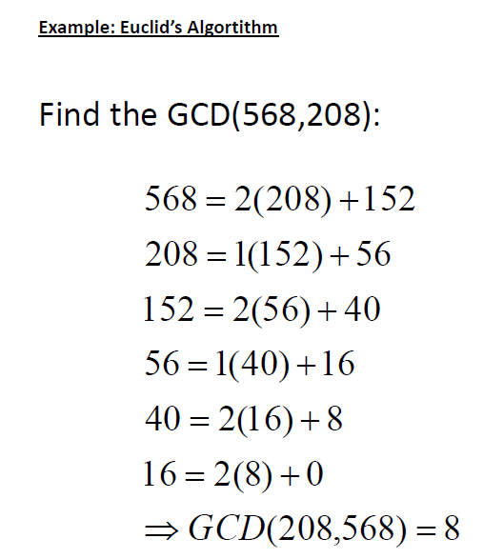

Slide 27
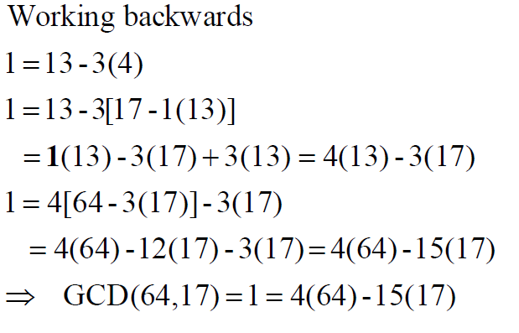
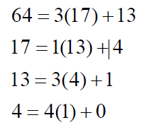
Use the Extended Euclidean Algorithm to find integers m and n such that GCD(64, 17) = m(64) + n(17)

Slide 28
Greatest Common Divisor Relatively Prime
Pairwise relatively prime: the numbers a, b, c, d, … are said to be pairwise relatively prime if any two distinct numbers in the list are relatively prime.
Q: Find a maximal pairwise relatively prime subset of
{ 44, 28, 21, 15, 169, 17 }

Slide 29
Greatest Common Divisor Relatively Prime
A: A maximal pairwise relatively prime subset of {44, 28, 21, 15, 169, 17} :
{17, 169, 28, 15} is one answer.
{17, 169, 44, 15} is another answer.

Slide 30
Least Common Multiple
DEF: The least common multiple of a, and b (lcm(a,b) ) is the smallest number m which is divisible by both a and b.
Q: Find the lcm’s:
lcm(10,100)
lcm(7,5)
lcm(9,21)

Slide 31
Least Common Multiple
A:
lcm(10,100) = 100
lcm(7,5) = 35
lcm(9,21) = 63
THM: lcm(a,b) = ab / gcd(a,b)
Notes:
Skip proof in lecture

Slide 32
lcm in terms of gcd Proof
THM: lcm(a,b) = ab / gcd(a,b)
Proof. Let g = gcd(a,b).
Notes:
Skip proof in lecture

Slide 33
lcm in terms of gcd Proof
THM: lcm(a,b) = ab / gcd(a,b)
Proof. Let g = gcd(a,b). Factor a and b using g: a = gx, b = gy where x and y are relatively prime.
Notes:
Skip proof in lecture

Slide 34
Modular Arithmetic
There are two types of “mod” (confusing):
the mod function
Inputs a number a and a base b
Outputs a mod b a number between 0 and b –1 inclusive
This is the remainder of a÷b
Similar to C’s % operator.
the (mod) congruence
Relates two numbers a, a’ to each other relative some base b
a ≡ a’ (mod b) means that a and a’ have the same remainder when dividing by b

Slide 35
mod function
Similar to C’s “%” operator except that answer is always positive. E.G.
-10 mod 3 = 2, but in C –10%3 = -1.
Q: Compute
113 mod 24
-29 mod 7

Slide 36
mod function
A: Compute
113 mod 24:
-29 mod 7

Slide 37
mod function
A: Compute
113 mod 24:
-29 mod 7

Slide 38
mod function
A: Compute
113 mod 24:
-29 mod 7

Slide 39
mod function
A: Compute
113 mod 24:
-29 mod 7

Slide 40
(mod) congruence (Formal Definition)
DEF: Let a,a’ be integers and b be a positive integer. We say that a is congruent to a’ modulo b (denoted by a ≡ a’ (mod b) ) iff b | (a – a’ ).
Equivalently: a mod b = a’ mod b
Q: Which of the following are true?
3 ≡ 3 (mod 17)
3 ≡ -3 (mod 17)
172 ≡ 177 (mod 5)
-13 ≡ 13 (mod 26)

Slide 41
(mod) congruence
A:
3 ≡ 3 (mod 17) True. any number is congruent to itself (3-3 = 0, divisible by all)
3 ≡ -3 (mod 17) False. (3-(-3)) = 6 isn’t divisible by 17.
172 ≡ 177 (mod 5) True. 172-177 = -5 is a multiple of 5
-13 ≡ 13 (mod 26) True: -13-13 = -26 divisible by 26.

Slide 42
(mod) congruence Identities
The (mod) congruence is useful for manipulating expressions involving the mod function. It lets us view modular arithmetic relative a fixed base, as creating a number system inside of which all the calculations can be carried out.
a mod b ≡ a (mod b)
Suppose a ≡ a’ (mod b) and c ≡ c’ (mod b) Then:
a+c ≡ (a’+c’ )(mod b)
ac ≡ a’c’ (mod b)
a ^{k} ≡ a’ ^{k} (mod b)

Slide 43
Modular arithmetic harder examples
Q: Compute the following.
307¹⁰⁰¹ mod 102
(-45 · 77) mod 17

Slide 44
Modular arithmetic harder examples
A: Use the previous identities to help simplify:
Using multiplication rules, before multiplying (or exponentiating) can reduce modulo 102:
307¹⁰⁰¹ mod 102 ≡ 307¹⁰⁰¹ (mod 102)
≡ 1¹⁰⁰¹ (mod 102) ≡ 1 (mod 102). Therefore, 307¹⁰⁰¹ mod 102 = 1.

Slide 45
Modular arithmetic harder examples
A: Use the previous identities to help simplify:
Repeatedly reduce after each multiplication:
(-45·77) mod 17 ≡ (-45·77) (mod 17)
≡(6·9) (mod 17) ≡ 54 (mod 17) ≡ 3 (mod 17). Therefore (-45·77) mod 17 = 3.

Slide 46
Simple Encryption
Variations on the following have been used to encrypt messages for thousands of years.
Convert a message to capitals.
Think of each letter as a number between 1 and 26.
Apply an invertible modular function to each number.
Convert back to letters (0 becomes 26).

Slide 47
Letter ←→ Number Conversion Table
A | B | C | D | E | F | G | H | I | J | K | L | M
1 | 2 | 3 | 4 | 5 | 6 | 7 | 8 | 9 | 10 | 11 | 12 | 13
N | O | P | Q | R | S | T | U | V | W | X | Y | Z
14 | 15 | 16 | 17 | 18 | 19 | 20 | 21 | 22 | 23 | 24 | 25 | 26

Slide 48
Encryption example
Let the encryption function be
f (a) = (3a + 9) mod 26
Encrypt “Stop Thief”
STOP THIEF (capitals)
19,20,15,16 20,8,9,5,6
14,17,2,5 17,7,10,24,1
NQBE QGJXA

Slide 49
Caesar’s Cipher
f (a) = (a+K) mod 26

