Slide 1


NetInfra - A Framework for Expressing Network Infrastructure as Code
Erick McGhee, Tom Krobatsch, and Stephen Milton
National Institute for Computational Sciences
University of Tennessee
Notes:
framework manage DHCP DNS
single file / which dup /errors
designed configuration management
Example deployment

Slide 2

Background
Kea/Bind 9
Configuration management
NetInfra as a bridge
ISC-Kea Logo: https://www.isc.org/images/isclogos/kea-imageonly-250.png // ISC-Bind9 Logo: https://www.isc.org/images/isclogos/Bind_9_Mark_ISC_Blue.png
Notes:
Motivated / dhcpd / older bind
DHCP / DNS
DHCP – assigns temp address connecting network
DNS – like a phone book, maps name address
Laptop wifi, assigned address unique to device by DHCP
pearc address - translates human readable to IP address
Misconfig network traffic stops
Mission critical almost all networks
Configuration management
Because / Human error / config review
Push known good config
Restart in last known good config
How stuff was done before
2 config
Not easily human readable - duplicated
Add host - Multistep, pushing configs, & restarting services

Slide 3
Solution Design
Goals
Benefits
Single File
DHCP & DNS Servers, Subnets, & Zones
All Hosts
Ansible Compatible
ISC-Kea & ISC-Bind naming conventions
Human Readable
Single Source of Truth
Single Structure to Learn
Error Checking
Easily Modified & Extendable
Notes:
- ISC – Internet Systems Consortium

Slide 4
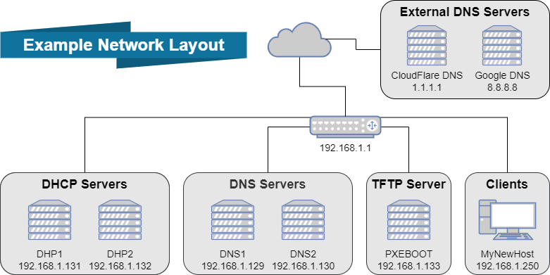
Notes:
External – typically set to the next upstream DNS server, using examples

Slide 5
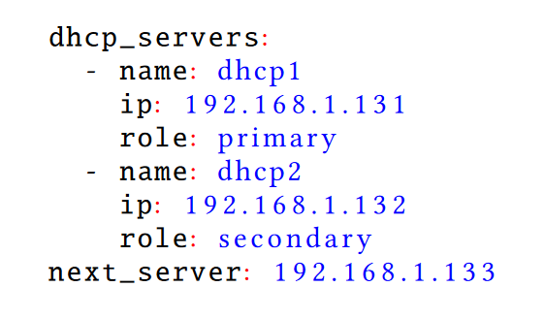
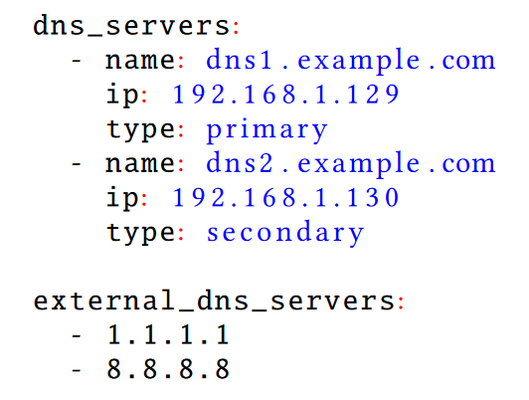
Server Declarations
DHCP Servers
DNS Servers
Notes:
DHCP Servers Sequence
Defined by name
Includes IP address & Role
Next Server defined separately
Internal DNS Servers
Defined by name
Includes IP & Type
External DNS servers are a separate list of IPS

Slide 6
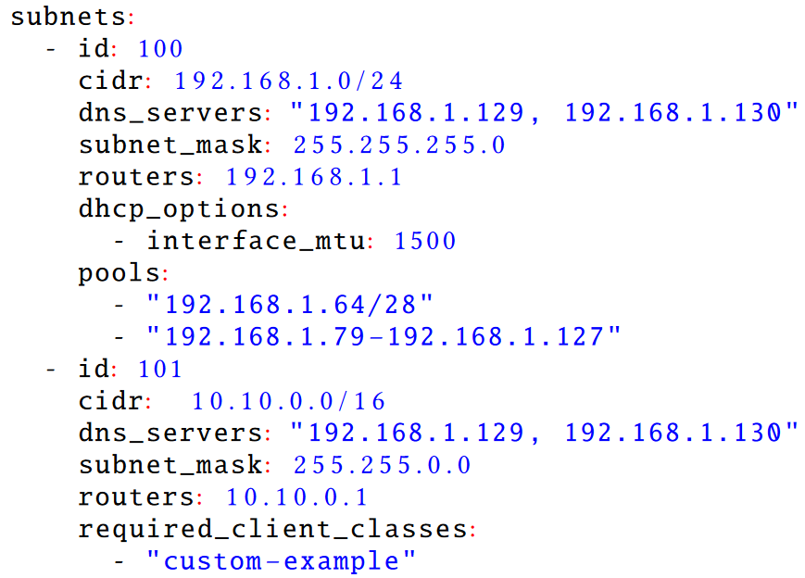
DHCP Subnet Declarations
Notes:
Sequence
Identified by id
Id = vlan id
Required client classes

Slide 7
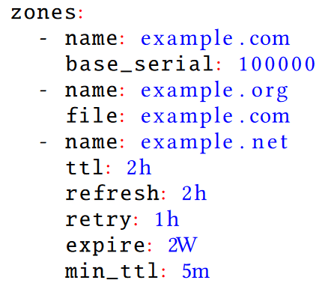
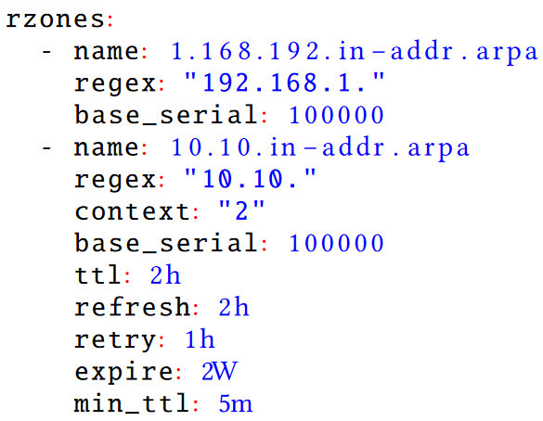
DNS Zone Declarations
Forward Zones
Reverse Zones
Notes:
What is forward vs reverse?
Forward Zones
Name
Can share File
May contain:
Time to live
Minimum Time to live
Refresh, Retry, Expire – verifying upr updating phone book entry
Base_ serial – in laymans a version number
Can be used to start at a specified serial number
Reverse Zones
Name is name of the file
Regex is subnet
Context is equivalent to the number of significant octets defined by netmask
Eg: 255.0.0.0 = 3, 255.255.255.0 = 1, 255.255.255.128 = 1

Slide 8
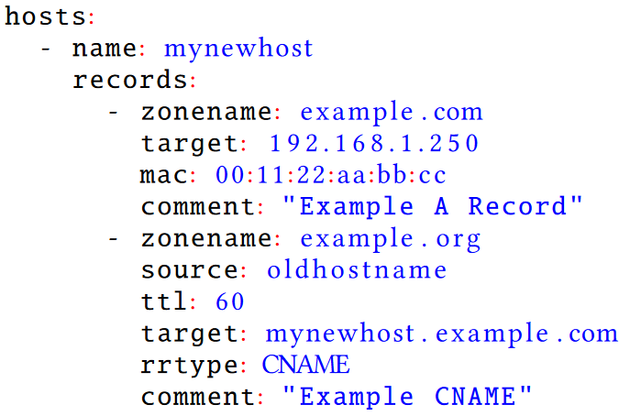
Host Declarations
Notes:
Hosts defined in sequence identified by Name
Each host may contain many records
Records contain properties necessary to define DHCP Reservations & DNS Records
DNS records require Zone Name, Target
DHCP Reservations require MAC Address
May also include Source, DNS Resource Record Type, Comment, Time to Live, and DHCP Options

Slide 9



Implementation
NetInfra
Roles:
kea
bind9
Templates:
kea-dhcp4.conf.j2
forward.zone.j2
reverse.zone.j2
Ansible Logo: https://commons.wikimedia.org/wiki/File:Ansible_Logo.png // Jinja Logo: https://jinja.palletsprojects.com/en/3.1.x/_images/jinja-logo.png

Slide 10
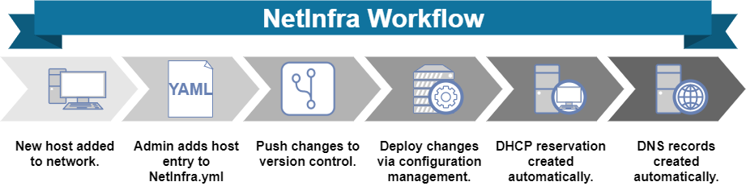

Slide 11
Lessons Learned
File Design
Incompatible Syntaxes
Deployment
Notes:
File Design
1st organize
By Zone logical to Host – Multiple entries – Duplicates
DHCP options global to subnet then hosts. All levels
Incompatible Syntaxes
YAML – Star Sig - Human readable - Filter Wildcard
DHCP Option name dashes – Ansible variable names underscores instead of dashes.
Deployment
Two policies
Changes on netinfra branch
Weekly code reviews

Slide 12
Future Work
Dynamic configuration files
Auto-discovery
Large Groupings
GUI
IPv6
Other DHCP/DNS packages
Notes:
Not fully dynamic / some elements static template file

Slide 13
Thank-you!
Any Questions?

Slide 14


Connect With Us!
Erick McGhee
Tom Krobatsch
Mailing List: network@nics.utk.edu

Slide 15
References
[1] Internet Systems Consortium. 2020. Bind 9. https://www.isc.org/bind/
[2] Internet Systems Consortium. 2020. Kea Dhcp. https://www.isc.org/kea/
[3] Internet Systems Consortium. 2020. Kea High Availability. https://kea.readthedocs.io/en/latest/arm/hooks.html?highlight=standby#ha-high- availability
[4] Internet Systems Consortium. 2020. Stork. https://www.isc.org/categories/stork/
[5] Ralph Droms. 1999. Automated configuration of TCP/IP with DHCP. IEEE Internet Computing 3, 4 (1999), 45–53.
[6] puppet. 2020. Discover Continuous Compliance: Compliance and Security at Scale. https://puppet.com/
[7] redhat. 2020. Red Hat Ansible Automation Platform. https://www.ansible.com/
[8] Michael Wurster, Uwe Breitenbücher, Michael Falkenthal, Christoph Krieger, Frank Leymann, Karoline Saatkamp, and Jacopo Soldani. 2020. The essential deployment metamodel: a systematic review of deployment automation technologies. SICS Software-Intensive Cyber-Physical Systems 35, 1 (2020), 63–75.

