Slide 1
A Survey on Transfer Learning in RL & Robotics
Juan Camilo Gamboa Higuera
Transfer Club Week 1
2018-08-26

Slide 2
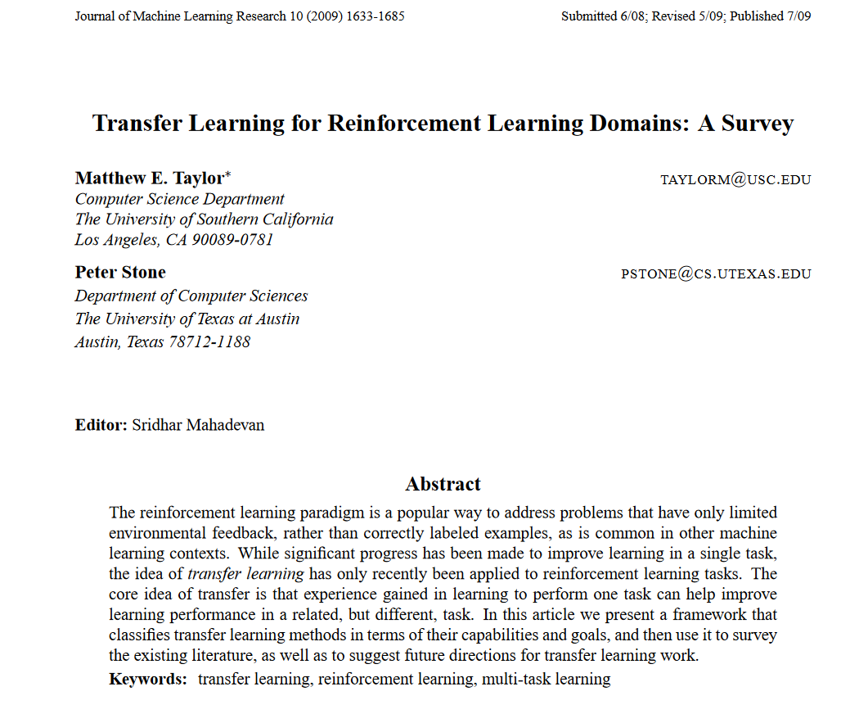

Slide 3
What is Transfer Learning?
A habit by which we always transfer the known to the unknown and conceive the latter to resemble the former
(Hume, 1689)
The ability of a system to recognize and apply knowledge and skills learned in previous tasks to novel tasks in new domains
(Pan and Yang, 2010)
Generalization across tasks
(Taylor and Stone, 2009)

Slide 4
Isn’t that the same as multi-task learning?
meta-learning?
learning?
Notes:
Warning, this concept of transfer is so vague that it overlaps with things that people consider multi-task learning, meta learning, unsupervised learning and fine tuning, domain adaptation, etc

Slide 5
Main difference
Source tasks may come from different distribution than target tasks
Source tasks/domains: cheap data or sunk cost
Target tasks/domains: unknown at training time
We want generalization to target tasks
Few-shot/one-shot/zero-shot learning
Notes:
Shots can have different interpretations: data samples is the usual one in supervised learning (i.e. learning from a single or few examples).
In RL an “example” could mean a trajectory outcome (or an episode)
In meta-learning (MAML) it gets a bit confusing as the call k-shot learning taking k-gradient steps. I think that the episodic definition makes more sense

Slide 6
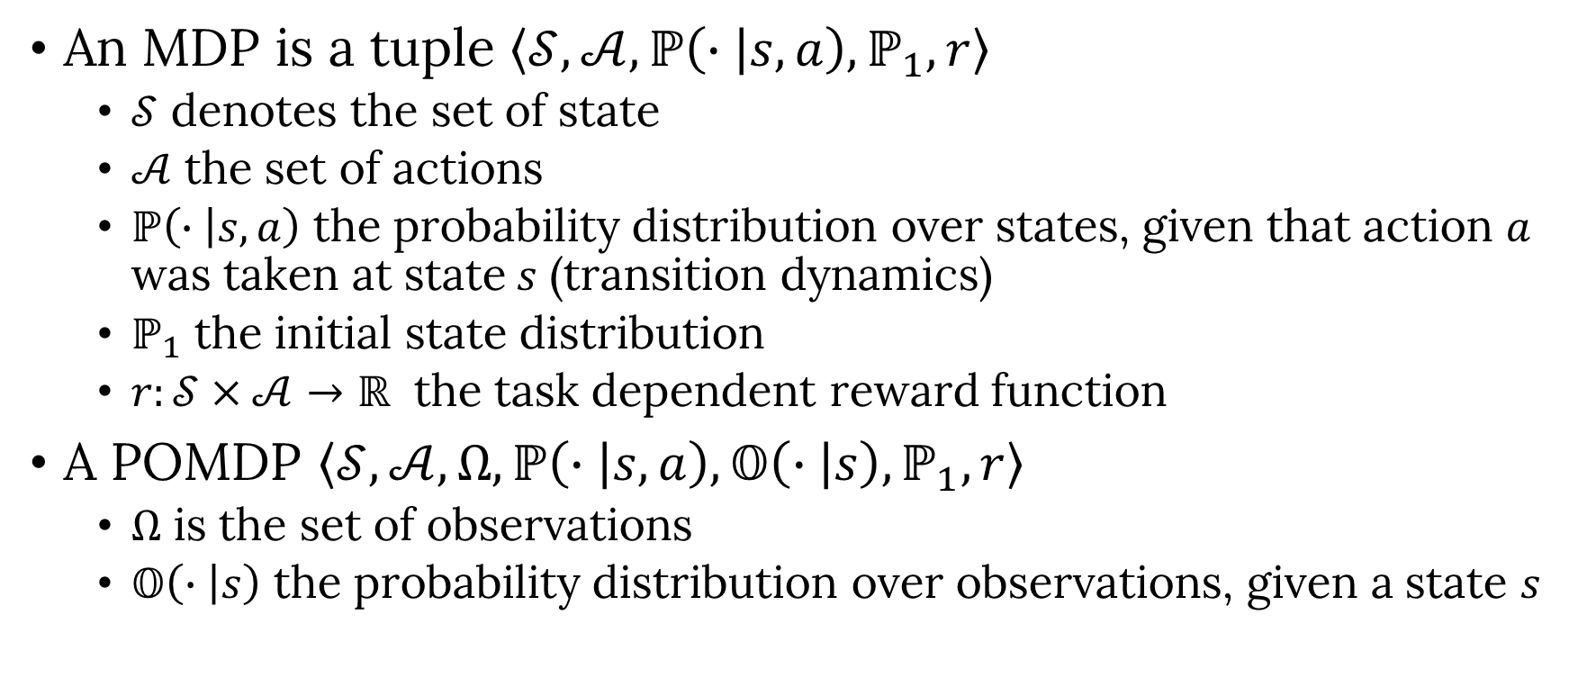
Tasks in the RL setting
An MDP is a tuple $\left\langle 𝒮,𝒜,ℙ\left(∙ | s,a\right),ℙ_{1},r\right\rangle$
$𝒮$ denotes the set of state
$𝒜$ the set of actions
$ℙ\left(∙ | s,a\right)$ the probability distribution over states, given that action $a$ was taken at state$s$ (transition dynamics)
$ℙ_{1}$ the initial state distribution
$r:𝒮×𝒜→ℝ$ the task dependent reward function
A POMDP $\left\langle 𝒮,𝒜,Ω, ℙ\left(∙ | s,a\right),𝕆\left(∙ | s\right),ℙ_{1},r\right\rangle$
$Ω$ is the set of observations
$𝕆\left(∙ | s\right)$ the probability distribution over observations, given a state $s$

Slide 7
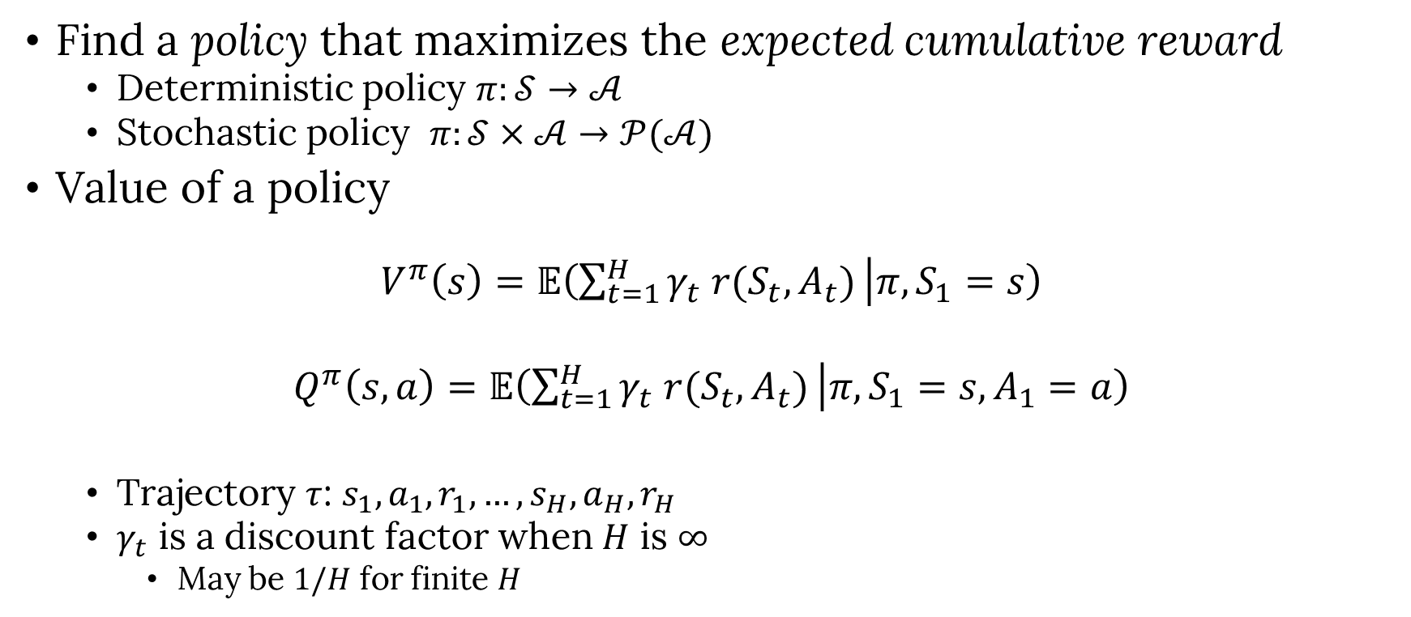
Objective in the RL setting
Find a policy that maximizes the expected cumulative reward
Deterministic policy $π:𝒮→𝒜$
Stochastic policy $π:𝒮×𝒜→𝒫(𝒜)$
Value of a policy
$$V^{π}\left(s\right)=𝔼\left(\sum_{t=1}^{H}{γ_{t} r(S_{t},A_{t})} | π, S_{1}=s\right)$$
$$Q^{π}\left(s,a\right)=𝔼\left(\sum_{t=1}^{H}{γ_{t} r(S_{t},A_{t})} | π, S_{1}=s, A_{1}=a\right)$$
Trajectory $τ$: $s_{1},a_{1},r_{1},…, s_{H},a_{H},r_{H}$
$γ_{t}$ is a discount factor when $H$ is $∞$
May be $1/H$ for finite $H$

Slide 8
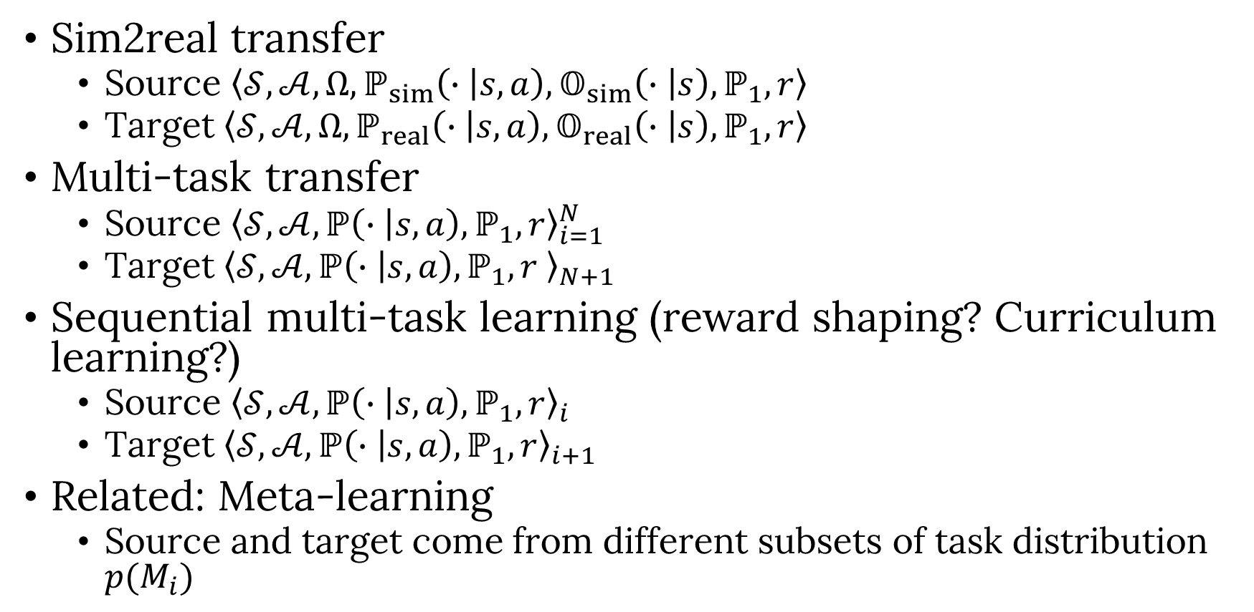
Some transfer problem settings
Sim2real transfer
Source $\left\langle 𝒮,𝒜,Ω, ℙ_{sim}\left(∙ | s,a\right),𝕆_{sim}\left(∙ | s\right),ℙ_{1},r\right\rangle$
Target $\left\langle 𝒮,𝒜,Ω, ℙ_{real}\left(∙ | s,a\right),𝕆_{real}\left(∙ | s\right),ℙ_{1},r\right\rangle$
Multi-task transfer
Source ${\left\langle 𝒮,𝒜,ℙ\left(∙ | s,a\right),ℙ_{1},r\right\rangle }_{i=1}^{N}$
Target ${\left\langle 𝒮,𝒜,ℙ\left(∙ | s,a\right),ℙ_{1},r \right\rangle }_{N+1}$
Sequential multi-task learning (reward shaping? Curriculum learning?)
Source ${\left\langle 𝒮,𝒜,ℙ\left(∙ | s,a\right),ℙ_{1},r\right\rangle }_{i}$
Target ${\left\langle 𝒮,𝒜,ℙ\left(∙ | s,a\right),ℙ_{1},r\right\rangle }_{i+1}$
Related: Meta-learning
Source and target come from different subsets of task distribution $p(M_{i})$
How do these fit under the taxonomy by Taylor and Stone?
Notes:
Task distribution can be induced by distribution over rewards, dynamics, observation functions

Slide 9
Back to the survey by Taylor and Stone
They provide a taxonomy of transfer problems and methods along five dimensions
Task difference assumptions
Source task selection
Transferred knowledge
Task Mappings
Allowed Learners
Disclaimer: This is from before the DL boom

Slide 10
Notes:
I feel the main issue with this categorization is that by trying to categorize papers, this survey is conflating problem definitions with solution techniques

Slide 11

Task differences
They refer to changes to any element of the MDP
Questionable categories in the survey?
changes in goal states ($s_{f}$) vs. changes in rewards ($r$)
changes in state ($s$) vs. changes in variables ($v$)
$$M_{source}=\left\langle 𝒮^{\left(source\right)},𝒜^{\left(source\right)}, ℙ^{\left(source\right)}\left(∙ | s,a\right),ℙ_{1}^{\left(source\right)},r^{\left(source\right)}\right\rangle$$
$$M_{ target }=\left\langle 𝒮^{ \left(target\right) },𝒜^{\left(target\right) }, ℙ^{ \left(target\right) }\left(∙ | s,a\right),ℙ_{1}^{\left(target\right)},r^{ \left(target\right) }\right\rangle$$

Slide 12
Source Task Selection
Fixed source set
Selected by designer
Single source task (h)
Multiple source tasks (all)
Control over source set
Algorithm selects subset of available source tasks (lib)
Algorithm modifies source task (mod)
Missing from their taxonomy?
Interactive source task selection (LfD, active learning)
Modifying the source task distribution (Chebotar, 2018)
…

Slide 13
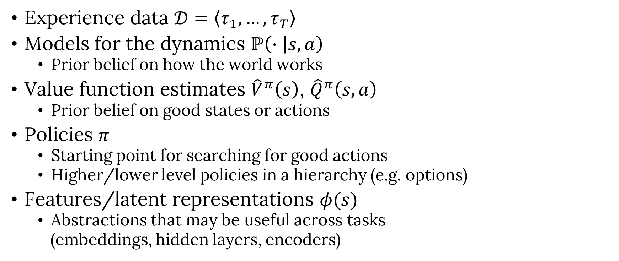
How do we transfer knowledge?
Harder to obtain?
Experience data $𝒟=\left\langle τ_{1},…, τ_{T}\right\rangle$
Models for the dynamics $ℙ\left(∙ | s,a\right)$
Prior belief on how the world works
Value function estimates ${\hat{V}}^{π}\left(s\right)$, ${\hat{Q}}^{π}\left(s,a\right)$
Prior belief on good states or actions
Policies $π$
Starting point for searching for good actions
Higher/lower level policies in a hierarchy (e.g. options)
Features/latent representations $φ(s)$
Abstractions that may be useful across tasks
(embeddings, hidden layers, encoders)
Notes:
Others, prior distributions over model parameters,

Slide 14
Transferring transition dynamics and policies
Model-based RL viewed as transfer (Cutler and How, 2016)
Guided policy search would fit here?

Slide 15
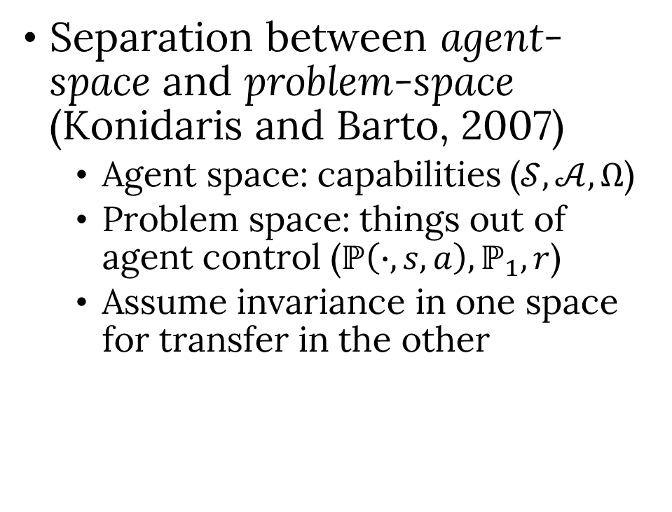
Transferring Invariant Knowledge
Separation between agent-space and problem-space (Konidaris and Barto, 2007)
Agent space: capabilities ($𝒮, 𝒜,Ω$)
Problem space: things out of agent control ($ℙ\left(∙, s, a\right), ℙ_{1},r$)
Assume invariance in one space for transfer in the other

Slide 16
Transferring Invariant Knowledge
Relational RL: Combining RL with symbolic reasoning
(Garnelo et al, 2016)
(Xu et al, 2016)

Slide 17
Transferring Invariant Knowledge
Graph NNs for learning a physics engine
(Sanchez-Gonzalez et al, ‎2018)

Slide 18
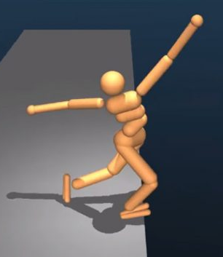
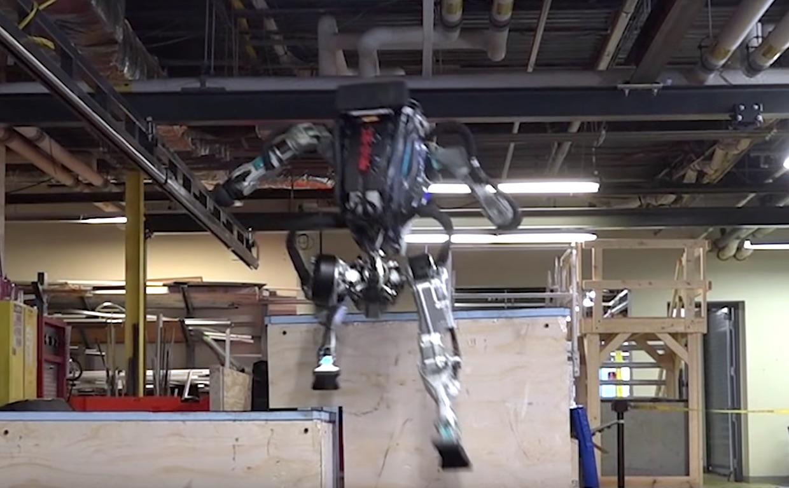
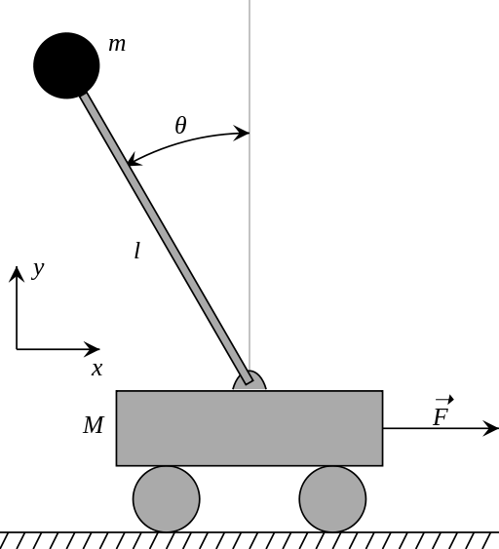
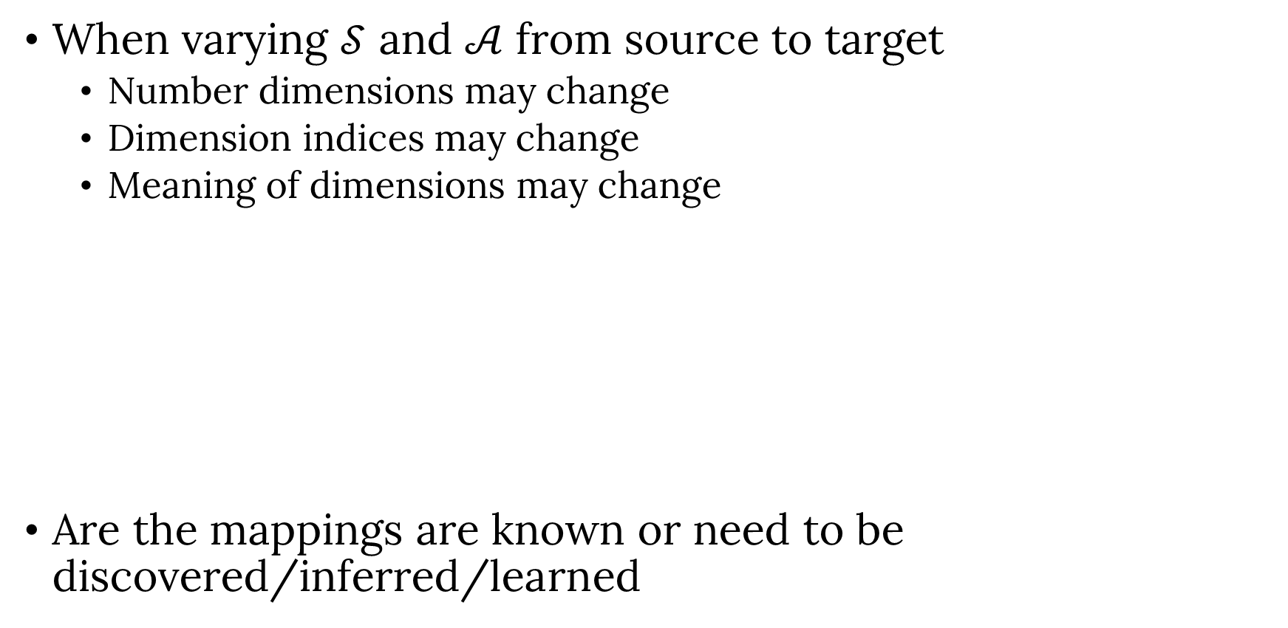
Task Mappings
When varying $𝒮$ and $𝒜$ from source to target
Number dimensions may change
Dimension indices may change
Meaning of dimensions may change
Are the mappings are known or need to be discovered/inferred/learned
Notes:
I think that this is mixing categorizing techniques with categorizing problem definitions

Slide 19

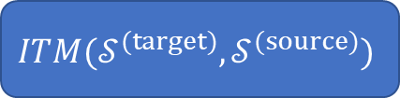





Task Mappings
Taylor and Stone refer to their inter-task mapping work (Taylor et al, 2007)
Progressive nets (Rusu et al, 2017) has some similarities, but mappings are at hidden feature level
We explored a similar idea with policy adjustments (Gamboa-Higuera et al, 2017)
$$s_{t}^{(target)}$$
$$ITM(𝒮^{(target)},𝒮^{(source)})$$
$$s_{t}^{(source)}$$
$π^{(source)}$
$$a_{t}^{(source)}$$
$$ITM(𝒜^{(source)},𝒜^{(target)})$$
$$a_{t}^{(target)}$$

Slide 20
Transferring value and transition models
Multi-fidelity Learning (Cutler and How, 2014)
Exploration: Transfer Q from low to high fidelity (adapted with optimism bounds)
Lower fidelity improvement: Transfer transition dynamics model parameters from high to low fidelity
Decision on when to transfer based on KWIK learning bounds

Slide 21
Allowed Learners
Categorization based on the learning algorithm used in the target tasks
Temporal differences
Model-based
Policy Search
Imitation Learning
…
Not sure this is an useful categorization
But you may disagree

Slide 22
How should we compare TL methods
The survey proposes the following metrics
Not sure if recent work follows this

Slide 23
Negative Transfer
Transferring optimal policy/value may result in negative transfer
in all proposed metrics!
but there is some similarity in structure that could be exploited
Can you predict whether an algorithm results in negative/positive transfer?
Bisimulation may help (Ferns et al, 2006)
What is negative transfer anyway?

Slide 24
Bisimulation (Ferns et al, 2006)
In the context of MDPs, bisimulation can roughly be described as the largest equivalence relation on the state space of an MDP that relates two states precisely when for every action, they achieve the same immediate reward and have the same probability of transitioning to classes of equivalent states. This means that bisimilar states lead to essentially the same long-term behavior.
In follow-up work, the authors have proposed tractable methods for computing similarities between MDPs
How can we use these ideas for transfer?
Notes:
I think in the strictes sense this is related to graph isomorphism
The first time I tried reading those papers I got really confused because of the background knowledge required. The bisimulation metrics are related to integral probability metrics comparing distributions (ee.g. the kantorivch Wasserstein distance
Anyone willing to present his in the reading group?
We can also ask Norm, who is currenty working at sporlogiq trying to apply these ideas to estimating

Slide 25
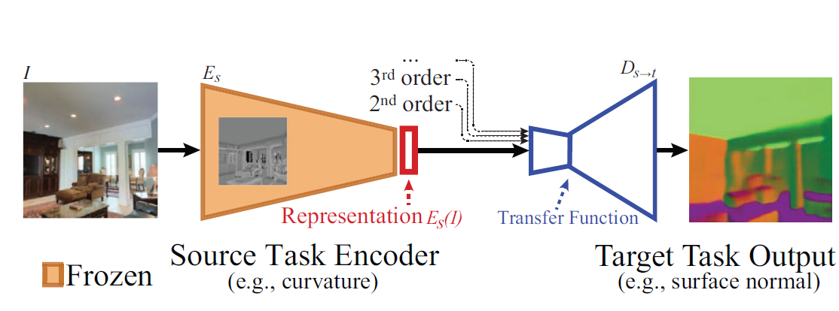
Taskonomy
Builds graph of transferability between computer vision tasks:
Collect dataset of 4 million input images and labels for 26 vision tasks
Surface normal, Depth estimation, Segmentation, 2D Keypoints, 3D pose estimation
Train convolutional autoencoder architecture for each tasks
Model transfer by taking the encoder from one or more source tasks, training a decoder for a target task, and recording its performance on a test set
http://taskonomy.stanford.edu/

Slide 26
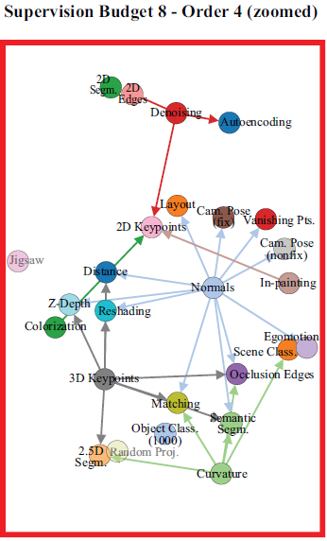
Taskonomy
Builds graph of transferability between computer vision tasks:
Transferability obtained by Analytic Hierarchy Process (from pairwise comparisons between all possible sources for each target task)
Final graph obtained by subgraph selection optimization (best performance from a limited set of source tasks): transfer policy
Empirical study on performance and data-efficiency gains from transfer using different datasets (Places and Imagenet)

Slide 27
Transferability
Can we come up with a transferability metric?
Based on bisimulation?
Empirical performance based metrics like tasknomony?
How would this metric be used?
Predicting whether transfer is possible or not
As an optimization objective?

