Slide 1


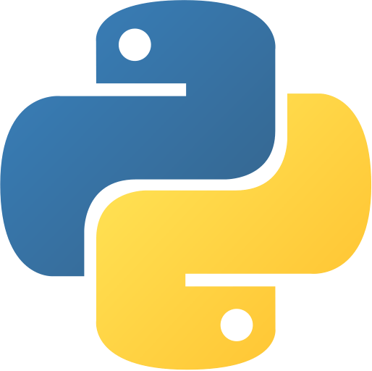
McGill
Students’
Trading Society
PYTHON FOR FINANCE
tradingsociety.wixsite.com/msts

Slide 2
AGENDA
WHAT WILL YOU LEARN?
1. MEASURING EXPECTED RETURN
2. MEASURING RISK
5. PYTHON : DATA ACCESS AND MANIPULATION
6. PYTHON DATA VISUALIZATION : STOCK ANALYSIS
3. PORTFOLIO EQUATIONS
4. PORTFOLIO CONCEPT : DIVERSIFICATION
7. PYTHON : PORTFOLIO CREATION
8. INTERVIEW QUESTIONS
Notes:
Before we get started:
Hopefully everyone has installed python and anaconda (send out links to those who have not)
We’re going to be going through with Jupyter, please use it

Slide 3


BUILDING YOUR PORTFOLIO
MEASURING RETURNS
For any given period for a security, this is the formula for measuring return:
The portfolio return is the weighted average of expected returns of the component assets in the portfolio
You can also compute the expected returns for a specific asset allocation within your portfolio; their weighted average will be the expected return of your portfolio
$$R_{t,t+1} =\frac{P_{t+1}−P_{t}}{P_{t}}$$
$$E\left[R_{P}\right]= \sum_{i=1}^{n}{w_{i}E[R_{i}]}$$
Notes:
Check if people have python installed by going into the terminal and typing python

Slide 4



BUILDING YOUR PORTFOLIO
MEASURING RISK
Volatility is the most common measure of risk in finance, the reason being that the uncertainty of returns is what investors fear.
We measure volatility with the variance and standard deviation:
Formula: To obtain the standard deviation, we simply square root the variance
Annualizing standard deviation:
$$σ_{R}^{2}= \frac{1}{N}{\sum_{i=1}^{n}{(R_{i}−\overline{R})}}^{2}$$
$$σ=\sqrt{σ_{R}^{2}}$$
$$σ_{annualized}=σ_{period}∗\sqrt{\# of periods per year}$$
Notes:
Check if people have python installed by going into the terminal and typing python

Slide 5
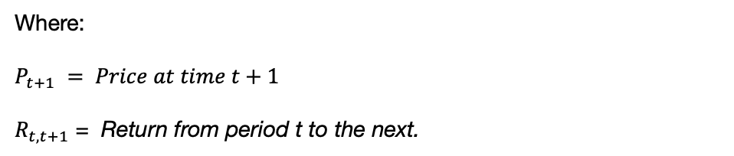



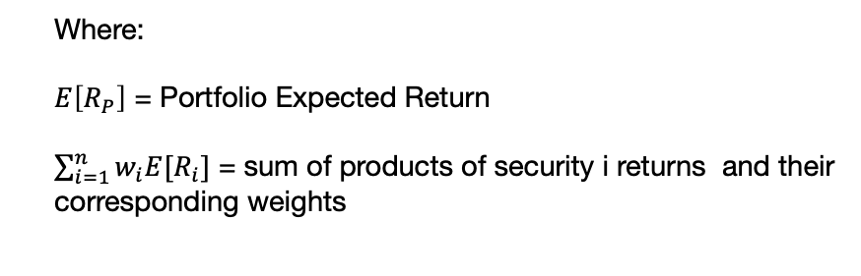
MSTS CODING FOR FINANCE
PORTFOLIO BASICS – Measuring Expected Return
Measuring Security Return
Measuring Portfolio Return
$$R_{t,t+1} =\frac{P_{t+1}−P_{t}}{P_{t}}$$
Portfolio Expected Return
$$E\left[R_{P}\right]= \sum_{i=1}^{n}{w_{i}E[R_{i}]}$$
Period Return
2 Period Return
Security Weight
$w_{i}$ = $\frac{\$ Invested in security i}{Total invested in Portfolio p }$
$R_{t,t+2} =\left(1+R_{t,t+1}\right)$ $\left(1+R_{t+1,t+2}\right) −1$
Where:
$$P_{t+1} = Price at time t+1$$
$R_{t,t+1}$ = Return from period t to the next.
Where:
$E\left[R_{P}\right]$ = Portfolio Expected Return
$\sum_{i=1}^{n}{w_{i}E[R_{i}]}$ = sum of products of security i returns and their corresponding weights
Notes:
Check if people have python installed by going into the terminal and typing python

Slide 6
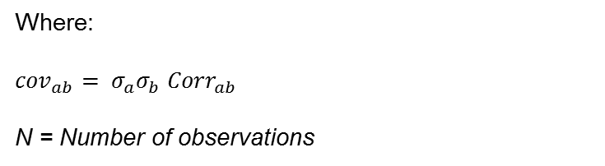

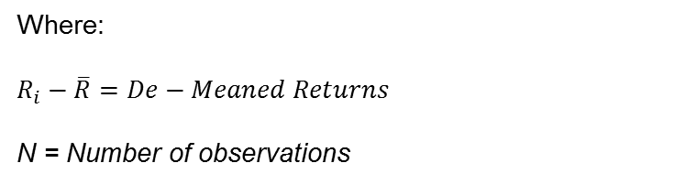



MSTS CODING FOR FINANCE
PORTFOLIO BASICS – Measuring Risk
Measuring Security Risk
Portfolio variance
Security Variance
2-Stock Portfolio Variance
$σ_{R}^{2}= \frac{1}{N}{\sum_{i=1}^{n}{(R_{i}−\overline{R})}}^{2}$
$σ_{p}^{2}=$ $w_{a}^{2}$ $σ_{a}^{2}$ + $w_{b}^{2}$ $σ_{b}^{2}$ + 2$w_{a}$ $w_{b}$ ${cov}_{ab}$
Standard Deviation
$$σ=\sqrt{σ_{R}^{2}}$$
Covariance Of Returns
$$Cov\left(r_{i},r_{j}\right)= \frac{\sum{\left(r_{i}−\overline{r}\right)∗} \left(r_{j}−\overline{r}\right)}{N}$$
Where:
$$R_{i}−\overline{R}=De−Meaned Returns$$
N = Number of observations
Where:
${cov}_{ab}= σ_{a}σ_{b}$ ${Corr}_{ab}$
N = Number of observations
Notes:
Check if people have python installed by going into the terminal and typing python

Slide 7
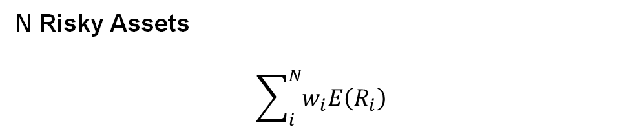
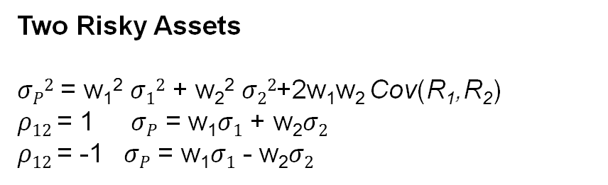
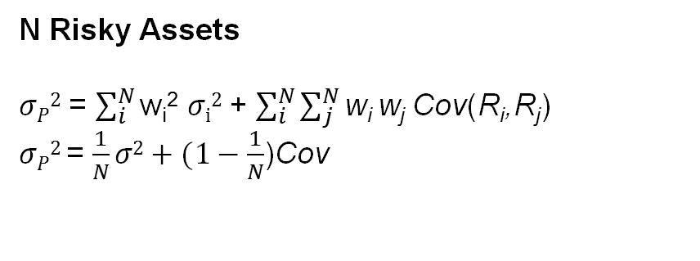
BUILDING YOUR PORTFOLIO
PORTFOLIO EQUATIONS
Portfolios can be thought of as a basket of securities with each individual security has expected return and risk properties.
In order to measure portfolio expected return:
Two Risky Assets
E(R_{p}) = w₁E(R₁) + w₂E(R₂)
N Risky Assets
$$\sum_{i}^{N}{w_{i}E\left(R_{i}\right)}$$
In order to measure portfolio risk :
Two Risky Assets
$σP2$ = w₁² $σ12$ + w₂² $σ22$+2w₁w₂ Cov(R₁,R₂)
$ρ12$ = 1 $σP$ = w₁$σ1$ + w₂$σ2$
$ρ12$ = -1 $σP$ = w₁$σ1$ - w₂$σ2$
N Risky Assets
$σP2$ = $\sum_{i}^{N}{\text{w}\text{i}\text{2} σi2}$ + $\sum_{i}^{N}{\sum_{j}^{N}{\text{w}\text{i} \text{w}\text{j}}}$ Cov(R_{i},R_{j})
$σP2$ = $\frac{1}{N}σ2+(1−\frac{1}{N}$)Cov
Notes:
Check if people have python installed by going into the terminal and typing python

Slide 8
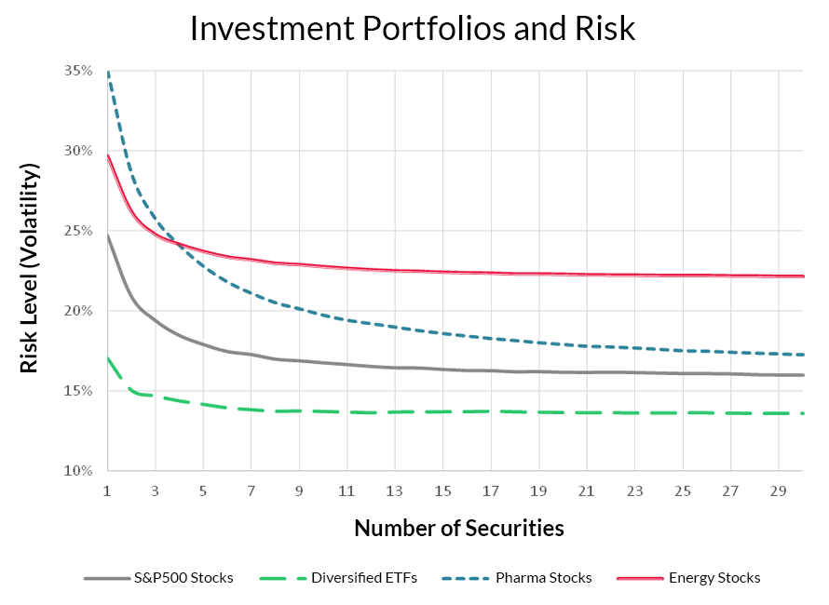
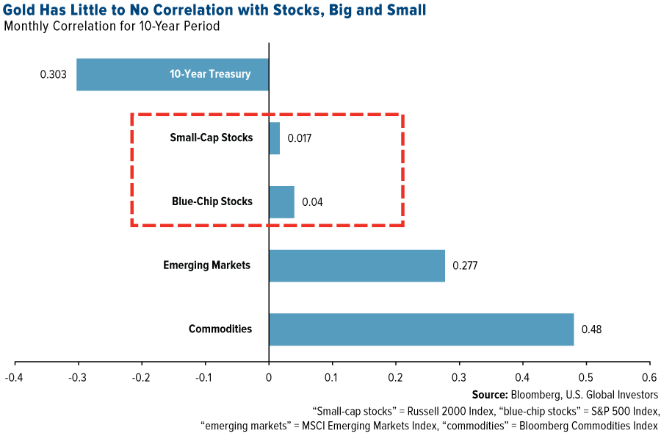
BUILDING YOUR PORTFOLIO
PORTFOLIO CONCEPT – DIVERSIFICATION
"Don't put all your eggs in one basket" - Warren Buffet
Listen to Ray Dalio explain the benefits of diversification
Notes:
Check if people have python installed by going into the terminal and typing python

Slide 9
INTERVIEW QUESTIONS
TRADING AND QUANT ROLES
Roles related to computer science in the finance industry often require creative thinking abilities and good knowledge of mathematics. We’ve chosen some fun questions to end the session.
The questions are of similar difficulty.
QUESTIONS
Two decks of cards. One deck has 52 cards, the other has 104. You pick two cards separately from a same pack. If both of two cards are red, you win. Which pack will you choose?
If the interest rate in the US increases, how does this affect USD/CAD rate?
3. You have a 3-gallon jug and 5-gallon jug, how do you measure out exactly 4 gallons? Is this possible?
Notes:
Check if people have python installed by going into the terminal and typing python

Slide 10
THANK YOU FOR JOINING
THE MSTS TEAM

Slide 11




THANK YOU FOR PARTICIPATING
FOR MORE
Thank you for taking part in MSTS’s first workshop in its series “Python For Finance”
If you’d like to learn more about upcoming workshops or the workshop series itself, please contact tradingsociety@ssmu.ca
If you have questions on the setup including, python, anaconda, NumPy, pandas, matplotlib or questions on the content of this PowerPoint, please contact Stanislas Motte (me) at stanislas.motte@mail.mcgill.ca or find me on Facebook or LinkedIn at Stan Motte and Stanislas Motte respectively
If you’re excited for what is to come, make sure to read our emails, visit our website tradingsociety.wixsite.com/msts
Don’t forget to follow us on Instagram, Facebook, Instagram, and LinkedIn for content, updates and news regarding exclusive MSTS events and signups
Notes:
Check if people have python installed by going into the terminal and typing python

Slide 12
DISCLAIMER
The MSTS members and executives are not licensed financial advisors, registered investment advisers, or registered broker-dealers. The MSTS does not provide investment or financial advice or make investment recommendations, nor is it in the business of transacting trades. Nothing contained in this communication constitutes a solicitation, recommendation, promotion, endorsement, or offer by the MSTS team and members of any particular security, transaction, or investment. The information provided on this presentation should not be taken as legal advice or professional advice on finance or investments. Do not use the information as a substitute for professional advice from legal or certified financial planner or investment professionals. This presentation is intended for McGill University students and the information contained herein is subject to change without notice. The owner and publisher of this presentation is not liable for any inaccuracies in the information provided. MSTS is not liable for the views expressed in this presentation and the damages that may arise from the use of its content.
Notes:
Check if people have python installed by going into the terminal and typing python

